Slide 1
Data Structures using Java
Lists
Stacks
Queues
Linked Lists, Doubly Linked Lists
Graphs
Custom Data Structures – Hash table of an array of Linked Lists Nodes
Hash Table
Heaps (Priority Queues)
Trees, Binary Trees
Binary Search Trees
AVL Trees
Tries (Prefix Tree)
Custom Data Structures – LRU Cache

Slide 2
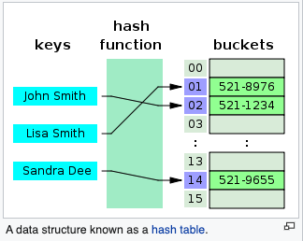
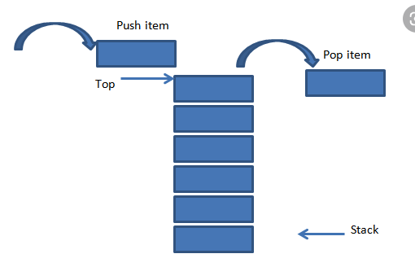
What is a Data Structure?
Collection of Data values
Data can be anything (even objects in Java)
Relationship among the values
Or any functions or operations applied to the data.

Slide 3
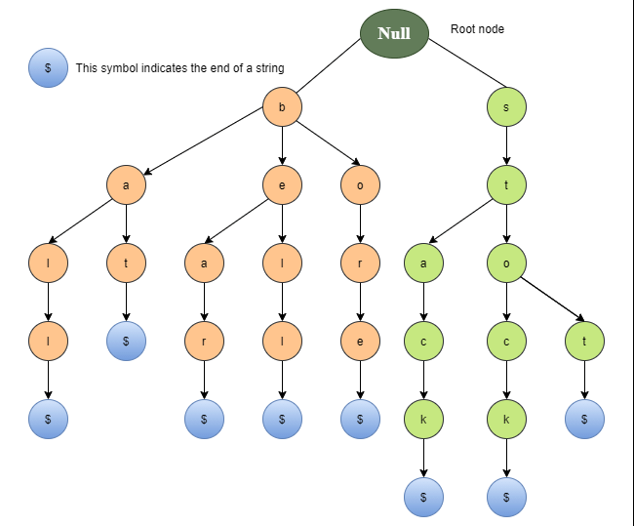
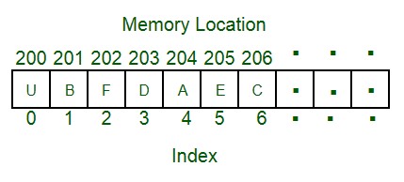
Data Type vs Data Structure
Kind of Data / Variable used in the program
Holds Value, not data
Values are directly assigned
No time complexity issues
Collection of different type of data
Holds different type of data
Values are assigned using respective functions
Time complexity matters here.

Slide 4
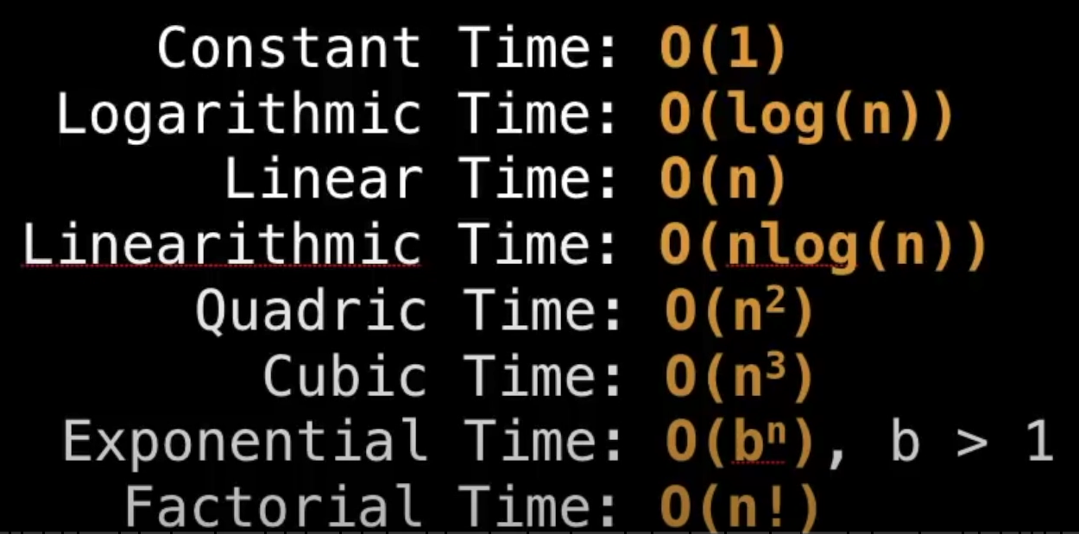
Time Complexity
In simple words – time taken by our function to run.
Big-O Notation:
Upper bound to our running function
Gives the worst-case running time possible for any function.
Helps to quantity as the input becomes large.
Notes:
Slowest growing to fastest growing functions.

Slide 5
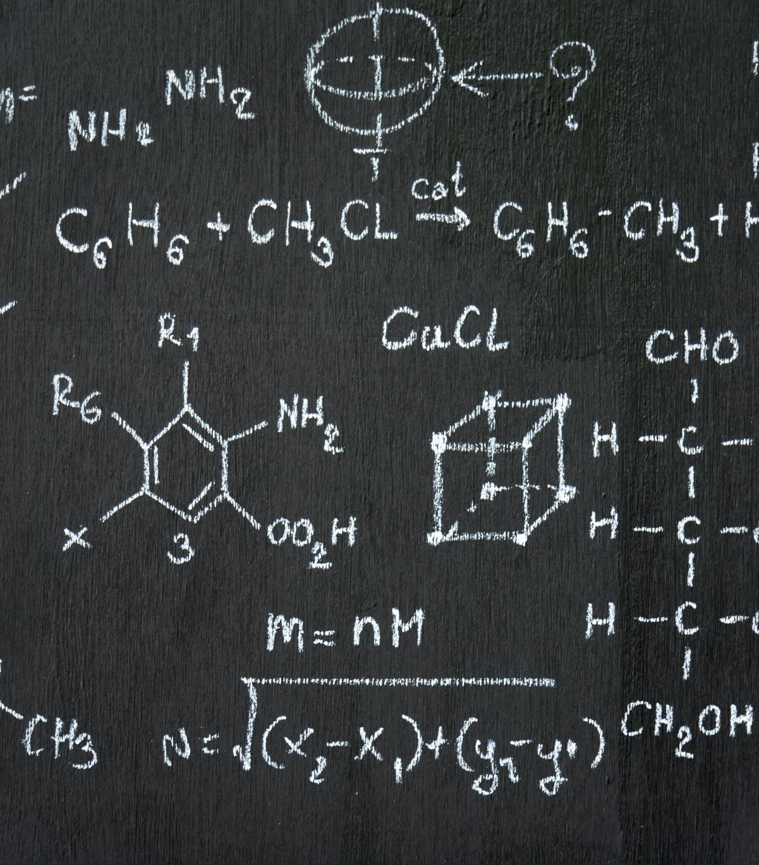
Big-O properties
Ignore Constants
Example: O(N + C) = O(N) for some input of size N.
Example: O(NlogN + CN) = O(NlogN) [shortly I’ll explain why we removed CN instead of just N]
Ignore the lower order terms
Example f(N) = 56NlogN + 10000000N + 1 => O(NlogN + N(1))
Notes:
Ignore constants. (Eliminate all other variables other than input size)
Ignore other lower order terms as shown in the example. Ex2: f(n) = 4.n^5 + 10000.n^5 + 234.n^4 = O(n^5)

Slide 6
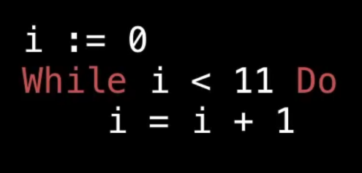
Examples
Notes:
O(11) = O(1) since 11 is a constant.

Slide 7
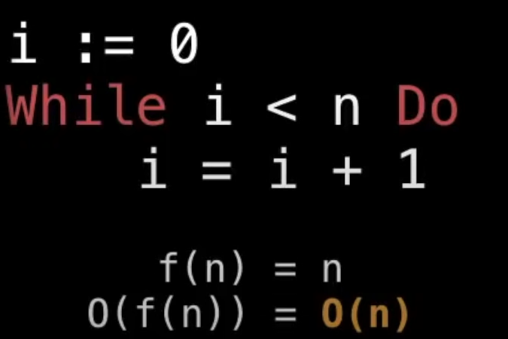

Slide 8
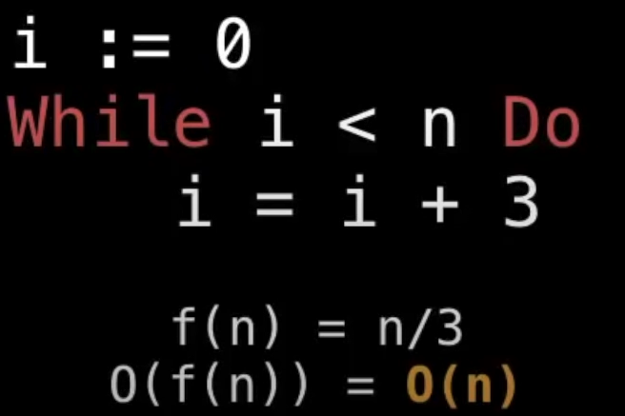

Slide 9
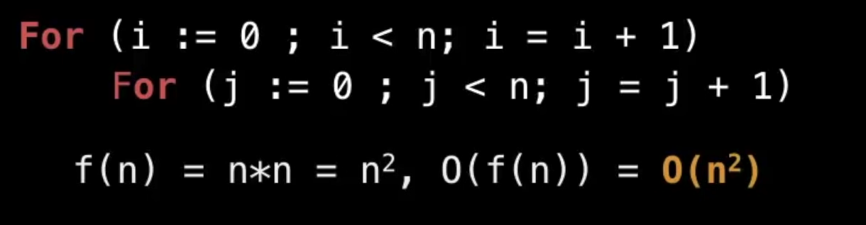
Time Complexity is O(N^2) as for every i, we loop to all the other elements of the data structures
Exactly N times.

Slide 10
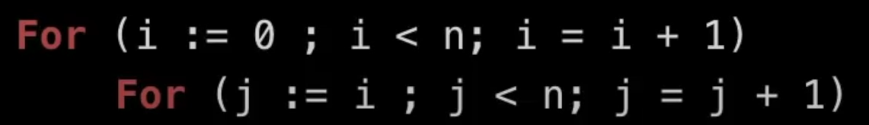
What is the time complexity for the following snippet?
Notes:
N + (N – 1) + (N + 2) + …… + 2 + 1 = (N. (N + 1)) /2 = O(N^2)

Slide 11
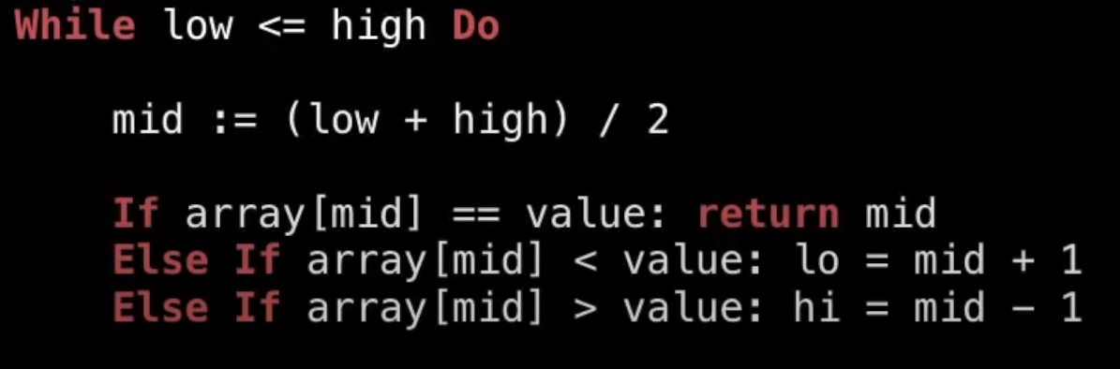
Notes:
O(logn) : as we truncate half the array in every iteration. The depth of the recursion tree will be ceil(logn) :
Ceil() represents the ceiling function.
here the base is 2

Slide 12
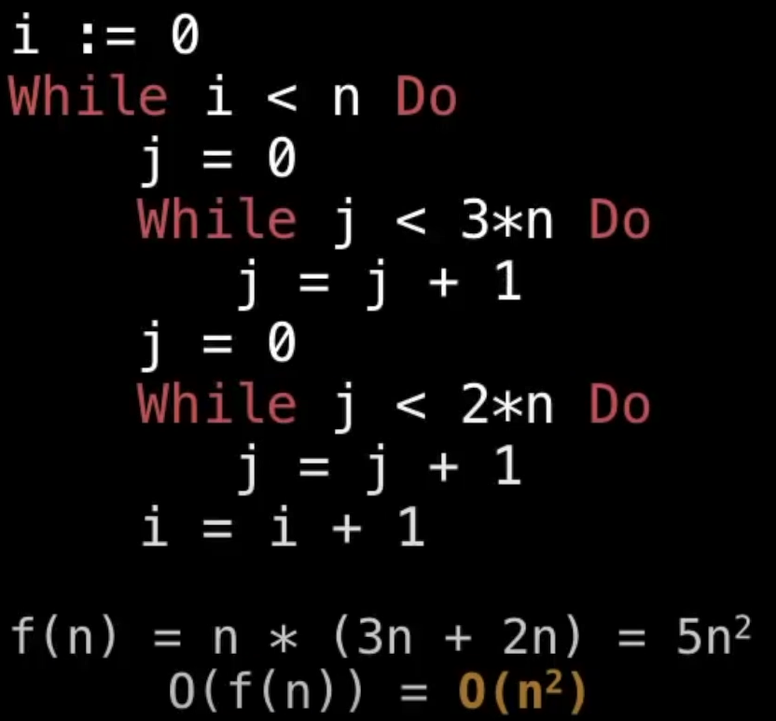
Good example of ignoring lower order terms.

Slide 13
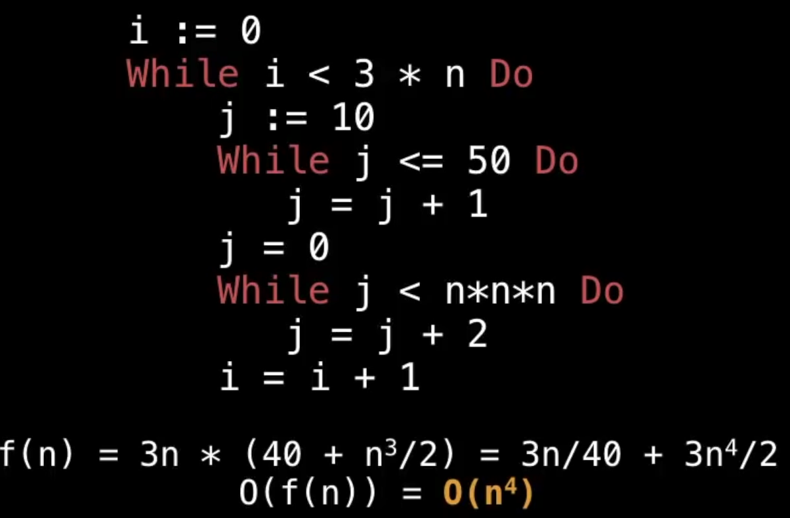

Slide 14
Jenish Soni: jenish1097@gmail.com
https://github.com/pro1zero/Data-Structures
Notes:
Feel free to email me.

