Slide 1



Slide 2

Meet the team
Paul & Kirsty
Challenge: LIVING IN OUR WORLD > From Curious Minds Come Helping Hands

Slide 3
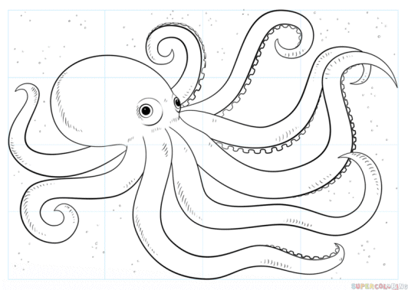
Octopus

Slide 4

Sumo wrestlers

Slide 5

Noise cancelling headphones

Slide 6

Limpet

Slide 7
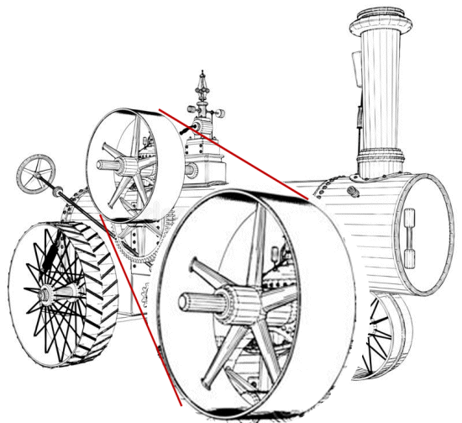
Steam traction engine flywheel

Slide 8
Challenge
LIVING IN OUR WORLD > From Curious Minds Come Helping Hands
“Your challenge is to design and build an innovative platform to integrate satellite data and information about vulnerable populations and environmental hazards in order to identify the most at-risk populations. Be creative and think outside the box. How will you identify those people that are often missed, but need aid the most?”

Slide 9
Solution
The Critical Infrastructure Protector (CIP) Engine
A database which utilises NASA data (with the addition of datasets from other expert sources)
To alert governments, local authorities, healthcare providers and other key stakeholders responsible for infrastructure, so that they can implement safety plans and open places of shelter.
Additionally, it is for the public – to alert them to danger, but also inform them where the nearest safe place to shelter is.
E.g: Via social media, online maps, and working with phone companies to send alerts.

Slide 10
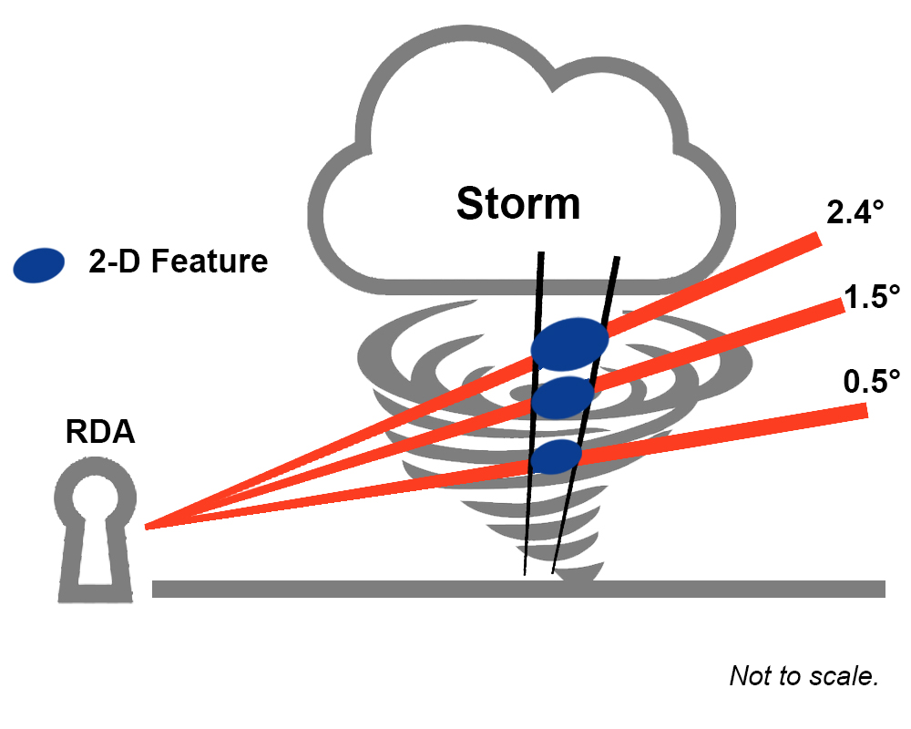
Storm data

Slide 11
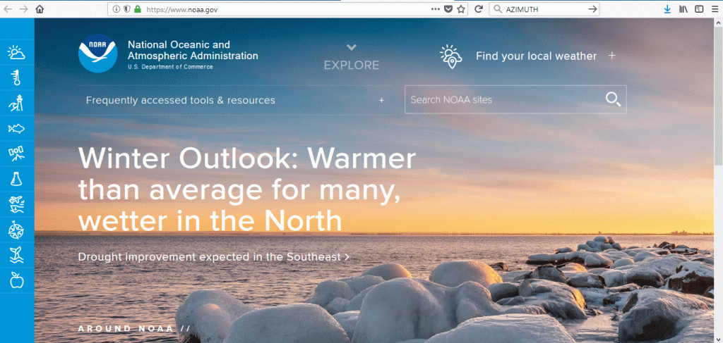
NOAA

Slide 12
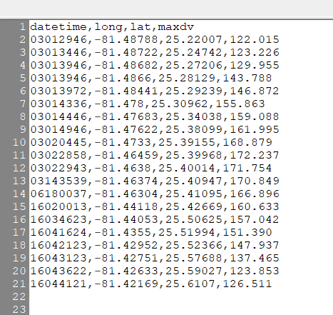
Dataset

Slide 13
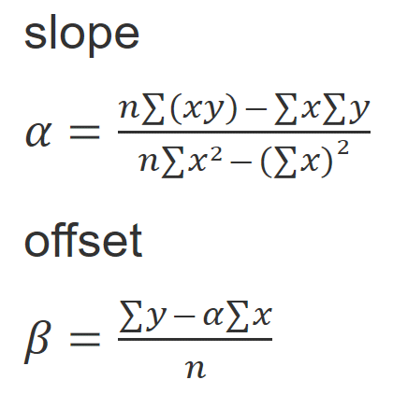
Equations

Slide 14
Demo
Data Demo

Slide 15
Code
Tools used

Slide 16
Future thinking
The CIP Engine could play an even bigger role in protecting critical infrastructure (as well as human life).
It could be linked to structures and trigger technology, such as protective coverings, that would serve as a defence against the weather and protect them from damage.
And introducing: Anti-Wind – technology to capture the energy of severe weather and use it for good.

Slide 17
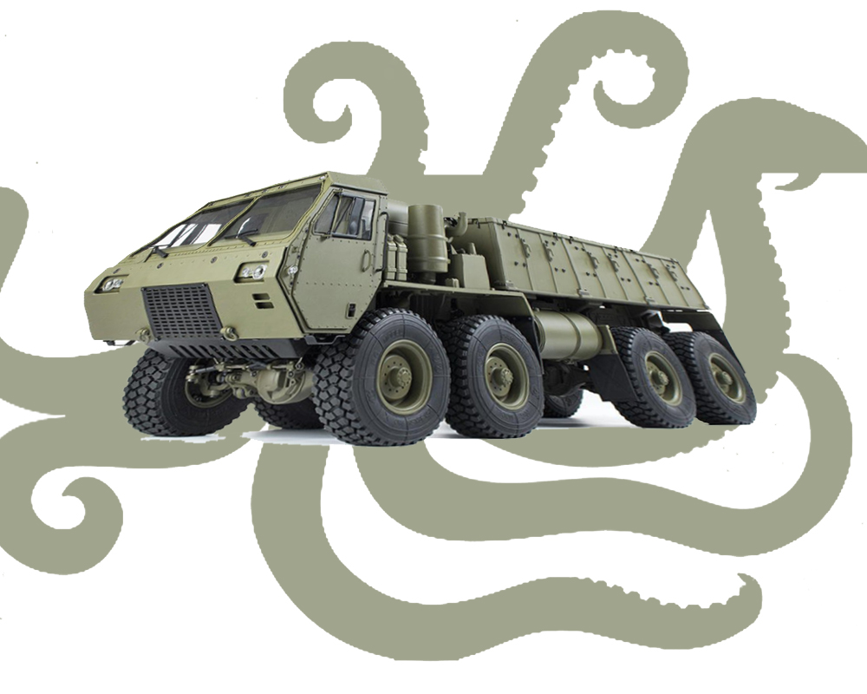
Future thinking

Slide 18
Close
Thanks for listening
You can see our project at …
https://www.criticalinfrastructureprotector.com

