Slide 1
BUREAU VERITAS
ISM – Google Analytics administration process
June 2017

Slide 2

PROCESS : GA Project creation
BUSINESS PM
Request a GA Account for a given application
Ism pm
Send a Google Analytics Project creation request
Ism EBIZ
Check the provided information (project name, URL…)
Ism EBIZ
Create an account in Google Analytics
Ism EBIZ
Add the requested project team according to the requested permissions in Google Analytics
Ism EBIZ
Send the tracking code and the script generated by GA to the JAVA DELIVERY team in Nantes
JAVA DELIVERY
JAVA DELIVERY
Include the tracking ID in the the application’s source code
JAVA DELIVERY
Send a confirmation to the EBIZ team once the development is done
Ism EBIZ
Ism PM
Inform the ISM project manager of the availability of the GA account (*)
Organize a new release of the application
Ism PM
business PM
Confirm to the Business the GA project creation
Administer the GA account
END USERS’ requests
*It may take up to 24 hours for data to appear in the reports

Slide 3
The request’s details

Slide 4
Ism project manager
Send a Google Analytics Project creation request
Once the web/mobile application is developped/being developped, the Project Manager may request a Google Analytics account.
Contact : bv.ism.analytics@gmail.com
The ISM Project Manager must provide the following information :
Information | Example
Google Analytics Account name* | VeriSTAR Dangerous Goods & Bulk
ISM Project Manager gmail account* | dmin@gmail.com
Business Project Manager gmail account* | pleandri@gmail.com
Project name * | VDGB
Project URL * | www.dgb.veristar.com
Key member n°1 gmail account + Associated permissions | member1@gmail.com (Edit)
Key member n°2 gmail account + Associated permissions | member2@gmail.com (Collaborate)
Key member n°3 gmail account + Associated permissions | member3@gmail.com (Read & Analyze)
*Mandatory data

Slide 5

Ism project manager
Send a Google Analytics Project creation request
If needed, the ISM Project Manager may request the tracking of several environments. In this case, information must be provided for each and every environment of the request :
Information | Example
GA Account name* | VeriSTAR Dangerous Goods & Bulk
ISM Project Manager gmail account* | dmin@gmail.com
Business Project Manager gmail account* | pleandri@gmail.com
Project name 1* | VDGB INT
Project URL 1* | www.dgb-int.veristar.com
Project name 2* | VDGB UAT
Project URL 2* | www.dgb-uat.veristar.com
Project name 3* | VDGB PROD
Project URL 3* | www.dgb.veristar.com
Project requested by the Business Project manager * | VDGB PROD
Key member n°1 gmail account + Associated permissions (per environment if it differs) | member1@gmail.com (Edit)
Key member n°2 gmail account + Associated permissions (per environment if it differs) | member2@gmail.com (Collaborate/INT, Edit/UAT)
Key member n°3 gmail account + Associated permissions (per environment if it differs) | member3@gmail.com (Read & Analyze/PROD)
*Mandatory data
For a given member, the permissions must be defined for each environment. Otherwise, the member’s permissions will be set for the project requested by the Business Project Manager only.

Slide 6
How to HANDLE GOOGLE ANALYTICS ?

Slide 7

INFO
Google Analytics’ general structure
Account (top-most level of organization)
Users
Property
(A website, mobile application or device)
Property
View
(Access point for reports)
View
For each level, the users and their permissions may be managed seperately, however :
A rule, applied in a given level, applies in all the lower levels
A rule, applied in a given level, is not automatically applied in the upper levels

Slide 8
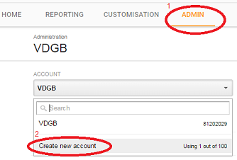
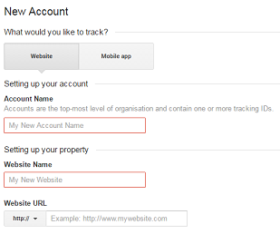
ISM EBIZ
Create account in Google Analytics
1. Go to : google.com/analytics
2. Log in with the BV Analytics gmail account : bv.ism.analytics@gmail.com
3. Go to the Administration interface
4. Create an account :
5. Fill in the account’s information according to the ISM Project Manager request :
6. Click on « Get tracking ID »
7. Accept the Google Analytics’ terms of Service Agreement

Slide 9
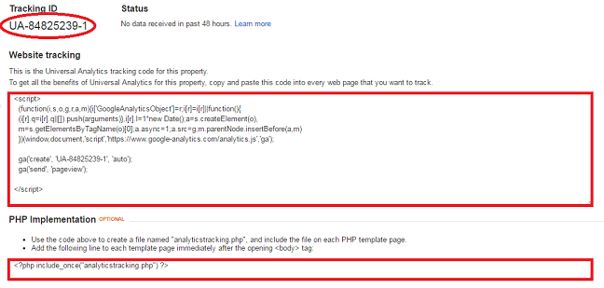
ISM EBIZ
Create account in Google Analytics
Result
The account is created
The property is automatically created
The view is automatically created
The tracking ID and the script to send to the JAVA DELIVERY team are available :

Slide 10
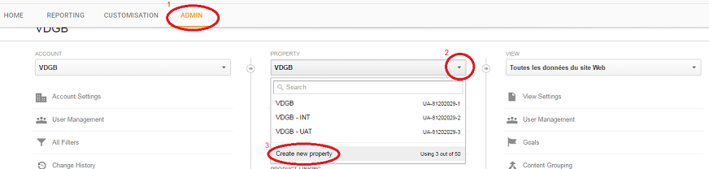
ISM EBIZ
Create account in Google Analytics
In case several environments’ tracking is requested :
Go to the administration interface
Click on the properties’ list
Create a new property for each environment
Fill in the property’s information (defined in the request)
Get the tracking ID

Slide 11
INFO
Google Analytics’ permissions
Permission | Explanation
Manage users | Can manage account users (add/delete users, assign permissions). Does not include Edit or Collaborate.
Edit | Can perform administrative and report-related functions (e.g., add/edit/delete accounts, properties, views, filters, goals, etc., but not manage users), and see report data. Includes Collaborate.
Collaborate | Can create personal assets, and share them. Can collaborate on shared assets, for example, edit a dashboard or annotation. Includes Read & Analyze.
Read & Analyze | Can see report and configuration data; can manipulate data within reports (e.g., filter a table, add a secondary dimension, create a segment); can create personal assets, and share them, and see shared assets. Cannot collaborate on shared assets.

Slide 12
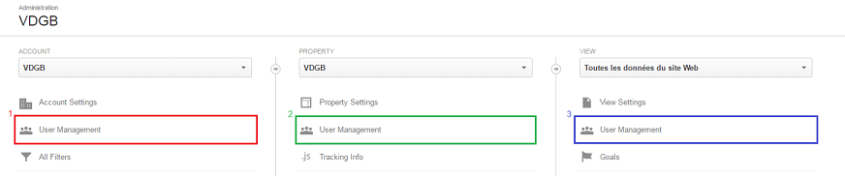
ISM EBIZ
Add the project team according to the requested permissions
The members will be added as defined in the GA project creation request.
The administrator may add users in the account, the property or the view :
Parent permissions are inherited by default (account > property > view). For example, when you set permissions for a user at the account level, that user then has those same permissions for all the properties and views in that account.
Permissions set for a child supercede permissions set for the parent.
As you progress down the hierarchy, you can give more permissions, but not fewer, e.g., if a user has Read & Analyze permission at the account level, you can then also grant Edit permission at the property or view level; but if a user has Edit permission at the account level, you can’t limit permission to just Read & Analyze at the property level.
.

Slide 13
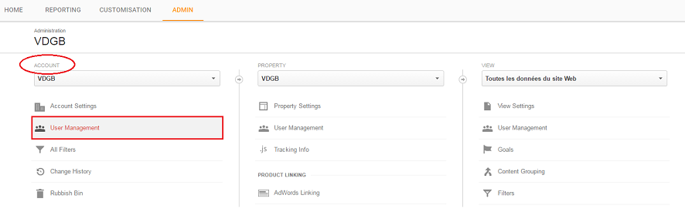
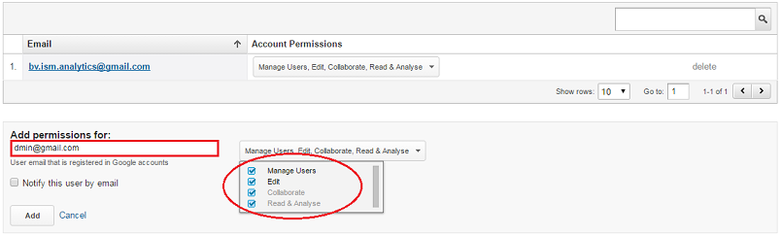
ISM EBIZ
Add the project team according to the requested permissions
ISM Project Manager
The ISM Project Manager will be affected the « Manage users » and « Edit » permissions by default in all of the project’s properties. Therefore, the configuration must be done in the account (not the property nor the view) :
The ISM Project Manager will automatically have the same permissions in all properties.
BY DEFAULT

Slide 14
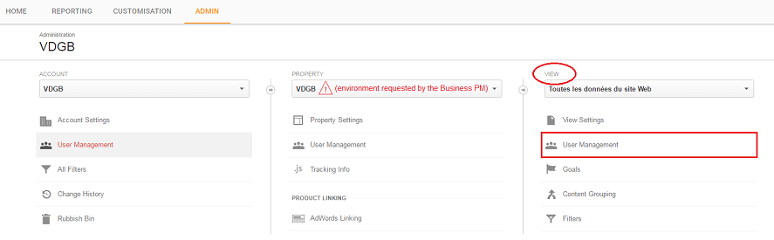
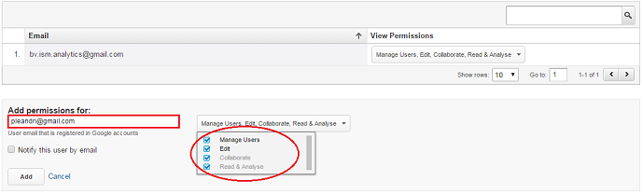
ISM EBIZ
Add the project team according to the requested permissions
Business Project Manager
The Business Project Manager will be affected the « Manage users » and « Edit » permissions by default in the view of the URL (environment) of which he requested the tracking.
The Business Project Manager is not meant to have access to any property unless it is requested differently.
BY DEFAULT

Slide 15
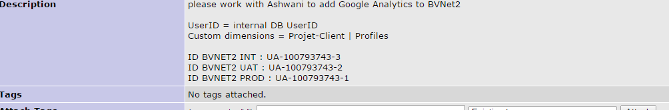
ISM EBIZ
Configuring Google Analytics in project
Configuration Request
Once ,all the profiling and configuration has been done at the Google Analytics admin , ISM-Java team would be requested to configure the google analytics in the related project .
Request will have following details :
Google tracking ID for each environment ( generated by admin ) that looks like :'UA-xxxxxxxx-x‘
User ID to be used in call to Google Analytics API ( in general it is ldap user id / user Id in DB for the logged in user in application ).
Pages / Events on which this call has to be made . ( Generally it is , whenever any page opens / updates )
Properties to be shared in call to google analytics .
Basically to differentiate the different calls on same page based on profile of user and other important project related attributes .
Example of one such request ( mantis id : #0190879 ) .

Slide 16
ISM EBIZ
Configuring Google Analytics in project
Configuring application
For google analytics for any request generated from page ,a developer will include following :
Script (analytics.js ) from google analytics shall be loaded at client side .
This is the script generated by Google Analytics Admin when Tracking Id is being generated .
Tracking ID configuration ( ISM-JAVA team confugure it only from INT environment ,keeping this ID in configuration file , infroming project manager about same to update the configuration file for different environments.
User ID configuration ( generally it is ldap / internal UserDB ID of the logged in user to keep track of who is performing action on the page )
Properties to segregate the request from different profile or in general term we cal say imparting intelligence to judge the request to perform analysis on it .
Page path from where request is being generated .
All the properties defines ,ajax call to google analytics is done via following js script :
in case URL contains the current page path
OR
in case URL does not contain exact page path ,in that case url is complted and is send in a javascript variable as is done in this case with ‘’path’’ variable.
All the other properties are set befor this send request and are shared in google analytics request .

Slide 17
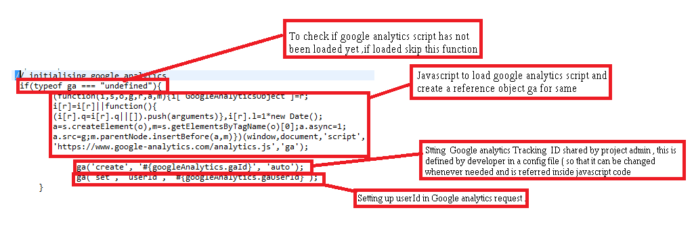
ISM EBIZ
Configuring Google Analytics in project
Configuring application
Segregate the properties which do not change over the session of logged in user ,so that these are called only once :
Loading of script analytics.js.
Setting tracking ID
Setting User ID
This code is included in a page that is loaded very first when user logs into application .

Slide 18
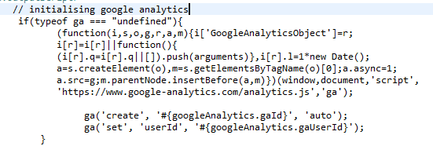
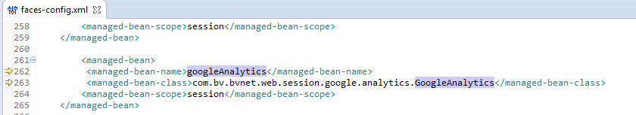
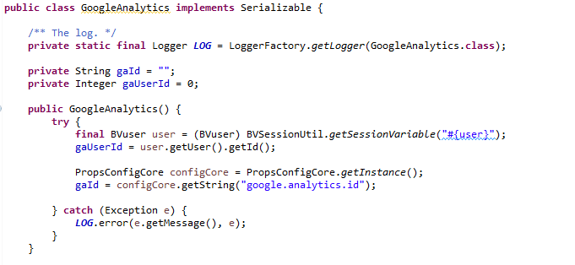
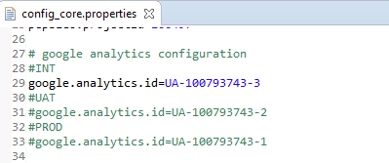
ISM EBIZ
Configuring Google Analytics in project
Configuring application

Slide 19
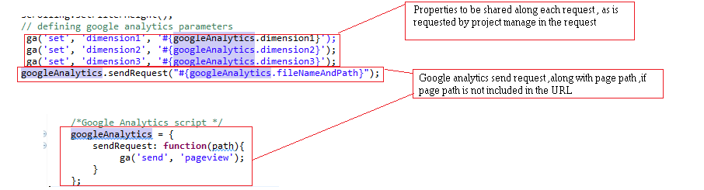
ISM EBIZ
Configuring Google Analytics in project
Configuring application
Then set up the properties which are included in each page :
Page path of page being accessed .
Properties to be shared along each request .
Make sure to either include these scripts to be included in every page of application that is being accessed or add it to a page that is subpart of each and every application page ( header page . Menu ,footer ,template etc )

Slide 20
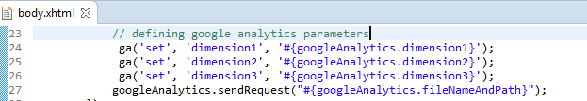
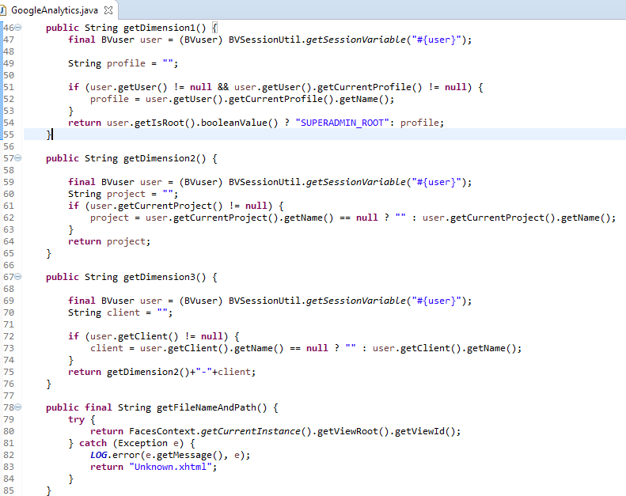
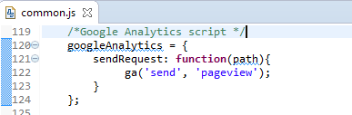
ISM EBIZ
Configuring Google Analytics in project
Configuring application

