Slide 1

Working with GIT
An Introduction
with Visual Studio Code

Slide 2
What is GIT
Once you go git, you never go back!
Version Control System
Distributed – Full local repository
Branching made easy

Slide 3
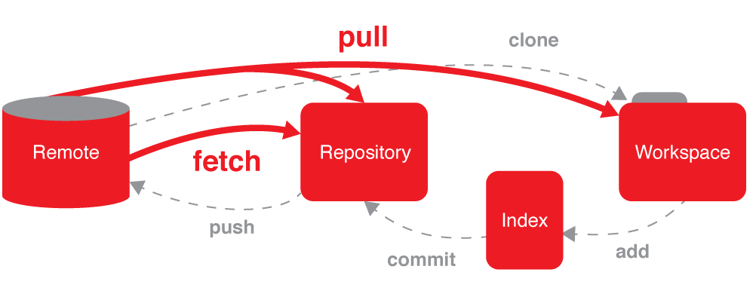

Slide 4
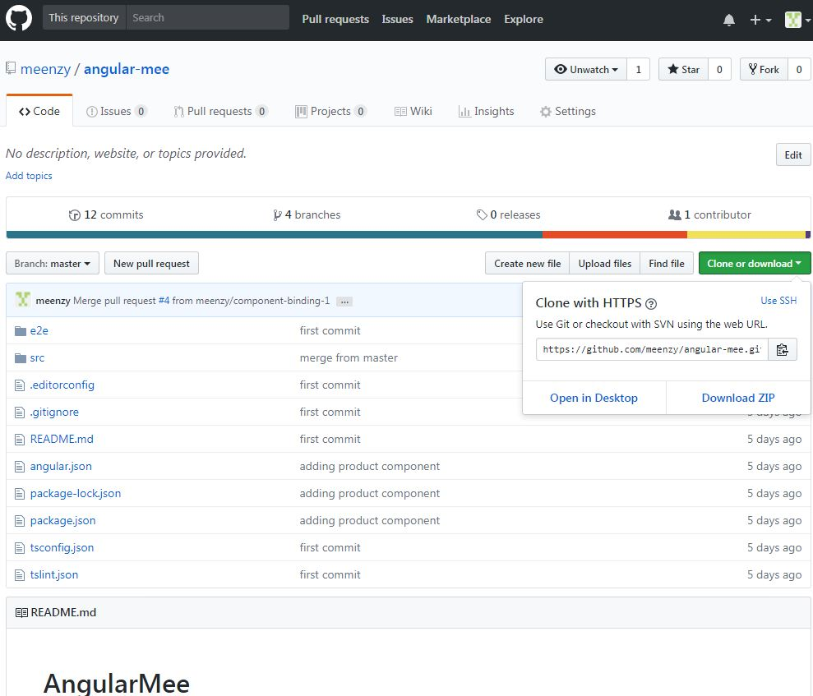
Git Repository & Branches
How can I create a copy of an existing repository?
git clone URL

Slide 5

Git Repository & Branches…
How can I see what branches my repository has?
By default, every Git repository has a branch called master.
To list all of the branches in a repository, you can run the command
git branch
The branch you are currently in will be shown with a * beside its name.
How can I turn an existing project into a Git repository?
Or
Creating a new one?
git init project-name
git remote add <remote_name> <remote_repo_url>

Slide 6


Git Lifecycle?
You commit changes to a Git repository in two steps:
Add one or more files to the staging area.
Commit everything in the staging area.
Stage
Commit
Pull from Remote
Push to Remote
Merge & commit

Slide 7
How can I see how Git is configured?
git config --list
--system : settings for every user on this computer
--global : settings for every of your projects
--local : settings for a specific project
git config --global setting.name setting.value
How can I change my Git configuration?

Slide 8
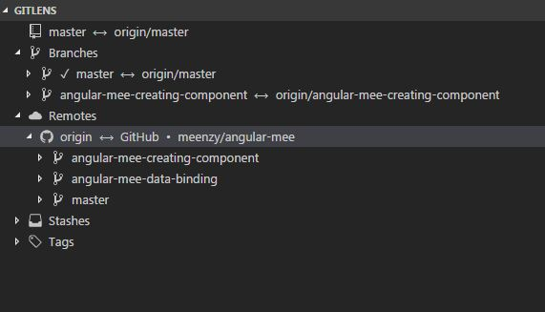
Visual Studio Code GitLens extension Local branches Remote branches

Slide 9
Remote repositories and How can I define them?
When you clone a repository, Git automatically creates a remote called origin that points to the original repository. You can add more remotes using:
git remote add remote-name URL
and remove existing ones using:
git remote rm remote-name

Slide 10
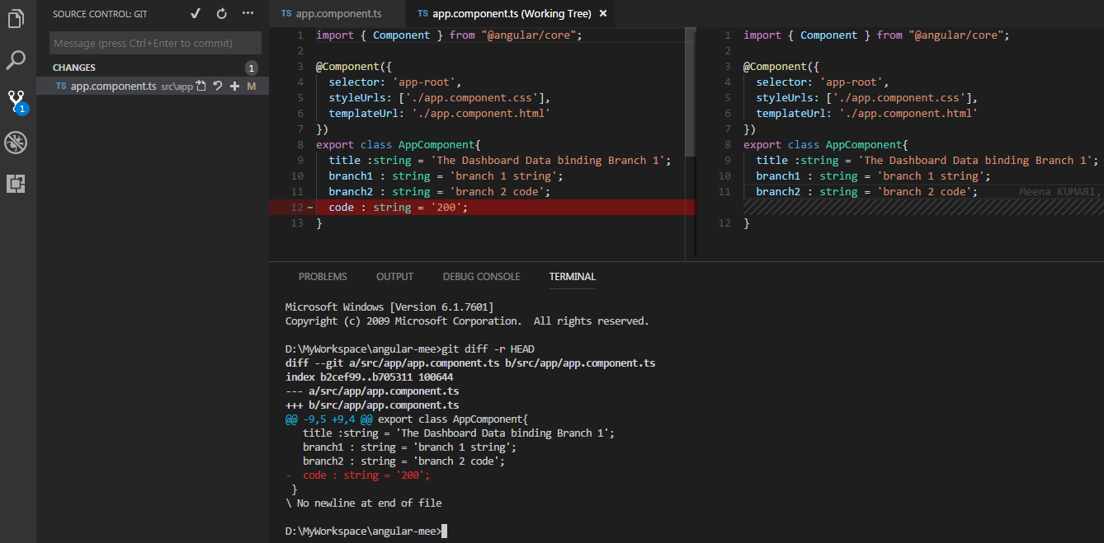
How can I tell what's going to be committed? git diff -r HEAD path/to/file or to reset to latest commit git reset HEAD
Snippet from Visual Studio Code
git diff –r HEAD

Slide 11
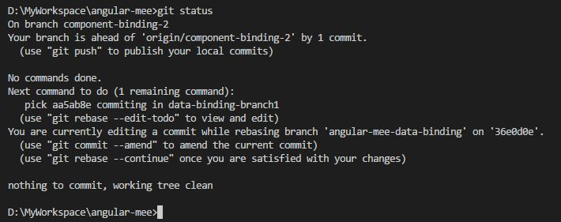
How do I commit my changes? git commit -m “committing my changes"
This will unstage any changes that you have staged, and git checkout will then restore those files to their previous state.
How can I undo all of the changes I have made?
git reset HEAD
git checkout

Slide 12
How to view my commit?
git log
git show <<commit-version>>
git diff abc123..def456
Difference between 2 commits?

Slide 13
Git Pull a day keeps the conflicts away ;)

Slide 14
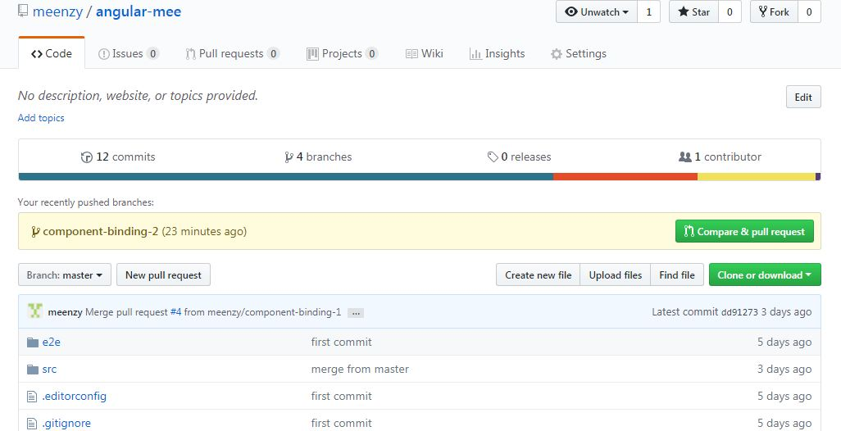
Pushing to Remote repositories
git push remote-name branch-name

Slide 15
Quick Start to set up
Creating and pushing repository to Git
D:\MyWorkspace\angular-mee>git remote add origin https://github.com/meenzy/angular-mee.git
git commit -m "first commit"
D:\MyWorkspace\angular-mee>git push -u origin master
Step 1: Switch to branch 'master'
D:\MyWorkspace\angular-mee>git checkout master
Step2: Create branch of master to work on
D:\MyWorkspace\angular-mee>git branch angular-mee-data-binding master
Step 3: Switch to branch newly created branch
D:\MyWorkspace\angular-mee>git checkout angular-mee-data-binding
Switched to branch 'angular-mee-data-binding'
Step 4: to create upstream - when you want to commit changes
git push --set-upstream origin angular-mee-creating-component
Setting up upstream tells which branch to push the changes in remote repository.
Step 5: commit your changes
Step 6: Pull from origin master
Step 7: Push into upstream.

Slide 16
Switching between branches?
When you run git branch, it puts a * beside the name of the branch you are currently in. To switch to another branch, you use
git checkout branch-name
git diff branch-1..branch-2
How can I view the differences between branches?

Slide 17
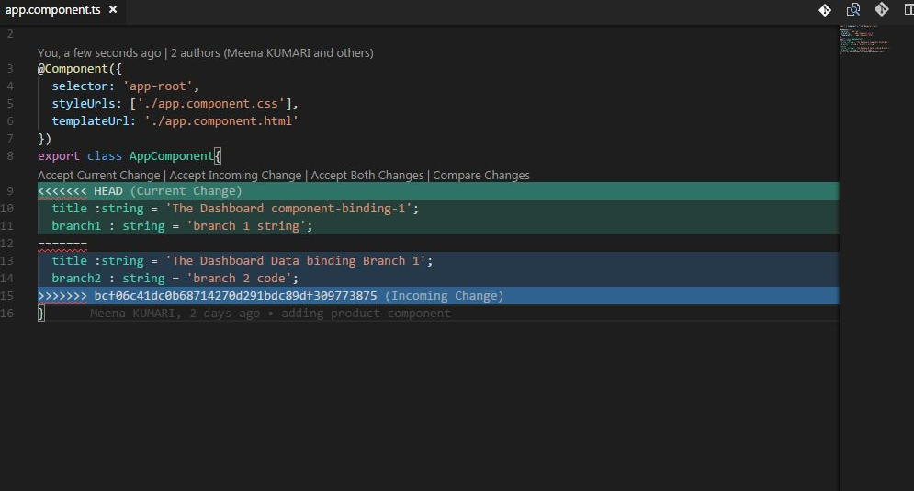
But, how can I merge two branches? git merge source destination

Slide 18
How about there is a conflict while merging? git merge source destination
Some hints?
Check status – git status
Edit the file
Stage the changed files
Commit your merged changes

Slide 19
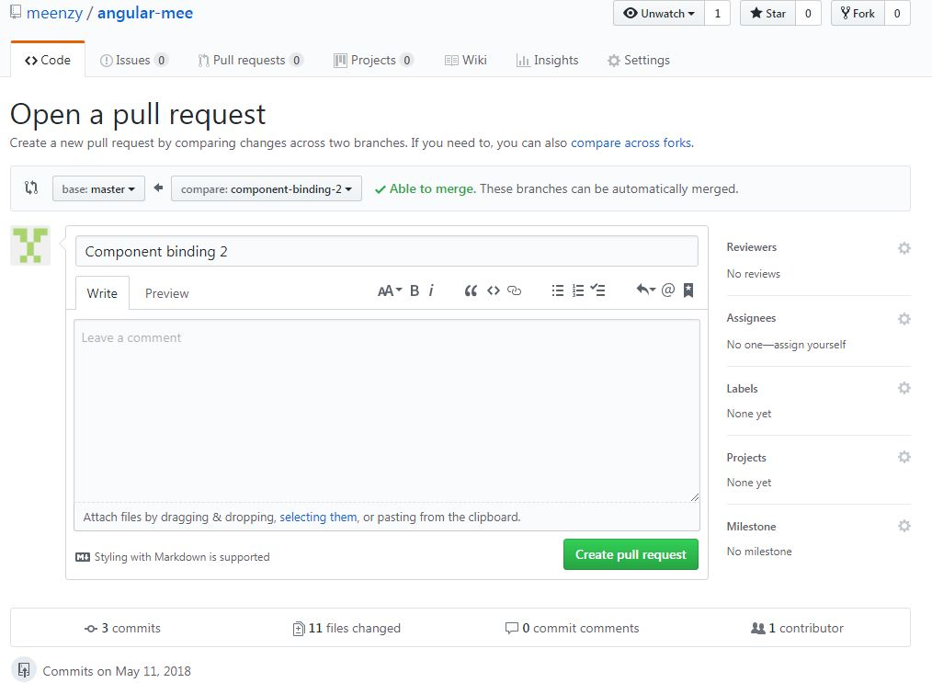
Creating Pull Request
Once you have pushed your changes to remote branch, the next step is to merge that branch with your remote/master.
It is a good practice to work on branches. The chances of corrupting the master is less likely.

