Slide 1

Ashwani Saxena
Pro.ashwani@gmail.com

Slide 2

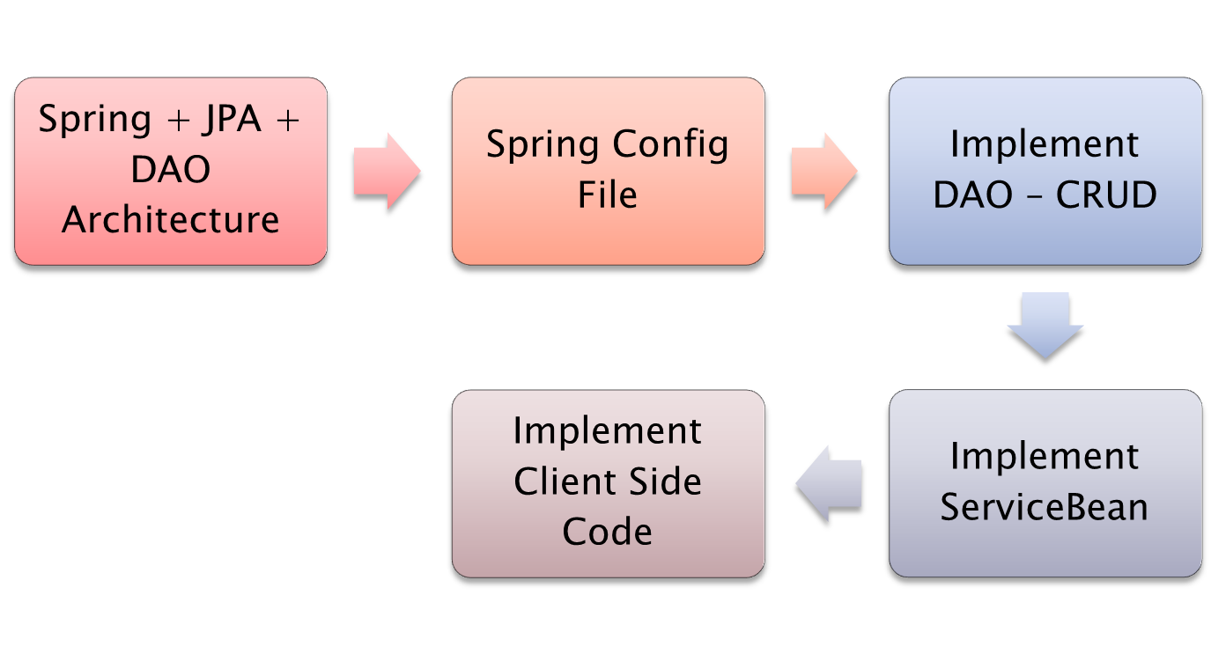

Slide 4







Persistence.xml
JpaTemplate
Persistence
Query
persist()
find()
merge()
delete()
EntityManagerFactory
EntityManager
EntityManagerFactoryBean
Transaction

Slide 5


EntityManagerFactoryBean
Injected into
JpaDaoSupport
JpaTemplate
extends
DepartmentDAO
IDepartmentDAO
implements

Slide 6
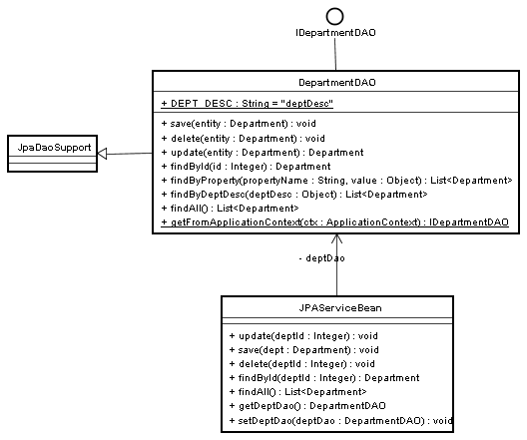

Slide 8

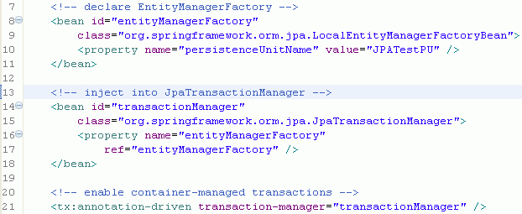


Inject into
entityManagerFactor
transactionManager

Slide 9
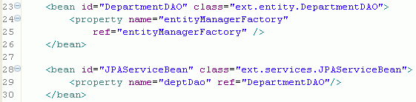



Inject into
entityManagerFactor
DepartmentDAO
Inject into
JPAServiceBean

Slide 11

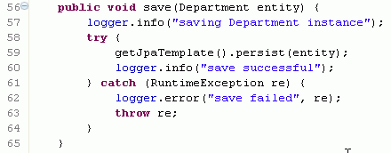

Slide 12

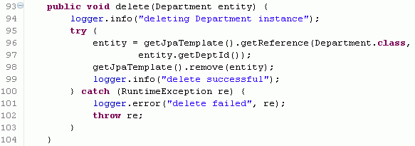

Slide 13

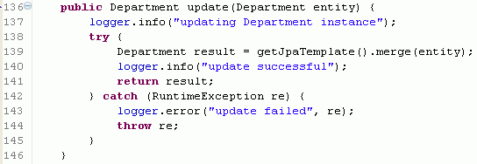

Slide 14

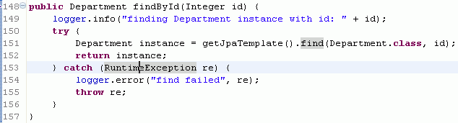

Slide 15
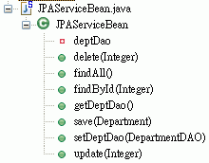

Slide 16

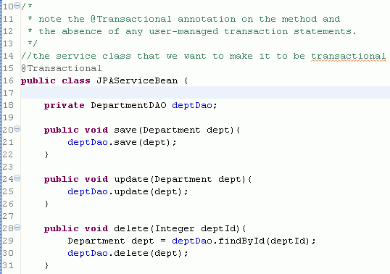

Slide 17
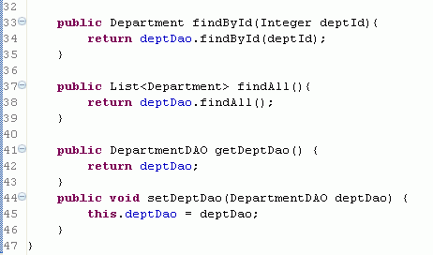

Slide 19

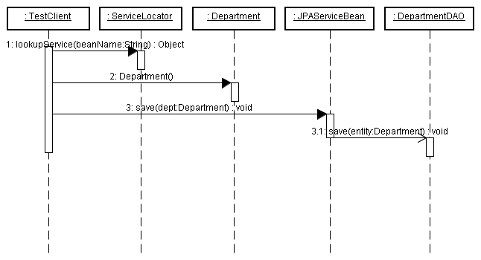
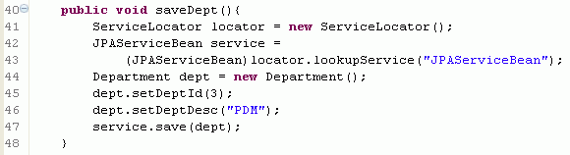

Slide 20

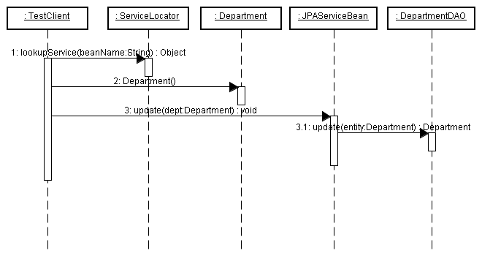
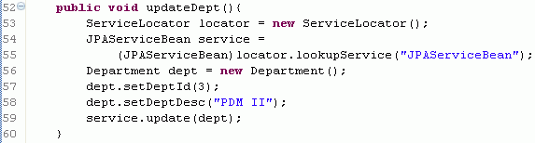

Slide 21

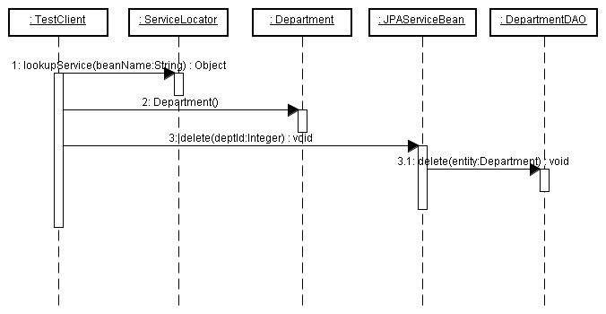
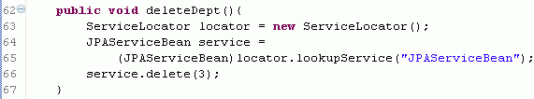

Slide 22

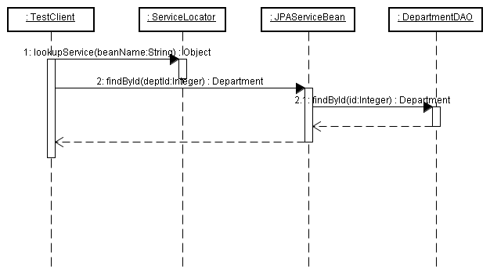
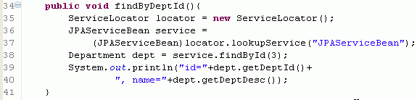

Slide 23



