Slide 1
Modelling Realistic User Behaviour in Information Systems Simulation as Fuzzing Aspects
Tom Wallis and Tim Storer
University of Glasgow
DDMACS Workshop, 2018.

Slide 2
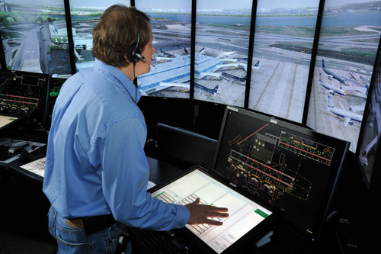
Designing for users in socio-technical systems
Heterogeneous collections of actors with varying degrees of autonomy
Complex, contingent, emergent actor behaviours
Notes:
Deploying large complex systems without quality assurance is risky. But testing implementations is hard, but so is modelling and simulation of designs.

Slide 3

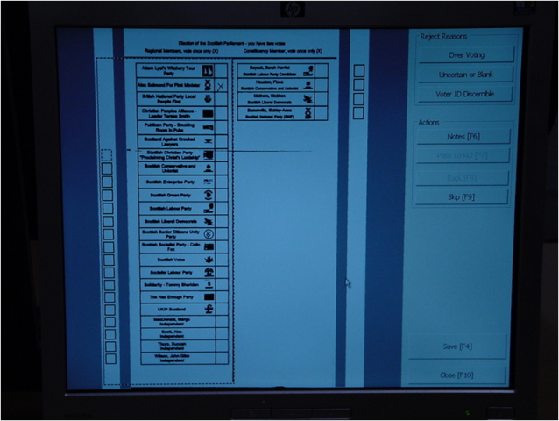


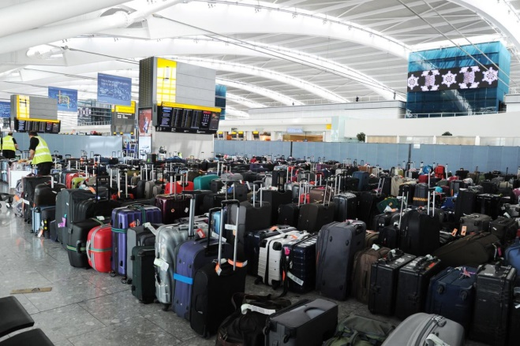
Coping Strategies in System Design
Simplistic Models
Small scale models
Rebuild (again)
Trial, error and revision
SIOSIBOA
Apply workarounds

Slide 4
Intuition: Variability and contingency in user behaviour is a cross-cutting concern.
The same causes of variability affect many different workflows, so apply their effects as fuzzing aspects to functional descriptions of workflow behaviours.
Example:
Forgetfulness
Distraction
Exhaustion
Mix-ups
Misjudgements
Inattention
Tunnel focus
Short cuts

Slide 5
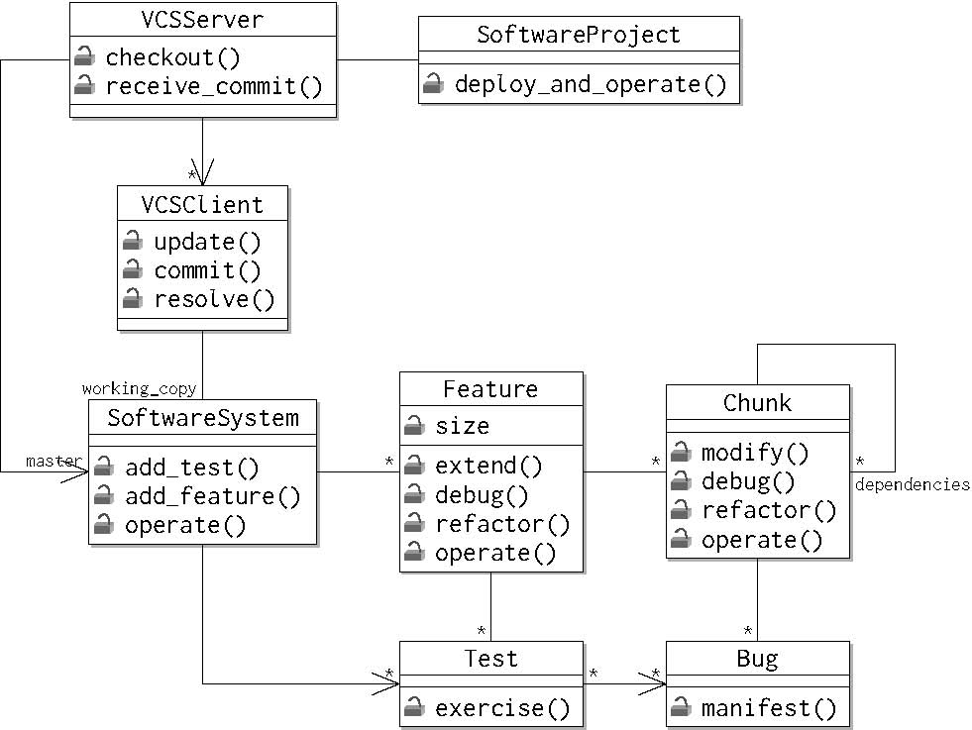
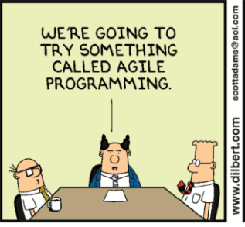
Our Approach - FuzziMoss
Object oriented problem domain model
Workflow classes
Variable user behaviour fuzzing aspects
(FuzziMoss)
class TestDrivenDevelopment(object): def __init__(self, centralised_vcs_server): change_management = ChangeManagement(centralised_vcs_server) self.specification = Specification(change_management) self.testing = Testing(change_management) self.implementation = Implementation(change_management) self.debugging = Debugging(change_management) self.refactoring = Refactoring(change_management) @default_cost() def implement_feature_tdd(self, user_story, random): self.specification.add_feature(user_story.logical_name, user_story.size, random) self.testing.test_per_chunk_ratio(user_story.logical_name, random) self.implementation.implement_feature(user_story.logical_name, random) self.debugging.debug_feature(user_story.logical_name, random) self.refactoring.refactor_feature(user_story.logical_name, random) @default_cost() def work_from_backlog(self, product_backlog, random): while True: try: user_story = product_backlog.get(block=False) self.implement_feature_tdd(user_story, random) except Empty: break
PyDySoFu Weaver
Socio-technical system simulation
Theatre_Ag Agent Simulation Library
Notes:
Represent problem domain as an object oriented model.
Model predictable domain behaviour stochastically
Implemented in Python for readability
Model user workflows as collections of related tasks with shared state (represented as methods encapsulated in Python classes).
Model variable user behaviour separately, using Python Dynamic Software Fuzzing (PyDySoFu) aspect oriented library.
Run simulations in Theatre_Ag simulation framework and observe emergent behaviour

Slide 6
Case Study Selection – Team Based Software Development
Actors have different roles (developer, project manager…)
Development work coordinated around a centralised VCS.
Well defined ideal workflows, but with potential for variability
change management, specification, implementation, testing, debugging, refactoring
Different coordination workflows possible (Waterfall, TDD)
Limited empirical evidence as to efficacy of different workflows [George & Williams, Israilidis et al., Bhat, T. & Nagappan].
Notes:
Systems have features, chunks, bugs and tests
Features have dependencies

Slide 7
Domain Model
def debug(self, random, bug=None): if len(self.bugs) == 0: return False if bug is None or bug not in self.bugs: if random.unknown_bug_should_be_removed(self): bug = random.choose_bug(self) self.bugs.remove(bug) elif random.known_bug_should_be_removed(self): self.bugs.remove(bug)

Slide 8
Workflow Example: Debugging
class Debugging(object): @default_cost(1) def debug(self, feature, bug, random): feature.debug(random, bug) @default_cost() def debug_test(self, test, random): while True: try: test.exercise() break except BugEncounteredException as e: self.debug(test.feature, e.bug, random) self.change_management.commit_changes(random) @default_cost() def debug_feature(self, logical_name, random): self.change_management.checkout() feature = self.change_management.centralised_vcs_client.working_copy.get_feature(logical_name) for test in feature.tests: self.debug_test(test, random) @default_cost() def debug_system(self, random): self.change_management.checkout() for test in self.change_management.centralised_vcs_client.working_copy.tests: self.debug_test(test, random)

Slide 9
Workflow Example: TDD
class TestDrivenDevelopment(object): def __init__(self, centralised_vcs_server): change_management = ChangeManagement(centralised_vcs_server) self.specification = Specification(change_management) self.testing = Testing(change_management) self.implementation = Implementation(change_management) self.debugging = Debugging(change_management) self.refactoring = Refactoring(change_management) @default_cost() def implement_feature_tdd(self, user_story, random): self.specification.add_feature(user_story.logical_name, user_story.size, random) self.testing.test_per_chunk_ratio(user_story.logical_name, random) self.implementation.implement_feature(user_story.logical_name, random) self.debugging.debug_feature(user_story.logical_name, random) self.refactoring.refactor_feature(user_story.logical_name, random) @default_cost() def work_from_backlog(self, product_backlog, random): while True: try: user_story = product_backlog.get(block=False) self.implement_feature_tdd(user_story, random) except Empty: break

Slide 10
Behaviour Fuzzer: Distraction
Represent the effect of distraction (by another task) as an incomplete procedure. Each time a workflow is invoked, remove one or more steps from the end, with increasing probability of removal as simulation time increases.
def _incomplete_procedure(steps, context): clock = context.actor.clock remaining_time = clock.max_ticks - clock.current_tick probability = random.uniform(0.0, 0.9999) n = pmf(remaining_time, probability) choose_last_steps_fuzzer = choose_last_steps(n, False) fuzzer = in_sequence( [ recurse_into_nested_steps( target_structures={ast.While, ast.For, ast.TryExcept}, fuzzer=filter_steps( choose_last_steps_fuzzer, replace_steps_with(
replacement='self.actor.idling.idle()') ) ) ] ) return fuzzer(steps, context)
Notes:
What’s going on here?
Going

Slide 11
Evaluation Strategy
Simulations of large scale systems are difficult to validate
Example: climate science
That’s why we simulate
Approach advocated by Naylor and Finger (1967) and others
Staged approach
Evaluate plausibility first
Gain confidence in predictive capability
Is the simulation useful?

Slide 12
Simulation Setup
Compare waterfall performance against TDD
Project of up to 6 user stories, length 2 or 4
3 actor development team, 500 clock ticks maximum
Apply fuzzing to top level or low level workflows
Vary extent of fuzzing by configuring distraction PMF

Slide 13
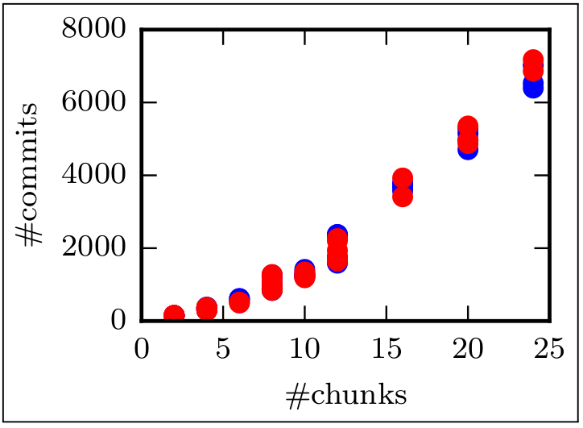
No fuzzing – Commits Versus Project Size
Waterfall (Blue)
TDD (Red)

Slide 14
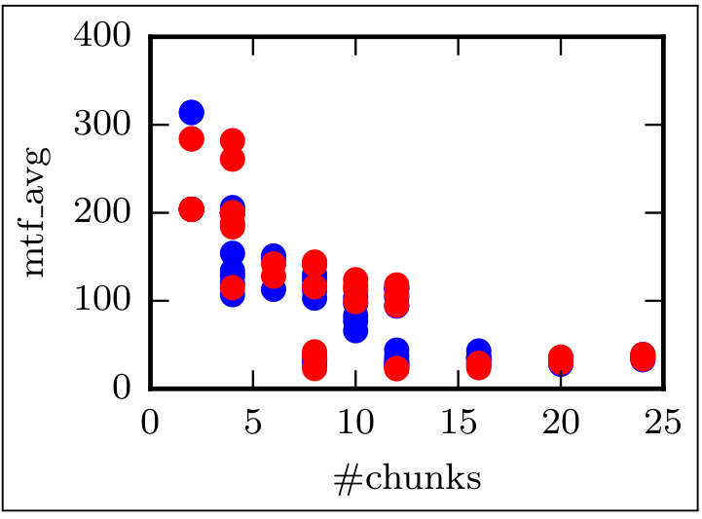
No fuzzing – mean time to failure versus project size
Waterfall (Blue)
TDD (Red)

Slide 15
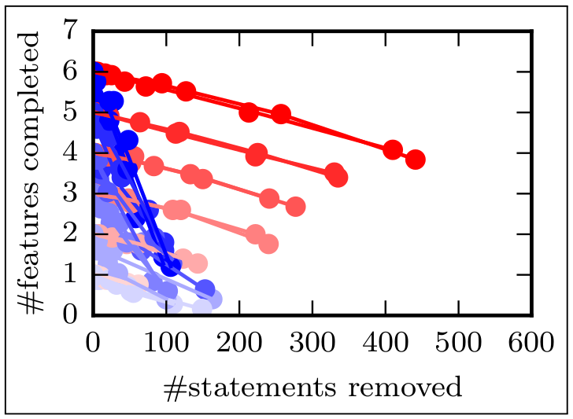
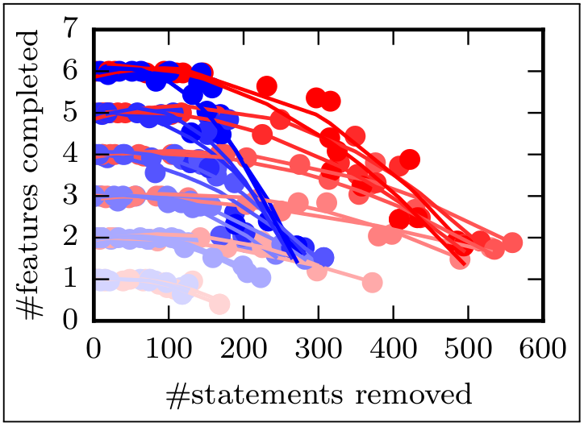
Effect of fuzzing on features completion
Waterfall (Blue)
TDD (Red)

Slide 16
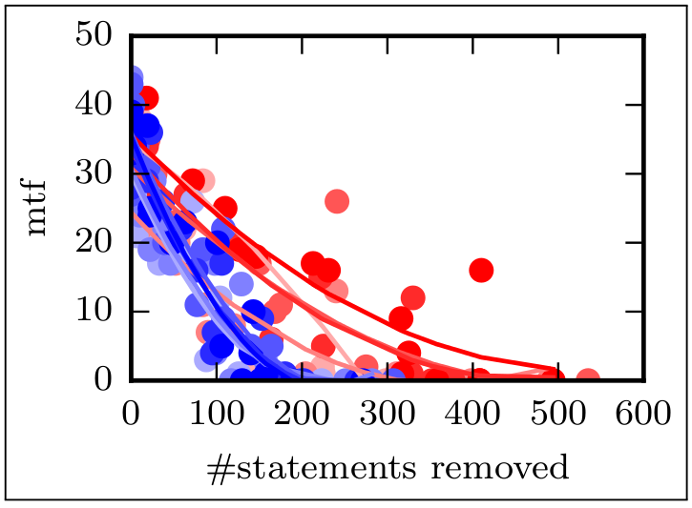
Effects of Fuzzing on mean time to failure on ‘Large’ Projects
Waterfall (Blue)
TDD (Red)

Slide 17
Take away: model irregular user behaviour separately as cross cutting concerns.
Future:
Bigger, better case studies
Application of fuzzing to other representations
Validate models of irregular behaviour using process log data sets.
Notes:
http://data.4tu.nl/repository/collection:event_logs_real

Slide 18
Thanks
Paper: Wallis, T. and Storer T. Modelling Realistic User Behaviour in Information Systems Simulation Models as Fuzzing Aspects. To Appear, CAISE Forum 2018.
https://github.com/probablytom/fuzzi-moss-paper
Code:
http://github.com/twsswt/softdev-workflow
http://github.com/twsswt/theatre_ag
http://github.com/twsswt/pydysofu
http://github.com/twsswt/fuzzi-moss

