Slide 1
Simulating Variance in Socio-Technical Behaviours using Executable Workflow Fuzzing
Tom Wallis and Tim Storer

Slide 2
All code available from my GitHub
This talk
http://github.com/twsswt/theatre_ag
http://github.com/twsswt/pydysofu
http://github.com/twsswt/fuzzi-moss
http://github.com/twsswt/softdev-workflow
Another Theatre Demo:
http://github.com/twsswt/pyagora

Slide 3
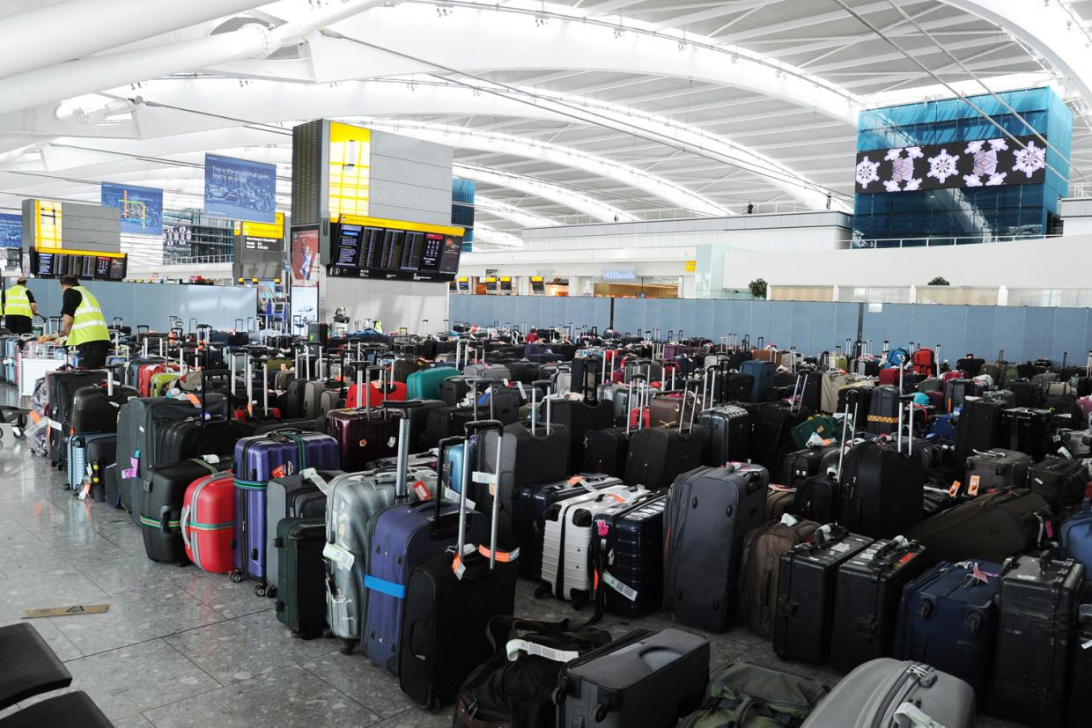
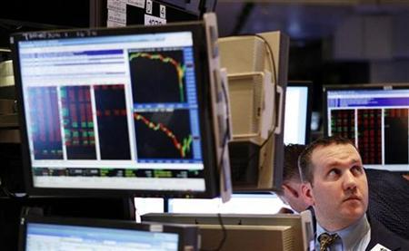
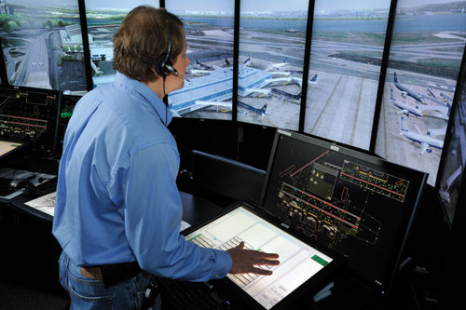
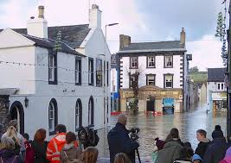
Socio Technical Systems

Slide 4

Characteristics
Heterogeneous collections of actors with varying degrees of autonomy
Complex, contingent, emergent behaviours
Autonomous component evolution at different timescales

Slide 5
Systems Engineering Methods vs Overwhelming Complexity
Notes:
Fundamental assumption in most systems engineering methods that
Lacks sufficient detail for useful results
Too narrow in scope
Too costly or intractable to analyse

Slide 6
Systems Engineering Methods vs Overwhelming Complexity
Notes:
Fundamental assumption in most systems engineering methods that
Lacks sufficient detail for useful results
Too narrow in scope
Too costly or intractable to analyse

Slide 7
Systems Engineering Methods vs Overwhelming Complexity
Notes:
Fundamental assumption in most systems engineering methods that
Lacks sufficient detail for useful results
Too narrow in scope
Too costly or intractable to analyse

Slide 8

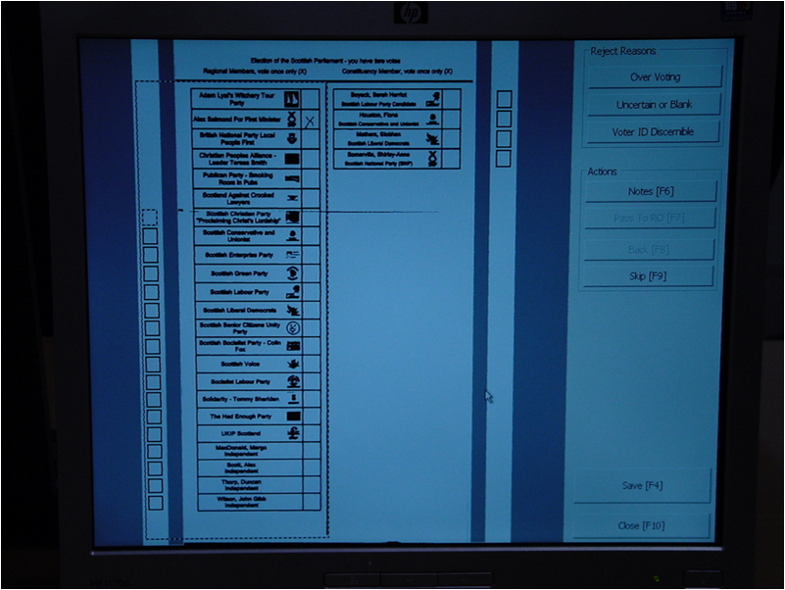
Trial, error and revision

Slide 9
Intuition
Variability and contingency in behaviour is a cross-cutting concern:
The same causes of variability affect many different workflows;
so apply their effects as aspects to functional descriptions of workflow behaviours.
Examples
Forgetfulness
Distraction
Exhaustion
Mix-ups
Misjudgements
Software/hardware failures
Inattention
Short of time

Slide 10
Fuzzi Moss
Object oriented model of problem domain
Implemented in Python
Represents the domain’s inviolable physics
Model predictable domain behaviour stochastically
Model workflows and tasks as classes and methods
Run simulations in Theatre_Ag simulation framework and observe emergent behaviour
Contingent, variable behaviour implemented using PyDySoFu aspect oriented dynamic fuzzing library.

Slide 11
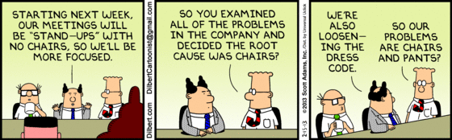
Case Study Selection (With apologies to Scott)
Team based software project development.
Actors have different roles
Development work coordinated around a centralised VCS.
Clear workflows, but with potential for variability
Different coordination workflows possible,
but little empirical evidence as to efficacy
Notes:
Systems have features, chunks, bugs and tests
Features have dependencies

Slide 12
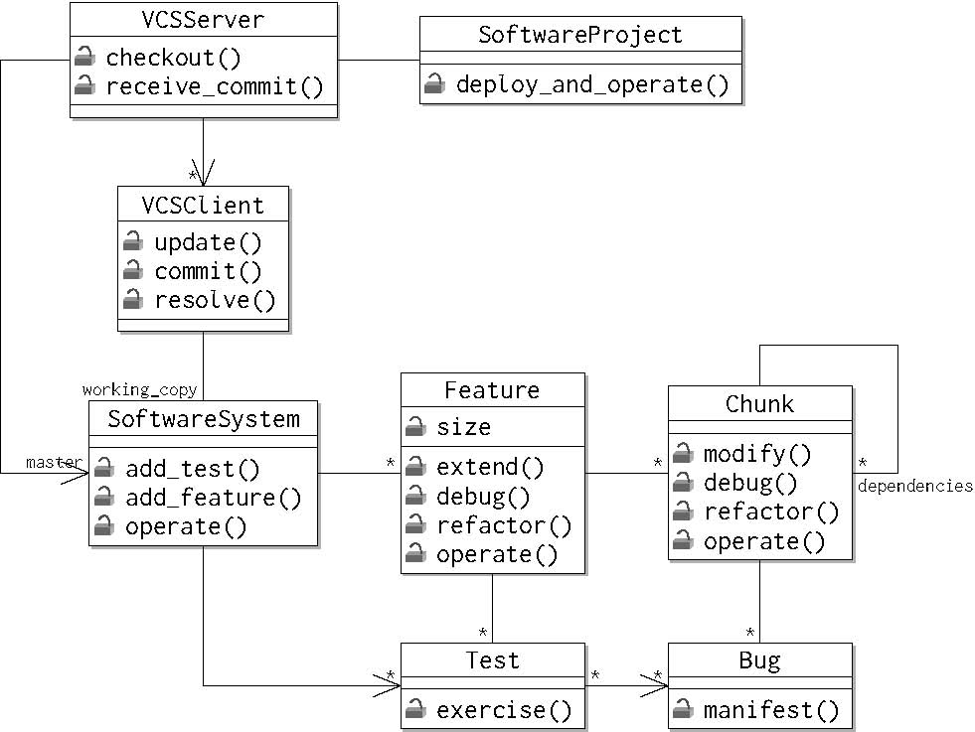
Domain Model (The ‘Physics’)

Slide 13
Domain Element Behaviour Examples
Class Chunk(object):
#...
def debug(self, random, bug=None): if len(self.bugs) == 0: return False if bug is None or bug not in self.bugs: if random.unknown_bug_should_be_removed(self): bug = random.choose_bug(self) self.bugs.remove(bug) elif random.known_bug_should_be_removed(self): self.bugs.remove(bug)

Slide 14
Idealised Workflow Overview
Waterfall software development
Add all features, implement all features, add tests, debug, refactor
Test driven development
Add a feature, add tests, implement, debug, refactor, repeat.
Change management
Checkout, update, commit
Specification
Add feature
Implementation
Complete feature
Testing
Add tests until sufficient coverage achieved
Debugging
Remove bugs revealed by tests
Refactoring
Reduce dependencies

Slide 15
Workflow Example: Debugging
class Debugging(object): @default_cost(1) def debug(self, feature, bug, random): feature.debug(random, bug) @default_cost() def debug_test(self, test, random): while True: try: test.exercise() break except BugEncounteredException as e: self.debug(test.feature, e.bug, random) self.change_management.commit_changes(random) @default_cost() def debug_feature(self, logical_name, random): self.change_management.checkout() feature = self.change_management.centralised_vcs_client.working_copy.get_feature(logical_name) for test in feature.tests: self.debug_test(test, random) @default_cost() def debug_system(self, random): self.change_management.checkout() for test in self.change_management.centralised_vcs_client.working_copy.tests: self.debug_test(test, random)

Slide 16
Workflow Example: TDD
class TestDrivenDevelopment(object): def __init__(self, centralised_vcs_server): change_management = ChangeManagement(centralised_vcs_server) self.specification = Specification(change_management) self.testing = Testing(change_management) self.implementation = Implementation(change_management) self.debugging = Debugging(change_management) self.refactoring = Refactoring(change_management) @default_cost() def implement_feature_tdd(self, user_story, random): self.specification.add_feature(user_story.logical_name, user_story.size, random) self.testing.test_per_chunk_ratio(user_story.logical_name, random) self.implementation.implement_feature(user_story.logical_name, random) self.debugging.debug_feature(user_story.logical_name, random) self.refactoring.refactor_feature(user_story.logical_name, random) @default_cost() def work_from_backlog(self, product_backlog, random): while True: try: user_story = product_backlog.get(block=False) self.implement_feature_tdd(user_story, random) except Empty: break

Slide 17
Theatre_Ag Agent Architecture
Theatre metaphor:
Actors, casts, scenes, episodes, directions
Actors are threads that synchronize on simulation clock ticks
Actors execute a workflow until a cost is encountered
Tasks are passed as workflow instance method references and arguments
Waits for sufficient clock ticks to pass before proceeding
Can idle for one tick if no work to do
Actors can allocate each other tasks

Slide 18
Costing and Synchronization (Workflow Modification)
reference_get_attr = workflow_class.__getattribute__ def __tracked_getattribute(self, item): attribute = reference_get_attr(self, item) if inspect.ismethod(attribute): def sync_wrap(*args, **kwargs): actor = self.actor actor.busy.acquire() actor.incur_delay(attribute, self, args) actor.wait_for_turn() try: return attribute.im_func(self, *args, **kwargs) finally: actor.busy.release() sync_wrap.func_name = attribute.im_func.func_name return sync_wrap else: return attribute workflow_class.__getattribute__ = __tracked_getattribute

Slide 19
PyDySoFu
Dynamic software fuzzing: alteration of program code/state at runtime
Fuzzers accept a context and function body AST and returns a new function body
Core fuzzing library,
identity
Removing steps
Re-ordering steps
Repeating steps
Recursing into control structures
Applying fuzzers in sequence
Replacing conditions
Filtering steps
Inserting steps
…

Slide 20
PyDySoFu User Interface
def shuffle_steps(steps, context): return pydysofu_random.shuffle(steps)
class ExampleWorkflow(object):
def __init__(self, environment): self.environment = environment
def method_for_fuzzing(self): self.environment.append(1) self.environment.append(2) self.environment.append(3)
advice = {
ExampleWorkflow.method_for_fuzzing: shuffle_steps
}
Pydysofu.fuzz_clazz(ExampleWorkflow, advice)
environment = list() target = ExampleWorkflow(environment)
target.method_for_fuzzing()
print environment
Define fuzzer
Define workflow
Map fuzzer to workflow

Slide 21
Dynamic Fuzzing Mechanism
def __fuzzed_getattribute__(self, item): attribute = object.__getattribute__(self, item) if inspect.ismethod(attribute): def wrap(*args, **kwargs): reference_function = attribute.im_func advice_key = getattr(attribute.im_class, attribute.func_name) fuzzer = advice.get(advice_key, identity) fuzz_function(reference_function, fuzzer, self) return reference_function(self, *args, **kwargs) wrap.func_name = attribute.func_name return wrap else: return attribute clazz.__getattribute__ = __fuzzed_getattribute__

Slide 22
Applying the Fuzzer
def get_reference_syntax_tree(func): if func not in _reference_syntax_trees: func_source_lines = inspect.getsourcelines(func)[0] global_indentation = len(func_source_lines[0]) - len(func_source_lines[0].strip()) for i in range(len(func_source_lines)): func_source_lines[i] = func_source_lines[i][global_indentation - 1:] func_source = ''.join(func_source_lines) _reference_syntax_trees[func] = ast.parse(func_source) return _reference_syntax_trees[func] def fuzz_function(reference_function, fuzzer=identity, context=None): reference_syntax_tree = get_reference_syntax_tree(reference_function) fuzzed_syntax_tree = copy.deepcopy(reference_syntax_tree) workflow_transformer = WorkflowTransformer(fuzzer=fuzzer, context=context) workflow_transformer.visit(fuzzed_syntax_tree) compiled_module = compile(fuzzed_syntax_tree, inspect.getsourcefile(reference_function), 'exec') reference_function.func_code = compiled_module.co_consts[0]

Slide 23
Socio-Technical Fuzzer: Distraction
def incomplete_procedure(random, pmf): def _incomplete_procedure(steps, context): clock = context.actor.clock remaining_time = clock.max_ticks - clock.current_tick probability = random.uniform(0.0, 0.9999) n = pmf(remaining_time, probability) choose_last_steps_fuzzer = choose_last_steps(n, False) fuzzer = in_sequence( [ recurse_into_nested_steps( target_structures={ast.While, ast.For, ast.TryExcept}, fuzzer=filter_steps( choose_last_steps_fuzzer, replace_steps_with(replacement='self.actor.idling.idle()') ) ) ] ) return fuzzer(steps, context) return _incomplete_procedure

Slide 24
Evaluation Strategy
Simulations of large scale systems are difficult to validate
Example: climate science
That’s why we simulate
Approach advocated by Naylor and Finger (1967) and others
Staged approach
Evaluate plausibility first
Gain confidence in predictive capability
Is the simulation useful?

Slide 25
Simulation Setup
Compare waterfall performance against TDD
Project of up to 6 user stories, length 2 or 4
3 actor development team, 500 clock ticks maximum
Apply fuzzing to top level or low level workflows
Vary extent of fuzzing by configuring distraction PMF

Slide 26
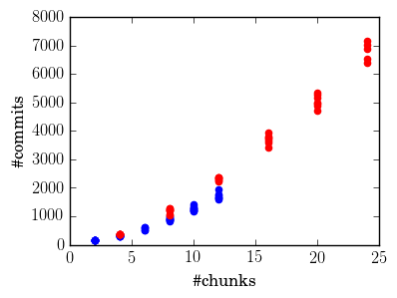
Plausibility Evaluation – Commits Versus Project Size
Large
Small

Slide 27
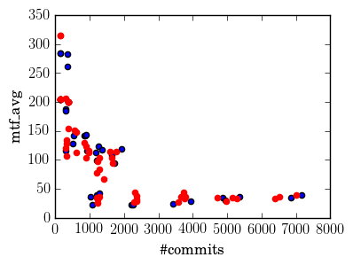
MTF against #Commits for 0 Fuzz Simulations
Waterfall
TDD

Slide 28
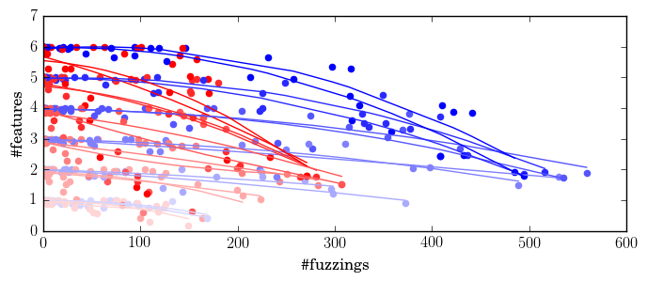
Effect of Fuzzing on Features Completed
Waterfall
TDD

Slide 29
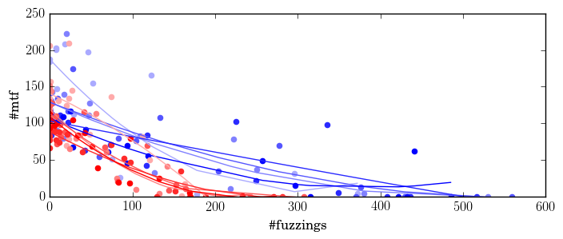
Effect of Fuzzing on MTF – Small Projects
Waterfall
TDD

Slide 30
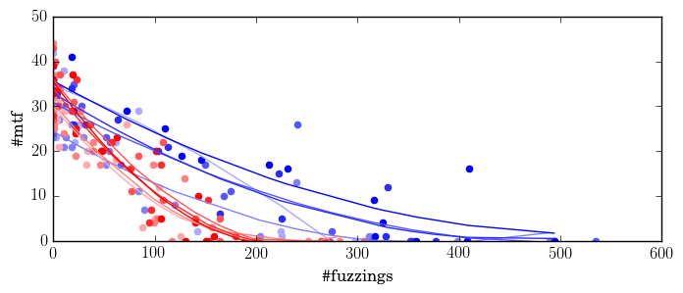
Effects of Fuzzing on MTF – Large Projects
Waterfall
TDD

Slide 31
Summary
Simulation environment for socio-technical systems (Theatre_Ag)
Aspect oriented dynamic fuzzing library for Python (PyDySoFu).
Modelling of contingency and variability in socio-technical systems as PyDySoFu AO fuzzers (Fuzzi_Moss)
Proof of concept case study of team based software development

Slide 32
Thanks! (and Questions)

