Slide 1
The Digital Sin City: An Empirical Study of Craigslist’s Impact on Prostitution Trends
Probal Mojumder Jason Chan
Carlson School of Management
University of Minnesota
31st October 2015
@ CIST 2015

Slide 2
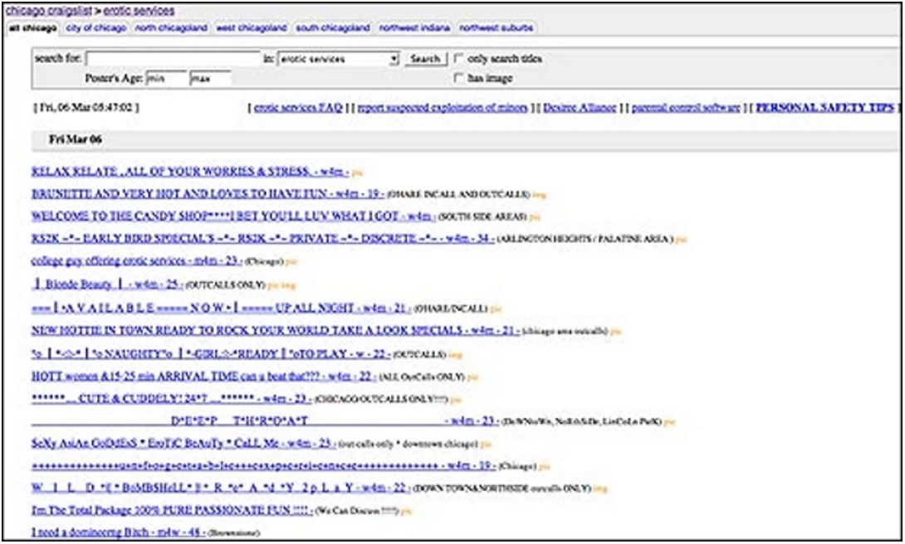
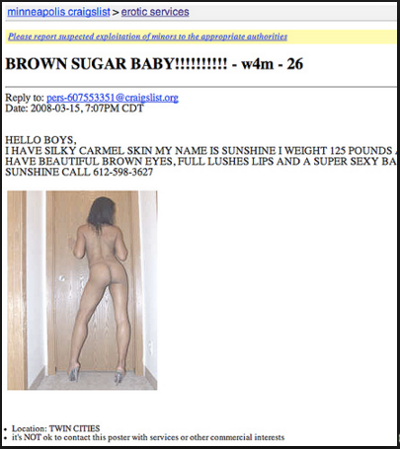
Craigslist and Prostitution Advertisement
chicago craigslist > erotic services
minneapolis craigslist > erotic services
Source: Chicago Tribune, June 18, 2008
Source: theguardian.com, August 8, 2010

Slide 3
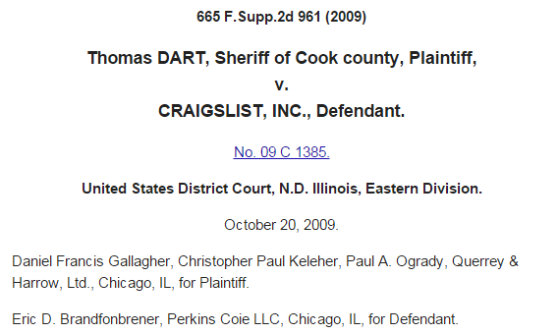
Community and Government Protest of Prostitution Related Posts
Examples
Following this, seventeen state attorneys general sent a letter to the founder and CEO of Craigslist, in August 2010, and requested the immediate removal of the “adult” services section of Craigslist.
In 2009, Cooke county Sheriff Thomas Dart sued Craigslist for hosting prostitution related ads.
Craigslist asked to stop advertising prostitution
Adult services section contains numerous ads
Updated: Tuesday, 24 Aug 2010, 1:44 PM EDT
Published : Tuesday, 24 Aug 2010, 1:31 PM EDT
COLUMBUS, Ohio (WANE) - Ohio Attorney General Richard Cordray, joined by 16 other state attorneys general, is calling on the craigslist online classified advertising service to immediately take down the Adult Services portion of the site. The request is due to continued prostitution advertisements and concern about reported sex trafficking of children through the Adult Services section of the craigslist website.
The multi-state letter, sent to craigslist CEO Jim Buckmaster and founder Craig Newmark, contends that craigslist cannot, or will not, adequately screen these illicit ads, so it must stop accepting them altogether and shut down the Adult Services section.
Link - https://scholar.google.com/scholar_case?case=5947039940466716121&hl=en&as_sdt=6,24
Link - http://comedying.org/wp-content/uploads/articles/SouthCarolina3.pdf

Slide 4

Timeline of Events
Craigslist permanently closed
Adult Services
Adult Services replaced
Erotic Services
Protests
On September 4, 2010
2000
2001
2002
2003
2004
2005
2006
2007
2008
2009
2010

Slide 5
Our Study
Primary Research Question → Economic Impact
Question 1a: Does Craigslist leads to more prostitution incidences?
Question 1b: If yes, how big is the impact size?
Secondary Research Question → Market Mechanisms
Question 1: Does Craigslist substitutes the existing market for prostitution, or create a new market on top of the existing market?
Question 2: Is the effect stronger for counties with no prior history of prostitution, or for counties with existing history of prostitution.
Question 3: Does Craigslist causes migration of prostitution to a neighboring county?
Question 4: Does Craigslist lead to an increase in actual prostitution, or induces an improvement in policing opportunities?

Slide 6
Data Sources
FBI’s Uniform Crime Reports (UCR)
Prostitution_{iy}, which is the number of prostitution arrests. It is constructed by summing the number of prostitution arrests across all the reporting ZIP codes in a county for a given year.
Other crime trends, like commercialized vice, drinking under influence, and vandalism.
Craigslist’s Website
Craigslist Entry_{iy}, which is a dummy variable indicating the entry of Craigslist in county i in year y.
U.S. Census Bureau
Population size,
Age-group proportions,
Racial proportions, and
Individuals below the poverty level.
FBI’s Law Enforcement Officers Killed and Assaulted Dataset
Number of police employees

Slide 7
Empirical Model: Difference in Difference Estimator
We rely on Craigslist’s expansion in the United States in a natural experiment setup, and apply difference-in-difference estimation with county and time fixed effects.
ln(𝑃𝑟𝑜𝑠𝑡𝑖𝑡𝑢𝑡𝑖𝑜𝑛𝑖𝑦)= 𝛼𝑖+ 𝛽𝑦+𝑔∙𝜸𝑖𝑦+𝑝∙𝐶𝑟𝑎𝑖𝑔𝑠𝑙𝑖𝑠𝑡𝑖𝑦+ 𝑒𝑖𝑦
Where,
i indicates 1763 counties
y refer to year, y = 1999, … , 2008
𝑃𝑟𝑜𝑠𝑡𝑖𝑡𝑢𝑡𝑖𝑜𝑛_{𝑖𝑦} is the number of prostitution arrests for county i in year y
𝜶_{𝒊} is a vector of 1,763 county fixed effects
𝜷_{𝒚} is a vector of year fixed effects
𝜸_{𝑖𝑦} is a vector of county-year demographics features, socioeconomic indicators, and crime-related factors
𝐶𝑟𝑎𝑖𝑔𝑠𝑙𝑖𝑠𝑡_{𝑖𝑦} is the binary indicator for Craigslist entry
𝑒_{𝑖𝑦} is error term

Slide 8
Main Result: Craigslist Leads to Increase in Prostitution Trends
Fixed Effect Regressions Showing Impact of Craigslist Entry on Prostitution, with Robustness Checks
Variables | Model 5 |  | Model 6 | Model 7 | Model 8 | Model 9
Craigslist Entry | 0.066*** |  | 0.066*** | 0.056*** | 0.198* | 2.710**
 | (0.02) |  | (0.02) | (0.02) | (0.10) | (1.33)
Age 15-19 Proportion | 0.096 |  | 0.096 | 0.123 | -10.851 | 22.665
 | (0.41) |  | (0.41) | (0.28) | (11.90) | (19.29)
Age 20-39 Proportion | -0.730** |  | -0.730** | -0.537** | -2.961 | -22.977**
 | (0.33) |  | (0.33) | (0.24) | (7.86) | (11.32)
Age 40-59 Proportion | -0.825*** |  | -0.825*** | -0.609*** | -2.790 | -34.646**
 | (0.30) |  | (0.30) | (0.22) | (7.52) | (15.11)
Age 60-79 Proportion | -0.978** |  | -0.978** | -0.737** | -11.288 | -43.203**
 | (0.42) |  | (0.42) | (0.30) | (8.59) | (19.96)
White Proportion | -6.961** |  | -6.961** | -4.842** | -119.999 | -426.096**
 | (3.31) |  | (3.31) | (2.27) | (75.37) | (205.54)
Black Proportion | -6.419** |  | -6.419** | -4.436** | -115.186 | -383.129**
 | (3.11) |  | (3.11) | (2.12) | (73.69) | (189.98)
Asian Proportion | -3.499* |  | -3.499* | -2.430** | -91.678 | -228.180*
 | (1.81) |  | (1.81) | (1.22) | (76.45) | (121.09)
American Indian Proportion | -6.565** |  | -6.565** | -4.468** | -175.154 | -401.575**
 | (3.34) |  | (3.34) | (2.27) | (106.95) | (202.89)
Log (Population Size) | -0.023 |  | -0.023 | 0.001 | 2.076 | -5.113
 | (0.05) |  | (0.05) | (0.04) | (1.40) | (3.36)
Log (Poverty) | 0.060*** |  | 0.060*** | 0.044*** | -0.015 | 3.765**
 | (0.02) |  | (0.02) | (0.02) | (0.33) | (1.70)
Employed Proportion | -0.319* |  | -0.319* | -0.253* | -2.213 | -13.270
 | (0.18) |  | (0.18) | (0.13) | (3.88) | (10.63)
Log(Annual Income) | -0.039* |  | -0.039* | -0.023* | -0.284 | -2.942
 | (0.02) |  | (0.02) | (0.01) | (1.14) | (1.91)
Log (Police Officers) | -0.009 |  | -0.009 | -0.007 | -0.257*** | -0.599*
 | (0.01) |  | (0.01) | (0.00) | (0.09) | (0.32)
Log (All Other Crimes)# | 0.003* |  | 0.003* | 0.003* | -0.658 | 0.095
 | (0.00) |  | (0.00) | (0.00) | (1.13) | (0.09)
Robust Standard Errors |  |  | ü
Un-Weighted Regression |  |  |  | ü
Prostitution Only Counties |  |  |  |  | ü
DV = Prostitution Arrests |  |  |  |  |  | ü
R-squared | 0.026 |  | 0.026 | 0.021 | 0.180 | 0.015
F-Stats | 2.048 |  | 2.048 | 2.028 | 3.860 | 0.870
Observations | 16377 |  | 16377 | 16377 | 884 | 16377
Effect size of 6.6% increase in prostitution trends
Age
Controls
Ethnicity
Controls
Economic
Controls
Police &
Crime
Controls

Slide 9
Falsification Result: No Effect on Alternative Crimes
Falsification Test Using Alternative Crimes
 | DV = Log (Driving Under Influence) | DV = Log (Vandalism)
Variables | Model 1 | Model 2
Craigslist Entry | 0.021 | -0.038
 | (0.03) | (0.03)
County Fixed Effect | ü | ü
Time Fixed Effect | ü | ü
R-squared | 0.046 | 0.016
F-Stats | 13.656 | 5.193
Observations | 16377 | 16377
No Effect
No Effect
Note: All control variables are included.

Slide 10
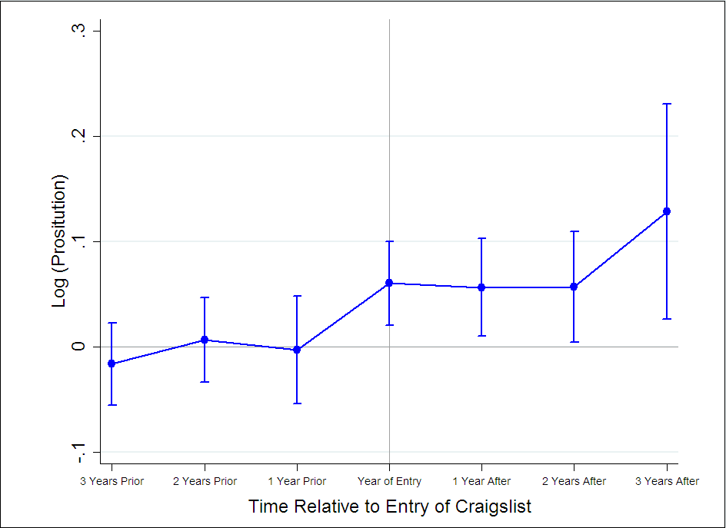
Falsification Result: No Pre-Entry Effect
Falsification Test Using Pre- and Post- Entry Craigslist Indicators
 |  | Weighted Regressions
Variables |  | Model 3 | Model 4
Craigslist Entry₋₃ |  | -0.014 | -0.016
 |  | (0.02) | (0.02)
Craigslist Entry₋₂ |  | 0.017 | 0.007
 |  | (0.02) | (0.02)
Craigslist Entry₋₁ |  | 0.004 | -0.003
 |  | (0.02) | (0.03)
Craigslist Entry₁ |  | 0.062*** | 0.056**
 |  | (0.02) | (0.02)
Craigslist Entry₂ |  | 0.060** | 0.057**
 |  | (0.03) | (0.03)
Craigslist Entry₃ |  | 0.131** | 0.128**
 |  | (0.05) | (0.05)
County Fixed Effect |  | ü | ü
Time Fixed Effect |  |  | ü
R-squared |  | 0.024 | 0.027
F-Stats |  | 1.636 | 1.733
Observations |  | 16377 | 16377
Pre-Entry Indicators
Post-Entry
Post-Entry Indicators
Pre-Entry
Note: All control variables are included.

Slide 11
Mechanism 1: Craigslist Creates a Separate Market for Prostitution
Impact of Commercialized Vice and Craigslist Entry on Prostitution
Variables | Model 1 | Model 2
Log (Commercialized Vice Arrests) | 0.715*** | 0.712***
 | (0.06) | (0.06)
Craigslist Entry |  | 0.051***
 |  | (0.02)
R-squared | 0.372 | 0.377
F-Stats | 11.536 | 11.389
Observations | 16377 | 16377
Similar Coefficient
Sizes
Note: All control variables are included.

Slide 12
Mechanism 2: Craigslist Introduces Prostitution in Counties with No Prior History of Prostitution
Impact of Craigslist Entry over Sample Split based on Presence of Past Prostitution
 | No Cases of Prostitution before Craigslist Entry | Had Cases of Prostitution before Craigslist Entry
Variables | Model 1 | Model 2
Craigslist Entry | 0.037*** | 0.095
 | (0.01) | (0.11)
R-squared | 0.018 | 0.139
F-Stats | 0.680 | 3.307
Observations | 15590 | 787
Effect size of 3.7% increase in prostitution trends
Note: All control variables are included.

Slide 13

Mechanism 3: Craigslist Entry in Neighboring County Causes Sex Worker Migration From Own County
We identify nearest county-pairs, where at least one county had Craigslist entry.
For this, we used the ‘haversine’ formula to calculate the shortest distance between 2 points on earth, where each point is the midpoint of a county.
We alternate the county pair, based on cases where focal county with Craigslist is either the own county or the neighboring county.
Migration of Prostitution Due to Neighboring County Craigslist Entry
 | DV = Log (Own County Prostitution)
 | Own County Has Craigslist | Own County Does Not Have Craigslist
Variables | Model 1 | Model 2
Own County Craigslist Entry | 0.182***
 | (0.04)
Neighboring County Craigslist Entry |  | -0.035**
 |  | (0.02)
Log (Commercialized Vice Arrests) | 0.779*** | 2.133***
 | (0.02) | (0.07)
R-squared | 0.688 | 0.622
F-Stats | 49.765 | 39.346
Observations | 709 | 752
3.5% decrease in own county prostitution due to Craigslist entry in neighboring county
Note: All control variables are included.

Slide 14
Mechanism 4: True Increase in Prostitution Or Increase in Police Effort?
We retrieve news articles from 4 databases that talk about police conducting sting opeartions over Craigslist to make prostitution arrests.
We ommit US states-years where reported police stings where mentioned, and re-run our models.
States Involved in Police Stings
News Articles on Police Stings
Years | States Where Police Conduct Stings Using Craigslist
2005 | CA, MA, NY, RI
2006 | CA, CT, FL, GA, IL, MA, NH, NJ, NY, OK, PA, RI, WA
2007 | AL, AR, CA, CO, CT, FL, GA, ID, IL, IN, LA, MA, MD, MN, NC, NH, NJ, NY, OH, OK, OR, PA, RI, WA
2008 | AL, AR, CA, CO, CT, FL, GA, ID, IL, IN, KS, KY, LA, MA, MD, MI, MN, MO, NC, NH, NJ, NY, OH, OK, OR, PA, RI, SC, TN, TX, UT, VA, WA, WI, WV
News Article Database | No. of News Articles
Access World News | 885
Factiva | 193
LexisNexis Academic | 120
Proquest Newsstand | 463

Slide 15
True Increase in Prostitution Trends
OLS and Fixed Effect Regressions Showing Impact of Craigslist Entry on Prostitution, with Robustness Checks on sample without Police Stings
 | OLS |  | Fixed Effect
Variables | Model 1 | Model 2 | Model 3 | Model 4 | Model 5 | Model 6 | Model 7
Craigslist Entry | 0.446*** | 0.366*** | 0.076*** | 0.464*** | 0.078*** | 0.078*** | 0.064***
 | (0.08) | (0.08) | (0.03) | (0.08) | (0.03) | (0.03) | (0.02)
County Fixed Effect |  |  | ü |  | ü | ü | ü
Time Fixed Effect |  |  |  | ü | ü | ü | ü
Control * Time Trend |  | ü
Robust Standard Errors |  |  |  |  |  | ü
Un-Weighted Regression |  |  |  |  |  |  | ü
Clustered Standard Errors | ü | ü | ü | ü | ü |  | ü
Weighted Regression | ü | ü | ü | ü | ü | ü
R-squared | 0.235 | 0.250 | 0.022 | 0.236 | 0.025 | 0.025 | 0.019
F-Stats | 4.282 | 2.746 | 1.497 | 2.833 | 1.642 | 1.642 | 1.606
Observations | 14107 | 14107 | 14107 | 14107 | 14107 | 14107 | 14107
Note: All control variables are included.

Slide 16
Future Work and Implications
Future Work
We want to further tease out whether there was true increase in prostitution, or increase in Police efforts.
For this we will use multinomial logit, to model police decision making in order to identify crimes where they can put effort to make arrests, among a set of alternative crimes against society.
Implications
Our results suggests that Craigslist's shutdown of ‘Adult Services’ is legitimate.
Our results suggests that there was actual increase in prostitution due to Craigslist’s entry.
Our results can generalize, since other similar websites like Backpage, etc. carry prostitution advertisement even to this day.

Slide 17
Thank You
Questions?

