Slide 1
Are Yang and McSteamy More Receptive to a Hot Vote than Meredith and George? Heterogeneity in Treatment Effects in Online Dating
Probal Mojumder Carlson School of Management University of Minnesota mojum003@umn.edu | Ravi Bapna Carlson School of Management University of Minnesota rbapna@umn.edu | Jui Ramaprasad Desautels Faculty of Management McGill University jui.ramaprasad@mcgill.ca | Akhmed Umyarov Carlson School of Management University of Minnesota aumyarov@umn.edu
14th December 2017
@ WISE 2017

Slide 2
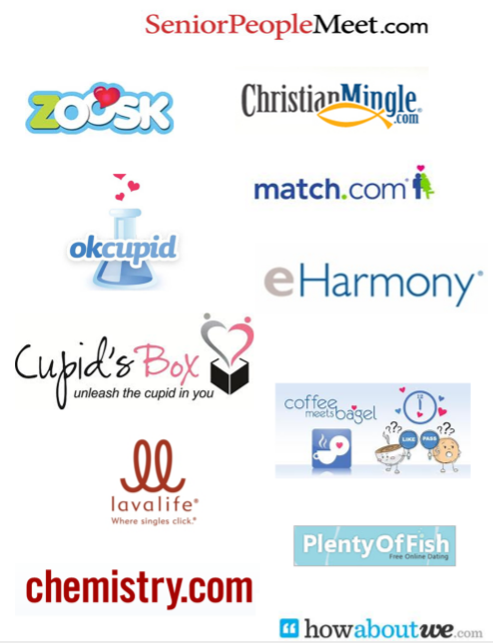
Online Dating Is Big!
Popular Online Dating Sites
“... More than one third of those married between 2005 and 2012 met on-line.” (Cacioppo et al., 2013)
“Usage [of online dating] by 18- to 24-year-olds has increased nearly threefold since 2013, while usage by 55- to 64-year-olds has doubled” (PewResearch, 2016)

Slide 3

Online Dating Site Features Influence User Behavior
Anonymous Viewing: Bapna et al. (2016) studied anonymous profile viewing, and found that it negatively impacted online dating matches, particularly for females!
Study of Anonymous Viewing
in Bapna et al. (2016)
This feature was known to hinder the weak-signaling strategy.
In this paper we study a strong-signaling strategy that is activated by our vote-identity revelation feature!

Slide 4
Main Research Question
Our research studies the impact of vote-identity revelation feature on users’ online dating engagement and matching outcomes.
Question 1: How does the vote-identity revelation feature impacts users’ online dating engagement and matching outcomes?
Question 2: Is there any differential impact of this feature based on attractiveness levels of the focal users and those who pursue them with a like vote?

Slide 5

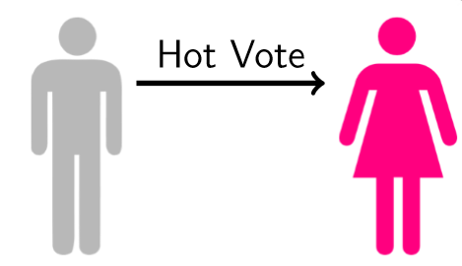
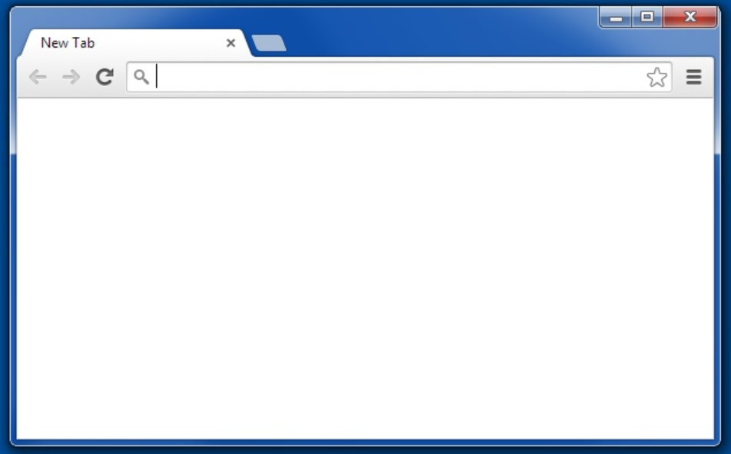
The Vote-Identity Revelation Feature
Definition: It is the feature that allows treated users to see the identity of other users who voted them with a like.
In the Control Group: Users only see the count of who likes them.
Recent Likes:
1 Person
Male X
Female Y
(The Pursuer)
(The Focal User)

Slide 6
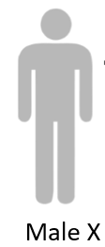
The Vote-Identity Revelation Feature
Definition: It is the feature that allows treated users to see the identity of other users who rated them with a like.
In the Treatment Group: Users can see the identity of who likes them.
Recent Likes:
Male X
Female Y
(The Pursuer)
(The Focal User)

Slide 7


How Can the Vote-Identity Revelation Feature’s Impact Span Out?
Answer: It’s not clear.
Pursuer’s Attractiveness
High
Low
or | (Thibaut & Kelley, 1959)
(Eagly et al. 1991)
High
Focal User Attractiveness
Low

Slide 8
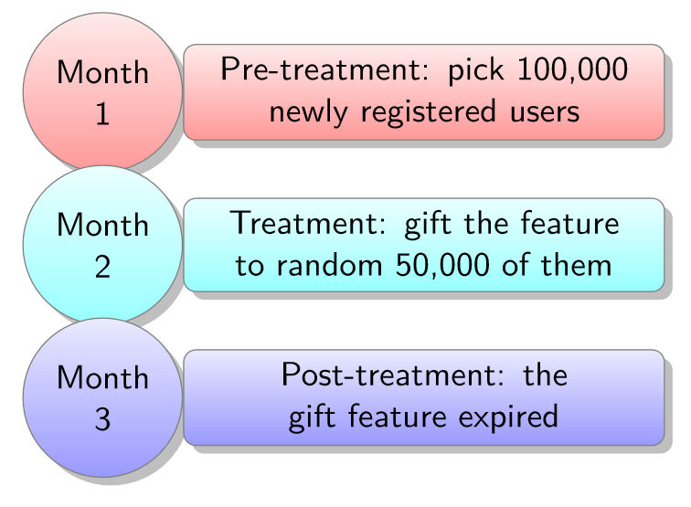
The Experiment
We ran a large-scale randomized field experiment with a big North American online dating site that we call monCherie.com.
Experiment Design
In this experiment, we follow 100,000 newly registered users, and gift a random sample of 50,000 users with the vote-identity revelation feature.

Slide 9


Online Dating Engagement and Matching Outcomes
viewing
messaging
matching
View Sent
Message Sent
Match Sent
view
sender
view
receiver
message
sender
message
receiver
match
sender
match
receiver
View Received
Message Received
Match Received
view
receiver
view
sender
message
receiver
message
sender
match
receiver
match
sender

Slide 10
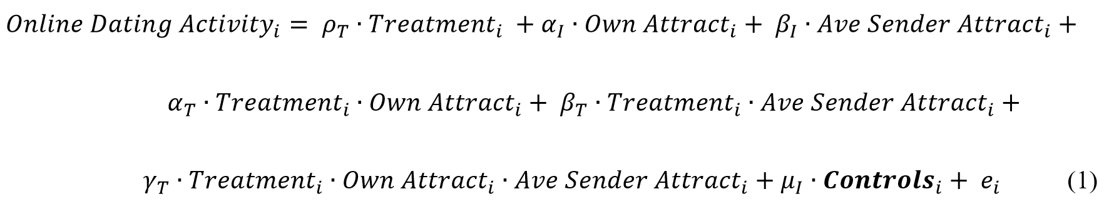
Empirical Model: Poisson Regression Model
We use the exogenous vote-identity revelation treatment provided by the field experiment setup, and apply a Poisson estimation model of the form:
Where,
i refer to users
Online Dating Activity_{𝑖} is the outcome variable for dating activities like viewing, messaging, and matching for user i.
Treatment_{𝑖} is the binary indicator of the vote-identity revelation.
ρ_{T} is the coefficient of main treatment effect
α_{T} is the coefficient of treatment effect interacted with focal users attractiveness
β_{T} is the coefficient of treatment effect interacted with pursuer's attractiveness
𝜸_{T} is the coefficient of the three-way interaction term among treatment, focal users attractiveness, and pursuer's attractiveness.

Slide 11
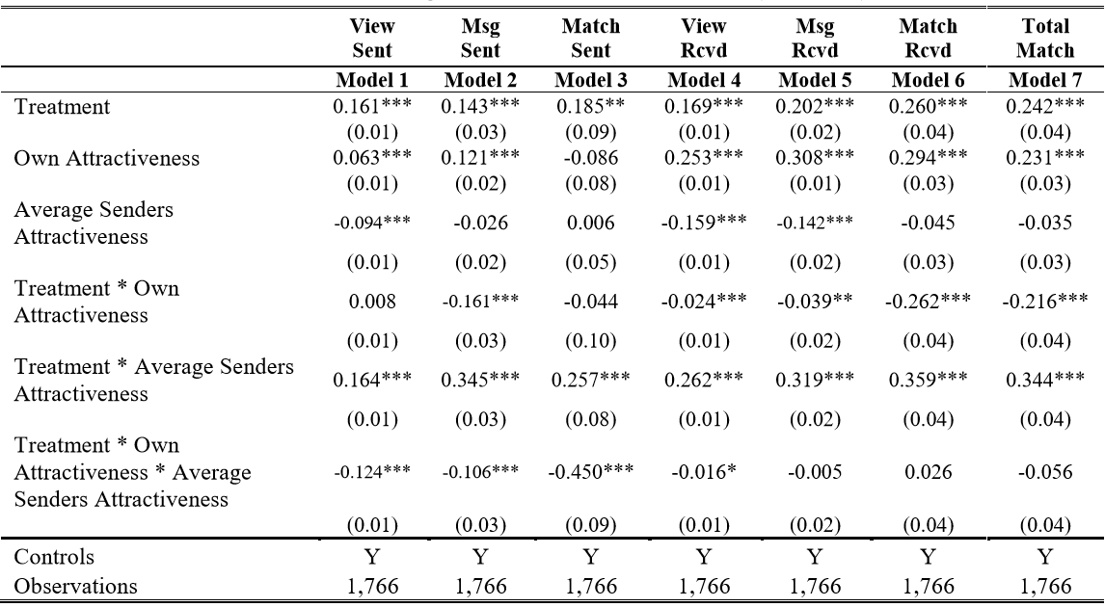
The Vote-Identity Revelation Treatment Shows Different Impacts Along the Attractiveness Dimensions
Treatment Effect Results
Heterogeneous Treatment Effects for Females
Let’s dig deep into these results …
11

Slide 12
Main Treatment Effect is Positive Across All Online Dating Engagement and Matching Outcomes
Treatment Effect Results
Main Treatment Effects for Females
View Sent | Message Sent | Match Sent | View Received | Message Received | Match Received | Total Match
0.161*** | 0.143*** | 0.185** | 0.169*** | 0.202*** | 0.260*** | 0.242***
(0.01) | (0.03) | (0.09) | (0.01) | (0.02) | (0.04) | (0.04)
Vote-Identity Revelation Treatment
Conclusion: We find that online dating engagement and matching outcome improved for female users, for both sent and received variables.
12

Slide 13
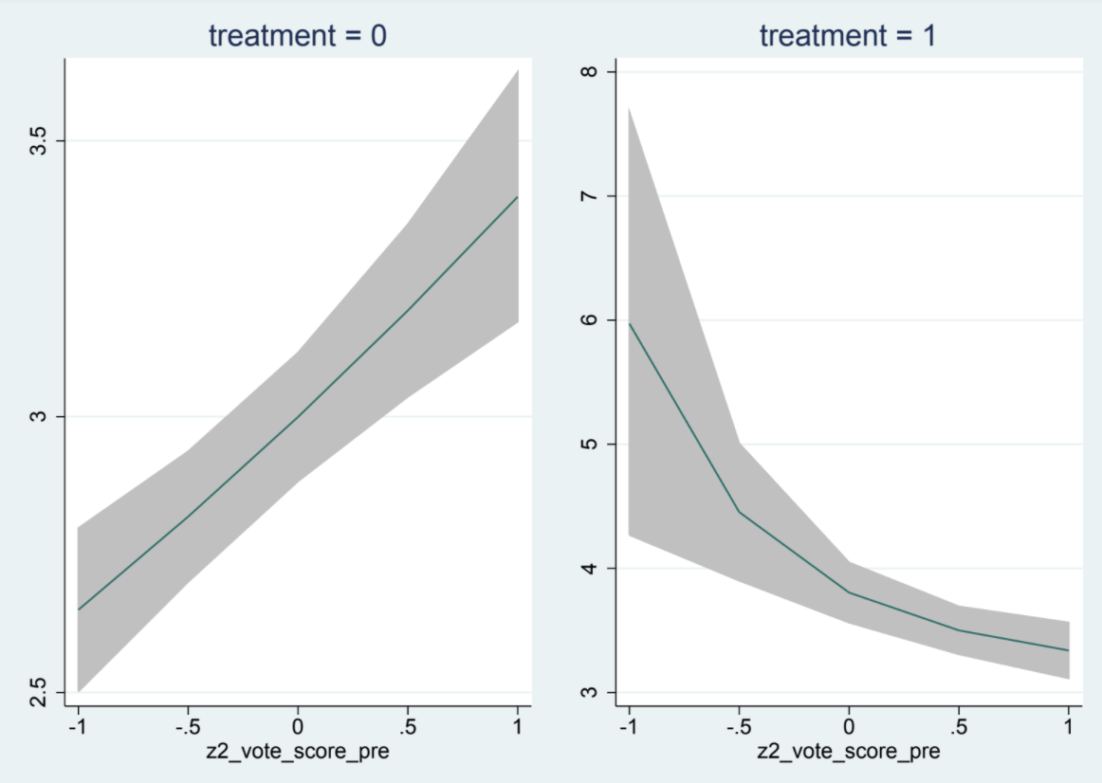
When Treatment Interacts with Focal Users Attractiveness Levels, We find an “Ego Effect”
Treatment Effect Results
Heterogeneity in Treatment Effects for Females
View Sent | Message Sent | Match Sent | View Received | Message Received | Match Received | Total Match
0.008 | -0.161*** | -0.044 | -0.024*** | -0.039** | -0.262*** | -0.216***
(0.01) | (0.03) | (0.10) | (0.01) | (0.02) | (0.04) | (0.04)
Treatment * Focal
Users Attractiveness
Marginal Effects Graph for Message Sent
Conclusion: We find that due to the treatment there is decrease in engagement and matching outcomes for highly attractive female users. For instance, females self initiated messaging decreases.
13

Slide 14
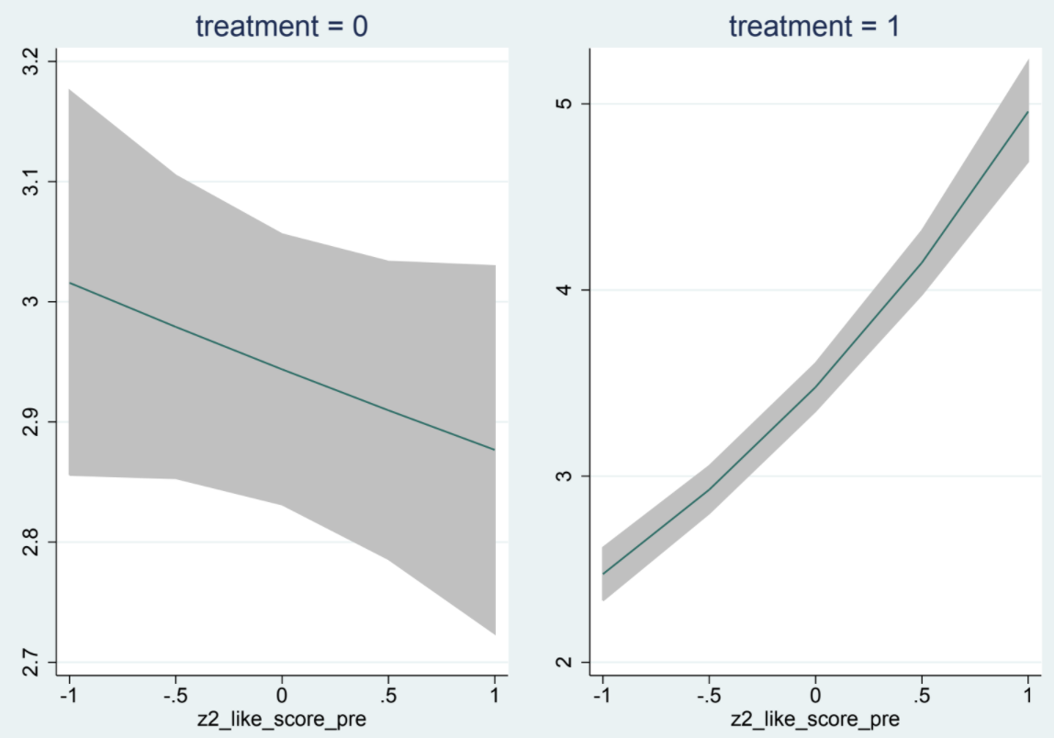
When Treatment Interacts with Pursuer's Attractiveness Levels, We find an “Encouragement Effect”
Treatment Effect Results
Heterogeneity in Treatment Effects for Females
View Sent | Message Sent | Match Sent | View Received | Message Received | Match Received | Total Match
0.164*** | 0.345*** | 0.257*** | 0.262*** | 0.319*** | 0.359*** | 0.344***
(0.01) | (0.03) | (0.08) | (0.01) | (0.02) | (0.04) | (0.04)
Treatment * Pursuer's Attractiveness
Marginal Effects Graph for Messages Sent
Conclusion: We find that due to treatment, there is increase in engagement and matching outcomes for female users when the user receives likes from attractive pursuers.
14

Slide 15
For the Three-Way Interaction Term, We Find that “Ego Effect” Dominates “Encouragement Effect”
Treatment Effect Results
Heterogeneity in Treatment Effects for Females
View Sent | Message Sent | Match Sent | View Received | Message Received | Match Received | Total Match
-0.124*** | -0.106*** | -0.450*** | -0.016* | -0.005 | 0.026 | -0.056
(0.01) | (0.03) | (0.09) | (0.01) | (0.02) | (0.04) | (0.04)
Treatment * Focal Users Attractiveness * Pursuer's Attractiveness
Conclusion: When both “Ego effect” and “Encouragement Effect” are simultaneously present, we find that the ego effect dominates the encouragement effect as shown by the negative significance of the engagement and matching coefficients, particularly for activities that were initiated by female users.
15

Slide 16
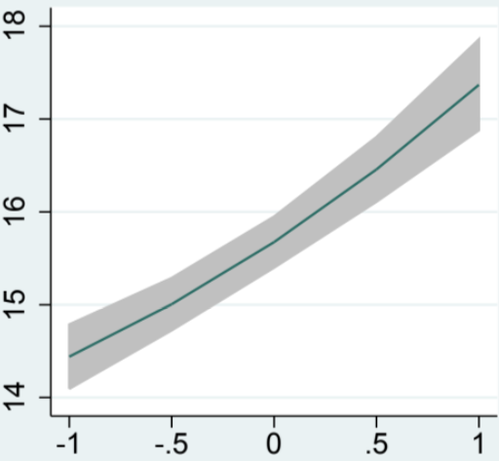
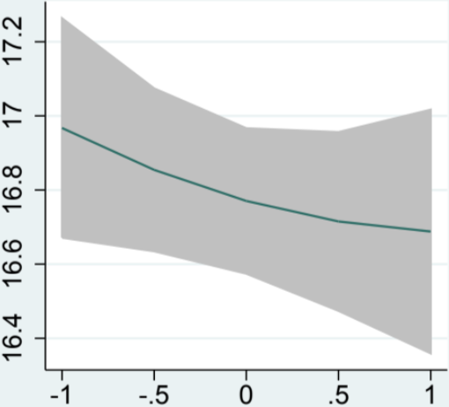
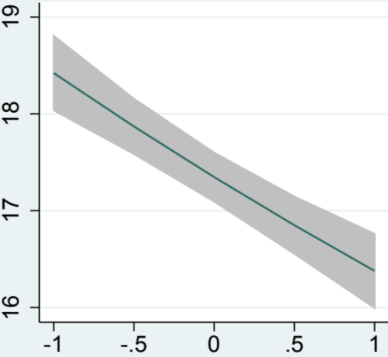
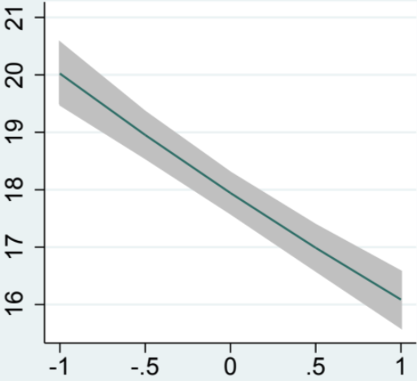
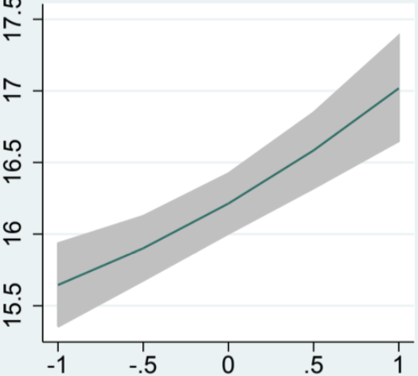
For the Three-Way Interaction Term, We Find that “Ego Effect” Dominates “Encouragement Effect”
Treatment Effect Results
Marginal Effects Graph for Views Sent
Focal User Attractiveness = Very High
Focal User Attractiveness = Somewhat High
Focal User Attractiveness = Average
Focal User Attractiveness = Very Low
Focal User Attractiveness = Somewhat Low
Pursuer’s Attractiveness
16

Slide 17

Research Implications
We find that online dating website features, like the vote-identity revelation feature, can increase user engagement.
Our analysis suggest that different cohorts reacts differently to the same feature.
Our results can inform business stakeholders and website managers on how to go about launching new site features, given the impacts are different across different cohorts!

Slide 18





So, Are Yang and McSteamy More Receptive to a Hot Vote than Meredith and George?
Answer: It depends!
Yang
McSteamy
Meredith
George
Thank You

Slide 19
References
Bapna, R., Ramaprasad, J., Shmueli, G., and A. Umyarov. 2016. “One-Way Mirrors and Weak Signaling in Online Dating: A Randomized Field Experiment,” Management Science, (62:11), pp. 3100–3122.
Eagly, Alice H., et al. "What is beautiful is good, but…: A meta-analytic review of research on the physical attractiveness stereotype." Psychological bulletin110.1 (1991): 109.
Thibaut, J. W., & Kelley, H. H. (1959). The social psychology of groups. Oxford, England: Wiley.

