Slide 1
PROBLEM STATEMENT
Churn is a silent revenue leak’
!
The Challenge
BUSINESS PATH
Telecom operators lose customers steadily to competitors. In the Telco dataset analysed here, 1,869 of 7,043 customers (26.5%) have already churned — and traditional CRM tools flag this only after the fact.
1
Predict Churn
Score every customer with a trained ML model
2
Retain Customers
Target retention offers at high-risk segments
✓
The Goal
Build a predictive system that flags at-risk customers before they leave — turning reactive CRM reporting into a proactive retention workflow that protects revenue.
3
Boost Revenue
Lower acquisition cost, protect lifetime value
02

Slide 2
THE DATA
Telco Customer Churn Dataset
7,043
KEY VARIABLES USED
1
Tenure
customer records
Months the customer has stayed with the company
21
2
Monthly Charges
Recurring billing amount per customer
attributes per customer
3
Contract Type
26.5%
Month-to-month, one-year, or two-year plans
4
Payment Method
historical churn rate
Electronic check, bank transfer, credit card, etc.
Target split: 5,174 retained (73.5%) • 1,869 churned (26.5%)
03

Slide 3
METHODOLOGY
From raw CSV to trained models
1
2
3
Preprocess
Train
Evaluate
Impute missing TotalCharges (median), label-encode categoricals, scale features with StandardScaler
80:20 train-test split; fit Logistic Regression, Decision Tree, Random Forest
Compare models on Accuracy, Precision, Recall and F1-score
preprocessing.py
train_and_evaluate.py
df['TotalCharges'] = pd.to_numeric(
df['TotalCharges'], errors='coerce')
df['TotalCharges'].fillna(
df['TotalCharges'].median(), inplace=True)
for col in df.select_dtypes(['object']).columns:
if col != 'customerID':
df[col] = LabelEncoder().fit_transform(df[col])
X_scaled = StandardScaler().fit_transform(X)
models = {'Logistic Regression': log_reg,
'Decision Tree': dtree,
'Random Forest': rf}
for name, model in models.items():
y_pred = model.predict(X_test)
acc = accuracy_score(y_test, y_pred)
f1 = f1_score(y_test, y_pred)
04

Slide 4
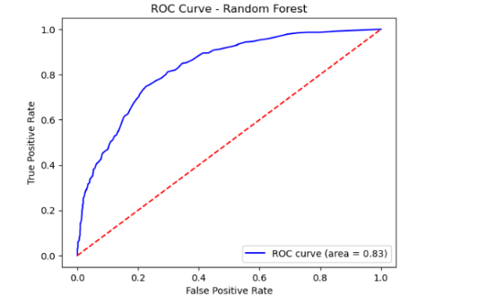
MODEL RESULTS
Logistic Regression wins on balance
ROC CURVE — RANDOM FOREST (AUC = 0.83)
Model | Accuracy | Precision | Recall | F1-Score
Logistic Regression | 81.55% | 67.71% | 57.91% | 62.43%
Decision Tree | 73.31% | 49.61% | 50.94% | 50.26%
Random Forest | 79.06% | 64.66% | 46.11% | 53.83%
✓ Final Selected Model: Logistic Regression — highest accuracy, recall & F1
CONFUSION MATRIX — LOGISTIC REGRESSION
Pred: No
Pred: Yes
Actual: No
933
103
True Negative
False Positive
Reference curve shown for the Random Forest classifier trained in the same notebook run.
Actual: Yes
157
216
False Negative
True Positive
05

Slide 5
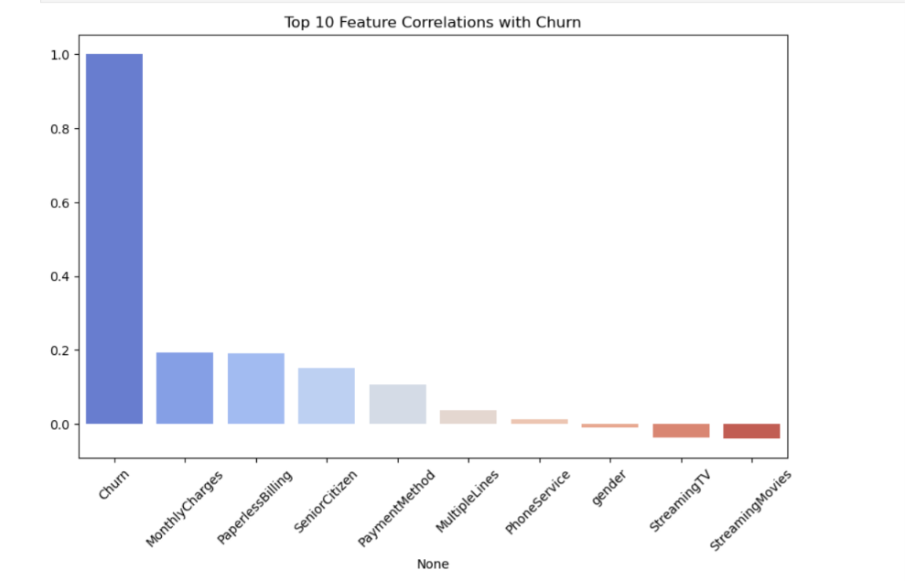
KEY INSIGHTS
What actually drives churn
•
Tenure
TOP FEATURE CORRELATIONS WITH CHURN
Newer customers churn far more often — short-tenure accounts carry the highest risk.
•
Contract Type
Month-to-month subscribers are the least stable segment vs. annual/two-year plans.
•
Monthly Charges
Higher recurring bills correlate with dissatisfaction and churn.
•
Payment Method
Certain payment methods (e.g. electronic check) track with higher churn.
Business implication: focus retention campaigns on new, month-to-month, high-bill customers.
06

Slide 6
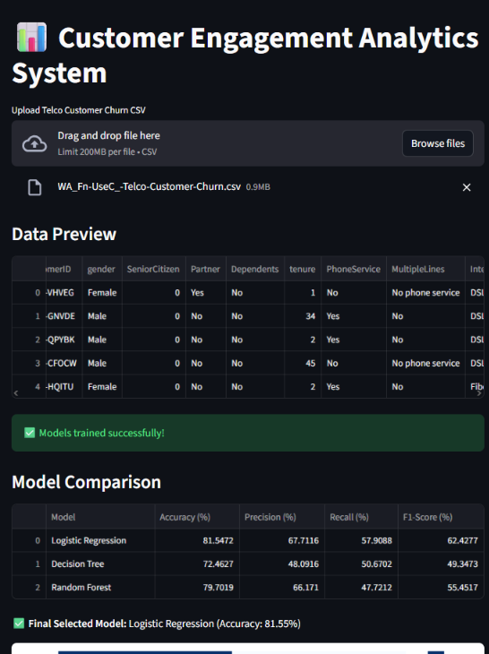
LIVE DEMO
A Streamlit app managers can actually use
1
Upload
Drop in any CSV that matches the Telco schema — no code required.
2
Preview & Train
The app previews the data and trains all three models instantly.
3
Predict
Outputs churn probability per customer and an overall churn rate.
4
Visualize
Confusion matrix, ROC curve, feature importance — all inline.
07

Slide 7
BUSINESS VALUE
Turning predictions into retained revenue
81.55%
22.6%
3
Model accuracy on held-out test customers
Of test-set customers flagged as churn-risk, with individual probabilities
Churn drivers surfaced for targeted retention offers
HOW THIS TRANSLATES TO ROI
Proactive retention: at-risk customers are flagged before they cancel, not after — giving retention teams a window to act.
Focused spend: campaigns can target the highest-probability churners instead of blanket discounts across the base.
Lifetime value: retaining even a portion of the 22.6% flagged customers directly protects recurring monthly revenue.
08

Slide 8
CONCLUSION
What we built, and where it goes next
ACHIEVEMENTS
FUTURE SCOPE
✓
End-to-end ML pipeline: preprocessing, training and evaluation across three algorithms
→
Hyperparameter-tune Random Forest and other ensembles to improve recall
→
Enrich data with behavioural signals — complaints, call records, usage patterns
✓
Logistic Regression selected as final model on balanced accuracy, recall and F1-score
→
Deploy the dashboard live so managers can test scenarios in real time
✓
Interactive Streamlit app for CSV upload, live prediction and visualization
→
Explore Gradient Boosting / XGBoost and automated risk alerts, with CRM integration
09

Slide 9
CLOSING
Sources & acknowledgement
REFERENCES
Telco Customer Churn dataset (WA_Fn-UseC_-Telco-Customer-Churn.csv)
Python libraries: pandas, numpy, scikit-learn, seaborn, matplotlib, Streamlit
Project report: “Customer Engagement Analytics System” (full report, 3.docx)
Source code: Jupyter notebook (model development) and app.py (Streamlit app)
— Probaron Baruah
10

