Slide 1


Technology overview
Business benefit
Success story
Design demonstration
Q & A
www.probe.com.tw

Slide 2
Probe Technology
www.probe.com.tw

Slide 3
Solution for n-tier Web application
  Developing
  Deploying
  Managing
Report system for printing anywhere on any platform
Builds on the success of the standard edition Java 2 Platform and is specifically targeted toward enterprise class business development
Probe technology

Slide 4


Enterprise Application, J2EE Blueprint
Browser
Web Server
DB Server
Legacy
Pure
HTML
JSP
Java
Applet
Servlet
Desktop
EJB
Java
Application
EJB
Web
Start
EJB
Supported by jLIVE Builder
Advance version of jLIVE Builder

Slide 5
Web Application vs. Web Page
System
Java class vs. simple HTML
System flow vs. stateless
Client
User interactive operations
Client computing ability
Server
Distributed computing
Server loading
Report
Printing data source
Server provided, client computing
Notes:
Web application vs. web page

Slide 6
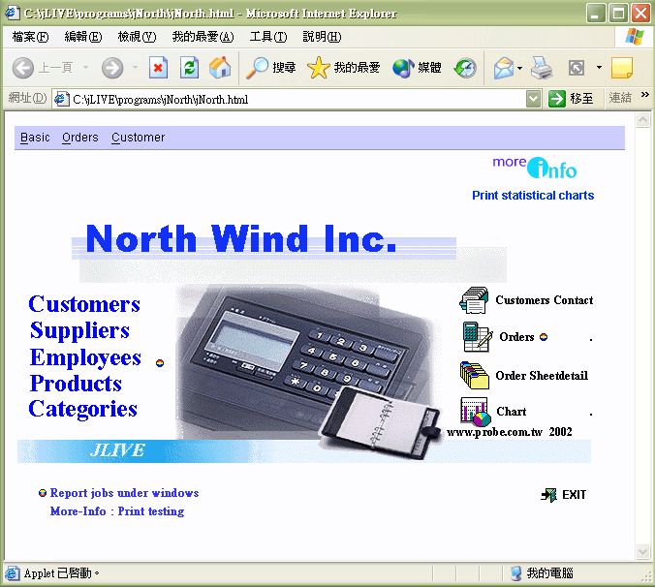
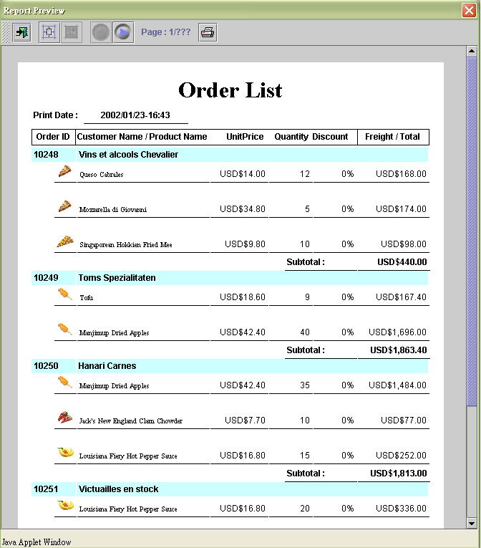
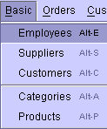
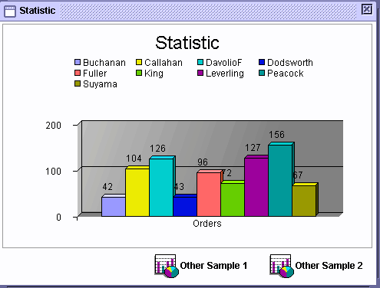
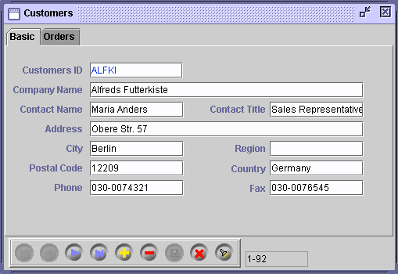
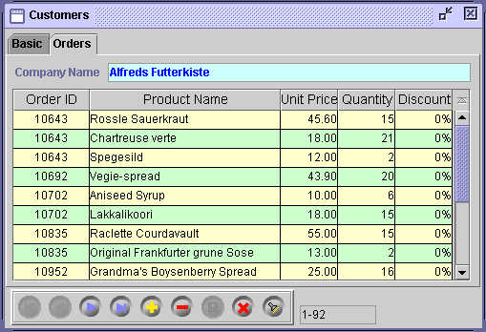
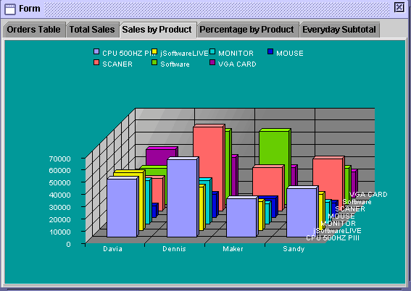
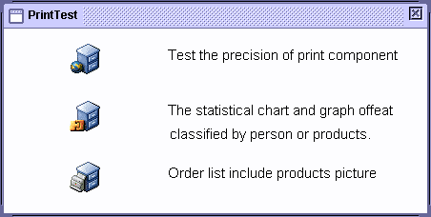
Web Application
Browser enabled application
Application Menu bar
Internal frame window
Tabbed pane & grid
Dynamic statistic chart
Chart samples
Print test window
Print preview window

Slide 7
Development
RAD environment
Fully visual framework
Software components architecture
Object oriental programming
Event-driven concept
Report system included
High productivity

Slide 8
Design Framework
jLIVE Builder
Run Time
Configure
  Project specification
  Middle tier setup
Make Executable
  Authority
  Preload images
  Main panel
  Compile
  Browser enabled
    Applet
    Html convert
  Standalone
    Main window
    Java jar file
Browser enabled
App.HTML
Database
  JDBC driver
  Connection database
class
*.calss
Jlive.jar, jimage.jar
images
Form design
  OOP & Event-driven
  Algorithms & logic
*.gif, *.jpg
Standalone
Report design
  Drag-drop layout
  Algorithms & logic
jLive.jar
Apps.jar jimage.jar
Http connection
Application Server (jsLive)
JDBC

Slide 9
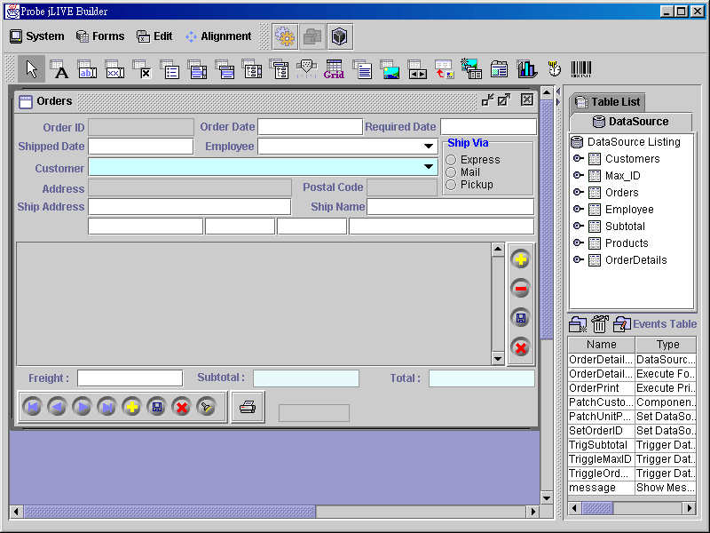
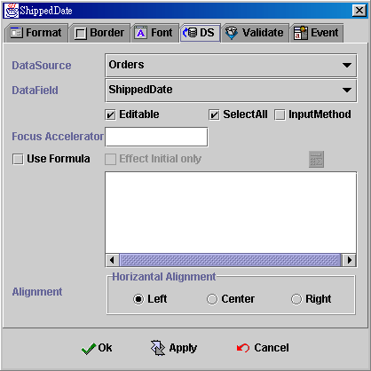
Design Panel – OOP Programming

Slide 10
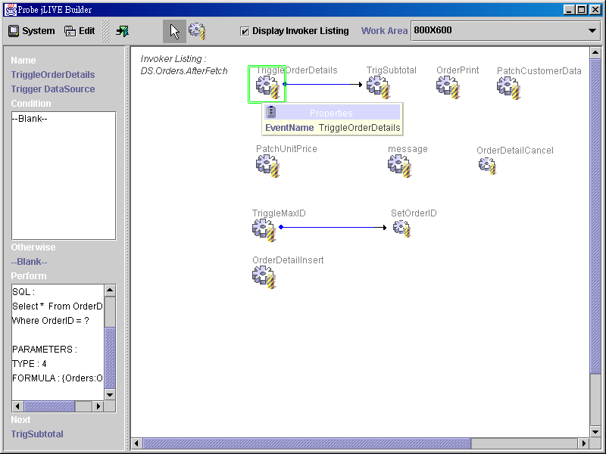
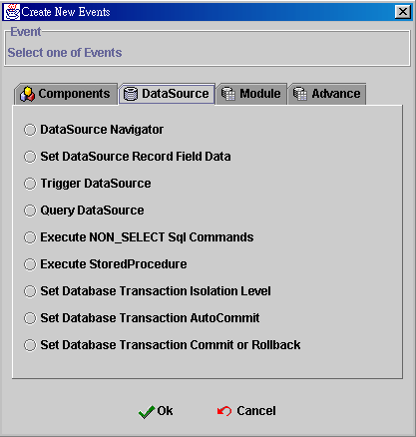
Event Schema – Event Driven Concept

Slide 11
Deployment
Client
Pure Java code, run anywhere
Zero installation in client site
Build-in HTML converter
Server
N-tiers architecture
Distributed instances
Java Servlet middle tier
Database
Heterogeneous database manipulated simultaneously
Security data stored in database
Administration
Remote administration
User and operation log service

Slide 12




Browser Enabled Run Time Flowchart
Http://…/jnorth.html
Java loading
User login
Application enable
Applet instantiation
Form class
Http request HTML
Request Applet
Ap Server Connection
System service
Database connection
Database service
Web Server
Application Server
Database log in & check
Execute SQL command
User authority data
Cache SQL result set
Stored procedure
DB Server
Database transaction

Slide 13
Management
Client
Auto reload for updated classes
Redirect JRE plug-in location
Build-in security and authority roles
Application
Distributed FORM_base runtime modules
Online update renewed modules
Security
Build-in security control and management
Build-in authority role control and management
Database login ID, Password re-mapped
Security and authority data stored in database
Administration
Remote user management

Slide 14
Report System
Developer
Highly integrate with FORM design frame work
Visual designers and wizards for drag-drop development
Online preview printing test
User
What you see is what you get, no matter what printer used
Preview printing and printed on demand
Technology
Absolute print position on sheet, measure by inch or mm
Printer head offset physical or printable adjustment
paging print data stream
Data source, server provided, client computing & printing

Slide 15
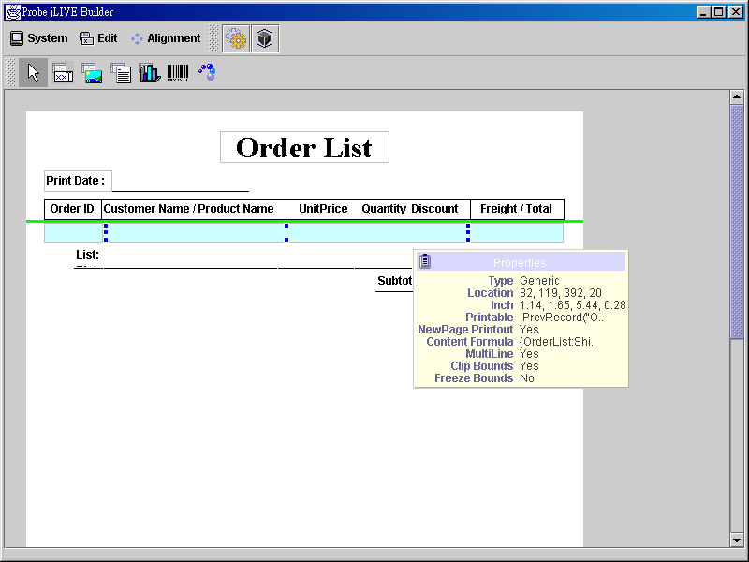
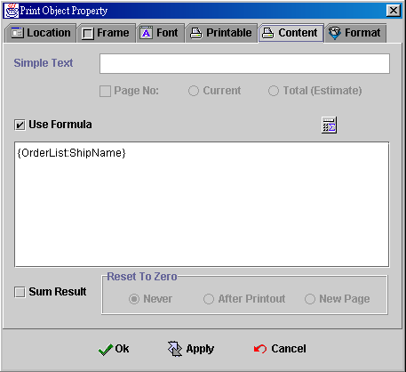
Report Design Panel

Slide 16
jLIVE Builder vs. jBuilder
Target
N-tier web application vs. generic purpose, DIY
Platform
Visual OOP & Event-driven vs. traditional coding IDE
Developer
No Java experiment required vs. High Java learning curve
Develop Time
Extremely short time vs. depend on developer Java skill
Maintenance
XML repository, fully visual components properties vs. code maintain
Productivity
Very high productivity vs. depend on developer Java skill
Report
Professional Web report system vs. none
Facility
Build-in n-tier architecture vs. none
Build-in security and authority management vs. none
Build-in middle-ware database arrangement vs. jDatastore
Build-in concurrent workgroup developer environment vs. none
Build-in export-import wizard vs. none

Slide 17
Milestone

