Slide 1

@me – Yash Singh SME – ML/AI and OpenSauce contributor to various packages

Slide 2
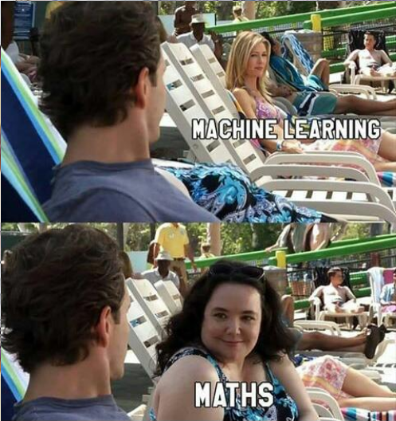
Now, before I start, I must tell you guys, maths is extremely essential for understanding the concepts and core functioning of Machine Learning. As you’ll later learn, without maths, you cannot simply derive the relation between input data and the output obtained.

Slide 3
Artificial Intelligence (AI)
The hot topic of Tech World
Decision Dictated Scenario
Derivation from Quantum Computing
Use cases

Slide 4
Machine Learning (ML)
Machine Learning AKA Statistical Learning is a subset of Artificial Intelligence which introduces closer derivation of procedure dictated logistic programming to the masses. It works with algorithms that works on probability inclination to fetch a data vector closest to the desired target.

Slide 5
Types of Machine Learning (ML)
Machine Learning consitutes of thousands of types. Generically tho, they’re categorized as these three :
Supervised
Unsupervised
Reinforcement

Slide 6
Supervised Learning
Supervised Learning is one of the most prominent types of Machine Learning implementation used by beginners as well as advance pro Data Scientists.
It involves training the model on a training dataset to make the model more accurate.

Slide 7
Unsupervised Learning
Unsupervised Learning is established as one of the ways of implementing Machine Learning when the model has to operated without a prediction training prior to application. This type of implementation is purposely selected in classification handling.

Slide 8
Reinforcement Learning
This type of model is preferred for a job where the model is rewarded with some sort of positive reinforcement everytime it manages to clear an exit node. These models work on the basis of trial and error for higher efficiency.

Slide 9
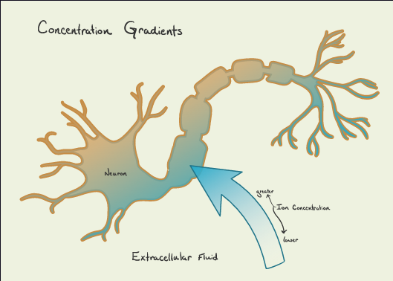
Neural Networks
Biological aspect of neurons.
Impulse travel by means of neurotransmitters
Communication across synaptic cleft

Slide 10
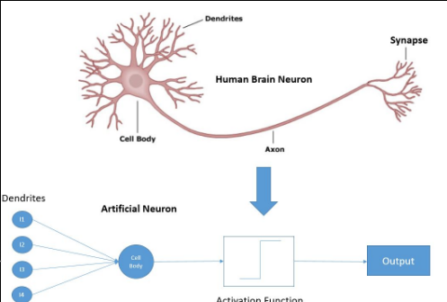
Neural Networks
Technical aspect of Neurons
Hidden neurons process tree
Neural Network & it’s functioning

Slide 11
Types of Supervised Learning
Classification
Classification deals with output data format comprising of types and/or categories
Regression
Regression deals with output data format in numerical nature

Slide 12
Machine Learning Elements :
Machine Learning Elements can be encapsulated in these 4 subtypes :
Data
Model
Objective Function
Optimization Algorithm

Slide 13
Linear Model Illustration with Exemplification
Let’s consider a simple intercept function given as
y = mx + c
Where, y is the output, m is the slope and c is the intercept point/range.

Slide 14
Translation to Machine Learning
The same function when translated to Machine Learning is given as
f(x) = xw + b
where w is the weight and b is the bias

Slide 15
Weight
Weights control the signal (or the strength of the connection) between two neurons. In other words, a weight decides how much influence the input will have on the output.
Bias
Biases are offset values acting as an additional input into the next layer that will always have the value of 1.

Slide 16
Example to tackle Weight-Bias Problem
Let’s say we have to predict the cost of an apartment based on the input – it’s area expressed in sq. Feet.
Using the model expression y = xw + b
Assumption – the weight is dealing as the cost per sq. Feet, depending on the locality, whether the apartment is fully furnished or not, and similar factors.
Bias talks about the sole quality of the input parameter, whether the apartment is close to a beach, has a nice glass view of the ocean, etc.

Slide 17
CASE I:
For an apartment of size x = 763 sq feet,
Let the model decide a weight of w = 300 rupees per sq feet, and the bias b = -1000 (discount for not so good look of the apartment).
Hence, cost of apartment = f(x) = xw + b = 227900 rupees.

Slide 18
CASE II:
For another flat in Goa of the same size x = 763 sq feet, we have a weight balance of w = 500 rupees per sq feet, and the bias is given as b = +5000 rupees because the apartment is new, and looks great.
Now, the cost of the apartment = f(x) = xw + b = 424650 rupees.

Slide 19
N-input Model
For higher number of parameters fed to the model, like the price, stories, services, etc,
the cost is given as
y = x₁w₁ + x₂w₂ +...+x_{n}w_{n} + b₁ + b₂ +...+ b_{n}

Slide 20
Objective Function
Objective Function is the evaluation handler of how good or bad a model is.
Works as two constraints :
Loss function Reward Function

Slide 21
L2 - norm
Squared loss function used for regression.
Given as
l2-norm = Σi (yi – ti)²
It is the summation of square of difference between target vector and
^{output vector.}

Slide 22
Cross Entropy
Loss function for classification Supervised Models
Given as
L(y, t) = -Σi ti ln yi
Hence, it is the summation of product of target vector and natural log of output vector

Slide 23
Example to Cross-Entropy
Let’s say a supervised model trained over alphabet sets A, B and C.
An image of B is processed by the model, Hence, target vector = t_{i} = [0, 1, 0], where 1 implies true for B.
Output vector obtained from model y_{i} = [0.2, 0.8, 0.1]
Hence, cross entropy is given as L(y, t) = -0 x ln 0.2 – 1 x ln 0.8 – 0 x ln 0.1 = 0.22314

Slide 24
Optimization Algorithm
Algorithm that handles the accuracy of the model output by means of variance in the bias and weights.
Most commonly used Algo – SGD (Stochastic Gradient Descent) that works over probability distribution.
SGD is calculated as :
x(i+1) = xi – ηf’(xi)

Slide 25
Functioning of SGD
Let’s say the user performs over a linear model relation given as
y = 5x² + 3x – 4
By formula, First derivative y’ = 10x + 3 Pick arbitrary number for x0 = 4, Calculating x1 = 4 – η[10 * 4 + 3] = 4 – η43
Where η is the learning rate of the model

Slide 26
Learning Rate η = NULL/0
Learning Rate should be iterative difference
Oscillation of Minimum
SGD step limit – 0.001
Relevance to Rayleigh’s Power Method
x(i+1) – xi > step

Slide 27
Underfitting – The model has not captured the underlying logic of the data
Overfitting – The model has trained over a particular dataset so much that it has “missed the point”
Bias-variance tradeoff – The aggregate balance for model stability

Slide 28
Pursuing ML/AI
Elasticity to relevant ideas and their scope
A clearer overview and wider perception for handling problems
Obvious requirements – calculus, linear algebra, probability distribution, well versed in atleast one HLL (ofc implementation on any platform is possible, but for beginners, it’s advisable to continue with languages that offer predef and well supported community libraries, like Java, Python, GoLang, JS)

Slide 29


Slide 30
THANK YOU!
Visit me https://probe2k.github.io
Contact
+91-8210832018
kyash054@gmail.com

