Slide 1

Android app architecture with ViewModel

Slide 2
Objectives
Show problems with non-modular approach of combined UI & Data when configuration change occurs
Show Activity LifeCycle States
ViewModel Characteristics
Change design to use Model-View-Controller (MVC)
Show ViewModels usage with ViewModelProvider class
Display ViewModel Scope

Slide 3
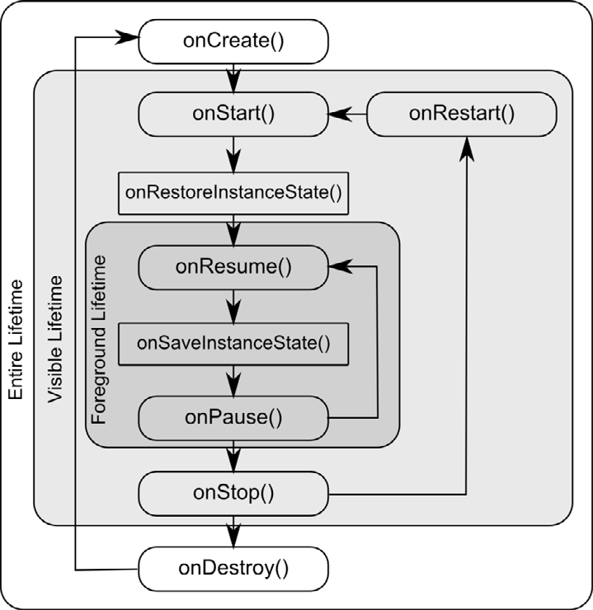
Activity LifeCycle

Slide 4
ViewModel
Store and manage UI-related data
Lifecycle conscious
Modularity
Survive configuration changes
Restore data
Asynchronous call delegation
Modularity, leak safety, testability

Slide 5
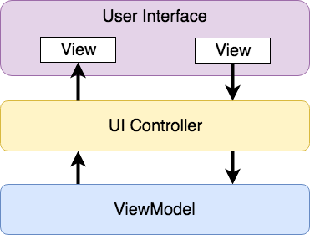
Modern architecture
One activity – different screens
ViewModel component
Separate UI related data model from code which manages the UI
UI controllers and ViewModel instances to manage data

Slide 6
ViewModel
Reference to the ViewModels are used for data using an instance of the ViewModelProvider class
val viewModel = ViewModelProvider(this).get(MyViewModel::class.java)
Use viewModel to access data

Slide 7
