Slide 1
P&C (Re)Insurer’s Share Buyback ROI
2013 – 2017

Slide 2
P&C (Re)Insurer’s Share Buyback ROI
Goal
The goal of this analysis is to calculate the historical return on investment (ROI) of share buybacks for P&C (re)insurance companies over the past 20 quarters (2013 - 2017). This is one way to measure whether companies have effectively allocated their capital to share buybacks. We split the buyback ROI into two components – overall buyback ROI and buyback effectiveness - to understand how well a company has timed their share repurchases.
The methodology used is inherently backwards looking and answers the question:
Based on what we know now (i.e. a company's stock price over the period), did the company achieve a reasonable return on their cash spent buying back shares?
Methodology
The buyback ROI is calculated based on three items:
The cash outflows associated with share repurchases each quarter
The implied cash inflows of dividends (common and special) "avoided" by repurchasing shares
A final cash inflow related to the total value of the cumulative shares repurchased
Given this set of cash flows, we then calculate the annualized internal rate of return to give us the buyback ROI.
An additional metric to calculate is the "buyback effectiveness" return. This metric isolates the impact of management timing in repurchasing shares by backing out the total shareholder return over the time period from the buyback ROI. Buyback effectiveness equals one plus buyback ROI divided one plus total shareholder return (minus one). This metric highlights companies that successfully buyback more shares right before their stock price increases and buy less before their stock decreases.

Slide 3
P&C (Re)Insurer’s Share Buyback ROI
Data used
The data used for this analysis is from SEC Forms 10-Q and 10-K for each company over the time period of 2013 - 2017 on a quarterly basis, per S&P Global Market Intelligence.
Number of shares repurchased in the quarter
Average price per share for shares repurchased
Common shares outstanding
Common dividend per share
Special dividend per share
Book value per share
Additionally, historical share price data was downloaded from Yahoo Finance.

Slide 4
Summary table
Top 25 most effective share repurchasers
Ticker | # of quarters | Current Mkt Cap ($m) | Initial Shares (mil) | Shares Repurchased (mil) | Dollar Repurchased ($m) | Percent of Initial Shares Repurchased | Percent of Mkt Cap Repurchased | Total Shareholder Return | Buyback ROI | Buyback Effectiveness
HRTG | 15 | 435 | 29.8 | 7.1 | 88 | 23.8% | 20.2% | 5.5% | 70.7% | 61.8%
EIG | 20 | 1,360 | 30.9 | 1.4 | 42 | 4.7% | 3.1% | 14.5% | 59.1% | 39.0%
TPRE | 18 | 1,410 | 103.9 | 3.9 | 48 | 3.8% | 3.4% | 0.2% | 26.6% | 26.3%
PRA | 20 | 2,520 | 61.8 | 9.3 | 426 | 15.1% | 16.9% | 12.4% | 23.4% | 9.8%
PGR | 20 | 35,550 | 603.2 | 37.0 | 1,008 | 6.1% | 2.8% | 19.8% | 31.0% | 9.4%
AFG | 20 | 10,140 | 89.9 | 8.8 | 534 | 9.8% | 5.3% | 22.1% | 30.2% | 6.6%
WRB | 20 | 9,450 | 136.0 | 17.4 | 809 | 12.8% | 8.6% | 12.6% | 19.9% | 6.6%
ALL | 20 | 34,720 | 468.0 | 157.4 | 9,313 | 33.6% | 26.8% | 17.9% | 24.7% | 5.8%
KMPR | 20 | 3,020 | 58.3 | 7.7 | 269 | 13.2% | 8.9% | 17.8% | 23.1% | 4.6%
ACGL | 20 | 11,080 | 133.1 | 17.9 | 1,052 | 13.5% | 9.5% | 11.5% | 16.5% | 4.4%
SAFT | 20 | 1,230 | 15.4 | 0.6 | 28 | 3.6% | 2.3% | 13.8% | 18.4% | 4.0%
UFCS | 20 | 1,240 | 25.3 | 1.4 | 51 | 5.5% | 4.1% | 14.5% | 18.8% | 3.8%
UVE | 20 | 1,130 | 40.7 | 12.4 | 113 | 30.5% | 10.0% | 45.1% | 50.4% | 3.7%
CINF | 20 | 12,350 | 163.0 | 4.9 | 285 | 3.0% | 2.3% | 12.8% | 16.6% | 3.4%
Y | 20 | 9,040 | 16.8 | 1.5 | 669 | 9.2% | 7.4% | 8.5% | 11.7% | 2.9%
THG | 20 | 5,100 | 44.0 | 6.2 | 428 | 14.0% | 8.4% | 18.6% | 21.9% | 2.7%
MKL | 20 | 16,030 | 9.6 | 0.3 | 199 | 2.7% | 1.2% | 17.7% | 21.0% | 2.7%
TRV | 20 | 36,980 | 376.4 | 128.6 | 12,929 | 34.2% | 35.0% | 12.1% | 14.8% | 2.3%
IPCC | 20 | 1,320 | 11.6 | 1.0 | 79 | 9.0% | 6.0% | 15.4% | 17.9% | 2.1%
HMN | 20 | 1,830 | 39.7 | 1.8 | 54 | 4.5% | 3.0% | 18.6% | 20.9% | 1.9%
CB | 20 | 64,130 | 340.0 | 34.1 | 3,800 | 10.0% | 5.9% | 12.0% | 13.8% | 1.6%
RNR | 20 | 5,530 | 44.5 | 14.7 | 1,521 | 33.0% | 27.5% | 7.5% | 8.9% | 1.3%
RE | 20 | 11,360 | 50.0 | 12.8 | 2,008 | 25.6% | 17.7% | 13.2% | 14.3% | 1.0%
AIZ | 20 | 4,910 | 78.4 | 29.6 | 2,160 | 37.8% | 44.0% | 19.5% | 18.6% | -0.8%
VR | 20 | 5,360 | 106.3 | 37.9 | 1,524 | 35.7% | 28.4% | 9.7% | 8.7% | -0.9%

Slide 5
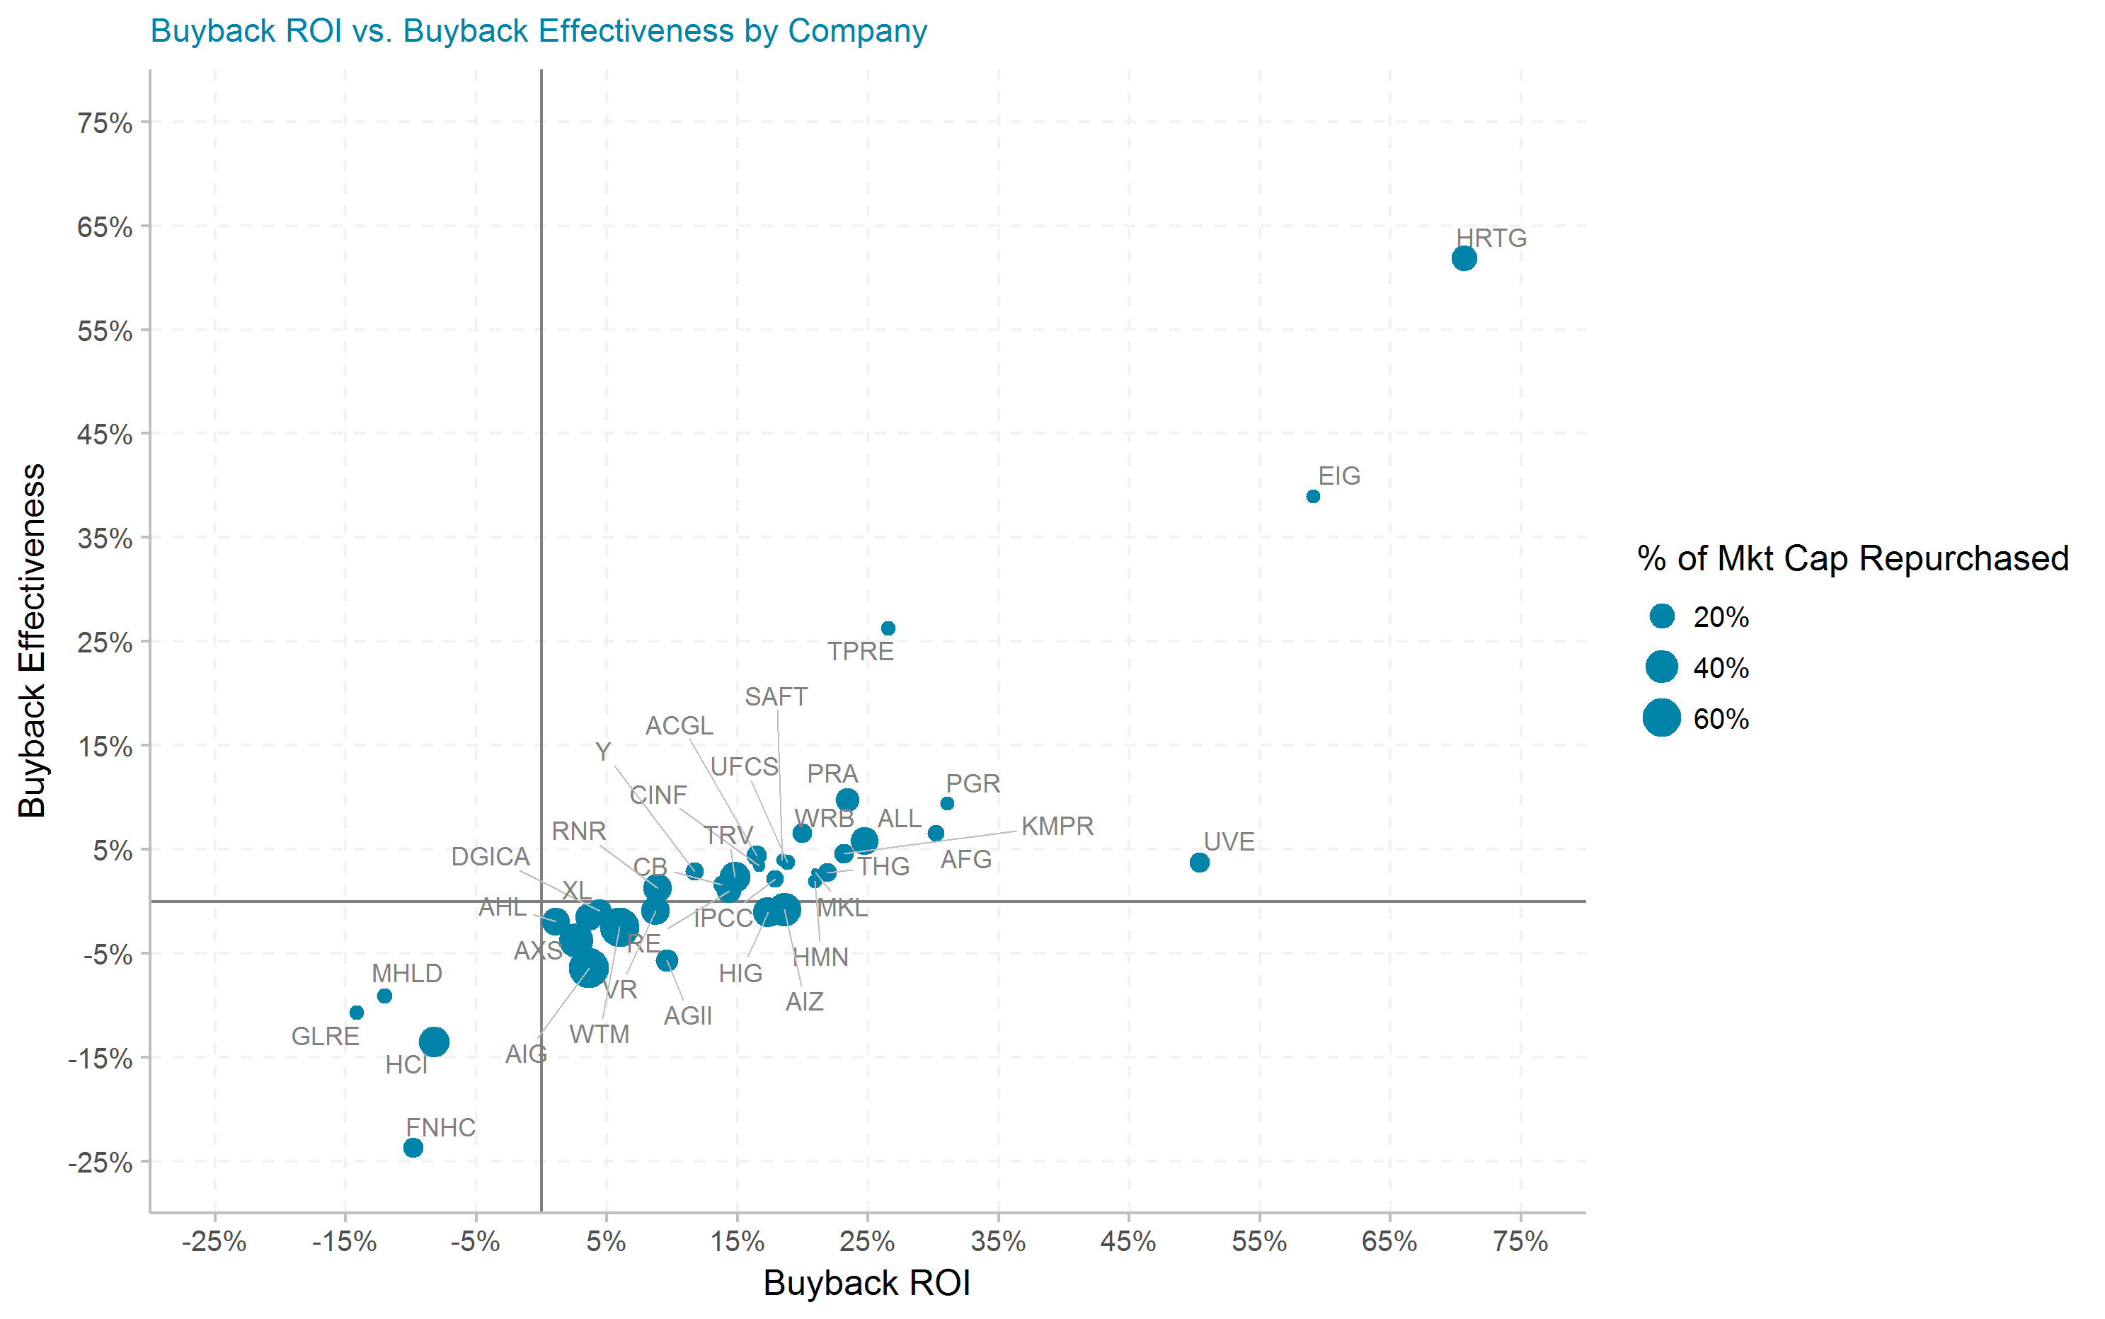
Buyback ROI vs. Buyback Effectiveness by Company

Slide 6
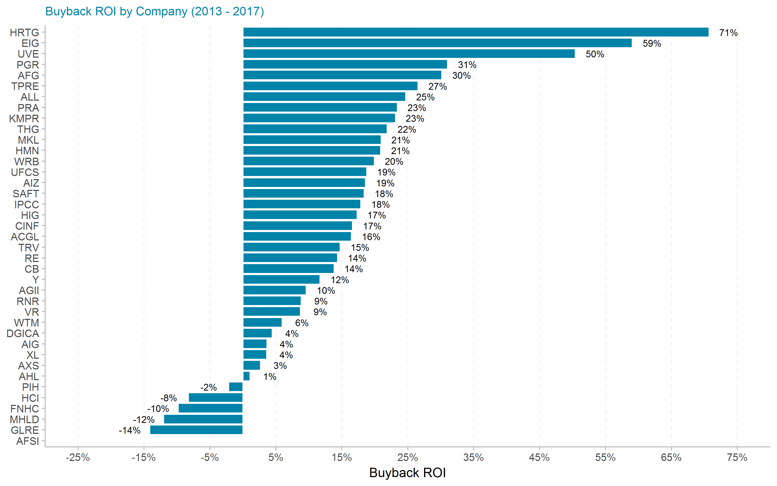
Buyback ROI by Company

Slide 7
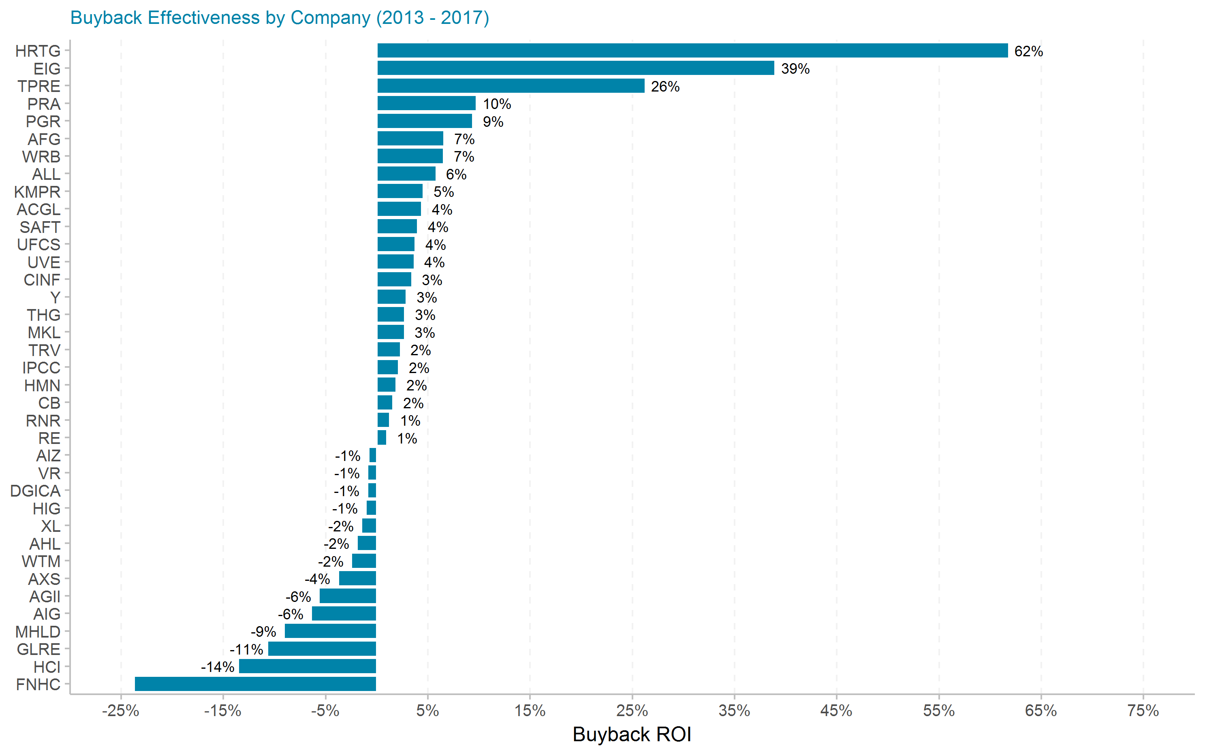
Buyback Effectiveness by Company

