Slide 1
Extras From Programming Lecture … And exercise solutions

Slide 2

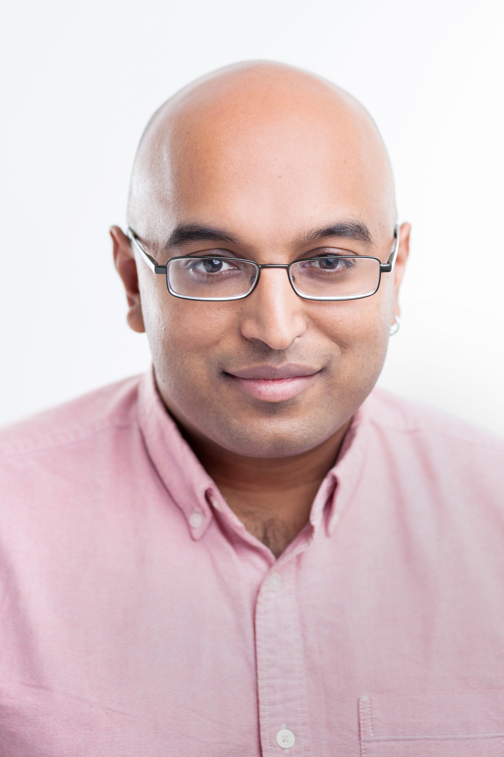
Church / Venture Comparison
http://forestdb.org/models/
http://probcomp.csail.mit.edu/venture/
(define observed-data
'(4.18 5.36 7.54 2.47 8.83 6.21 5.22 6.41))
(define num-observations (length observed-data))
(define samples
(mh-query 10 100
; defines
(define mean (gaussian 0 10))
(define var (abs (gaussian 0 5)))
(define sample-gaussian (lambda () (gaussian mean var)))
; query expression
(list mean var)
; condition expression
(equal? observed-data
(repeat num-observations sample-gaussian))))
samples
v.clear()
v.assume('get_mu','(normal 0 1)')
v.assume('get_x','(lambda () (normal get_mu 1))')
v.observe('(get_x)','5.0')
v.observe('(get_x)','6.0')
mu_samples=posterior_samples('get_mu',no_samples=400,int_mh=200)
true_e_mu=3.7; true_sd_mu = .58 # true value (analytically computed)
diff=abs(np.mean(mu_samples) - true_e_mu)
print 'true E(mu / D)=%.2f; estimated =%.3f' % (true_e_mu, np.mean(mu_samples))
assert diff < .5 ,'difference > .5'
x=np.arange(1,6,.1)
y=sp.norm.pdf(x,loc=true_e_mu,scale=true_sd_mu)
plt.plot(x,y)
plt.hist(mu_samples,bins=15,normed=True)
plt.title('Histograpm of Posterior samples of Mu vs. True Posterior on Mu')
plt.xlabel('Mu'); plt.ylabel('P(mu / data)')
or
[assume get_mu (normal 0 1)]
[assume get_x (lambda () (normal get_mu 1))]
[observe (get_x) 5.0]
[observe (get_x) 6.0]
[predict get_mu]
[infer (mh default one 1)]
[predict get_mu]
[infer]
[predict get_mu]
[infer (rejection default all) ]
….
Stuhlmüller
Mansinghka

Slide 3
Limitations
General
Still small models and data only
DARPA PPAML / Venture / Probabilistic-C / probabilistic-js
Little documentation
Buggy implementations
Philosophical
Not all machine learning models and techniques are naturally generative
Markov Random Fields / Factor Graphs
Anglican
Forcing outermost observe to be an ERP can be programmatically cumbersome

Slide 4
Workflow
Traditional
Probabilistic Programming
Repeat
Define model
Derive inference updates
MCMC
Conditionals
Variational
Fixed point updates
Code inference algorithm
Test
Find bugs In code
Use
Find
Find bugs in model
Inference doesn’t work
Repeat
Code generative model
Use
Find
Find bugs in model
Inference doesn’t work

