Slide 1

Integer Valued Random Variables
Previo al Tema III.C Distribución Geométrica

Slide 2
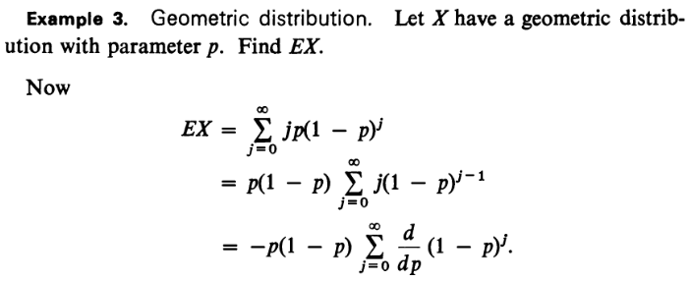
Integer-Valued Random Variables

Slide 3
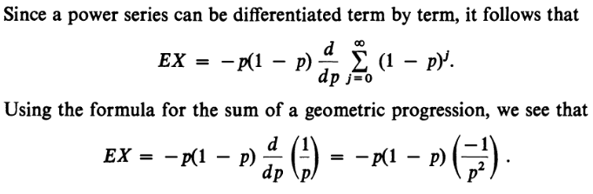

Integer-Valued Random Variables

Slide 4
Integer-Valued Random Variables
DON’T MISS EXAMPLE 4 ON PAGE 85 (97/271 OF [HOEL, PORT, STONE] INTRODUCTION TO PROBABILITY THEORY)

Slide 5
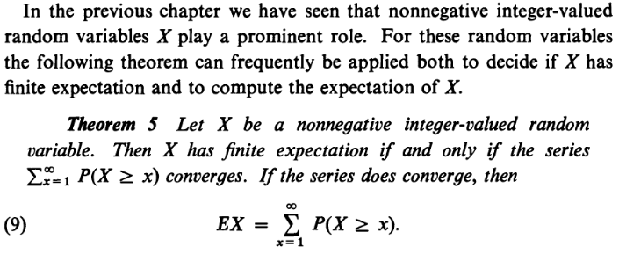
Integer-Valued Random Variables
REF.: [Hoel, Port, Stone], pág. 91 (103/271 de (The Houghton-Mifflin series in statistics) Paul G. Hoel, Sidney C. Port, Charles J. Stone - Introduction to probability theory-Houghton Mifflin (1971).djvu)

Slide 6
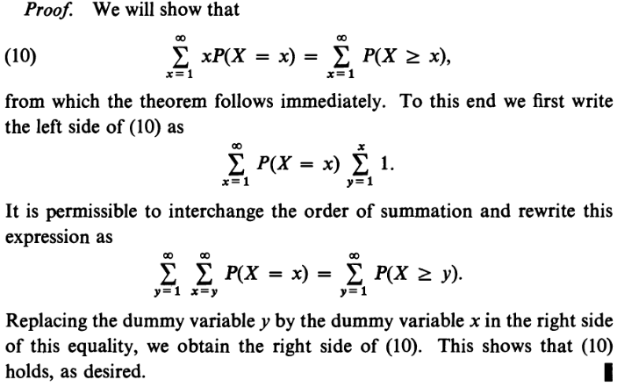

Slide 7
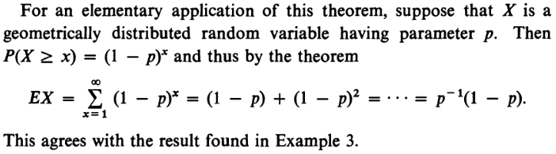
Integer-Valued Random Variables

Slide 8
Integer-Valued Random Variables

Slide 9
REFERENCIA(s)
https://math.stackexchange.com/questions/1299465/proof-variance-of-geometric-distribution
Hoel, P. G., & Port, S. C., & Stone, Ch. J. (1971). Introduction to Probability Theory (1/a edición). Houghton Mifflin Company.

