Slide 1
GROUP 1 · CA6001
Human-Context Chess
Outcome Prediction
Can player context improve prediction beyond Stockfish's view of the board?
BLACK WIN · DRAW · WHITE WIN
FANG ZHOU · GU SHUCHENG · YANG QINGYANG · YANG TIANHAO · ZHONG YUXUAN
Notes:
Good afternoon. We are Group 1 from CA6001, and our project focuses on human-context chess outcome prediction.
Modern chess engines such as Stockfish can evaluate the objective strength of a board position very effectively. However, the outcome of a game between human players may also depend on factors beyond the board, such as player ratings and time control.
We selected the Chess Game Dataset from Lichess, which contains approximately 20,000 games played by human players. It includes pre-match information, complete move sequences, and final results.
Using this dataset, we developed a machine-learning classifier based on HistGradientBoostingClassifier. It combines pre-match context, Stockfish evaluations of positions throughout the game, and a small set of interpretable manually engineered features to predict whether Black wins, the game is drawn, or White wins.
Our results show that incorporating human context improves outcome prediction beyond position-based evaluation alone, with particularly clear gains during the early stages of a game.

Slide 2
One question, three predictors
Does human context add predictive information beyond the current position?
DIRECT STOCKFISH WDL
POSITION-ONLY HGB
HUMAN-CONTEXT HGB
Engine W/D/L probabilities
No fitted classifier
4 engine + 3 manual features
Learns human outcome mapping
Same HGB + 10 pre-match features
Prespecified main model
Controlled ablation: the two learned models use the same HGB settings; only human context changes.
02
Notes:
The storyline is a controlled comparison. Direct Stockfish WDL is the engine reference and is not fitted to this dataset. Position-only HGB then learns how the same engine evidence and simple board summaries map to recorded human outcomes. The main Human-context HGB uses exactly the same classifier settings and position representation, then adds ratings, rated status, and time-control variables. Because the two learned models differ only in their information set, their performance gap directly answers our predictive research question within this experiment. It is an association and ablation result, not a causal claim about rating or time control.

Slide 3
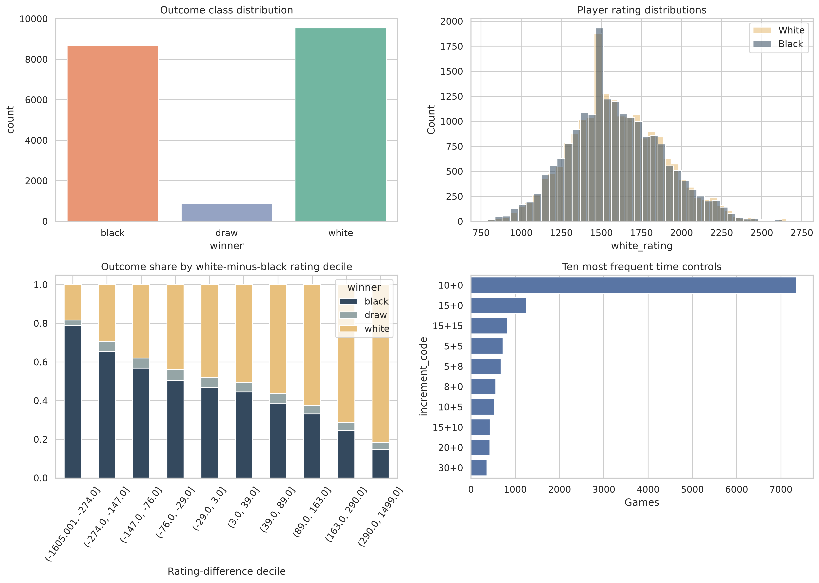
Data: 19,113 unique human games
Public Lichess sample from Kaggle; all splits are made at game level
20,058
RAW ROWS
Before duplicate-ID removal
19,113
CLEAN GAMES
945 duplicate IDs removed
4.6%
DRAW SHARE
888 draws; class imbalance matters
70 / 15 / 15
GAME SPLIT
Train / validation / test
03
Notes:
The source contains 20,058 rows. Removing 945 repeated game identifiers leaves 19,113 unique games: 8,680 Black wins, 888 draws, and 9,545 White wins. Draws are only 4.6 percent, so accuracy alone is not sufficient; macro-F1 is also reported. The split is stratified by outcome, with 70 percent for training and 15 percent each for validation and test, using seed 6001. Splitting happens before position extraction, so every snapshot from a game remains in the same partition. The figure also shows overlapping rating distributions, the relationship between rating difference and outcome, and the dominant time controls.

Slide 4
Progress without future leakage
Percentage is useful for reporting—but unsafe as a model input
UNSAFE INPUT
SAFE INPUT
progress % = current ply ÷ final ply
ply = half-moves already observed
Final game length is unknown live → future information
Observable at prediction time
Leakage-safe training and validation snapshots
ply 4
ply 8
ply 16
ply 24
…
ply 160
Example: ply 24 means 12 complete moves. Shorter games contribute only checkpoints they reach.
After test games finish: percentages select 10%, 25%, 50%, 75%, 100% reporting positions only.
04
Notes:
One ply is one move by one player, or half of a full move. Training and validation sample positions after ply 4 and then plies 8, 16, 24, and so on to 160. For example, ply 24 is the position after 12 complete moves. A short game contributes only checkpoints it reaches. This absolute schedule limits computation and never requires knowing the future. Percentage progress would be current ply divided by the final ply count, but the denominator is unknown during live prediction. Using it as a feature would leak future game length. We therefore use current ply as the input and calculate percentages only after test games finish, solely to align reporting positions across games.

Slide 5
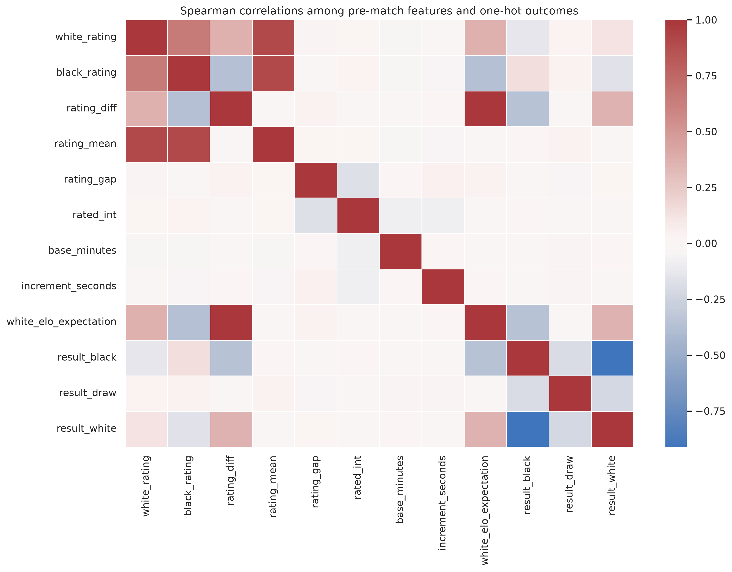
Compact, interpretable feature set
STOCKFISH · 4
score_cp
score_mate
wdl_wins
wdl_draws
MANUAL · 3
ply
material_total
material_diff
PRE-MATCH · 10
ratings and engineered differences
rated status · base time · increment
All engine scores and material differences are oriented from White's perspective.
Excluded: player IDs, opening labels, final length, termination status, and the target.
05
Notes:
The feature set is intentionally small. Stockfish contributes centipawn score, mate score, White-win count, and draw count. Centipawn and mate scores are missing in complementary situations, which histogram gradient boosting can handle. Three manual features describe how many plies have been observed, total non-king material, and White minus Black material. The main model adds ten pre-match variables derived from ratings, rated status, and time control. The correlation figure shows why engineered rating summaries are useful but not sufficient. All directional values use White's perspective. Player IDs, opening labels, final game length, termination status, and the target are excluded.

Slide 6
Two HGB instances, one progressive system
Histogram Gradient Boosting is the final learned model family
PRE-MATCH HGB
HUMAN-CONTEXT HGB
UPDATED PROBABILITY
Used only before the first move
10 context features
Supplies the 0% estimate
Used after moves appear
17 total inputs
Prespecified main model
Black win · Draw · White win
Recomputed at the current board
Why HGB?
Controlled in-game settings
• Learns nonlinear thresholds and feature interactions
• Handles missing cp / mate values without imputation
• Efficient and reproducible for tabular snapshots
• Learning rate 0.08 · up to 240 iterations · 31 leaves
• Class- and game-balanced training weights
• Position-only HGB uses the same settings
Primary in-game score = pooled predictions from all available 10–100% test snapshots.
06
Notes:
The final learned model family is histogram gradient boosting. There are two separately fitted HGB instances because the available information changes. Before play, the Pre-match HGB uses context only and supplies the zero-percent estimate. Once a board exists, the Human-context HGB uses the position plus the same pre-match context and updates the probabilities. HGB is appropriate because the relationships are nonlinear, score_cp and score_mate contain structured missing values, and the data are tabular. Both in-game HGBs use learning rate 0.08, up to 240 iterations, 31 leaves, L2 regularisation, and early stopping. The primary comparison pools all available test snapshots at the five percentage checkpoints.

Slide 7
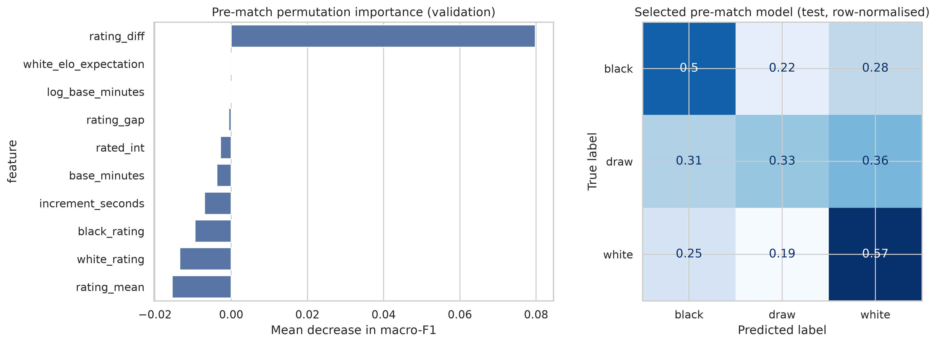
Initial prediction: validation selects Pre-match HGB
Candidate selection and held-out estimation are reported separately
0.400
VALIDATION SELECTION
Highest candidate macro-F1
Dummy: 0.222
Logistic: 0.393
0.523
TEST ACCURACY
Selected Pre-match HGB
Evaluated once after selection
0.427
TEST MACRO-F1
Initial 0% estimate
Validation candidate scores are not compared directly with the selected model's test score.
07
Notes:
Before play, the notebook compares a majority dummy, balanced multinomial logistic regression, and Pre-match HGB on validation games only. Macro-F1 is the selection criterion because it gives equal class-level influence to Black wins, draws, and White wins. HGB has the highest validation macro-F1 at 0.400 and is selected. Only the selected Pre-match HGB is then evaluated once on the held-out test games, where it reaches 0.523 accuracy and 0.427 macro-F1. The figure also shows rating-related permutation importance and the held-out confusion matrix. The validation table and selected-model test table are deliberately separate because they describe different samples and different purposes.

Slide 8
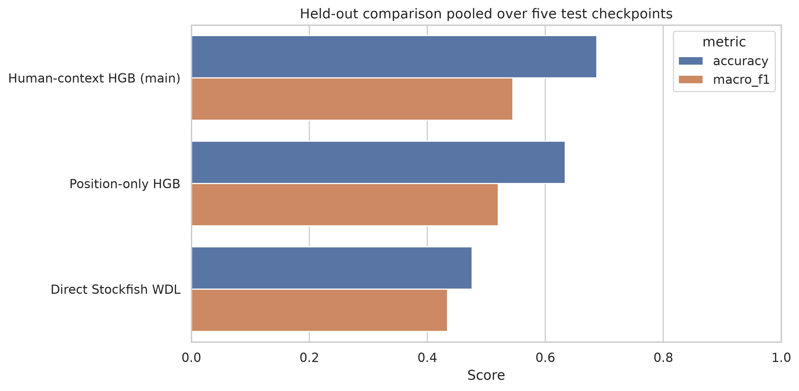
Human context improves the matched HGB
Primary metrics pool 14,179 held-out snapshots across the five test checkpoints
47.6%
DIRECT WDL
Macro-F1 0.434 Log loss 5.751
63.4%
POSITION-ONLY HGB
Macro-F1 0.520 Log loss 0.853
68.7%
HUMAN-CONTEXT HGB
Macro-F1 0.545 Log loss 0.714
+5.4 accuracy points · +0.025 macro-F1 · −0.139 log loss vs position-only HGB
08
Notes:
This is the primary controlled result. Each score pools all available test snapshots at 10, 25, 50, 75, and 100 percent progress. It is not one checkpoint and not a simple average of five checkpoint metrics. Direct Stockfish WDL reaches 47.6 percent accuracy and 0.434 macro-F1. The Position-only HGB reaches 63.4 percent and 0.520. Adding human context while keeping the HGB specification fixed raises accuracy to 68.7 percent and macro-F1 to 0.545, while log loss falls from 0.853 to 0.714. The controlled gain is therefore 5.4 accuracy percentage points, 0.025 macro-F1, and a 0.139 reduction in log loss.

Slide 9
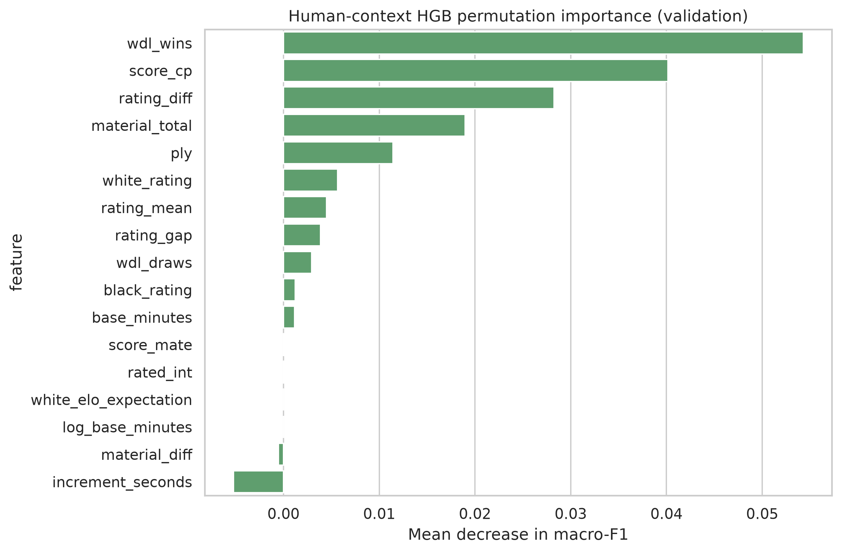
What drives the Human-context HGB?
Permutation importance measures validation macro-F1 loss when a feature is shuffled
ENGINE STATE
wdl_wins and score_cp dominate: the board remains the strongest evidence.
HUMAN CONTEXT
rating_diff remains important after the objective position is known.
GAME PHASE
material_total and ply help interpret how convertible a position may be.
Importance supports complementarity; it does not establish causality.
09
Notes:
Permutation importance asks how much validation macro-F1 falls when one feature is shuffled while the fitted model is held fixed. The leading features are Stockfish WDL wins and centipawn score, confirming that the current board is the main evidence. Rating difference also ranks highly, which is consistent with the hypothesis that practical conversion depends on who is playing. Material total and ply add game-phase information. Correlated features can share or mask importance, so the exact ranking is not a causal decomposition. The useful conclusion is narrower: engine evidence and human context both contribute to the fitted predictor, and the test ablation shows that adding context improves held-out prediction.

Slide 10
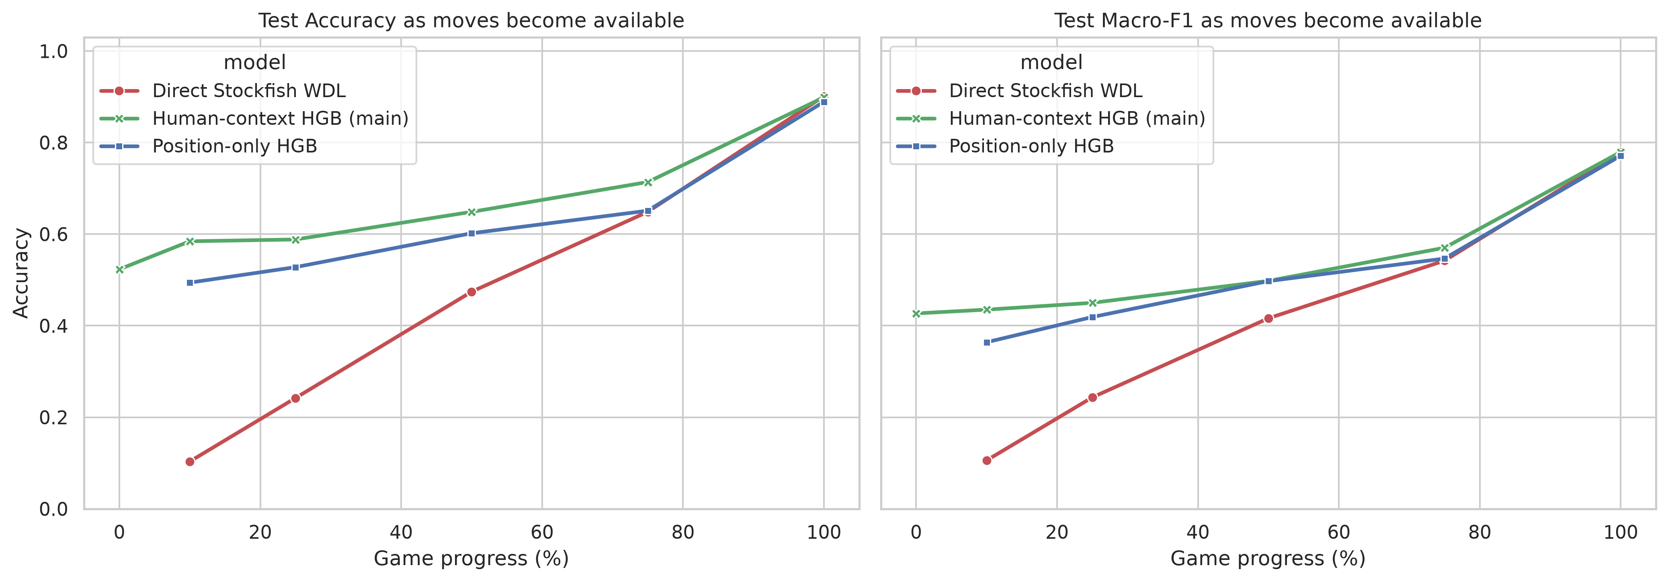
Predictions strengthen as the game unfolds
Percentage checkpoints are retrospective reporting locations, never model inputs
52.3%
0% · PRE-MATCH
Separate Pre-match HGB
64.9%
50% · MAIN
Macro-F1 0.498
89.9%
100% · MAIN
Macro-F1 0.779
Direct WDL reaches 90.1% at the final recorded board.
Main-model AUPC (10–100%): Accuracy 0.683 · Macro-F1 0.541
10
Notes:
The progress curve separates the initial estimate from in-game updates. At zero percent, the Pre-match HGB reaches 52.3 percent accuracy. The Human-context HGB reaches 58.4 percent at 10 percent progress, 64.9 percent at the midpoint, and 89.9 percent at the final recorded board. Its normalised 10-to-100-percent area under the progress curve is 0.683 for accuracy and 0.541 for macro-F1. Direct WDL is weak early because it often favours draws in balanced positions, while draws are rare in this human sample. At the endpoint it reaches 90.1 percent, slightly above the main model. The endpoint remains a prediction, but some final boards may already determine the result.

Slide 11
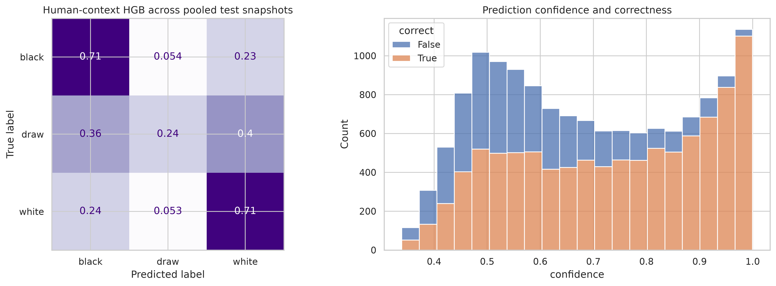
Draw prediction remains the main weakness
Diagnostics pool the same five held-out checkpoint sets as the primary comparison
0.180
DRAW PRECISION
Only 18% of predictions labelled draw are correct.
0.240
DRAW RECALL
Only 24% of true draw snapshots are detected.
0.206
DRAW F1
Black F1 0.708
White F1 0.722
Snapshot-level supports are correlated within games.
11
Notes:
The confusion matrix explains why macro-F1 remains much lower than accuracy. Black-win and White-win F1 scores are 0.708 and 0.722, but draw F1 is only 0.206. Draw recall is 0.240, so most true draw snapshots are missed. Draw precision is 0.180, so most predictions labelled draw are false alarms. The confidence plot also shows that errors are not confined to low-confidence cases. These supports count snapshots rather than independent games; the same game can appear at multiple checkpoints with one final label. Future interval estimates or significance tests should therefore group by game rather than treat snapshots as independent.

Slide 12
Interpretation, limitations, and next step
WHAT WE ESTABLISH
WHAT WE DO NOT ESTABLISH
ENGINE LIMIT
Human context improves a matched HGB predictor beyond position evidence in this dataset.
The model does not play stronger chess than Stockfish, and the result is not causal.
Stockfish uses a reproducible 1,000-node budget; deeper analysis may change its features.
DATA LIMIT
EVALUATION LIMIT
CLASS LIMIT
No per-move clock; random game split does not test temporal drift or unseen-player transfer.
Training uses fixed-ply positions; the test curve uses percentage-selected positions.
Only 4.6% of games are draws, and draw precision and recall remain low.
NEXT STEP
Freeze the pipeline and evaluate on a fresh chronological or unseen-player holdout, with game-grouped uncertainty estimates.
12
Notes:
The evidence supports a predictive conclusion: within this dataset and model specification, human context improves outcome prediction beyond the current position. It does not show that the classifier understands or plays chess better than Stockfish, and feature importance is not causal. Stockfish analysis is deliberately shallow at 1,000 nodes. The data lack per-move clock information, random splitting does not test temporal drift or transfer to unseen players, and fixed-ply development positions differ from percentage-selected test positions. Draw scarcity remains a major class limitation. The strongest next step is to freeze the complete pipeline and evaluate once on a fresh chronological or unseen-player holdout, with uncertainty estimates grouped by game.

Slide 13
Conclusion
Objective board strength and human context answer complementary parts of the prediction problem
ENGINE VIEW
LEARNED MAPPING
MAIN RESULT
Direct WDL is principled, but mismatched to early human-game outcomes.
Position-only HGB adapts engine evidence to recorded human results.
Human-context HGB reaches 68.7% pooled accuracy and 0.545 macro-F1.
Selected references
• datasnaek. Chess Game Dataset (Lichess). Kaggle.
• Fiekas, N. python-chess engine documentation.
• Stockfish developers. Stockfish 19 documentation.
• scikit-learn developers. HistGradientBoostingClassifier documentation.
GENERATIVE AI USE
OpenAI Codex assisted with analysis structure, code, debugging, language editing, and slide preparation. The authors verified all methods, results, references, and interpretations.
Takeaway: model the board objectively—then model the humans who play it.
13
Notes:
To conclude, Stockfish provides strong objective position evidence, but direct WDL is not calibrated to the outcome distribution of these human games, especially early in play. A Position-only HGB learns a better human-outcome mapping, and adding pre-match context produces a further controlled improvement. The main Human-context HGB reaches 68.7 percent pooled accuracy and 0.545 macro-F1 across held-out in-game snapshots. Its prediction strengthens as moves arrive, reaching 89.9 percent accuracy at the final recorded board. The result is useful but bounded by draw scarcity, shallow engine analysis, and the random split. Our takeaway is to model the board objectively, then model the humans who must play it.

