Slide 1
Twitter Stock Analysis
Mining Twitter for Stock Sentiment Scores
Author: Paul Roche

Slide 2
Mining with the Twitter API
By connecting to Twitter via the Twitter API, we are able to pull the most up to date, current data, from Twitter itself.
Using social media as a data source allows us to put our finger on the pulse of the community
Text mining and preprocessing will be performed on the tweets in order to standardize the content. These techniques include:
    Removing URLs
    Removing stopwords
    Removing punctuation
    Forcing all text to be lowercase
    Removing emojis

Slide 3
Stock Selection
Two sets of stocks will be selected for the primary analysis:
  Top Gainers:
    I +11.69% Intelsat S.A.
    ARRY +11.92% Array BioPHarma Inc.
    CRSP +10.31% CRISPR Therapeutics AG
  Top Losers
    GWW -11.95% W W Grainger Inc
    ACBFF -7.45% Aurora Cannabis
    CGC -6.82% Canopy Growth Corporation
Secondary analysis was also performed on a set of 7 handpicked stocks/ETFs
  Large capitalization names: AAPL, GM, GOOG, JNJ
  Weekly Gainers/Losers: CVIA (Covia Holdings Corp), AU (AngloGold Ashanti)
    Interestingly, CVIA is a mineral mining company and AU is a gold miner
  Largest S&P 500 Index Fund: SPY

Slide 4
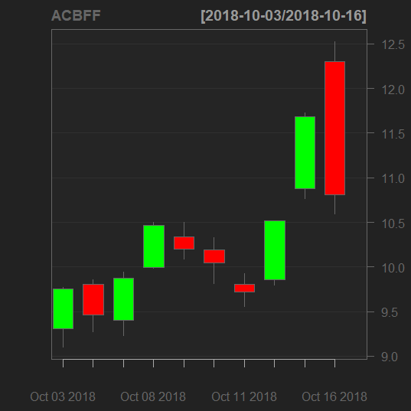
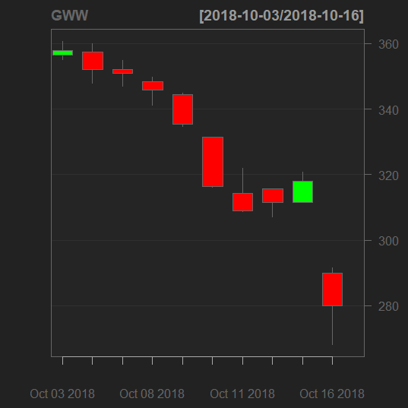
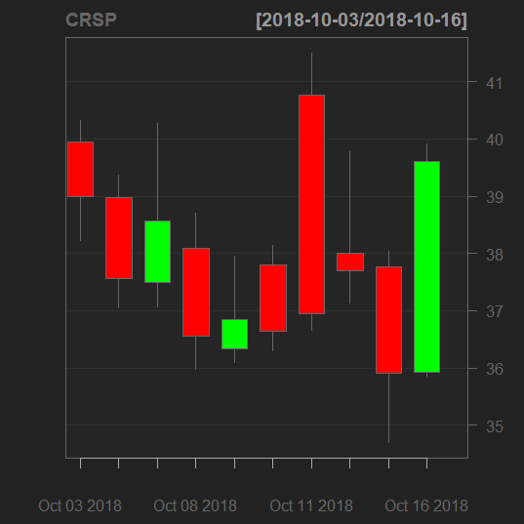
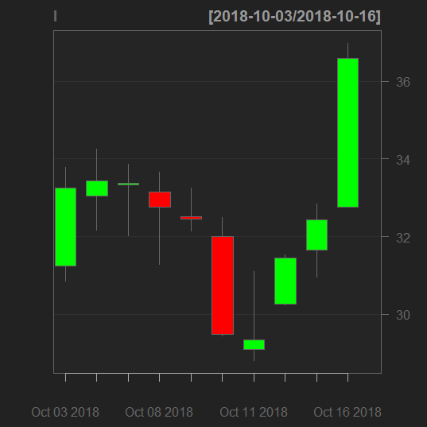
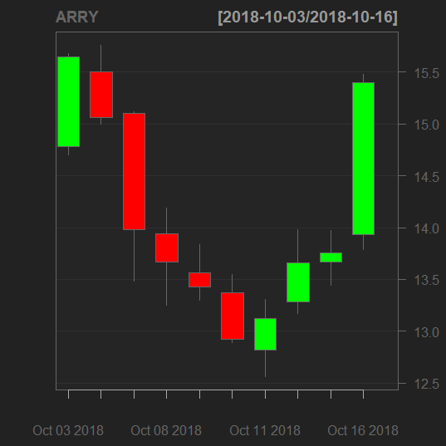
Losers
Gainers
Graphs were generated using a package called quantmod. This package is used to “specify, build, trade, and analyse quantitative financial trading strategies” (Ryan & Ulrich)

Slide 5
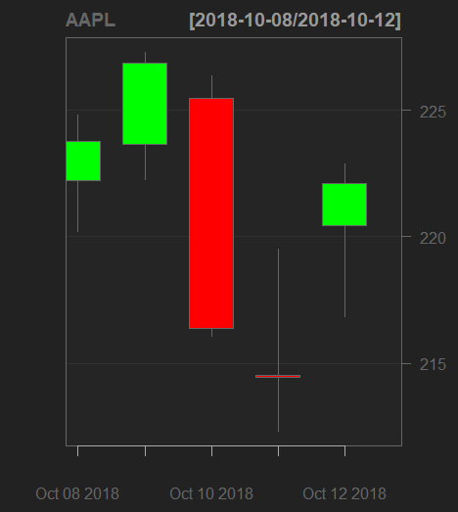
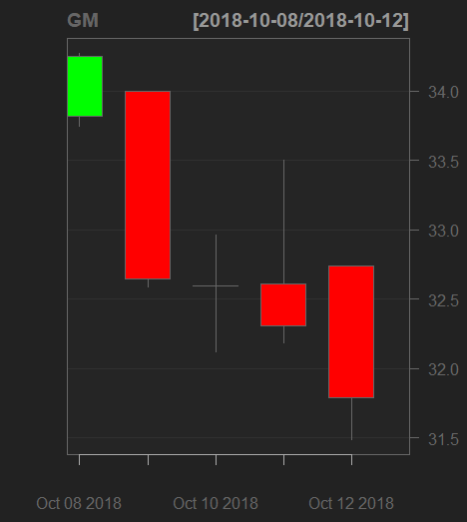
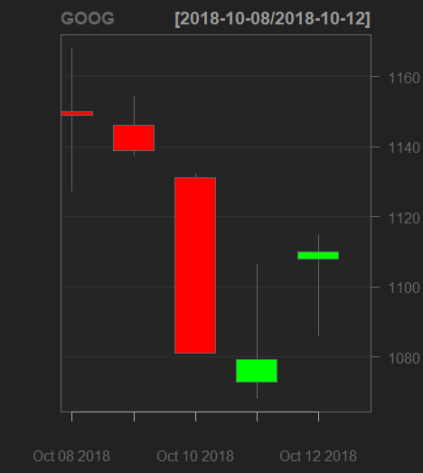
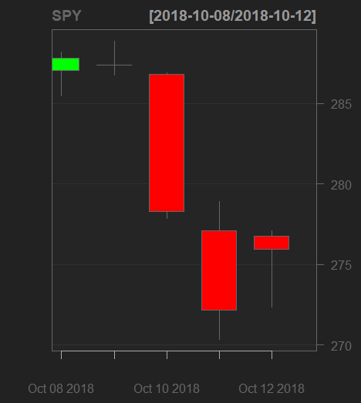
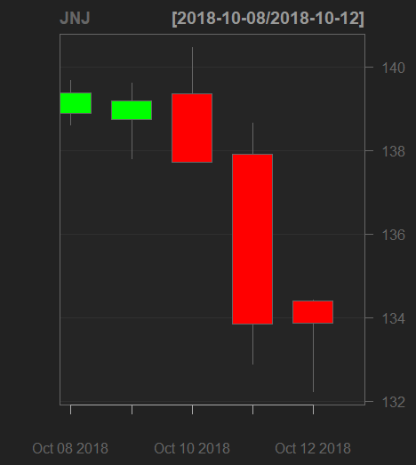
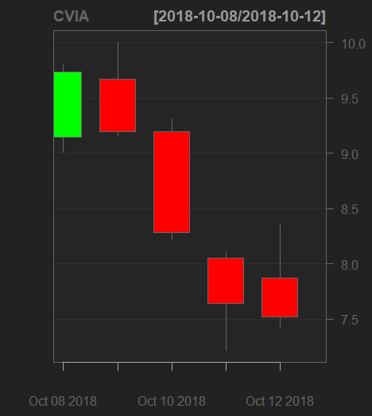
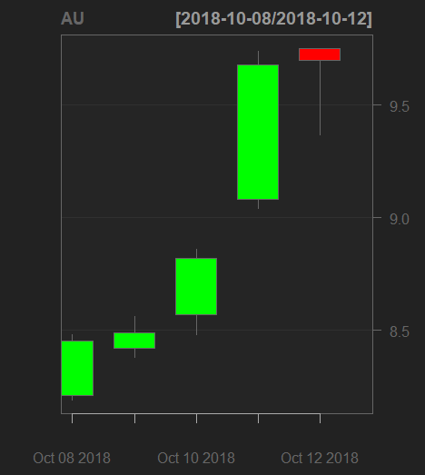
Price Analysis for Handpicked stocks

Slide 6
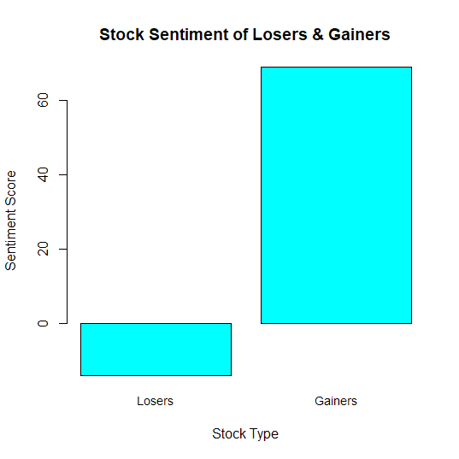
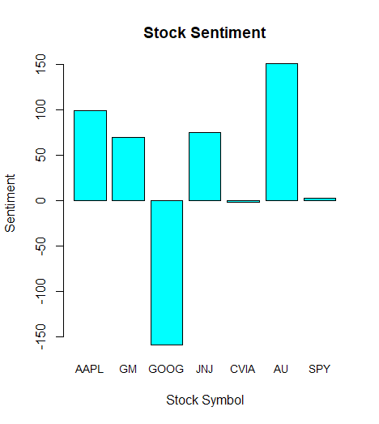
Sentiment Analysis

Slide 7
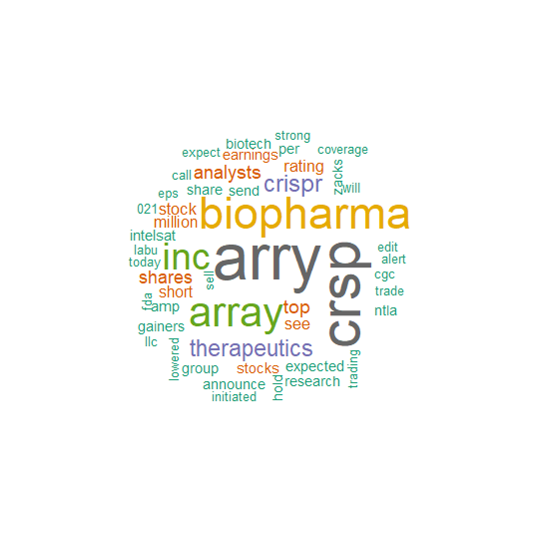
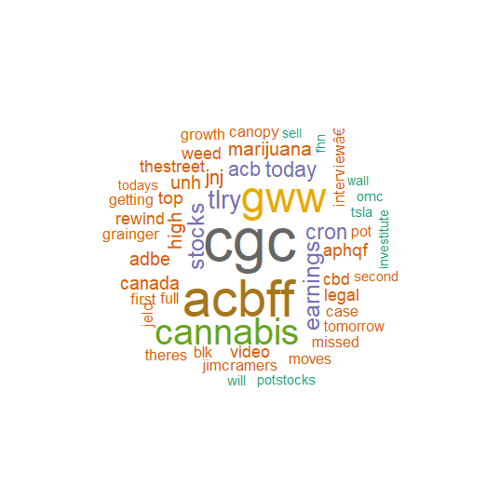
Word Clouds for Losers vs. Gainers
Losers
Gainers

Slide 8
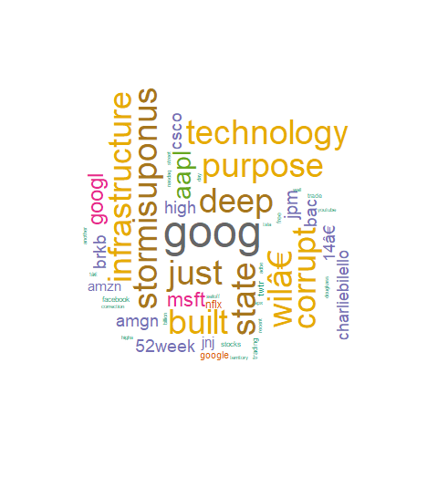
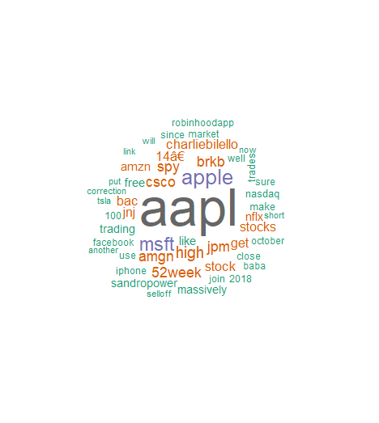
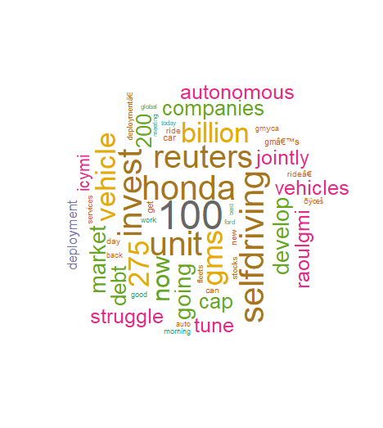
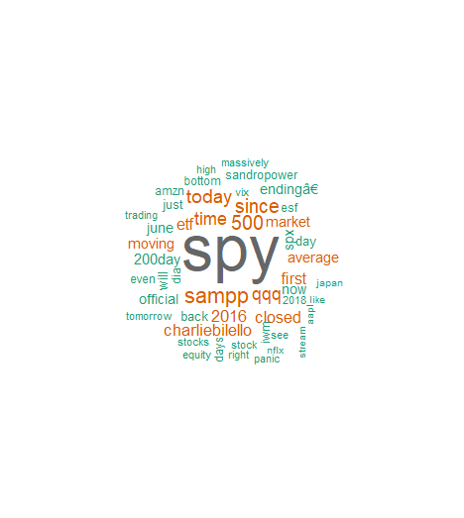
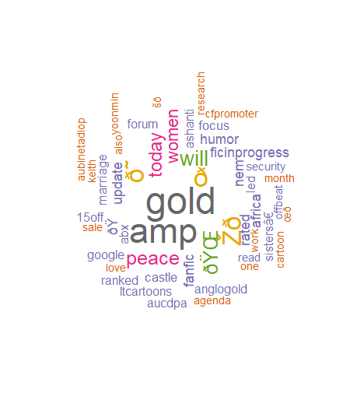
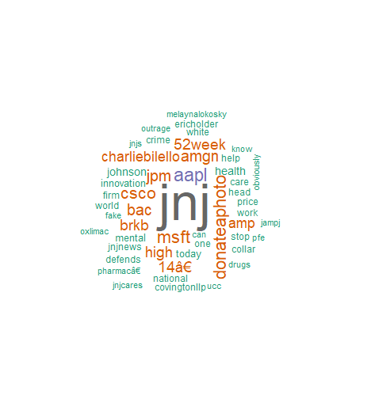

Word Clouds for Hand Selected Stocks

Slide 9
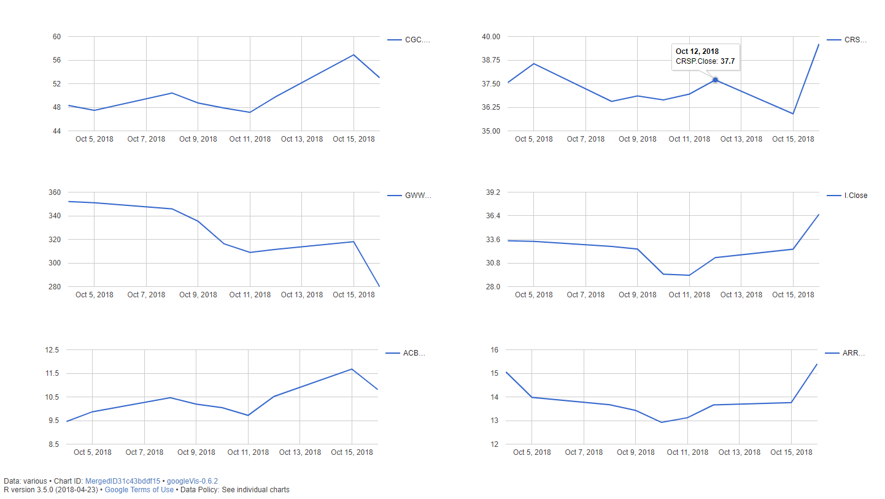
Extra: Analysis with googleVis
Interactive charts can be created using the googleVis package
These charts can be merged to create a master view or dashboard
Charts show volatility among gainers and losers

Slide 10
Conclusion
Twitter mining to be a useful tool in determining social sentiment for a particular topic
The word clouds that can be obtained from mining tweets give a good overview of the contents of a particular topic and enable you to put your finger on the pulse of the public
By combining and standardizing the text in hundreds of tweets, we are able to quiet the noise in the data.
This can be a useful tool in the stock market, where any sort of edge on competition can translate into profits.

Slide 11
THE END

Slide 12
References
Ryan, J. A. (n.d.). Quantitative Financial Modelling & Trading Framework for R.
Retrieved from http://www.quantmod.com/examples/intro/
Ryan, J. A., & Ulrich, J. M. (n.d.). Quantitative Financial Modelling Framework [R
package quantmod version 0.4-13]. Retrieved from https://cran.r- project.org/web/packages/quantmod/index.html

