Slide 1


Company
Profile
Technology consulting and delivery assurance for banks and telecom operators
DAR ES SALAAM
ZANZIBAR
NAIROBI
Notes:
Finsys Company Profile (4), contact directory and supplied brand assets. Cover artwork is illustrative.

Slide 2




THE COMPANY
A Tanzanian technology consultancy
Finsys helps organisations plan technology investments, design solutions and oversee implementation.
Who we serve
Banks and telecom operators, alongside public agencies and infrastructure organisations.
TANZANIAN INCORPORATION NUMBER
Where we work
154610014
Dar es Salaam head office, Zanzibar local office and Nairobi regional contact office.
Private company limited by shares
How we staff assignments
Registered with BRELA
A core team works with local and international specialists selected for each project.
Notes:
Company Structure – Finsys (1); Finsys Company Profile (4). Add only current, approved credentials.

Slide 3









HAPPY CLIENTS
Trusted by leading institutions
Banks, telecom operators, government agencies and public institutions across Tanzania.
WHAT WE HAVE DELIVERED
BANKING
Tanzania Commercial Bank
CRDB Bank
Ministry of Communication and Information Technology
Core banking consultancy, data centre, paperless branch
BANKING
BANKING
GOVERNMENT
TELECOMS
ERP assurance, business process redesign and CRM advisory
TTCL Corporation
National Construction Council
Zanzibar Communication Corp.
PUBLIC SECTOR
TELECOMS
PUBLIC SECTOR
PUBLIC SECTOR
Process automation, ICT planning and data centre studies
TRANSPORT AND LOGISTICS
ICT planning, e-commerce and maritime digital transformation
Tanzania Airports Authority
Tanzania Posts Corporation
Tanzania Shipping Agencies Corp.
TRANSPORT
TRANSPORT
TRANSPORT
Notes:
Client logos supplied by Finsys. Scope descriptions are taken from the Client Portfolio slide and the Finsys Company Profile; they describe sector-level work, not per-client contract claims. Confirm permission to show each logo before external use.

Slide 4




CLIENT PORTFOLIO
Selected clients by sector
A selection of Finsys assignments across banking, telecoms, government and public services.
Telecommunications
Banking
Tanzania Telecommunications Corporation (TTCL)
Tanzania Commercial Bank (TCB)
CRDB Bank
Azania Bank
ERP assurance, business process redesign and CRM advisory.
Core banking consultancy, Data Center, Paperless Branch
Public infrastructure
Transport, trade and logistics
National Construction Council (NCC)
Zanzibar Communication Corporation (ZICTIA)
Tanzania Airports Authority (TAA)
Tanzania Posts Corporation (TPC)
Tanzania Shipping Agencies Corporation (TASAC)
Business process automation, ICT planning and data centre studies.
ICT planning, e-commerce and maritime digital transformation.
Notes:
Finsys Company Profile (4); TIB prequalification draft, NCC experience; Smart Cities and Zanzibar project records. Confirm permissions before using logos or reference contacts.

Slide 5



BUSINESS PORTFOLIO
Our core business
Four portfolios for regulated organisations and complex operations.
01
02
03
04
Telecom and enterprise systems
Banking technology
Infrastructure and resilience
Digital platforms and public services
ERP, EPM and CRM advisory, process redesign and independent implementation assurance.
Core banking advisory, paperless branch workflows, treasury solutions and licence optimization reviews.
Data Centre feasibility and design, disaster recovery, connectivity and readiness.
Digital roadmaps, workflow automation, e-commerce and systems integration.
Notes:
Services based on Finsys Company Profile (4) and the previous Regional Edition. This is the offering, not a list of completed deployments.

Slide 6




BUSINESS PORTFOLIO
Banking technology
Advisory and integration assurance across core systems, customer channels and bank operations.
Core banking and digital channels
Payments and integration
Core modernisation, mobile and internet banking, agency banking and lending workflows.
Cards, switches, RTGS, SWIFT and mobile money; API security, data quality and reconciliation.
Treasury management
Software licence reviews
Cash and liquidity visibility, forecasting, funding, payment connectivity and risk reporting.
Review entitlements against deployments, assess audit exposure and evaluate renewal options.
Notes:
Banking Solutions deck slides 2–4. Tanzania Commercial Bank is a Finsys core banking consultancy reference. Listed capabilities are service offerings.

Slide 7







BANKING SOLUTIONS
Paperless banking
From customer onboarding to auditable records, with controls built into the workflow.
01
Onboard and verify
02
Capture documents
03
Route and approve
Open accounts and capture identity, KYC information and mandates.
Scan, classify and index records using OCR or ICR where appropriate.
Use maker-checker controls and route exceptions to the right team.
04
Sign and store
05
Integrate and reconcile
06
Retrieve and audit
Capture consent and e-signatures; retain records under the bank’s policies.
Connect to core banking, CRM, ERP, AML and document systems.
Retrieve records and approvals through audit trails and reports.
Designed to shorten turnaround, reduce paper handling and strengthen auditability.
Notes:
Banking Solutions deck slide 5. Illustrative workflow, not a live deployment claim.

Slide 8
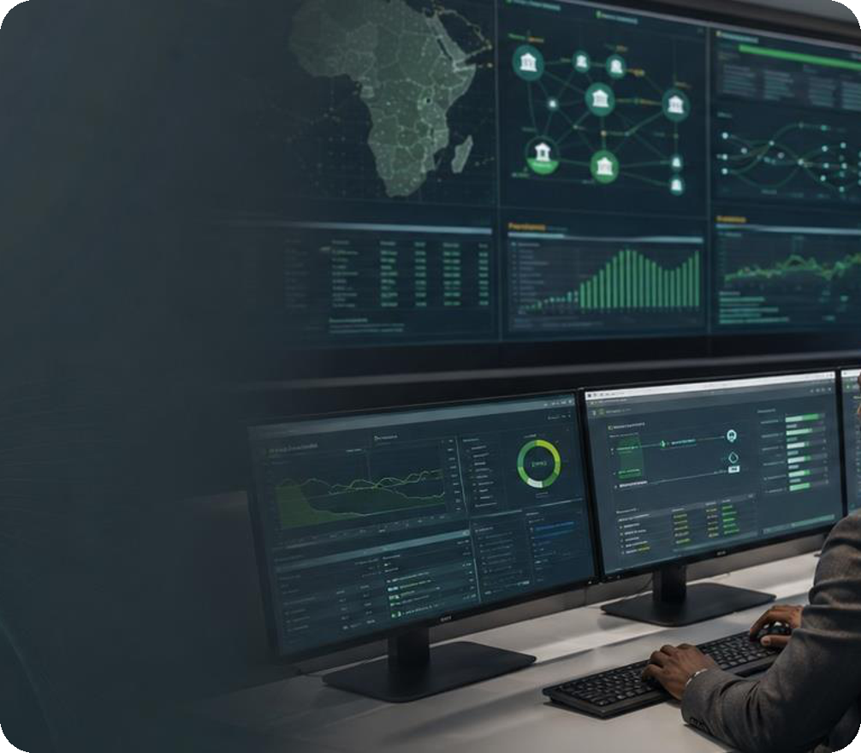


BUSINESS PORTFOLIO
Telecom and enterprise systems
Finsys helps operators modernise enterprise operations and oversee complex platform changes.
Strategy and process redesign
ICT strategy, enterprise architecture and process redesign across finance, procurement, HR and operations.
ERP, EPM and CRM advisory
Oracle Fusion and EBS advisory, planning and budgeting, CRM requirements and solution design reviews.
Implementation assurance
SELECTED REFERENCE
Project governance, requirements traceability, test and release readiness, and change management.
TTCL Digital Fusion / ERP project management and QA
Notes:
Finsys Company Profile (4) and TTCL Digital Fusion engagement records. Oracle implementation vendor and Finsys oversight roles are distinct.

Slide 9


PROJECT EXPERIENCE
TTCL Digital Fusion
Project management and quality assurance for an enterprise ERP implementation.
FINSYS ROLE
What Finsys reviewed
Independent implementation oversight
Business requirements, process walkthroughs and solution designs across finance, procurement, supply chain, HR and planning.
How Finsys supported governance
Client: Tanzania Telecommunications Corporation
Tracked QA findings, checked requirements against solution design and supported testing and readiness reviews.
Notes:
TTCL Digital Fusion project correspondence and QA records; Finsys company and technical profiles. No go-live or performance improvement claimed.

Slide 10




BUSINESS PORTFOLIO
Infrastructure and resilience
We help clients assess, design and plan resilient technology infrastructure.
Data centre feasibility and design
Demand, site and risk assessment; building layout, power, cooling, fire protection and security.
Disaster recovery and connectivity
Recovery objectives, geographic separation, network options and operational resilience.
SELECTED REFERENCES
Investment and procurement planning
National Tier III Data Centre and Pemba Disaster Recovery Site
Cost estimates, bills of quantities and assessment of implementation or operating options.
Notes:
Finsys data centre technical proposal, Pemba feasibility and Pemba business model. The visual is illustrative.

Slide 11
PROJECT EXPERIENCE
Infrastructure and city planning
Selected studies for public infrastructure and digital investment.
01
National Tier III Data Centre
02
Pemba Disaster Recovery Site
03
Smart Cities feasibility
Feasibility study and detailed design based on 200 racks and 2 MW of IT load. Scope included site assessment, architecture, engineering and lifecycle costs.
Feasibility, high-level design and business model for a separate recovery site, including utility, connectivity and operating options.
Assessment and planning for pilot central business districts in Dar es Salaam, Dodoma, Arusha and Mbeya.
200
2 MW
Utility
Connectivity
Dar es Salaam
Dodoma
racks
IT load
Operating options
Arusha
Mbeya
Notes:
Finsys Technical Proposal Data Centre Consultancy; Pemba DR feasibility and business model; Smart City Feasibility contract and project records. Fumba sizing represents design parameters only.

Slide 12




HOW WE WORK
From selection to stabilisation
Finsys supports client teams at the decisions that shape complex technology programmes.
STEP 01
STEP 02
STEP 03
STEP 04
Assess and select
Design and govern
Integrate and migrate
Launch and stabilise
Baseline capabilities and requirements; develop the business case and evaluate vendors.
Review architecture and controls; establish decision rights and acceptance criteria.
Review API design, migration, data quality, reconciliation and test evidence.
Assess cutover readiness, support issue triage and agree handover and training.
Notes:
Banking Solutions deck, slide 6 (modernisation lifecycle); adapted for both sectors.

Slide 13








PARTNERS AND CERTIFICATIONS
Specialist partners, certified expertise
Finsys leads local coordination and assurance, with specialist collaborators mobilised to suit the scope.
JMR Infotech
CERTIFICATIONS AND STANDARDS
Banking transformation and paperless branch expertise. Selected JMR references: Groupe Cofina, Diamond Trust Bank Uganda and Zanaco.
Financial analysis
Information security
AHEAD / Jethro
Core and digital banking platform capabilities for retail banking, SACCOs and microfinance.
Project management
Enterprise architecture
Binary Limited
TECHNOLOGY EXPERTISE
Software engineering, banking application development, digital channels and systems integration.
Oracle Fusion and EBS advisory and implementation assurance
Notes:
Banking Solutions deck slides 9–10, Finsys–JMR consortium and Binary JV draft. JMR references are partner experience as listed in supplied material; confirm reference permissions before external use.

Slide 14


NEW SERVICE | TRAINING PARTNERS
Professional ICT Trainings
Certified ICT skills for banks, telecoms and public institutions, with two established partners.
Computer Learning Centre (CLC)
WHAT WE TRAIN
KENYA | 30 YEARS IN BUSINESS
Cybersecurity
Cloud computing
Authorised IT and business training provider with 25 vendor certifications. Has trained 20,000+ professionals across 10 countries in Africa and the Middle East.
Networking
Data and AI
Software and infrastructure
Project and service management
Torque IT
SOUTH AFRICA | SINCE 1995
Technology training and certification company with 500+ courses and 23 global technology partners. Trains 16,000+ students a year and is a leading Pearson VUE testing centre.
VENDOR CERTIFICATIONS
Microsoft, Cisco, AWS, CompTIA and more, delivered instructor-led, virtual or onsite.

Slide 15





DELIVERY AND ENABLEMENT
Local support and capability building
We help client teams prepare for launch, operate new systems and build the skills to support them.
Delivery assurance
Local stakeholder coordination, quality reviews, issue tracking and readiness checks.
Risk and operational controls
Security, data protection, auditability and resilience considerations built into reviews.
Training and knowledge transfer
Role-based sessions for technical teams and business users; instructor-led, onsite or virtual formats.
Specialist training topics
Cybersecurity, cloud, data centre operations, IT service management, business analysis and project delivery.
Notes:
Banking Solutions deck slides 7-9 and 11. Training delivery partners (CLC Kenya, Torque IT South Africa) are shown on the previous slide.

Slide 16
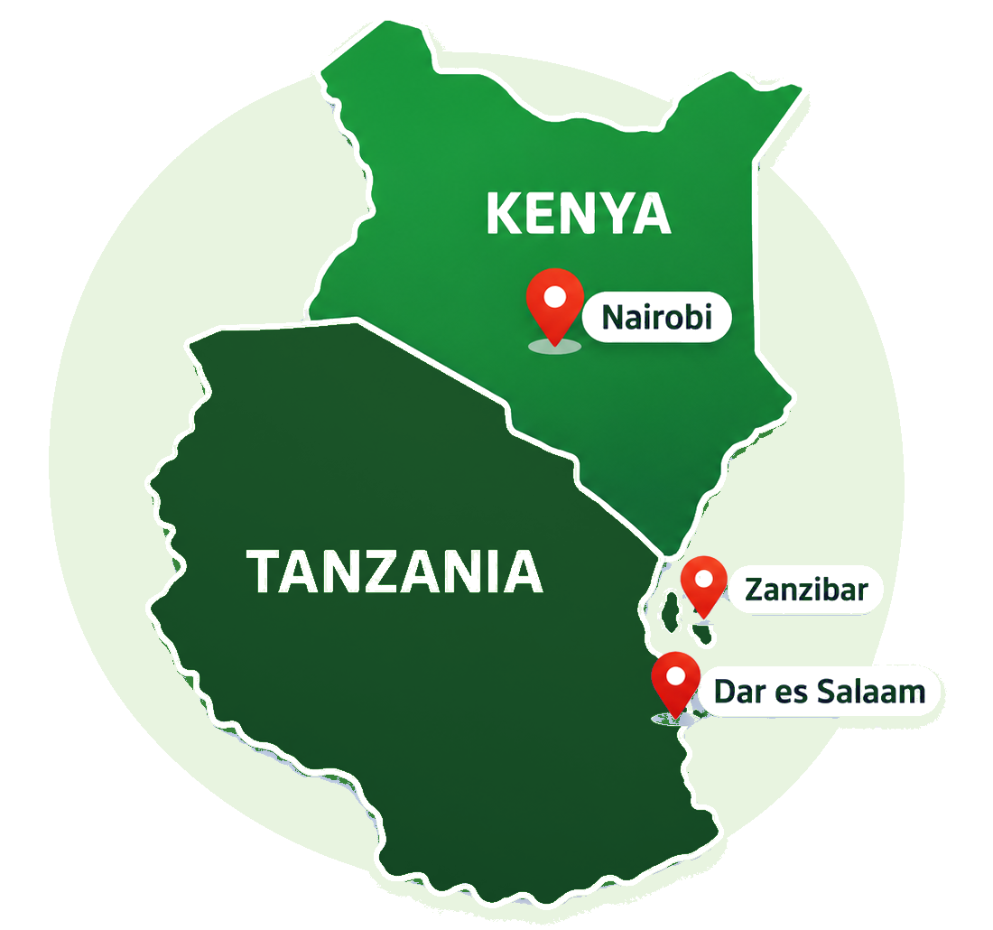




OFFICE DIRECTORY
Find us in Tanzania and Kenya
Dar es Salaam and Zanzibar serve clients in Tanzania. Nairobi is our regional contact office in Kenya.
HEAD OFFICE
Derm House, 7th Floor
Kijitonyama, Tanzania
Dar es Salaam
LOCAL OFFICE
House SH/MB232/B, Airport Road
Mbweni, Zanzibar
Zanzibar
REGIONAL CONTACT OFFICE
Piedmont Plaza, 3rd Floor
West Wing, Nairobi, Kenya
Nairobi
info@finsys-tech.co.tz
+255 752 897 733
www.finsys-tech.co.tz
Notes:
Finsys Company Profile (4), company structure and Finsys–JMR consortium agreement. Nairobi is a regional contact office; confirm local details before publication.

