Slide 1

I need help with my Pharmaceutical Stock Portfolio!
Group 3: Corey, Jackson, Irfan

Slide 2

Goals:
Anon wants to invest in pharmaceutical stock and is unsure which one(s) they should invest in. We have compiled stock data from 10 different pharmaceutical companies within the S&P 500 stock index. We created graphs and data frames to compare each company and made a professional opinion based on the collected data.

Slide 3

Questions:
How many companies should be compared?
How have the stock trends performed over time?
How can we predict future trends?

Slide 4

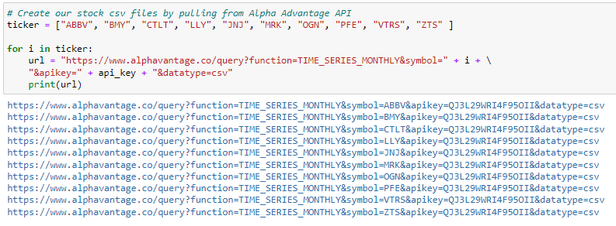
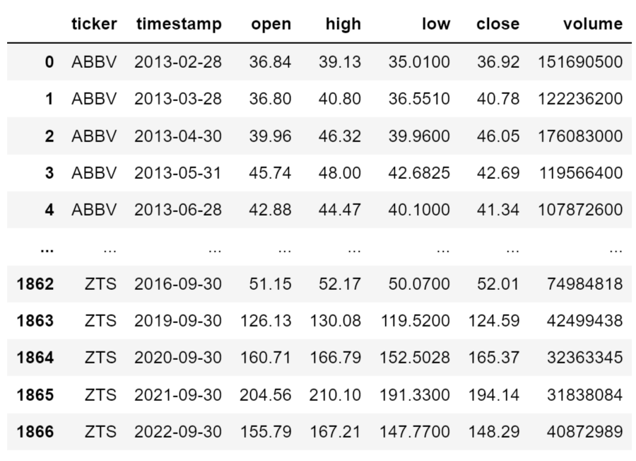
What Data did we use?
We pulled the entire available stock history for each of the companies from the Alpha Advantage API and converted the pulled data into easy-to-read csv files.
Irfan

Slide 5
How many companies should we compare?
We researched the S&P 500 stock index and found that there were only 10 companies labeled as pharmaceutical, so we decided to pull the data from all of them to have a large enough data set to compare. The Alpha Advantage API “returns current and 20+ years of historical stock data” and we were able to pull the data by month to make the data less clustered and easier to read.

Slide 6
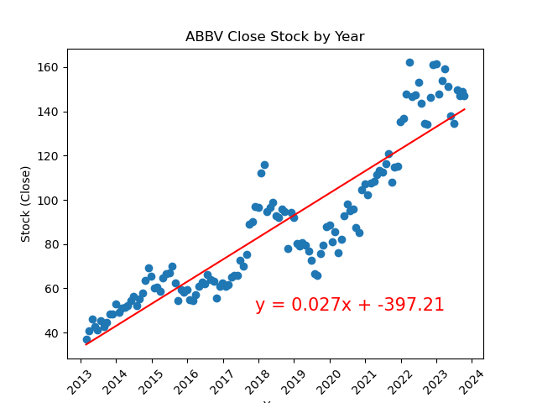
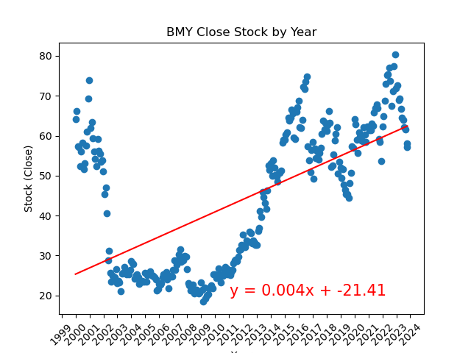
How have the stock trends performed over time?
Bristol-Myers Squibb Co
AbbVie Inc

Slide 7
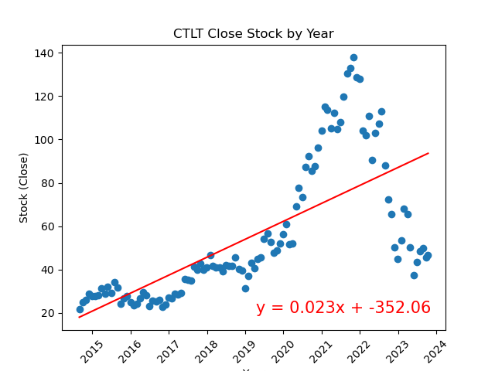
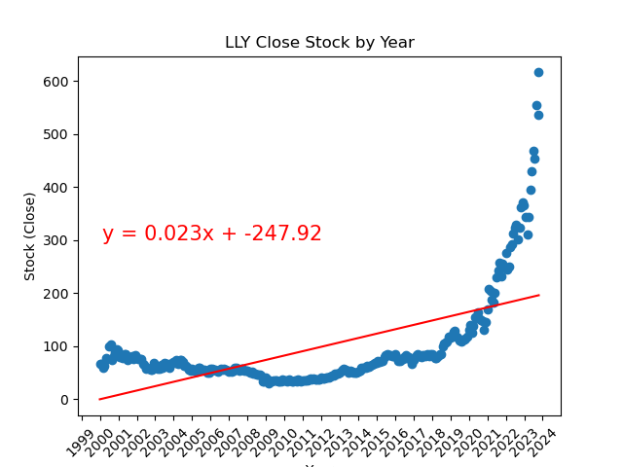
How have the stock trends performed over time?
Catalent Inc
Eli Lilly And Co

Slide 8
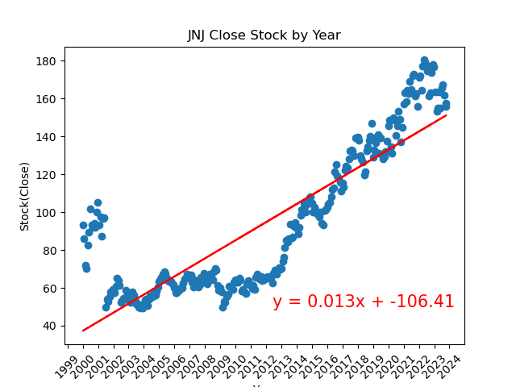
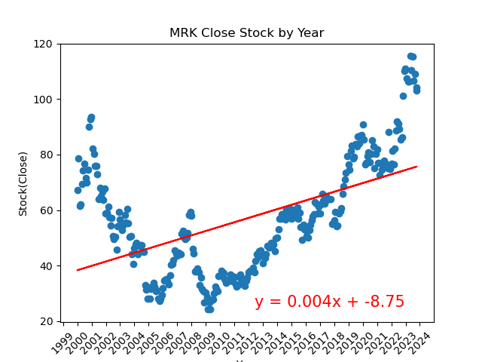
How have the stock trends performed over time?
Johnson & Johnson
Merck & Co Inc

Slide 9
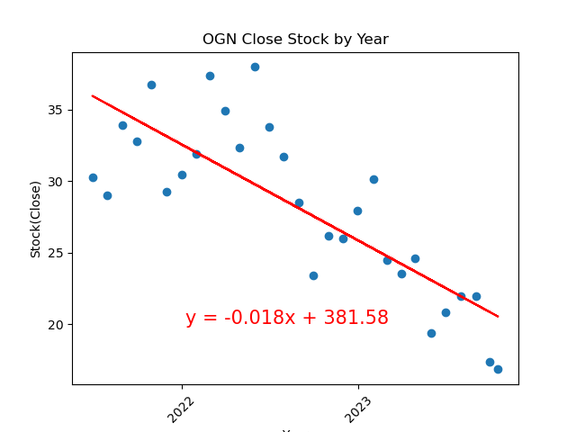
How have the stock trends performed over time?
Organon & Co

Slide 10
How can we predict future trends?
Text & Graphs

Slide 11
THANK YOU
Mirjam Nilsson
mirjam@contoso.com
www.contoso.com

