Slide 1

I need help with my Pharmaceutical Stock Portfolio!
Group 3: Corey, Jackson, Irfan

Slide 2

Goals:
Anon wants to invest in pharmaceutical stock and is unsure which one(s) they should invest in. We have compiled stock data from 10 different pharmaceutical companies within the S&P 500 stock index. We created graphs and data frames to compare each company and made a professional opinion based on the collected data.

Slide 3

Questions:
How many companies should be compared?
How have the stock trends performed over time?
How can we predict future trends?

Slide 4
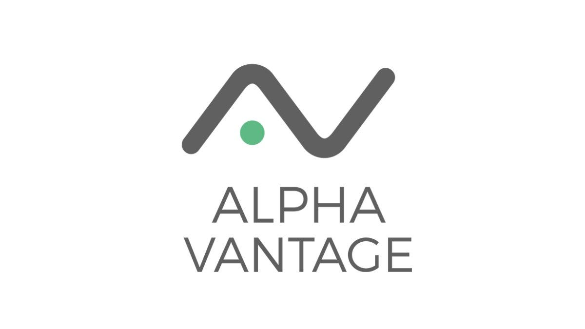
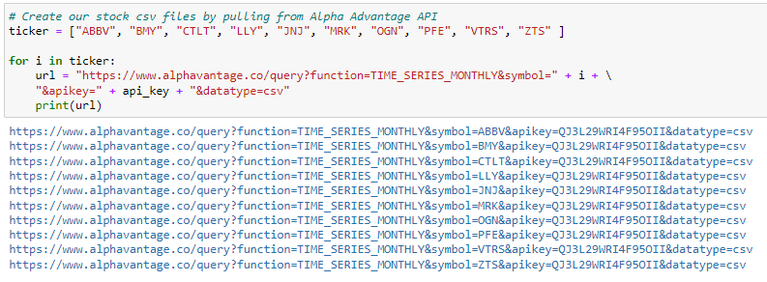
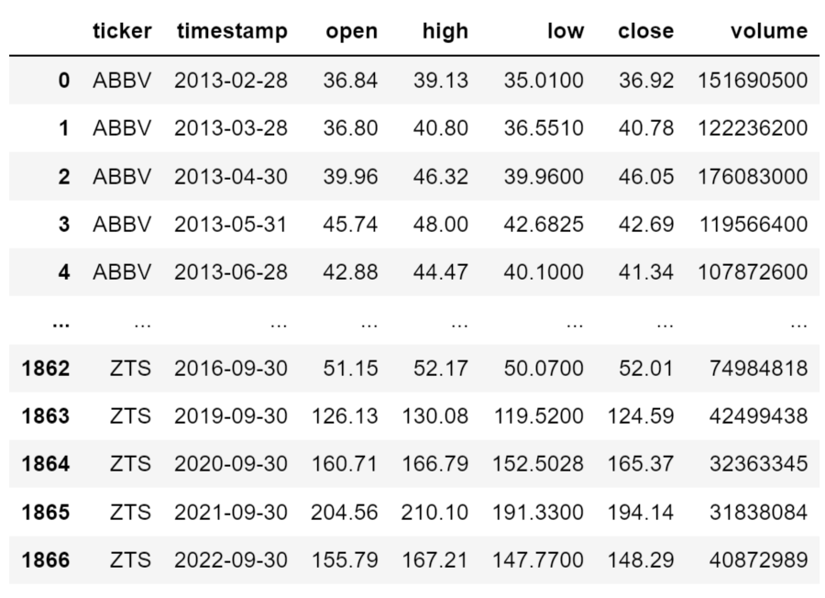
What Data did we use?
We pulled the entire available stock history for each of the companies from the Alpha Advantage API and converted the pulled data into easy-to-read csv files.
Irfan

Slide 5
How many companies should we compare?
We researched the S&P 500 stock index and found that there were only 10 companies labeled as pharmaceutical, so we decided to pull the data from all of them to have a large enough data set to compare. The Alpha Advantage API “returns current and 20+ years of historical stock data” and we were able to pull the data by month to make the data less clustered and easier to read.

Slide 6
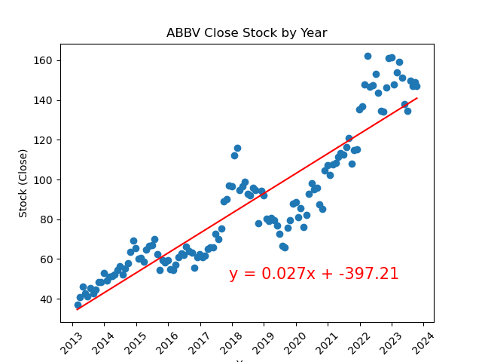
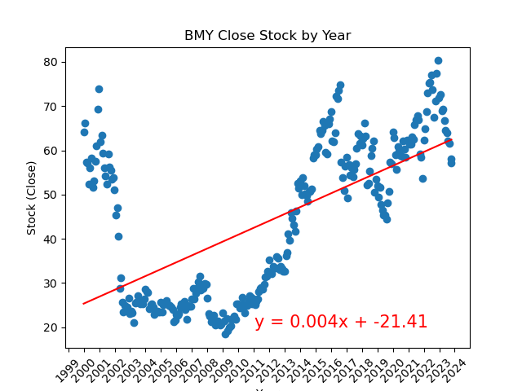
How have the stock trends performed over time? can we Predict Future Trends?
Bristol-Myers Squibb Co
AbbVie Inc

Slide 7
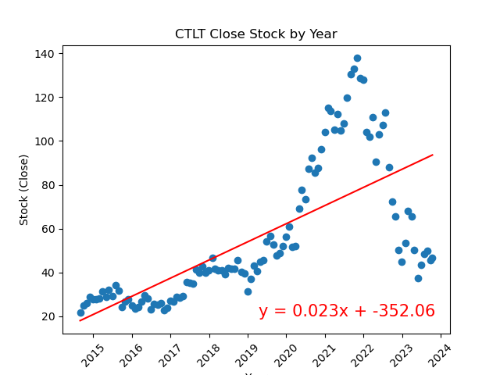
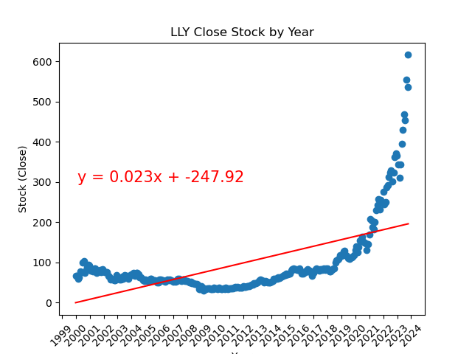
How have the stock trends performed over time? can we Predict Future Trends?
Catalent Inc
Eli Lilly And Co

Slide 8
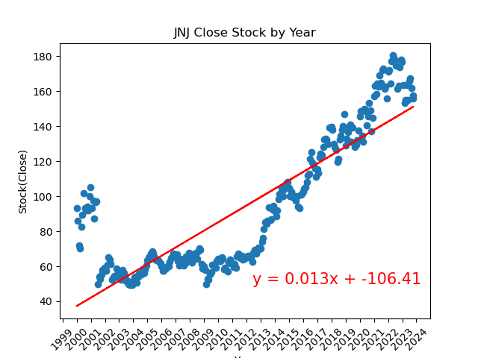
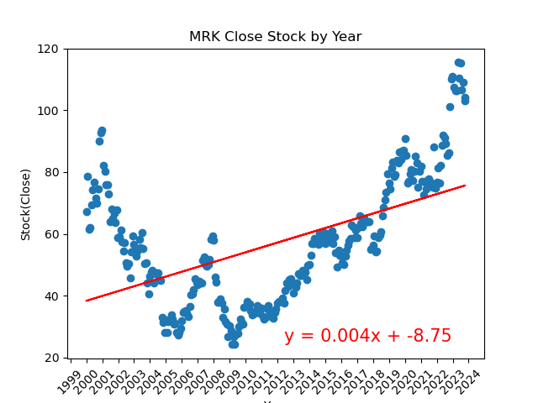
How have the stock trends performed over time? can we Predict Future Trends?
Johnson & Johnson
Merck & Co Inc

Slide 9
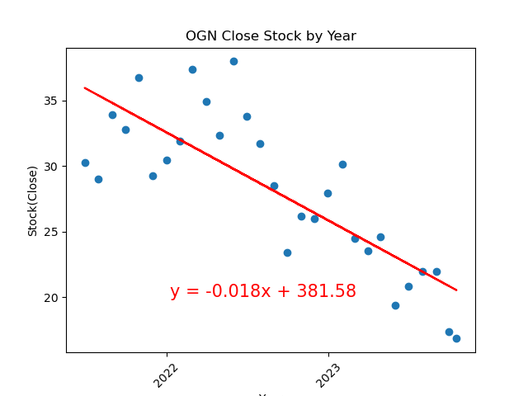
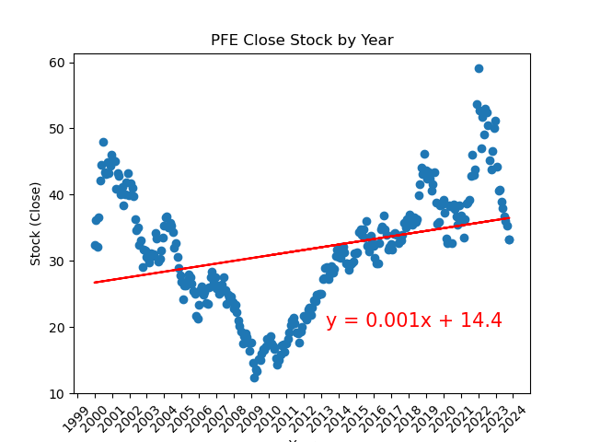
How have the stock trends performed over time? can we Predict Future Trends?
Organon & Co
Pfizer Inc.
Irfan

Slide 10
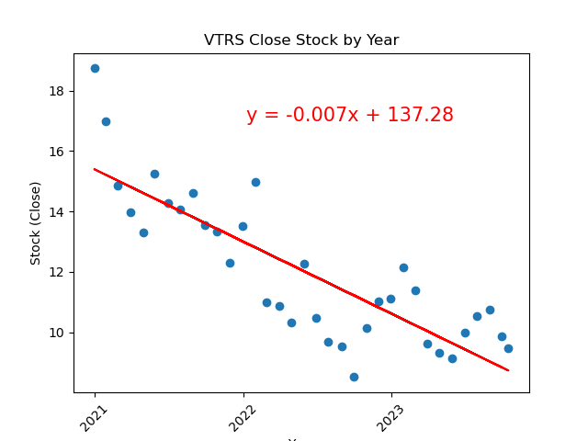
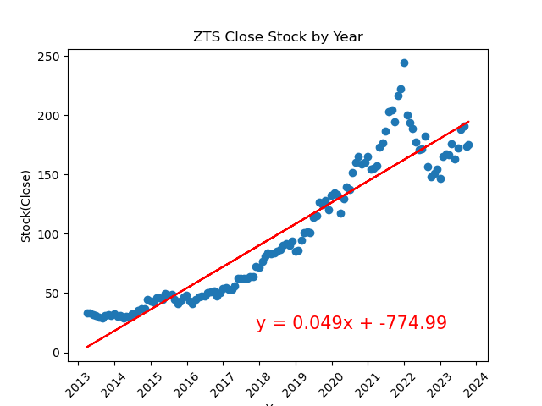
How have the stock trends performed over time? can we Predict Future Trends?
Viatris Inc.
Zoetis Inc.
Irfan

Slide 11
FUTURE BASED ON REGRESSION LINES
Company | Expected Close Value in 20 Years | Percent Change
ABBV | 330.71 | 124.6%
BMY | 86.43 | 51.2%
CTLT | 268.02 | 452.4%
LLY | 372.16 | -39.6%
JNJ | 244.07 | 54.9%
MRK | 99.09 | -4.8%
OGN | -4.61 | -127.3%
PFE | 41.36 | 24.3%
VTRS | -51.44 | -643.2%
ZTS | 546.05 | 222.7%

Slide 12
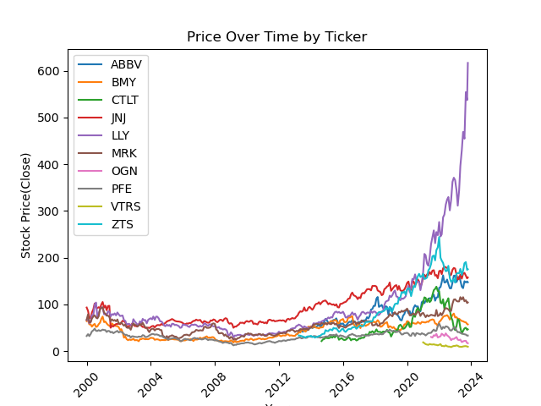
Overall Performance

Slide 13
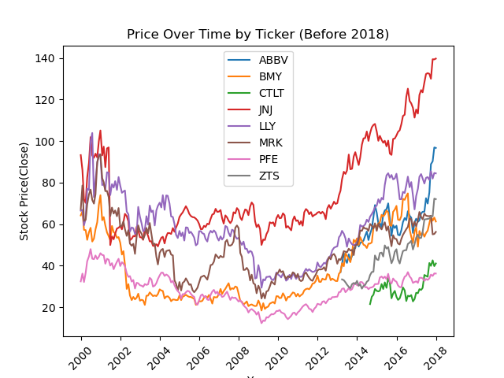
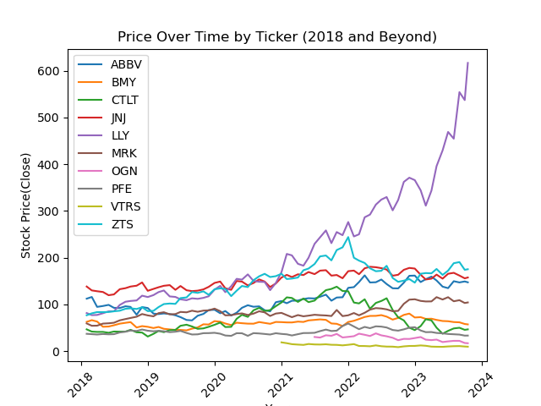
Same Data. Two Stories

Slide 14

cONCLUSION:
Based on our analysis, we believe that three different companies show promise for potential investment.
LLY – Short-term Analysis
CTLT – Percent Change Analysis
JNJ – Long-term Analysis

Slide 15
Questions?

Slide 16
THANK YOU!

