Slide 1
Fossils
By: Noah Proctor

Slide 2
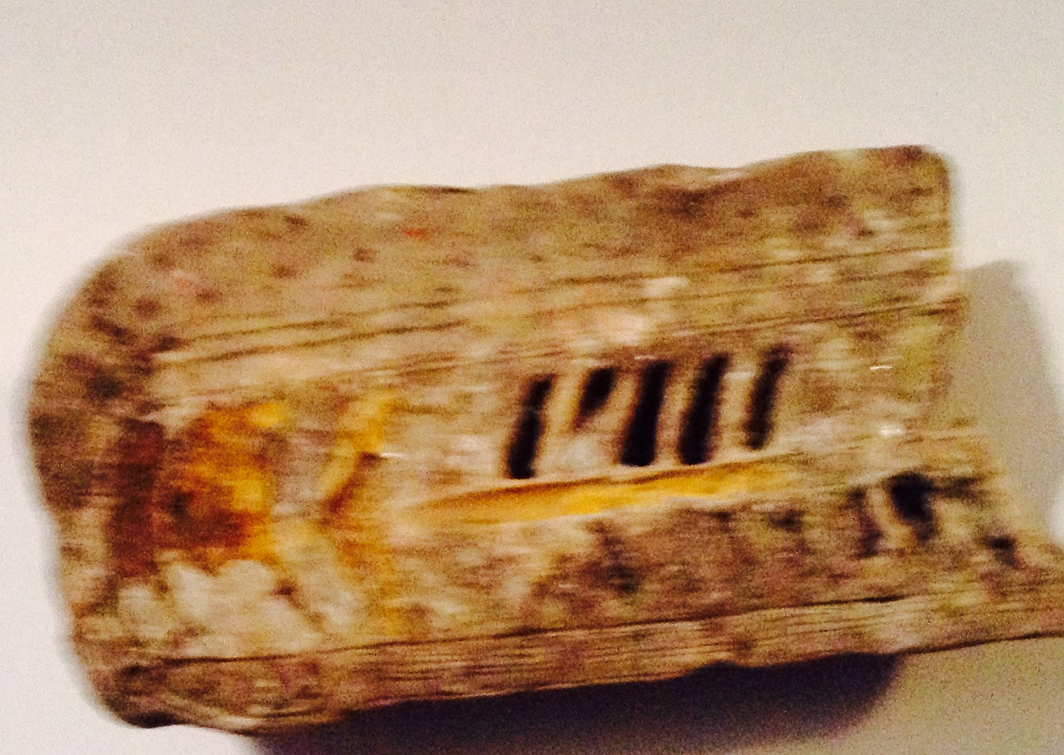
Tree Fossil Example

Slide 3
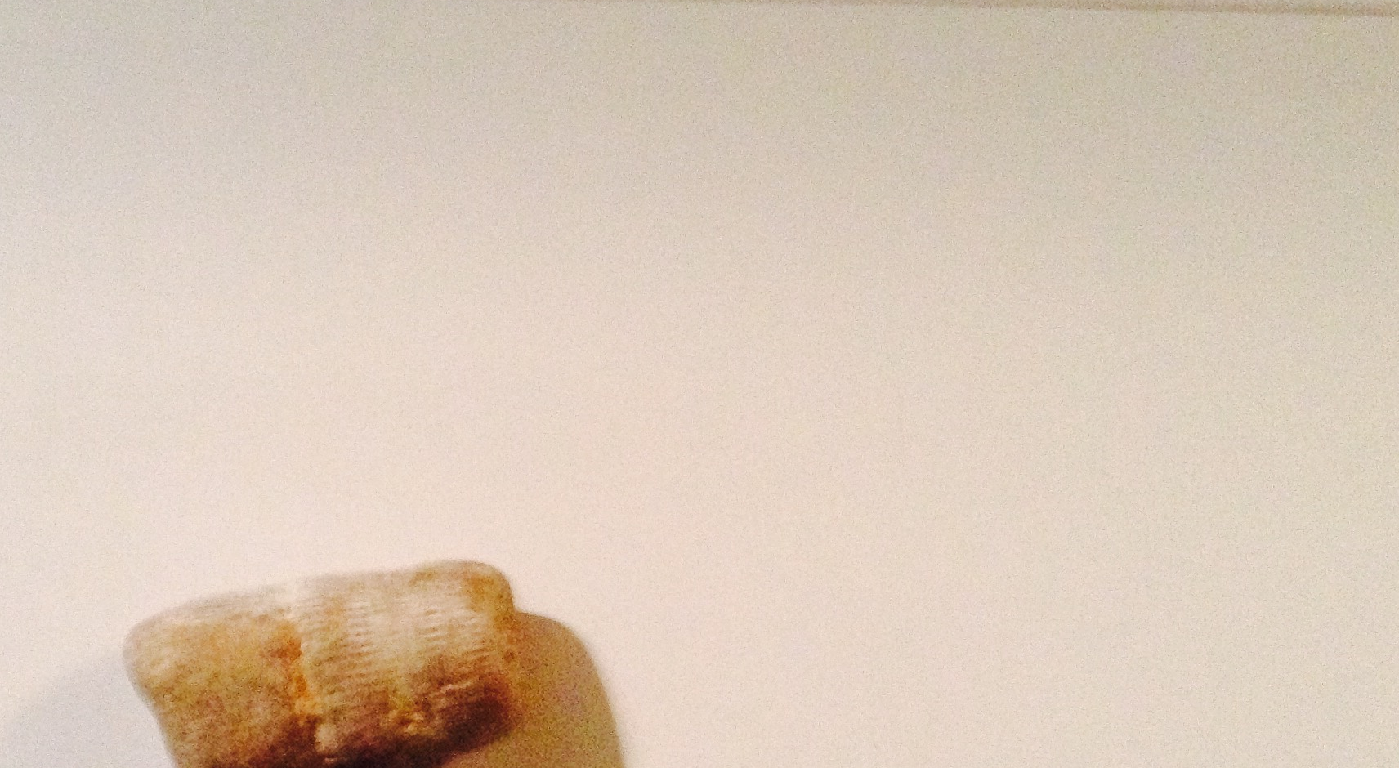
A fossil was formed in this:

Slide 4
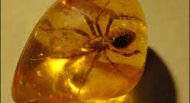
This is what happens when a bug gets stuck :

Slide 5
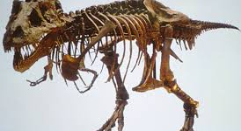
This is what happens when fossils are put together.

