Slide 1
Geodes
By Noah Proctor

Slide 2
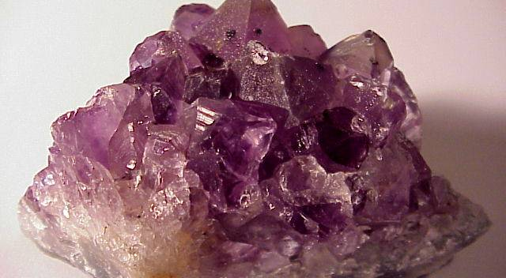
This is a geode.

Slide 3
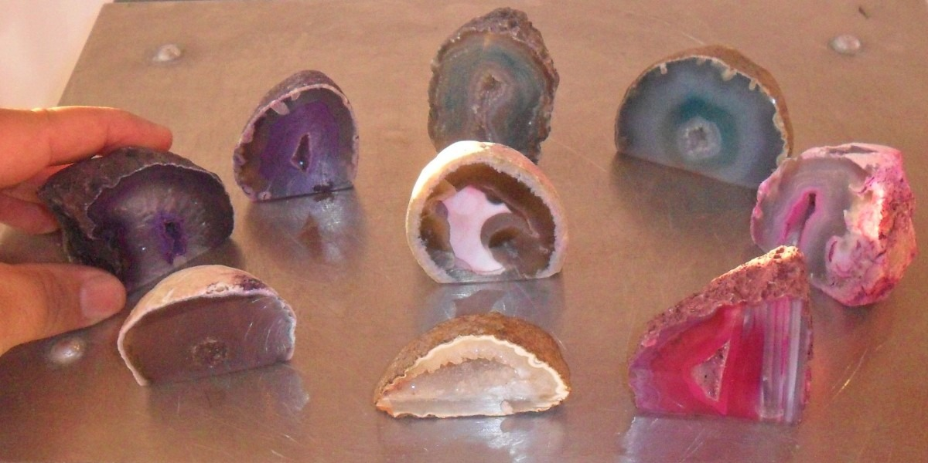
There are different colors

Slide 4
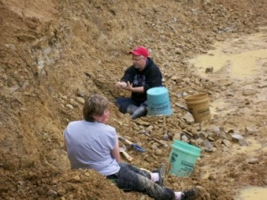
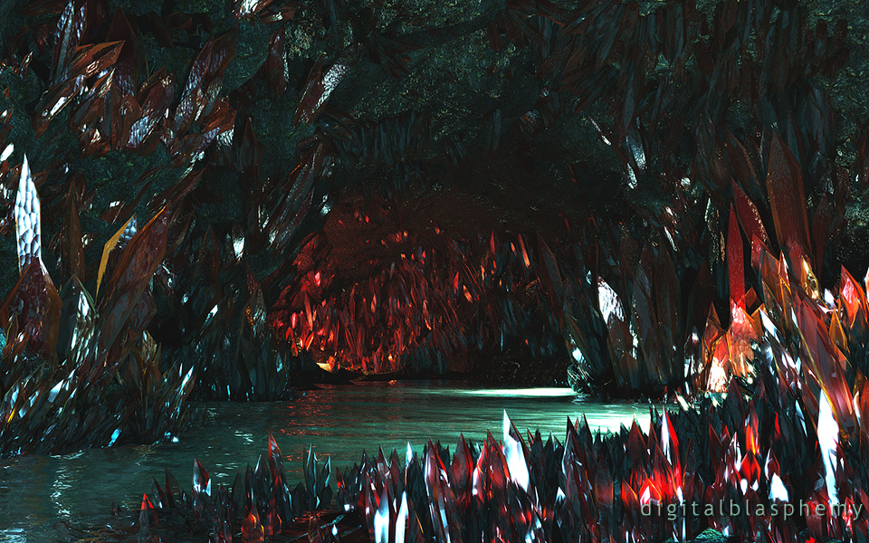
Digging

Slide 5
geodes!

