Slide 1

Implementing Shared Functionality using Middleware
Amit Saha
https://echorand.me
In your WSGI, ASGI and gRPC applications
Notes:
Hello everyone, welcome to my talk, “implementing shared functionality using middleware”. Very excited to be presenting to you – my first kiwipycon, would have loved to be there in person, but a certain virus didn’t want me to.

Slide 2
Agenda
Middleware in Computing
WSGI Middleware
gRPC Middleware
ASGI Middleware
Notes:
My goal in this talk is to take you through an exploration how middleware works in the context of web and gRPC applications today. Preparing this talk was an insightful journey for me, full of ah ha moments – and I will hopefully reproduce it with high fidelity given the constraints of time.
We start with a very brief history of the origin of term middleware in computing, then we learn how middleware works in WSGI applications, followed by how middleware works in ASGI applications and finally gRPC applications.

Slide 3
Slides and Resources
https://echorand.me/talks/
Notes:
Let’s follow our curiosity!

Slide 4
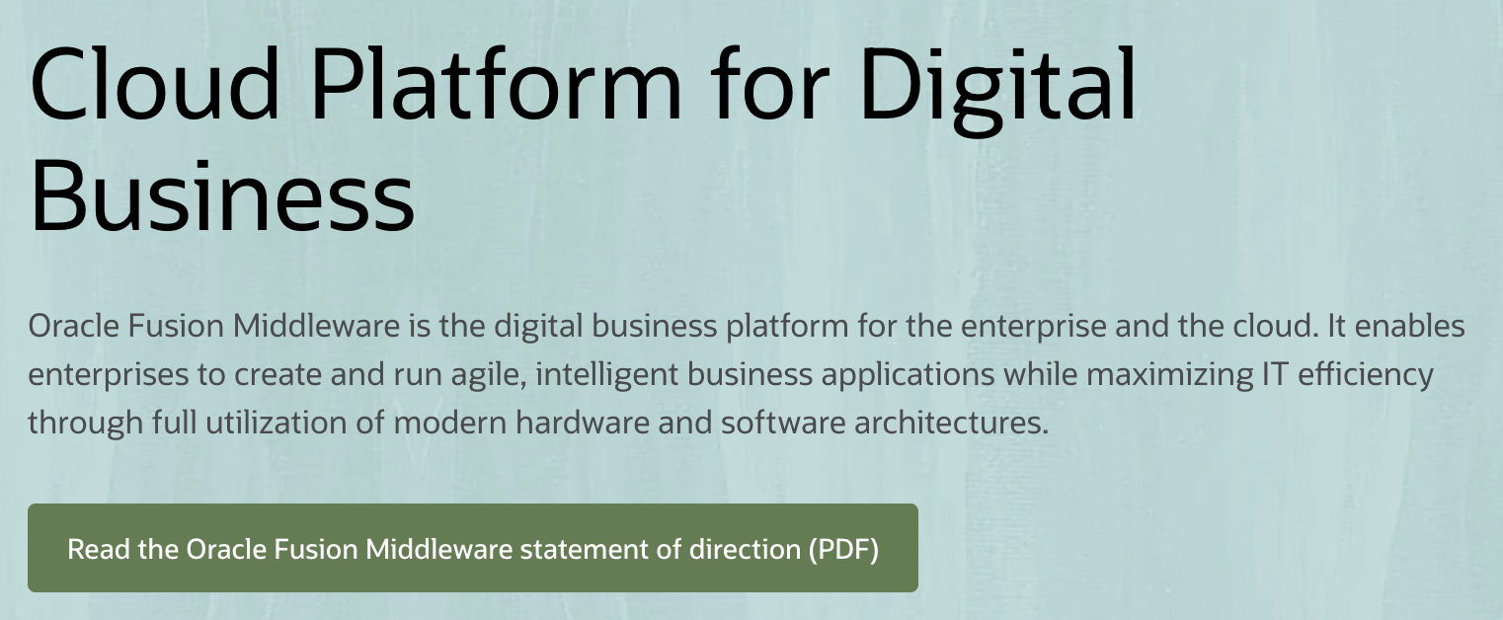
Origin of “middleware”
Usage in computing as early as 1968
“..middleware can be described as the dash ("-") in client-server, or the -to- in peer-to-peer.” –
Etzkorn, L. H. (2017). Introduction to Middleware: Web Services, Object Components, and Cloud Computing. CRC Press.
Notes:
Depending on the time you have spent in the software world, you may have heard of the term middleware outside of web applications. I remember getting free CDs for BEA Weblogic circa, early 2000s, didn’t do anything with them as far as I recall. The usage of the term can be found in computing as early as 1968. A book on the topic, describes middleware as the “-” in client-server or the –to- in peer-to-peer.
Of course, the term middleware is still in use today in that context, such as a product by Oracle, called Oracle Fusion Middleware

Slide 5
Today’s working definition
PEP 333 – Python Web Server Gateway Interface v1.0
.. it is also possible to create “middleware” components that implement both sides of this specification.
..and can be used to provide extended APIs, content transformation, navigation, and other useful functions.
Notes:
Consider a web application consists of one or more API endpoints or views:
Middleware is code you write to implement functionality that is common across one or more endpoints or views
Count of page views
Error handling
Caching, and many others
The WSGI specification ..
This leads us to our second topic of the talk, middleware for WSGI applications.

Slide 6
Middleware for WSGI applications

Slide 7
A Flask Application
bp = Blueprint("blog", __name__)
@bp.route("/")
def index():
return render_template("blog/index.html", posts=posts)
Notes:
Consider a Flask application. Here I create a Blueprint, and then define a route. Of course, I have omittied a lot of the code that’s not relevant here. Simple. We will refer to the index() function as the view function, the one handling the application requests.

Slide 8
Flask middleware
When a request is coming in,
this function will be executed before
the view function
@bp.before_request
def start_render_timer():
g.start_render = time.time()
@bp.after_request
def stop_render_timer(response):
print(f”latency:{time.time()-g.start_render} seconds")
return response
When a response is going out,
this function will be executed before
the response is sent to the client
Notes:
This is how we define middleware for a Flask application, using the before_request and after_request decorators. When a function is decorated with the before_request decorator, it is called before a request is processed by the view function if one is defined. The after_request function is called after the request has been processed by the view function.
The same applies to non-Blueprint applications, by the way in case you are wondering.

Slide 9
Result of middleware integration
$ FLASK_APP=flaskr poetry run flask run --port=5001
Page rendered in: 0.00033783912658691406 seconds
Our @after_request middleware

Slide 10
A Django Application: View function
def index(request):
return HttpResponse("Hello, world”)
Notes:
Let’s consider a Django view function. To define a middleware in Django, we can use a define a class or a function.

Slide 11
Django middleware – class based
class ExecHandlingMiddleware:
def __init__(self, get_response):
self.get_response = get_response
def __call__(self, request):
# Execute any custom code here before
# processing the request
try:
response = self.get_response(request)
# Execute any custom code here before
# sending the response
except:
# return custom response
Notes:
A class based Middleware in Django looks as follows.
The key is the special __call__ method which takes one argument the current request being handled, this is exactly how the view function looks as well in the previous slide.
The get_response attribute points to the view function that will be called or another middleware to be called next.

Slide 12
Activate middleware
# settings.py
MIDDLEWARE = [
'polls.my_exc_handler.ExcHandlingMiddleware'
]
Notes:
Then, we activate it by including them via their path in settings.py. The ordering here matters, as does in the case of Flask applications.

Slide 13
Result of middleware integration
$ python manage.py runserver
Got exception: division by zero when processing
<WSGIRequest: GET '/polls/’>
Our ExecHandlingMiddleware
middleware
Client sees:
An exception occured!

Slide 14
Recap
Using middleware, you define custom code to run before and after request processing
WSGI Frameworks define their own mechanism to define middleware
Notes:
How the middleware works is a framework specific detail which usually you can find out by looking up the framework’s source code. I would have loved to include it today, but time constraints!

Slide 15
Pause
Notes:
As we have just seen, the way we write a middleware for Flask is different from Django. Could we write middleware in a framework independent way? It turns out we can. These are WSGI frameworks, which means they define WSGI applications..and there lies the answer as we shall see next.

Slide 16
A WSGI application
def simple_handler(environ, start_response):
# ..
start_response(status, headers)
ret = [b'Hello world\n’]
return ret
Notes:
I want to start by taking a step back. Irrespective of which WSGI framework you are using, somewhere hidden underneath there is a function like this defined which kickstarts everything in your application. This is an WSGI application.
And this function signature is going to be the key for us to better understand WSGI middleware. You can ignore everything for this part of this talk, except for the function signature.
environ is a dictionary containing various key value pairs describing the current request. And start_response is a function that is used to send back a response to the client.

Slide 17
A WSGI middleware
class MyExceptionProcessor:
def __init__(self, wsgi_app):
self.wsgi_app = wsgi_app
def __call__(self, environ, start_response):
try:
return self.wsgi_app(environ, start_response)
except Exception as e:
start_response(status, headers)
return [b'An error occured!\n']

Slide 18
WSGI application with middleware
app = MyExceptionProcessor(simple_handler)
$ gunicorn app:app
[2022-04-26 09:40:27 +1000] [72117] [INFO] Starting gunicorn 20.1.0
[2022-04-26 09:40:27 +1000] [72117] [INFO] Listening at: http://127.0.0.1:8000 (72117)
[2022-04-26 09:40:27 +1000] [72117] [INFO] Using worker: sync
[2022-04-26 09:40:27 +1000] [72119] [INFO] Booting worker with pid: 72119
Notes:
I am going to refer to this as the wrapping technique of defining middleware for WSGI applications

Slide 19
Flask + WSGI Middleware
# import MyExceptionProcessor
app = Flask(__name__)
app.wsgi_app = MyExceptionProcessor(app.wsgi_app)
Notes:
def wsgi_app(self, environ, start_response) -> t.Any:

Slide 20
Django + WSGI Middleware
# wsgi.py
# import MyExceptionprocessor
application = get_wsgi_application()
application = MyExceptionProcessor(application)
Notes:
def wsgi_app(self, environ, start_response) -> t.Any:

Slide 21
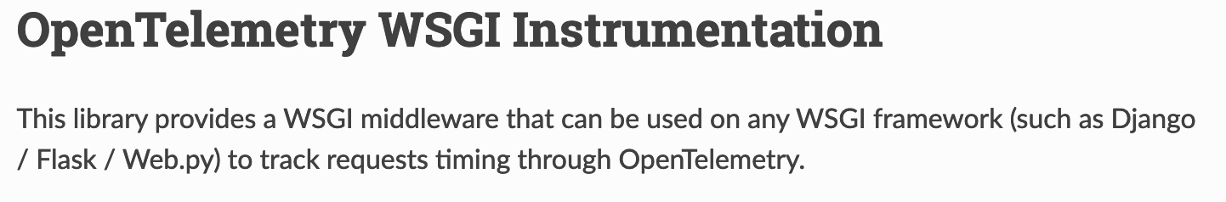
Recap
WSGI middleware is framework agnostic
Open source package example:
Notes:
WSGI frameworks such as Django and Flask define custom mechanisms for defining middleware. You can also however write a middleware as an WSGI application and then wrap your WSGI application inside it. That middleware you wrote is framework independent. However, I haven’t fully explored if there are potential problems or limitations with that approach.

Slide 22
Middleware for ASGI applications
Notes:
Next, we are going to look at middleware for ASGI applications.

Slide 23
A FastAPI application
app = FastAPI()
@app.get("/expensive")
async def root():
await asyncio.sleep(10)
return {"message": "Expensive calculation completed"}

Slide 24
Using ASGI Middleware
class ExpensiveCache:
def __init__(self, app, excluded_paths):
self.app = app
# other initialization
async def __call__(self, scope, receive, send):
if cache_hit:
# send cached response
await self.app(scope, receive, cache_and_send)
Your Fast API application
Calls the FastAPI application

Slide 25
Sending the cached response
if cached_response:
await send({
'type': 'http.response.start',
'status': 200,
'headers': [
[b'content-type', b'application/json'],
[b'x-cached-data', b'yes']
],
})
await send({
'type': 'http.response.body',
'body': cached_response,
})
return

Slide 26
Adding the Middleware
app = FastAPI()
app.add_middleware(
ExpensiveCache,
excluded_paths=["/chat"]
)

Slide 27
Result of middleware integration
$ gunicorn app:app # ..other arguments
http:/expensive: Got request.
http: /expensive: Finished request. 10.002439737319946s.
http:/expensive: Got request.
http: /expensive: Finished request. 0.0002880096435546875s.
First request
Second request

Slide 28
ASGI Middleware and WebSocket
class RequestTimer:
async def __call__(self, scope, receive, send):
await self.app(scope, receive, send)
# print(“latency...”)
http:/chat: Got request.
http: /chat: Finished request. 0.001107931137084961s.
websocket:/ws: Got request.
..
websocket: /ws: Finished request. 28.716175079345703s.
Notes:
Scope lasts for the lifetime of the connection

Slide 29
Recap
FastAPI, like Flask and Django defines helper methods to add ASGI middleware
ASGI middleware is framework agnostic
ASGI middleware works for both HTTP and WebSocket connections
Notes:
ASGI middleware is an ASGI application, ASGI middleware is framework independent. An ASGI middleware supports HTTP and WebSockets.

Slide 30
Interceptors for gRPC applications
Notes:
gRPC community uses the term “interceptors” to refer to what is traditionally referred to as middleware in the web community.

Slide 31
gRPC Applications
Unary-Unary
One request, one response (Protobuf message)
Bidirectional streaming
One or more requests and responses (Protobuf messages)
Think of it like a WebSocket connection
Notes:
We are going to look at two patterns of implementation of gRPC applications today in the context of implementing interceptors. Unary-Unary, where the client sends one request – a protobuf message and waits for a reply from the server.
The second category of applications we will look at implements the bidirectional streaming pattern. A client can send one or more requests and the server can send one or more replies, like a websocket connection from the HTTP world.

Slide 32
Unary-Unary gRPC Applications
Notes:
First, let’s look at a unary-unary gRPC application pattern and how we can implement intereceptors – both server and client side.

Slide 33
A gRPC service
class Identity(..):
def ValidateToken(self, request, context):
user_details = identity_pb2.ValidateTokenReply(user_id="default-user-id")
return user_details
def serve(app_config: dict):
server = grpc.server(
futures.ThreadPoolExecutor(max_workers=10),
)
# ..
RPC Method

Slide 34
A logging interceptor
import grpc
class LoggingInterceptor(grpc.ServerInterceptor):
def __init__(self):
pass
def intercept_service(self, continuation, handler_call_details):
print(
handler_call_details.method,
handler_call_details.invocation_metadata
)
return continuation(handler_call_details)
Next interceptor or RPC method
Request Metadata

Slide 35
Integrating the interceptor(s)
def serve(app_config: dict):
server = grpc.server(
futures.ThreadPoolExecutor(max_workers=10),
interceptors = (LoggingInterceptor(),)
)
# .. Rest of the server
RPC Method called
Client metadata
Server logs
/Identity/ValidateToken (_Metadatum(‘grpc-python/1.48.0 grpc-c/26.0.0 (osx; chttp2)'),)
Notes:
This is how we integrate the interceptor – we add a keyword argument, interceptors which is a tuple of the interceptors we want to add.
Then a call to the server will be logged..

Slide 36
Bidirectional streaming gRPC Applications

Slide 37
A bidi streaming RPC method
class Identity(..):
def ExpireToken(self, request_iterator, context):
for r in request_iterator:
yield identity_pb2.ExpireTokenReply(result=True)
Notes:
Request iterator, response iterator

Slide 38
A logging interceptor
class LoggingInterceptor(grpc.ServerInterceptor):
def intercept_service(self, continuation, handler_call_details):
def logging_wrapper(behavior, request_streaming, response_streaming):
def logging_interceptor(request_or_iterator, context):
# More stuff
if request_streaming or response_streaming:
return self._intercept_server_stream(
behavior,
request_or_iterator,
context,
)
return behavior(request_or_iterator, context)
# More stuff
Called once when the stream is created
Unary-Unary RPC methods

Slide 39
def _intercept_server_stream(
self, behavior, request_or_iterator, context
):
def wrapd(behavior, request_or_iterator, context):
for r in request_or_iterator:
print("Processing stream message", r)
resp = behavior(list([r]), context)
yield from resp
This loop is executed for every message exchanged during the stream session
Create an iterator for a single request

Slide 40
Server logs
/Identity/ExpireToken (_Metadatum(key='user-agent’, ..(osx; chttp2)'),)
Processing stream message token: "a-token"
Processing stream message token: "b-token"
Processing stream message token: "c-token"
Stream duration: 3.0171940326690674 seconds

Slide 41
Key takeaways
Web application middleware can be defined generally as an WSGI or ASGI application or be framework specific
03
Code that’s acting as both a client and a server
02
Enables decoupling and sharing of non-functional requirements
01
Implementing gRPC interceptors varies based on the pattern of communication
04
Notes:
Key takeaways
Client for another middleware or your application
Server for an external request or another middleware
Migration between application frameworks/versions WSGI or ASGI

Slide 42
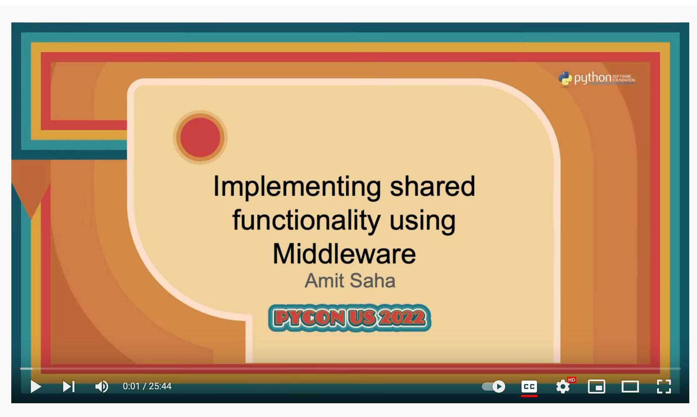
My PyCon US 2022 Talk
Using middleware to:
Migrate between WSGI frameworks
Migrate between WSGI and ASGI frameworks
More!
Notes:
Before we move onto gRPC applications, a shoutout to my own talk at PyCon US 2022 where I demonstrate how you can use middleware to help you migrate between WSGI frameworks or between ASGI and WSGI frameworks.

Slide 43
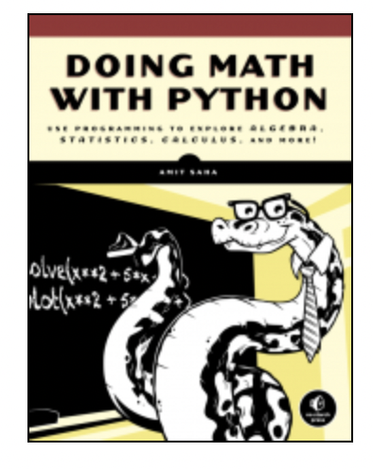
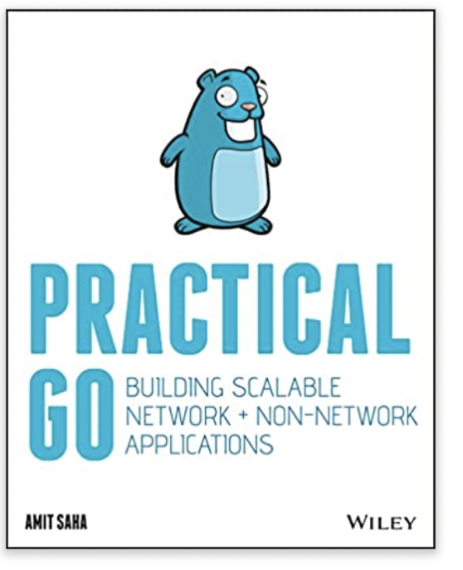
Thanks!
https://echorand.me
Check out my books!
Doing Math with Python: https://doingmathwithpython.github.io
Practical Go: https://practicalgobook.net
Notes:
I hope you have gained insights into the internals of middleware as they apply to WSGI, ASGI and gRPC applications and go away with a few new neural pathways formed in your brain. Thank you for coming to my talk. I hope you will check out my books and enjoy the rest of your conference!

