Slide 1

Implementing Shared Functionality using Middleware
Amit Saha
https://echorand.me
In your WSGI, ASGI and gRPC applications
Notes:
Hello everyone, welcome to my talk, “implementing shared functionality using middleware”. My name is Amit Saha and I work as a software engineer at Atlassian, in Sydney, Australia. I am very excited to be presenting to you – my first kiwipycon, would have loved to be there in person, but a certain virus didn’t want me to.
Like all of you, I love figuring out how things work and that brings me to the agenda for my presentation today.

Slide 2
Agenda
Middleware in Computing
WSGI Middleware
gRPC Middleware
ASGI Middleware
Notes:
My goal in this talk is to take you through an exploration how middleware works in the context of web and gRPC applications today. Preparing this talk was an insightful journey for me, full of ah ha moments – and I will hopefully reproduce it with high fidelity given the constraints of time.
We start with a very brief history of the origin of term middleware in computing, then we learn how middleware works in WSGI applications, followed by how middleware works in ASGI applications and finally gRPC applications.

Slide 3
Slides and Resources
https://echorand.me/talks/
Notes:
Let’s follow our curiosity!

Slide 4
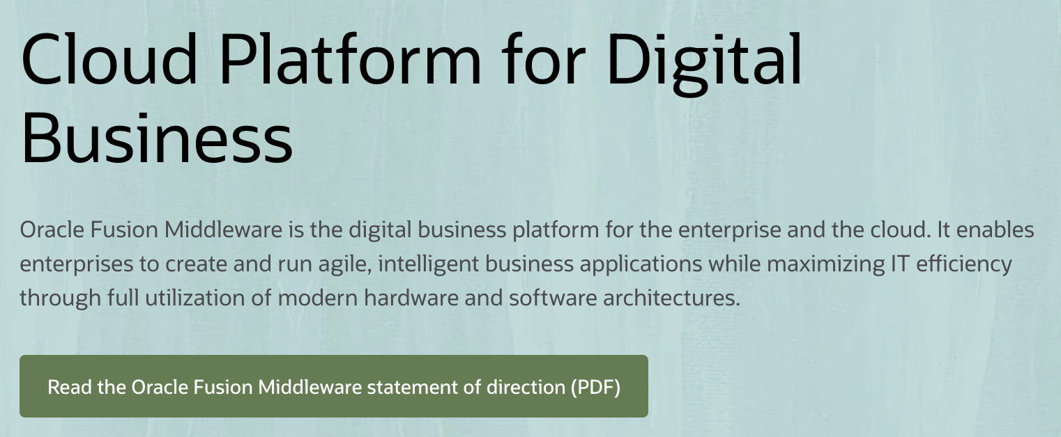
Origin of “middleware”
Usage in computing as early as 1968
“..middleware can be described as the dash ("-") in client-server, or the -to- in peer-to-peer.” –
Etzkorn, L. H. (2017). Introduction to Middleware: Web Services, Object Components, and Cloud Computing. CRC Press.
Notes:
Depending on the time you have spent in the software world, you may have heard of the term middleware outside of web applications. I remember getting free CDs for BEA Weblogic circa, early 2000s, didn’t do anything with them as far as I recall. The usage of the term can be found in computing as early as 1968. A book on the topic, describes middleware as the “-” in client-server or the –to- in peer-to-peer.
Of course, the term middleware is still in use today in that context, such as a product by Oracle, called Oracle Fusion Middleware

Slide 5
Today’s working definition
PEP 333 – Python Web Server Gateway Interface v1.0
.. it is also possible to create “middleware” components that implement both sides of this specification.
..and can be used to provide extended APIs, content transformation, navigation, and other useful functions.
Notes:
Consider a web application consists of one or more API endpoints or views:
Middleware is code you write to implement functionality that is common across one or more endpoints or views
Count of page views
Error handling
Caching, and many others
The WSGI specification ..
This leads us to our second topic of the talk, middleware for WSGI applications.

Slide 6
Middleware for WSGI applications

Slide 7
A Flask Application
bp = Blueprint("blog", __name__)
@bp.route("/")
def index():
return render_template("blog/index.html", posts=posts)
Notes:
Consider a Flask application. Here I create a Blueprint, and then define a route. Of course, I have omittied a lot of the code that’s not relevant here. Simple. We will refer to the index() function as the view function, the one handling the application requests.

Slide 8
Flask middleware
@bp.before_request
def start_render_timer():
g.start_render = time.time()
@bp.after_request
def stop_render_timer(response):
print(f”latency:{time.time()-g.start_render} seconds")
return response
Notes:
This is how we define middleware for a Flask application, using the before_request and after_request decorators. When a function is decorated with the before_request decorator, it is called before a request is processed by the view function if one is defined. The after_request function is called after the request has been processed by the view function.
The same applies to non-Blueprint applications, by the way in case you are wondering.

Slide 9
A Django Application: View function
def index(request):
return HttpResponse("Hello, world”)
Notes:
Let’s consider a Django view function. To define a middleware in Django, we can use a define a class or a function.

Slide 10
Django middleware – class based
class ExecHandlingMiddleware:
def __init__(self, get_response):
self.get_response = get_response
def __call__(self, request):
try:
return self.get_response(request)
except:
# return custom response
Notes:
A class based Middleware in Django looks as follows.
The key is the special __call__ method which takes one argument the current request being handled, this is exactly how the view function looks as well in the previous slide.
The get_response attribute points to the view function that will be called or another middleware to be called next.

Slide 11
Activate middleware
# settings.py
MIDDLEWARE = [
'polls.my_exc_handler.ExcHandlingMiddleware'
]
Notes:
Then, we activate it by including them via their path in settings.py. The ordering here matters, as does in the case of Flask applications.

Slide 12
Recap
Using middleware, you define custom code to run before and after request processing
WSGI Frameworks define their own mechanism to define middleware
Notes:
How the middleware works is a framework specific detail which usually you can find out by looking up the framework’s source code. I would have loved to include it today, but time constraints!

Slide 13
Pause
Notes:
As we have just seen, the way we write a middleware for Flask is different from Django. Could we write middleware in a framework independent way? It turns out we can. These are WSGI frameworks, which means they define WSGI applications..and there lies the answer as we shall see next.

Slide 14
A WSGI application
def simple_handler(environ, start_response):
# ..
start_response(status, headers)
ret = [b'Hello world\n’]
return ret
Notes:
I want to start by taking a step back. Irrespective of which WSGI framework you are using, somewhere hidden underneath there is a function like this defined which kickstarts everything in your application. This is an WSGI application.
And this function signature is going to be the key for us to better understand WSGI middleware. You can ignore everything for this part of this talk, except for the function signature.
environ is a dictionary containing various key value pairs describing the current request. And start_response is a function that is used to send back a response to the client.

Slide 15
A WSGI middleware
class MyExceptionProcessor:
def __init__(self, wsgi_app):
self.wsgi_app = wsgi_app
def __call__(self, environ, start_response):
try:
return self.wsgi_app(environ, start_response)
except Exception as e:
start_response(status, headers)
return [b'An error occured!\n']

Slide 16
WSGI application with middleware
app = MyExceptionProcessor(simple_handler)
$ gunicorn app:app
[2022-04-26 09:40:27 +1000] [72117] [INFO] Starting gunicorn 20.1.0
[2022-04-26 09:40:27 +1000] [72117] [INFO] Listening at: http://127.0.0.1:8000 (72117)
[2022-04-26 09:40:27 +1000] [72117] [INFO] Using worker: sync
[2022-04-26 09:40:27 +1000] [72119] [INFO] Booting worker with pid: 72119
Notes:
I am going to refer to this as the wrapping technique of defining middleware for WSGI applications

Slide 17
Pause
Notes:
Frameworks implement their own mechanisms to define middleware, WSGI middleware = Another WSGI application, So that means if we implement a functionality using WSGI middleware, they are framework independent, let’s see how they work.

Slide 18
Flask + WSGI Middleware
# import MyExceptionProcessor
app = Flask(__name__)
app.wsgi_app = MyExceptionProcessor(app.wsgi_app)
Notes:
def wsgi_app(self, environ, start_response) -> t.Any:

Slide 19
Django + WSGI Middleware
# wsgi.py
# import MyExceptionprocessor
application = get_wsgi_application()
application = MyExceptionProcessor(application)
Notes:
def wsgi_app(self, environ, start_response) -> t.Any:

Slide 20
Recap
Flask and Django implement custom mechanisms to allow users to define middleware
WSGI middleware is framework agnostic
Notes:
WSGI frameworks such as Django and Flask define custom mechanisms for defining middleware. You can also however write a middleware as an WSGI application and then wrap your WSGI application inside it. That middleware you wrote is framework independent. However, I haven’t fully explored if there are potential problems or limitations with that approach.

Slide 21
Middleware for ASGI applications
Notes:
Next, we are going to look at middleware for ASGI applications.

Slide 22
A FastAPI application
app = FastAPI()
@app.get("/expensive")
async def root():
await asyncio.sleep(10)
return {"message": "Expensive calculation completed"}

Slide 23
Using ASGI Middleware
class ExpensiveCache:
def __init__(self, app, excluded_paths):
# initialization
async def __call__(self, scope, receive, send):
if cache_hit:
# send cached response
await self.app(scope, receive, cache_and_send)

Slide 24
Adding the Middleware
app = FastAPI()
app.add_middleware(
ExpensiveCache,
excluded_paths=["/chat"]
)

Slide 25
ASGI Middleware and WebSocket
class RequestTimer:
async def __call__(self, scope, receive, send):
await self.app(scope, receive, send)
# print(“latency...”)
http:/chat: Got request.
http: /chat: Finished request. 0.001107931137084961s.
websocket:/ws: Got request.
..
websocket: /ws: Finished request. 28.716175079345703s.
Notes:
Scope lasts for the lifetime of the connection

Slide 26
Recap
ASGI middleware is framework agnostic
FastAPI has helper methods to add ASGI middleware
Notes:
ASGI middleware is an ASGI application, ASGI middleware is framework independent. An ASGI middleware supports HTTP and WebSockets.

Slide 27
Interceptors for gRPC applications
Notes:
gRPC community uses the term “interceptors” to refer to what is traditionally referred to as middleware in the web community.

Slide 28
gRPC Applications
Unary-Unary
One request, one response (Protobuf message)
Bidirectional streaming
One or more requests and responses (Protobuf messages)
Think of it like a WebSocket connection
Notes:
We are going to look at two patterns of implementation of gRPC applications today in the context of implementing interceptors. Unary-Unary, where the client sends one request – a protobuf message and waits for a reply from the server.
The second category of applications we will look at implements the bidirectional streaming pattern. A client can send one or more requests and the server can send one or more replies, like a websocket connection from the HTTP world.

Slide 29
Unary-Unary gRPC Applications
Notes:
First, let’s look at a unary-unary gRPC application pattern and how we can implement intereceptors – both server and client side.

Slide 30
A gRPC service
class Identity(..):
def ValidateToken(self, request, context):
user_details = identity_pb2.ValidateTokenReply(user_id="default-user-id")
return user_details
def serve(app_config: dict):
server = grpc.server(
futures.ThreadPoolExecutor(max_workers=10),
)
# ..
RPC Method

Slide 31
A Minimal Logging interceptor
import grpc
class LoggingInterceptor(grpc.ServerInterceptor):
def __init__(self):
pass
def intercept_service(self, continuation, handler_call_details):
print(handler_call_details.method, handler_call_details.invocation_metadata)
return continuation(handler_call_details)
Next interceptor or RPC method
Request Metadata

Slide 32
Integrating the interceptor(s)
def serve(app_config: dict):
server = grpc.server(
futures.ThreadPoolExecutor(max_workers=10),
interceptors = (LoggingInterceptor(),)
)
# .. Rest of the server
RPC Method called
Client metadata
Server logs
/Identity/ValidateToken (_Metadatum(‘grpc-python/1.48.0 grpc-c/26.0.0 (osx; chttp2)'),)
Notes:
This is how we integrate the interceptor – we add a keyword argument, interceptors which is a tuple of the interceptors we want to add.
Then a call to the server will be logged..

Slide 33
Bidi-streaming gRPC Applications

Slide 34
A bidi streaming RPC method
class Identity(..):
def ExpireToken(self, request_iterator, context):
for r in request_iterator:
yield identity_pb2.ExpireTokenReply(result=True)
Notes:
Request iterator, response iterator

Slide 35
A logging interceptor
class LoggingInterceptor(grpc.ServerInterceptor):
def intercept_service(self, continuation, handler_call_details):
def logging_wrapper(behavior, request_streaming, response_streaming):
def logging_interceptor(request_or_iterator, context):
# More stuff
if request_streaming or response_streaming:
return self._intercept_server_stream(
behavior,
request_or_iterator,
context,
)
return behavior(request_or_iterator, context)
# More stuff
Called once when the stream is created
Unary-Unary RPC methods

Slide 36
def _intercept_server_stream(
self, behavior, request_or_iterator, context
):
def wrapd(behavior, request_or_iterator, context):
for r in request_or_iterator:
print("Processing stream message", r)
resp = behavior(list([r]), context)
yield from resp
This loop is executed for every message exchanged during the stream session

Slide 37
Server logs
/Identity/ExpireToken (_Metadatum(key='user-agent’, ..(osx; chttp2)'),)
Processing stream message token: "a-token"
Processing stream message token: "b-token"
Processing stream message token: "c-token"
Stream duration: 3.0171940326690674 seconds

Slide 38
Logging client-side interceptor
class LoggingClientInterceptor(grpc.UnaryUnaryClientInterceptor,
grpc.StreamStreamClientInterceptor):
# def intercept_unary_unary(self, continuation, client_call_details, request):
# def intercept_stream_stream(self, continuation, client_call_details, request_iterator)

Slide 39
Logging client-side interceptor
def intercept_stream_stream(
self,continuation, client_call_details, request_iterator
):
response_it = continuation(
client_call_details,
self._intercept_request_stream_msg(request_iterator)
)
yield from self._intercept_response_stream_msg(response_it)
stream_duration = time.time() - self.stream_started
print("Stream duration: {0} seconds".format(stream_duration))

Slide 40
Logging client-side interceptor
def _intercept_request_stream_msg(self, request_iterator):
for r in request_iterator:
print("Streaming request")
yield r
def _intercept_response_stream_msg(self, response_iterator):
for r in response_iterator:
print("Streaming response")
yield r

Slide 41
Client-side logs
Call details _ClientCallDetails(method='/Identity/ExpireToken’..)
Streaming request
Streaming response
Streaming request
Streaming response
Streaming request
Streaming response
3.0214710235595703

Slide 42
Key takeaways
Web application middleware can be defined generally as an WSGI or ASGI application or be framework specific
01
Code that’s acting as both a client and a server
03
Enables decoupling and sharing of non-functional requirements
04
gRPC interceptors is used to implement middleware in server and client applications
02
Notes:
Key takeaways
Client for another middleware or your application
Server for an external request or another middleware
Migration between application frameworks/versions WSGI or ASGI

Slide 43
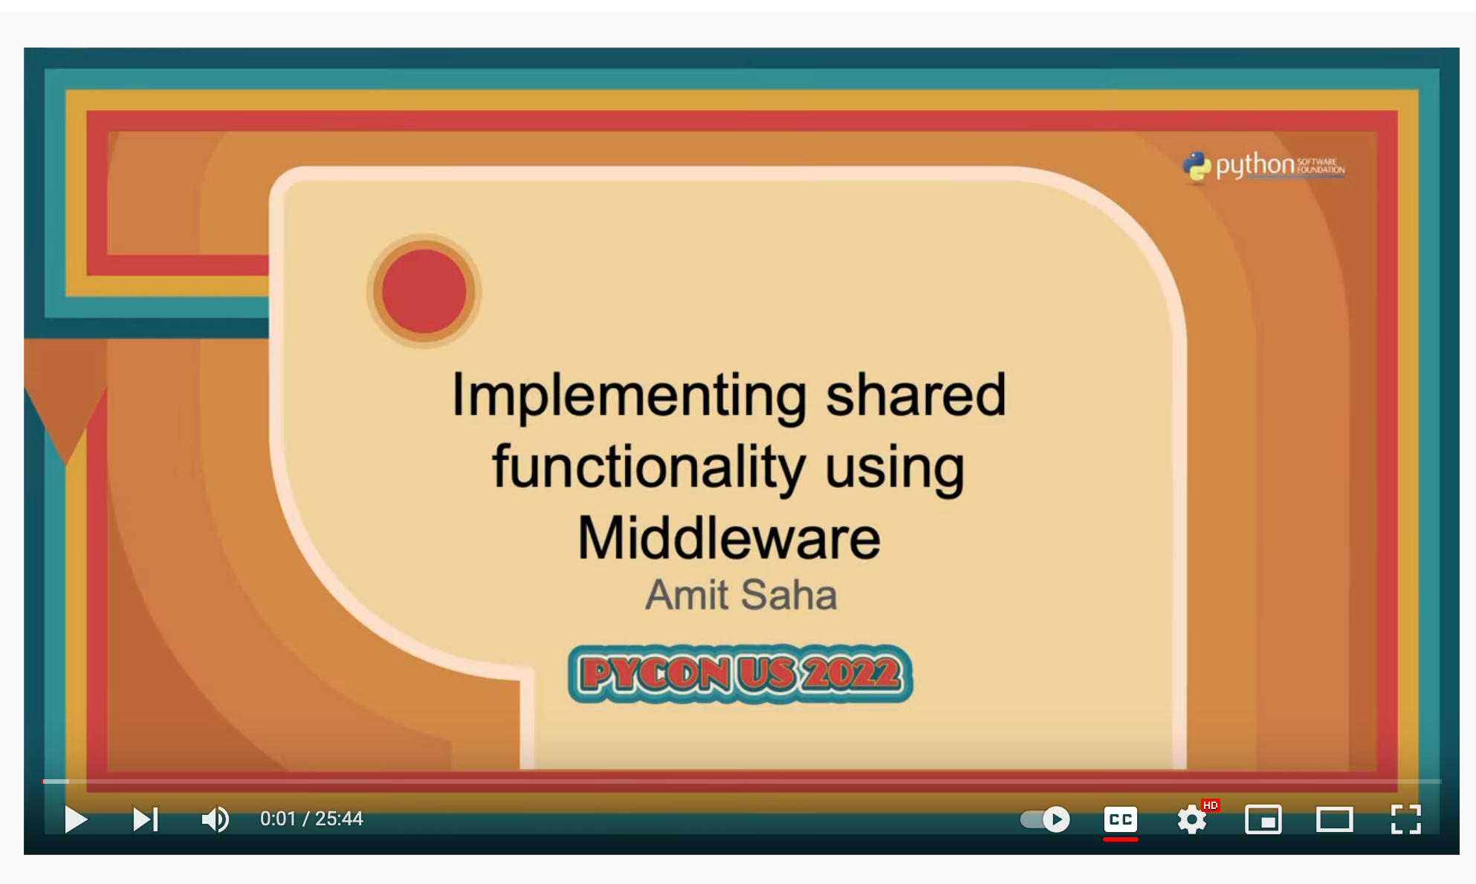
Check out my PyCon US 2022 Talk!
Using middleware to:
Migrate between WSGI frameworks
Migrate between WSGI and ASGI frameworks
More!
Notes:
Before we move onto gRPC applications, a shoutout to my own talk at PyCon US 2022 where I demonstrate how you can use middleware to help you migrate between WSGI frameworks or between ASGI and WSGI frameworks.

Slide 44
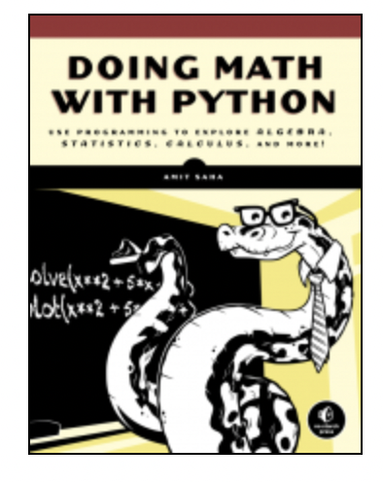
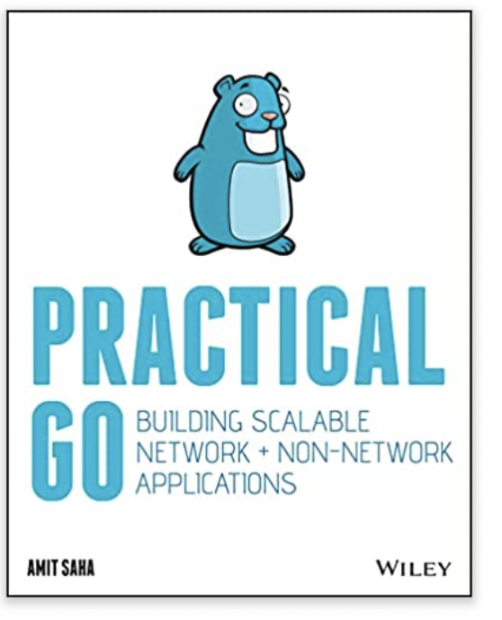
Thanks!
https://echorand.me
Check out my books!
Doing Math with Python: https://doingmathwithpython.github.io
Practical Go: https://practicalgobook.net
Notes:
I hope you have gained insights into the internals of middleware as they apply to WSGI, ASGI and gRPC applications and go away with a few new neural pathways formed in your brain. Thank you for coming to my talk. I hope you will check out my books and enjoy the rest of your conference!

