Slide 1

Implementing Shared Functionality using Middleware
Amit Saha
https://echorand.me
In your WSGI, ASGI and gRPC applications
Notes:
Hello everyone, welcome to my talk, “implementing shared functionality using middleware”. My name is Amit Saha and I work as a software engineer at Atlassian, in Sydney, Australia.
Like all of you, I love figuring out how things work and that brings me to the agenda for my presentation today.

Slide 2
Agenda
Middleware in Computing
WSGI Middleware
ASGI Middleware
gRPC Middleware
Notes:
Perhaps, you haven’t had the chance to yet peel the layers of the web frameworks you are using and really explore how middleware works. My goal in this talk is to take you through an exploration how middleware works in the context of web applications today. Preparing this talk was an insightful journey for me, full of ah ha moments – and I will hopefully reproduce it with high fidelity given the constraints of time.
We start with a very brief history of the origin of term middleware in computing, then we learn how middleware works in WSGI applications, followed by how middleware works in ASGI applications and finally gRPC applications.

Slide 3
Slides and Resources
https://echorand.me/talks/
Notes:
Let’s follow our curiosity!

Slide 4
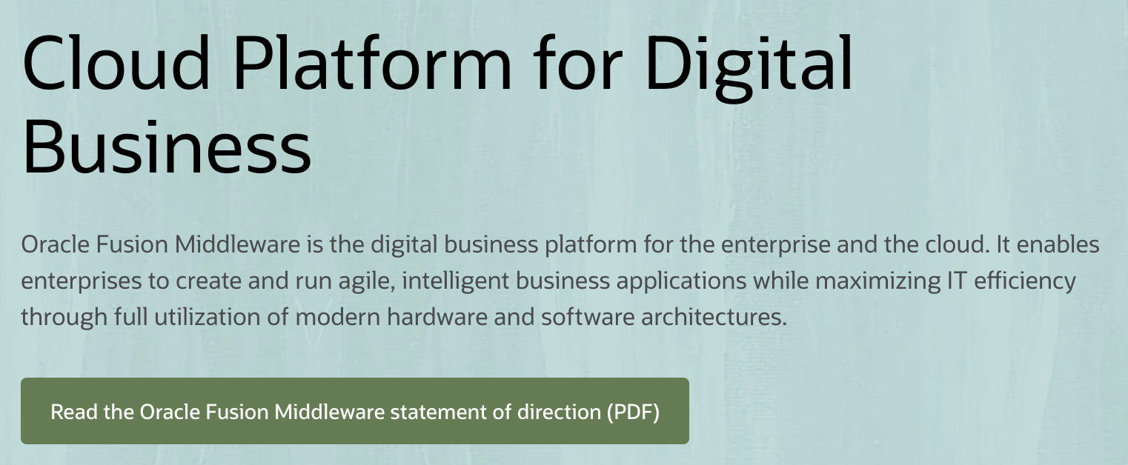
Origin of “middleware”
Usage in computing as early as 1968
“..middleware can be described as the dash ("-") in client-server, or the -to- in peer-to-peer.” –
Etzkorn, L. H. (2017). Introduction to Middleware: Web Services, Object Components, and Cloud Computing. CRC Press.
Notes:
Depending on the time you have spent in the software world, you may have heard of the term middleware outside of web applications. I remember getting free CDs for BEA Weblogic circa, early 2000s, didn’t do anything with them as far as I recall. The usage of the term can be found in computing as early as 1968. A book on the topic, describes middleware as the “-” in client-server or the –to- in peer-to-peer.
Of course, the term middleware is still in use today in that context, such as a product by Oracle, called Oracle Fusion Middleware

Slide 5
Key relevant ideas from back then
“Glue”
“interface between hardware and software”
IETF workshop in 2000: middleware as those services found above the transport layer .. but below the application environment..
Notes:
Although the usage of the term in the previous slide is quite far from what we will be discussing today, some key ideas from back then are relevant today I think. Sure, we are not going to talk about hardware today, but there is something that seems quite applicable to be when I discovered that middleware was referred to as “glue”, ”an interface between hardward and software” or “services sitting above the transport layer and below the application environment”.

Slide 6
Today’s working definition
PEP 333 – Python Web Server Gateway Interface v1.0
.. it is also possible to create “middleware” components that implement both sides of this specification.
..and can be used to provide extended APIs, content transformation, navigation, and other useful functions.
Notes:
Consider a web application consists of one or more API endpoints or views:
Middleware is code you write to implement functionality that is common across one or more endpoints or views
Count of page views
Error handling
Caching, and many others
The WSGI specification ..
This leads us to our second topic of the talk, middleware for WSGI applications.

Slide 7
Middleware for WSGI applications

Slide 8
A Flask Application
bp = Blueprint("blog", __name__)
@bp.route("/")
def index():
return render_template("blog/index.html", posts=posts)
Notes:
Consider a Flask application. Here I create a Blueprint, and then define a route. Of course, I have omittied a lot of the code that’s not relevant here. Simple. We will refer to the index() function as the view function, the one handling the application requests.

Slide 9
Flask middleware
@bp.before_request
def start_render_timer():
g.start_render = time.time()
@bp.after_request
def stop_render_timer(response):
print(f”latency:{time.time()-g.start_render} seconds")
return response
Notes:
This is how we define middleware for a Flask application, using the before_request and after_request decorators. When a function is decorated with the before_request decorator, it is called before a request is processed by the view function if one is defined. The after_request function is called after the request has been processed by the view function.
The same applies to non-Blueprint applications, by the way in case you are wondering.

Slide 10
(Optional) Before and After request functions
wsgi_app()
full_dispatch_request()
preprocess_request
before_request_funcs
(If none of the methods returns Non-None)
dispatch_request
finalize_request
make_response
process_response
after_request_funcs
Code snippets from flask source: src/flask/app.py

Slide 11
Multiple middleware in Flask
before_request_f1()
before_request_f2()
view_function
after_request_f1()
after_request_f2()
view_function
Request
Response
Notes:
The ordering specified middleware is significant. For Flask, the middleware defined via before_request are called in order. The middleware defined via after_request are called in reverse_order.

Slide 12
(Optional) Implementation of middleware in Flask
for before_func in self.before_request_funcs[name]:
rv = self.ensure_sync(before_func)()
if rv is not None:
return rv
for func in reversed(self.after_request_funcs[name]):
response = self.ensure_sync(func)(response)
Code snippets from flask source: src/flask/app.py

Slide 13
A Django Application: View function
def index(request):
return HttpResponse("Hello, world”)
Notes:
Let’s consider a Django view function. To define a middleware in Django, we can use a define a class or a function.

Slide 14
Django middleware – class based
class ExecHandlingMiddleware:
def __init__(self, get_response):
self.get_response = get_response
def __call__(self, request):
try:
return self.get_response(request)
except:
# return custom response
Notes:
A class based Middleware in Django looks as follows.
The key is the special __call__ method which takes one argument the current request being handled, this is exactly how the view function looks as well in the previous slide.
The get_response attribute points to the view function that will be called or another middleware to be called next.

Slide 15
Django middleware – function based
def latency_reporter(get_response):
def middleware(request):
request_begin = time.time()
response = get_response(request)
print(“Latency:f{time.time()-request_begin} seconds”)
return response
return middleware
Notes:
A function based middleware returns another function – a closure as shown in the example.

Slide 16
Activate middleware
# settings.py
MIDDLEWARE = [
'polls.latency_reporter.latency_reporter',
'polls.my_exc_handler.ExcHandlingMiddleware'
]
Notes:
Then, we activate it by including them via their path in settings.py. The ordering here matters, as does in the case of Flask applications.

Slide 17
Multiple middleware in Django
Middleware A
Middleware B
Application Handler
Request
Response
Notes:
For Django, the ordering of the elements in the list in the previous slide matters. For an incoming request, the first middleware is called before the next middleware before the view function is called. Once a response has been generated, the middleware defined are invoked in the reverse order.
One key difference betweek Flask and Django middleware is that in Flask, your middleware may not be invoked for both request and the response to the request where as in Django, a middleware is always invoked when the request is being sent to the view function and when the response is being sent back.

Slide 18
(Optional) Built-In Middleware
Cache middleware
GZip middleware
Message middleware
Security Middleware
https://docs.djangoproject.com/en/4.0/ref/middleware/

Slide 19
(Optional) Security Middleware
class SecurityMiddleware(MiddlewareMixin):
def __init__(self, get_response):
super().__init__(get_response)
def process_request(self, request):
# <code snipped>
def process_response(self, request, response):
response.headers["Strict-Transport-Security"] = sts_header
# <code snipped>
return response

Slide 20
Recap
Using middleware, you define custom code to run before and after request processing
WSGI Frameworks define their own mechanism to define middleware
Notes:
How the middleware works is a framework specific detail which usually you can find out by looking up the framework’s source code. I would have loved to include it today, but time constraints!

Slide 21
Pause
Notes:
As we have just seen, the way we write a middleware for Flask is different from Django. Could we write middleware in a framework independent way? It turns out we can. These are WSGI frameworks, which means they define WSGI applications..and there lies the answer as we shall see next.

Slide 22
A WSGI application
def simple_handler(environ, start_response):
# ..
start_response(status, headers)
ret = [b'Hello world\n’]
return ret
Notes:
I want to start by taking a step back. Irrespective of which WSGI framework you are using, somewhere hidden underneath there is a function like this defined which kickstarts everything in your application. This is an WSGI application.
And this function signature is going to be the key for us to better understand WSGI middleware. You can ignore everything for this part of this talk, except for the function signature.
environ is a dictionary containing various key value pairs describing the current request. And start_response is a function that is used to send back a response to the client.

Slide 23
A WSGI middleware
class MyExceptionProcessor:
def __init__(self, wsgi_app):
self.wsgi_app = wsgi_app
def __call__(self, environ, start_response):
try:
return self.wsgi_app(environ, start_response)
except Exception as e:
start_response(status, headers)
return [b'An error occured!\n']

Slide 24
WSGI application with middleware
app = MyExceptionProcessor(simple_handler)
$ gunicorn app:app
[2022-04-26 09:40:27 +1000] [72117] [INFO] Starting gunicorn 20.1.0
[2022-04-26 09:40:27 +1000] [72117] [INFO] Listening at: http://127.0.0.1:8000 (72117)
[2022-04-26 09:40:27 +1000] [72117] [INFO] Using worker: sync
[2022-04-26 09:40:27 +1000] [72119] [INFO] Booting worker with pid: 72119
Notes:
I am going to refer to this as the wrapping technique of defining middleware for WSGI applications

Slide 25
Pause
Notes:
Frameworks implement their own mechanisms to define middleware, WSGI middleware = Another WSGI application, So that means if we implement a functionality using WSGI middleware, they are framework independent, let’s see how they work.

Slide 26
OpenTelemetry WSGI Middleware
class OpenTelemetryMiddleware:
def __init__(self, wsgi):
self.wsgi = wsgi
# other things
def __call__(self, environ, start_response):
try:
iterable = self.wsgi(environ, start_response)
except Exception as ex:
# do other stuff
https://opentelemetry-python-contrib.readthedocs.io/en/latest/instrumentation/wsgi/wsgi.html

Slide 27
Flask + WSGI Middleware
from opentelemetry.instrumentation.wsgi \
import OpenTelemetryMiddleware
app = Flask(__name__)
app.wsgi_app = OpenTelemetryMiddleware(app.wsgi_app)
Notes:
def wsgi_app(self, environ, start_response) -> t.Any:

Slide 28
Django + WSGI Middleware
# wsgi.py
from opentelemetry.instrumentation.wsgi \
import OpenTelemetryMiddleware
application = get_wsgi_application()
application = OpenTelemetryMiddleware(application)
Notes:
def wsgi_app(self, environ, start_response) -> t.Any:

Slide 29
Pause
Notes:
We saw that a middleware, the OpenTelemetry middleware is an WSGI middleware. And since it is written as an WSGI middleware, we can use the same middleware for both Flask and Django applications by wrapping the original WSGI application inside the OpenTelemetry middlewae. That sounds like a win, right? I am not sure if there are any pitfalls to doing that though.

Slide 30

Middleware for wrapping another WSGI application
You have a Django application, and moving some views to a Flask backend
Write a middleware to include the Django app inside your Flask app
Notes:
We can use the same technique of wrapping an WSGI application inside other to help in scenarios such as framework migration. For example, say you have a Django application – you are migrating some views to Flask. What you can do is, write a middleware to embed the Django application inside the Flask application. Let’s see how.

Slide 31
Wrapper Middleware
class FlaskAppWrapper(object):
def __call__(self, environ, start_response):
data = flask_app.app.wsgi_app(
environ, start_response
)
if not self.status.startswith('404'):
return data
return self.wsgi_app(environ, start_response)
Notes:
We define a class FlaskAppWrapper, I have omitted the constructor here for brevity.
Flask_app refers to the Flask application. We first invoke the flask WSGI application to process the current request. If we get any response status other than a 404, we return the response.
If however, we get a 404 response indicating there is no registered view function for a particular request path, we then invoke the Django application which is referred to by the self.wsgi_app attribute.

Slide 32
Wrapping Django Application
# wsgi.py
application = get_wsgi_application()
application = FlaskAppWrapper(application)
Notes:
Then, we update the wsgi.py module of the Django application to define the module level application variable as shown.

Slide 33
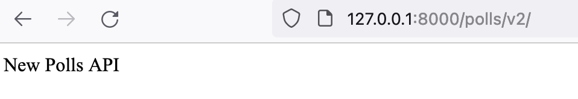
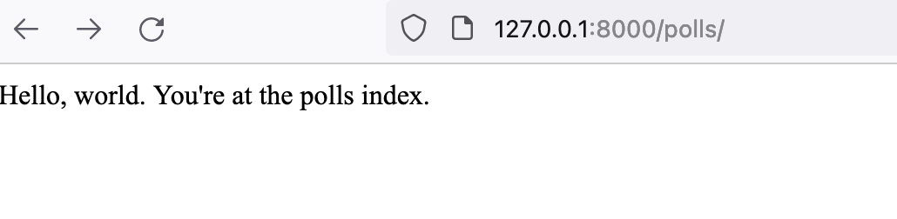
Wrapping a WSGI application
Flask
Django
Notes:
The result looks as follows.

Slide 34
Recap
Flask and Django implement custom mechanisms to allow users to define middleware
WSGI middleware is framework agnostic
Use the wrapping technique to include WSGI middleware
Notes:
WSGI frameworks such as Django and Flask define custom mechanisms for defining middleware. You can also however write a middleware as an WSGI application and then wrap your WSGI application inside it. That middleware you wrote is framework independent. However, I haven’t fully explored if there are potential problems or limitations with that approach.

Slide 35
Middleware for ASGI applications
Notes:
Next, we are going to take a look at middleware for ASGI applications.

Slide 36
An ASGI HTTP application
async def simple_handler(scope, receive, send):
request = await receive()
await send({
'type': 'http.response.start',
'status': 200,
'headers’: [..]
})
await send({
'type': 'http.response.body',
'body': b'Hello, world!',
})
Notes:
Once again, remember this is the foundation for FastAPI or Starlette or any ASGI frameworks, so I want you to keep the function signature in mind here.

Slide 37
An ASGI Middleware
class RateLimiter(object):
def __init__(self, asgi_app):
self.asgi_app = asgi_app
async def __call__(self, scope, receive, send):
if self.allowed(scope):
await self.asgi_app(scope, receive, send)
else:
# Send custom response

Slide 38
ASGI application with middleware
app = RateLimiter(simple_handler)
$ gunicorn app:app --worker-class uvicorn.workers.UvicornWorker
2022-04-26 13:04:14 +1000] [74357] [INFO] Starting gunicorn 20.1.0
[2022-04-26 13:04:14 +1000] [74357] [INFO] Listening at: http://0.0.0.0:8000 (74357)
[2022-04-26 13:04:14 +1000] [74357] [INFO] Using worker: uvicorn.workers.UvicornWorker

Slide 39
A FastAPI application
app = FastAPI()
@app.get("/expensive")
async def root():
await asyncio.sleep(10)
return {"message": "Expensive calculation completed"}

Slide 40
Using ASGI Middleware
class ExpensiveCache:
def __init__(self, app, excluded_paths):
# initialization
async def __call__(self, scope, receive, send):
if cache_hit:
# send cached response
await self.app(scope, receive, cache_and_send)

Slide 41
Adding the Middleware
app = FastAPI()
app.add_middleware(
ExpensiveCache,
excluded_paths=["/chat"]
)

Slide 42
ASGI Middleware and WebSocket
class RequestTimer:
async def __call__(self, scope, receive, send):
await self.app(scope, receive, send)
# print(“latency...”)
http:/chat: Got request.
http: /chat: Finished request. 0.001107931137084961s.
websocket:/ws: Got request.
..
websocket: /ws: Finished request. 28.716175079345703s.
Notes:
Scope lasts for the lifetime of the connection

Slide 43
FastAPI/Starlette specific approach
@app.middleware("http")
async def exc_handler(request: Request, call_next):
try:
return await call_next(request)
except Exception as e:
return HTMLResponse(
'An error occured!’,
status_code=500,
headers={'x-exception-handled': 'application'}
)
Notes:
Instead of defining a middleware as an ASGI middleware, you could also use the FastAPI/Starlette specific approach of using the app.middleware decorator.

Slide 44
Framework Implementation
# starlette/middleware/base.py
def middleware(self, middleware_type):
def decorator(func):
self.add_middleware(BaseHTTPMiddleware, dispatch=func)
return func
return decorator
Notes:
BaseHTTPMiddleware defined in starlette, is an ASGI middleware which calls the function you specified.

Slide 45
Pause
Notes:
ASGI middleware is an ASGI application, ASGI middleware is framework independent. An ASGI middleware supports HTTP and WebSockets.
Let’s go back to our migration story again, say you want to serve requests to your existing WSGI application from your ASGI application while you add new functionality in your ASGI application. What can you do?

Slide 46
Integrate a WSGI application
$ curl localhost:8000/v1/
Hello world from Flask!
$ curl localhost:8000/v2/
{"message":"Hello from FastAPI"}
from fastapi.middleware.wsgi \
import WSGIMiddleware
app = FastAPI()
app.mount("/v1", WSGIMiddleware(flask_app))
Notes:
We can use the WSGIMidleware to associate a path to an WSGI application as shown in the example.

Slide 47
WSGIMiddleware Implementation
# starlette/middleware/wsgi.py
class WSGIMiddleware:
def __init__(self, app):
self.app = app
async def __call__(self, scope, receive, send):
responder = WSGIResponder(self.app, scope)
await responder(receive, send)
Notes:
# WSGIResponder class
def wsgi(self, environ, start_response):
for chunk in self.app(environ, start_response):
# Send response

Slide 48
Recap
ASGI middleware is framework agnostic
FastAPI has helper methods to add ASGI middleware
WSGIMiddleware allows you to forward requests to an WSGI application

Slide 49
Key takeaways
Can be defined generally as an WSGI or ASGI application or be framework specific
01
Code that’s acting as both a client and a server
02
Enables decoupling and sharing of non-functional requirements
03
Notes:
Key takeaways
Client for another middleware or your application
Server for an external request or another middleware
Migration between application frameworks/versions WSGI or ASGI

Slide 50
Exercise!
Check out the source code of the built-in and community middleware in Flask, Django and FastAPI!

Slide 51
Interceptors for gRPC applications

Slide 52
gRPC Applications
Unary-Unary
One request, one response (Protobuf message)
Bidirectional streaming
One or more requests and responses (Protobuf messages)
Think of it like a WebSocket connection

Slide 53
Unary-Unary gRPC Applications

Slide 54
A gRPC server
class Identity(identity_pb2_grpc.IdentityServicer):
def ValidateToken(self, request, context):
user_details = identity_pb2.ValidateTokenReply(user_id="default-user-id")
return user_details
def serve(app_config: dict):
server = grpc.server(
futures.ThreadPoolExecutor(max_workers=10),
)
identity_pb2_grpc.add_IdentityServicer_to_server(
Identity(), server,
)
# ..

Slide 55
A logging interceptor
import grpc
class LoggingInterceptor(grpc.ServerInterceptor):
def __init__(self):
pass
def intercept_service(self, continuation, handler_call_details):
print(handler_call_details.method, handler_call_details.invocation_metadata)
return continuation(handler_call_details)

Slide 56
Integrating the interceptor(s)
def serve(app_config: dict):
server = grpc.server(
futures.ThreadPoolExecutor(max_workers=10),
interceptors = (LoggingInterceptor(),)
)
# .. Rest of the server
Server logs
/Identity/ValidateToken (_Metadatum(‘grpc-python/1.48.0 grpc-c/26.0.0 (osx; chttp2)'),)

Slide 57
A gRPC Client
import grpc
import identity_pb2
import identity_pb2_grpc
def run():
channel_credentials = grpc.ssl_channel_credentials(server_cert)
with grpc.secure_channel('localhost:50051', channel_credentials) as channel:
stub = identity_pb2_grpc.IdentityStub(channel)
response = stub.ValidateToken(
identity_pb2.ValidateTokenRequest(token="a-token")
)
print("Reply:", response.user_id)

Slide 58
A logging interceptor
import grpc
class LoggingClientInterceptor(grpc.UnaryUnaryClientInterceptor):
def intercept_unary_unary(self, continuation, client_call_details, request):
print("Call details", client_call_details)
response = continuation(client_call_details, request)
return response

Slide 59
Integrating the interceptor(s)
import logging_client_interceptor
def run():
with grpc.secure_channel('localhost:50051', channel_credentials) as channel:
intercepted_channel = grpc.intercept_channel(
channel,
logging_client_interceptor.LoggingClientInterceptor()
)
stub = identity_pb2_grpc.IdentityStub(intercepted_channel)
# .. Rest of client

Slide 60
Bidi-streaming gRPC Applications

Slide 61
A bidi streaming RPC method
class Identity(identity_pb2_grpc.IdentityServicer):
def ExpireToken(self, request_iterator, context):
for r in request_iterator:
yield identity_pb2.ExpireTokenReply(result=True)

Slide 62
A logging interceptor
class LoggingInterceptor(grpc.ServerInterceptor):
def intercept_service(self, continuation, handler_call_details):
def logging_wrapper(behavior, request_streaming, response_streaming):
def logging_interceptor(request_or_iterator, context):
# More stuff
if request_streaming or response_streaming:
return self._intercept_server_stream(
behavior,
request_or_iterator,
context,
)
return behavior(request_or_iterator, context)
# More stuff
Called once when the stream is created
Unary-Unary RPC methods

Slide 63
def _intercept_server_stream(
self, behavior, request_or_iterator, context
):
def wrapd(behavior, request_or_iterator, context):
for r in request_or_iterator:
print("Processing stream message", r)
resp = behavior(list([r]), context)
yield from resp
This loop is executed for every message exchanged during the stream session

Slide 64
Server logs
/Identity/ExpireToken (_Metadatum(key='user-agent’, ..(osx; chttp2)'),)
Processing stream message token: "a-token"
Processing stream message token: "b-token"
Processing stream message token: "c-token"
Stream duration: 3.0171940326690674 seconds

Slide 65
Logging client-side interceptor
class LoggingClientInterceptor(grpc.UnaryUnaryClientInterceptor,
grpc.StreamStreamClientInterceptor):
# def intercept_unary_unary(self, continuation, client_call_details, request):
# def intercept_stream_stream(self, continuation, client_call_details, request_iterator)

Slide 66
Logging client-side interceptor
def intercept_stream_stream(self, continuation, client_call_details, request_iterator):
response_it = continuation(
client_call_details,
self._intercept_request_stream_msg(request_iterator)
)
yield from self._intercept_response_stream_msg(response_it)
stream_duration = time.time() - self.stream_started
print("Stream duration: {0} seconds".format(stream_duration))

Slide 67
Logging client-side interceptor
def _intercept_request_stream_msg(self, request_iterator):
for r in request_iterator:
print("Streaming request")
yield r
def _intercept_response_stream_msg(self, response_iterator):
for r in response_iterator:
print("Streaming response")
yield r

Slide 68
Client side logs
Call details _ClientCallDetails(method='/Identity/ExpireToken’..)
Streaming request
Streaming response
Streaming request
Streaming response
Streaming request
Streaming response
3.0214710235595703

Slide 69
Key takeaways
Can be defined generally as an WSGI or ASGI application or be framework specific
01
Code that’s acting as both a client and a server
02
Enables decoupling and sharing of non-functional requirements
03
Notes:
Key takeaways
Client for another middleware or your application
Server for an external request or another middleware
Migration between application frameworks/versions WSGI or ASGI

Slide 70
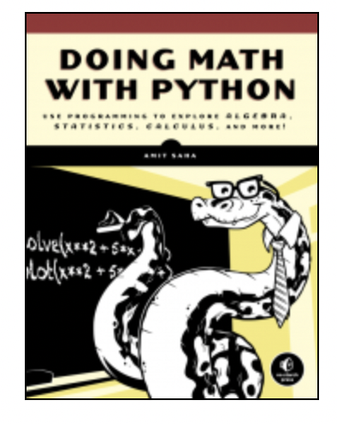
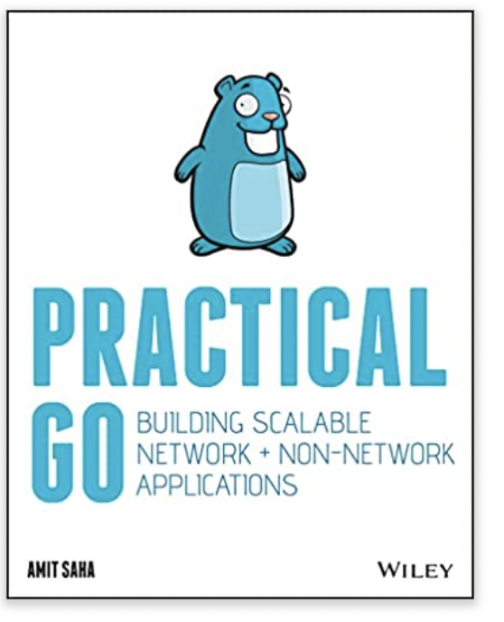
Thanks!
https://echorand.me
mail@echorand.me
Check out my books!
Practical Go: https://practicalgobook.net
Doing Math with Python: https://doingmathwithpython.github.io
Notes:
I hope you have gained insights into the internals of middleware as they apply to WSGI and ASGI applications and go away with a few new neural pathways formed in your brain. Thank you for coming to my talk. I hope you will check out my books and enjoy the rest of your conference!

