Slide 1

Shared Functionality using Middleware
Amit Saha
https://echorand.me
In your WSGI and ASGI applications
Notes:
Hello everyone, welcome to my talk, “shared functionality using middleware”. My name is Amit Saha and I work as a software engineer at Atlassian, in Sydney, Australia. It’s been a long journey, literally and metaphorically. I am super excited to be here standing infront of you all to share my learnings! This is the most excited I have ever been to be presenting at a conference, and I am not sure who is winning – my excitement or my anxiety.
Like all of you, I love figuring out how things work and that brings me to the agenda for my presentation.

Slide 2
Agenda
Middleware in Computing
WSGI Middleware
ASGI Middleware
Notes:
Like me, you are here because you are curious. Perhaps, you haven’t had the chance to yet peel the layers of the web frameworks you are using and really explore how middleware works. My goal in this talk is to take you through an exploration how middleware works in the context of web applications today. I welcome you to join me as I take you through this what was for me an insightful journey full of ah ha moments – hopefully reproduced with high fidelity.
We start with a very brief history of the origin of term middleware in computing, then we learn how middleware works in WSGI applications, followed by how middleware works in ASGI applications.

Slide 3
Slides and Resources
https://echorand.me/talks/

Slide 4
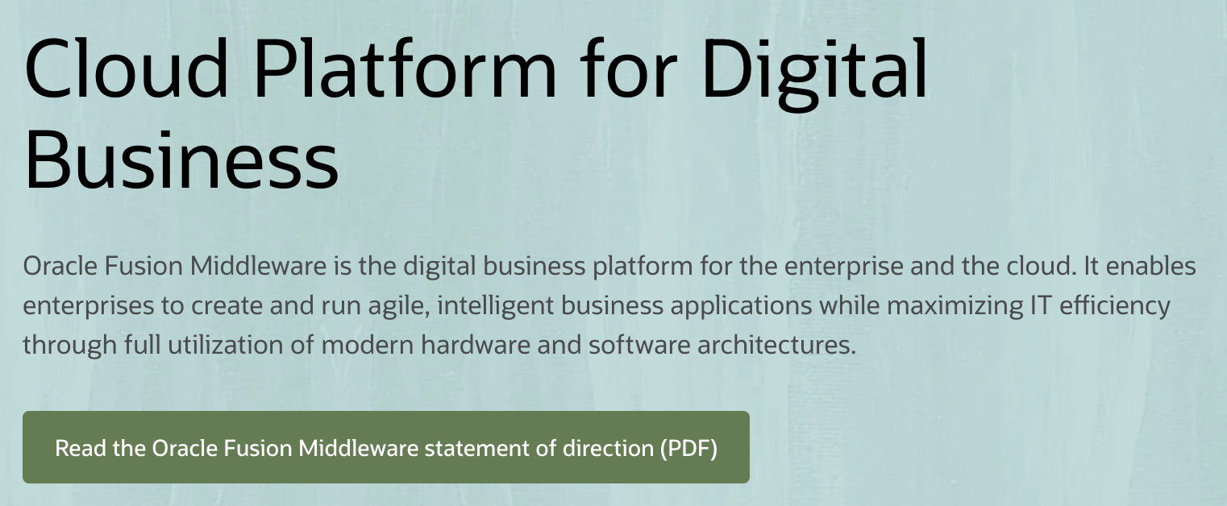
What is Middleware?
Usage in computing as early as 1968
“..middleware can be described as the dash ("-") in client-server, or the -to- in peer-to-peer.” –
Etzkorn, L. H. (2017). Introduction to Middleware: Web Services, Object Components, and Cloud Computing. CRC Press.
Notes:
Depending on the time you have spent in the software world, you may have heard of the term middleware outside of web applications. I remember getting free CDs for BEA Weblogic circa, early 2000s, didn’t do anything with them as far as I recall. The usage of the term can be found ..

Slide 5
Key relevant ideas from back then
“Glue”
“interface between hardware and software”
IETF workshop in 2000: middleware as those services found above the transport layer .. but below the application environment..

Slide 6
Today’s working definition(s)
“..As such, other functions or classes can wrap around your web application object and do other things before and/or after your web application gets called.
That’s really all WSGI middleware is.”
https://web.archive.org/web/20191008011715/https://be.groovie.org/2005/10/07/wsgi_and_wsgi_middleware_is_easy.html

Slide 7
Today’s working definition
In addition to “pure” servers/gateways and applications/frameworks, it is also possible to create “middleware” components that implement both sides of this specification.
..and can be used to provide extended APIs, content transformation, navigation, and other useful functions.
PEP 333 – Python Web Server Gateway Interface v1.0
Notes:
Considering a web application consists of one or more API endpoints or views:
Middleware is code you write to implement functionality that is common across one or more endpoints or views
Count of page views
Error handling
Caching, and many others

Slide 8
Middleware for WSGI applications

Slide 9
A WSGI application
def simple_handler(environ, start_response):
# ..
start_response(status, headers)
ret = [b'Hello world\n’]
return ret
Notes:
Irrespective of which WSGI framework you are using, somewhere hidden underneath there is a function like this defined which kickstarts everything in your application. And this function signature is going to be the key for us to better understand WSGI middleware, so you can ignore everything for this part of this talk, except for the function signature.

Slide 10
A WSGI middleware
class MyExceptionProcessor:
def __init__(self, wsgi_app):
self.wsgi_app = wsgi_app
def __call__(self, environ, start_response):
try:
return self.wsgi_app(environ, start_response)
except Exception as e:
start_response(status, headers)
return [b'An error occured!\n']

Slide 11
WSGI application with middleware
app = MyExceptionProcessor(simple_handler)
$ gunicorn app:app
[2022-04-26 09:40:27 +1000] [72117] [INFO] Starting gunicorn 20.1.0
[2022-04-26 09:40:27 +1000] [72117] [INFO] Listening at: http://127.0.0.1:8000 (72117)
[2022-04-26 09:40:27 +1000] [72117] [INFO] Using worker: sync
[2022-04-26 09:40:27 +1000] [72119] [INFO] Booting worker with pid: 72119

Slide 12
Response showing the processed exception
$ curl -v http://localhost:8000
..
< HTTP/1.0 500 Something Went Wrong
..
< X-Error-Processed: Handled
<
An error occured!

Slide 13
Request and Response Flow
WSGI server gets request
MyExceptionProcessor
simple_handler()
Request
Response

Slide 14
Flask applications

Slide 15
A Flask Application
bp = Blueprint("blog", __name__)
@bp.route("/")
def index():
return render_template("blog/index.html", posts=posts)

Slide 16
Defining Middleware - Pattern 1
@bp.before_request
def start_render_timer():
g.start_render = time.time()
@bp.after_request
def stop_render_timer(response):
print(f”latency:{time.time()-g.start_render} seconds")
return response

Slide 17
Order of Execution
for before_func in self.before_request_funcs[name]:
rv = self.ensure_sync(before_func)()
if rv is not None:
return rv
for func in reversed(self.after_request_funcs[name]):
response = self.ensure_sync(func)(response)
Code snippets from flask source: src/flask/app.py

Slide 18
Before and After request functions
wsgi_app()
full_dispatch_request()
preprocess_request
before_request_funcs
(If none of the methods returns Non-None)
dispatch_request
finalize_request
make_response
process_response
after_request_funcs
Code snippets from flask source: src/flask/app.py

Slide 19
Defining Middleware - Pattern 2
from opentelemetry.instrumentation.wsgi \
import OpenTelemetryMiddleware
app = Flask(__name__)
app.wsgi_app = OpenTelemetryMiddleware(app.wsgi_app)
Notes:
def wsgi_app(self, environ, start_response) -> t.Any:

Slide 20
Open Telemetry Middleware
class OpenTelemetryMiddleware:
def __init__(self, wsgi):
self.wsgi = wsgi
# other things
def __call__(self, environ, start_response):
try:
iterable = self.wsgi(environ, start_response)
except Exception as ex:
pass
https://opentelemetry-python-contrib.readthedocs.io/en/latest/instrumentation/flask/flask.html

Slide 21
Django applications

Slide 22
A Django Application: View function
def index(request):
return HttpResponse("Hello, world”)

Slide 23
Defining Middleware – Pattern 1
class ExcHandlingMiddleware:
def __init__(self, get_response):
self.get_response = get_response
def __call__(self, request):
response = self.get_response(request)
return response

Slide 24
Defining Middleware – Pattern 2
def latency_reporter(get_response):
def middleware(request):
request_begin = time.time()
response = get_response(request)
return response
return middleware

Slide 25
Activate middleware
# settings.py
MIDDLEWARE = [
'polls.latency_reporter.latency_reporter',
'polls.my_exc_handler.ExcHandlingMiddleware'
]

Slide 26
Request and Response Flow with multiple middleware
Middleware A
Middleware B
Application Handler
Request
Response

Slide 27
Order of middleware execution
latency_reporter: Calling next view
exc handler: Calling next view
index view: inside application handler
Got exception: division by zero when processing <WSGIRequest: GET '/polls/’>
exc handler: back from view
latency_reporter: back from view
Request<WSGIRequest: GET '/polls/'> took 0.0006771087646484375 seconds
[20/Apr/2022 21:48:27] "GET /polls/ HTTP/1.1" 200 21

Slide 28
Built-In Middleware
Cache middleware
GZip middleware
Message middleware
Security Middleware
https://docs.djangoproject.com/en/4.0/ref/middleware/

Slide 29
Security Middleware
class SecurityMiddleware(MiddlewareMixin):
def __init__(self, get_response):
super().__init__(get_response)
def process_request(self, request):
# <code snipped>
def process_response(self, request, response):
# <code snipped>
response.headers["Strict-Transport-Security"] = sts_header
# <code snipped>
return response
django/middleware/security.py

Slide 30

Middleware for wrapping another WSGI application
You have a Django application, and moving some views to a Flask backend
Write a middleware to include the Django app inside your Flask app

Slide 31
Flask V2 Application
app = Flask(__name__)
@app.route("/polls/v2/")
def new_polls_api():
return "New Polls API", 200

Slide 32
Wrapper Middleware
class FlaskAppWrapper(object):
def __call__(self, environ, start_response):
data = flask_app.app.wsgi_app(
environ, start_response
)
if not self.status.startswith('404'):
return data
return self.wsgi_app(environ, start_response)

Slide 33
Wrapping Django Application
# wsgi.py
application = get_wsgi_application()
application = FlaskAppWrapper(application)

Slide 34
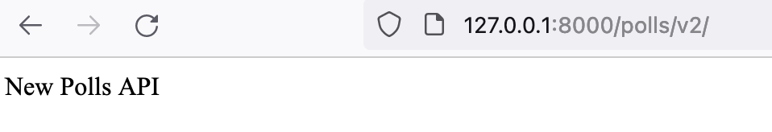
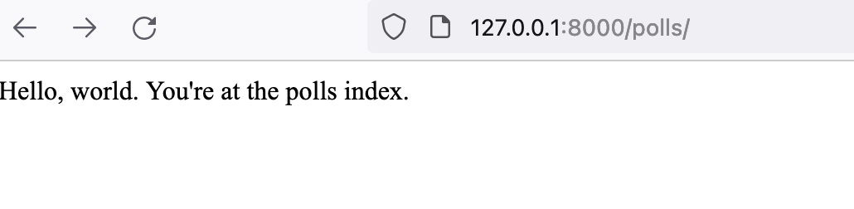
Wrapping a WSGI application
Handled by Flask application
Handled by Django application

Slide 35
Middleware for ASGI applications

Slide 36
ASGI HTTP application
async def simple_handler(scope, receive, send):
request = await receive()
await send({
'type': 'http.response.start',
'status': 200,
'headers’: [..]
})
await send({
'type': 'http.response.body',
'body': b'Hello, world!',
})
Notes:
Once again, remember this is the foundation for FastAPI or Starlette or any ASGI frameworks, so I want you to keep the function signature in mind here.

Slide 37
Defining Middleware – Pattern 1
class RateLimiter(object):
def __init__(self, asgi_app):
self.asgi_app = asgi_app
async def __call__(self, scope, receive, send):
if self.allowed(scope):
await self.asgi_app(scope, receive, send)
else:
# Send custom response

Slide 38
Defining Middleware – Pattern 2
async def exc_handler(handler, scope, receive, send):
try:
await handler(scope, receive, send)
except Exception as e:
# Send custom response

Slide 39
ASGI application with middleware
app = RateLimiter(simple_handler)
$ gunicorn app:app --worker-class uvicorn.workers.UvicornWorker
2022-04-26 13:04:14 +1000] [74357] [INFO] Starting gunicorn 20.1.0
[2022-04-26 13:04:14 +1000] [74357] [INFO] Listening at: http://0.0.0.0:8000 (74357)
[2022-04-26 13:04:14 +1000] [74357] [INFO] Using worker: uvicorn.workers.UvicornWorker

Slide 40
FastAPI applications

Slide 41
A FastAPI application
app = FastAPI()
@app.get("/expensive")
async def root():
await asyncio.sleep(10)
return {"message": "Expensive calculation completed"}

Slide 42
Middleware Pattern 1 – ASGI Middleware
class ExpensiveCache:
def __init__(self, app, excluded_paths):
# initialization
async def __call__(self, scope, receive, send):
if cache_hit:
# send cached response
await self.app(scope, receive, cache_and_send)

Slide 43
Adding the Middleware
app = FastAPI()
app.add_middleware(ExpensiveCache, excluded_paths=["/chat"])

Slide 44
Middleware Pattern 2 – FastAPI/Starlette
@app.middleware("http")
async def exc_handler(request: Request, call_next):
try:
return await call_next(request)
except Exception as e:
return HTMLResponse(
'An error occured!’,
status_code=500,
headers={'x-exception-handled': 'application'}
)

Slide 45
Middleware Pattern 2 Implementation
def middleware(self, middleware_type):
def decorator(func):
self.add_middleware(BaseHTTPMiddleware, dispatch=func)
return func
return decorator
starlette/middleware/base.py
Notes:
BaseHTTPMiddleware defined in starlette, is an ASGI middleware which calls the function you specified.

Slide 46
Middleware Pattern 2 Implementation
class BaseHTTPMiddleware:
def __init__(self, app ..):
self.app = app
async def __call__(self, scope: Scope, receive: Receive, send: Send) -> None:
# ..
response = await self.dispatch_func(request, call_next)
starlette/middleware/base.py

Slide 47
Built-in Middleware
HTTPSRedirectMiddleware
TrustedHostMiddleware
GZipMiddleware
https://fastapi.tiangolo.com/advanced/middleware/

Slide 48
class HTTPSRedirectMiddleware:
def __init__(self, app: ASGIApp) -> None:
self.app = app
async def __call__(self, scope: Scope, receive: Receive, send: Send) -> None:
if scope["type"] in ("http", "websocket") and scope["scheme"] in ("http", "ws"):
url = URL(scope=scope)
redirect_scheme = {"http": "https", "ws": "wss"}[url.scheme]
netloc = url.hostname if url.port in (80, 443) else url.netloc
url = url.replace(scheme=redirect_scheme, netloc=netloc)
response = RedirectResponse(url, status_code=307)
await response(scope, receive, send)
else:
await self.app(scope, receive, send)
starlette/middleware/httpsredirect.py

Slide 49
A FastAPI WebSocket backend
@app.websocket("/ws")
async def websocket_endpoint(websocket: WebSocket):
await websocket.accept()
try:
while True:
data = await websocket.receive_text()
await websocket.send_text(f"Message text was: {data}")
except WebSocketDisconnect as e:
print("WebSocketDisconnect: ", e)

Slide 50
Middleware and WebSocket
class RequestTimer:
async def __call__(self, scope, receive, send):
await self.app(scope, receive, send)
# print(“latency...”)
http:/chat: Got request.
http: /chat: Finished request. 0.001107931137084961s.
websocket:/ws: Got request.
..
websocket: /ws: Finished request. 28.716175079345703s.
Notes:
Scope lasts for the lifetime of the connection

Slide 51
Integrate a WSGI application
from fastapi.middleware.wsgi \
import WSGIMiddleware
flask_app = Flask(__name__)
# Define flask routes
app = FastAPI()
# Define FastAPI routes
app.mount("/v1", WSGIMiddleware(flask_app))
$ curl localhost:8000/v1/
Hello world from Flask!
$ curl localhost:8000/v2/
{"message":"Hello from FastAPI"}

Slide 52
WSGIMiddleware Implementation
class WSGIMiddleware:
def __init__(self, app):
self.app = app
async def __call__(self, scope, receive, send):
responder = WSGIResponder(self.app, scope)
await responder(receive, send)
starlette/middleware/wsgi.py
Notes:
# WSGIResponder class
def wsgi(self, environ, start_response):
for chunk in self.app(environ, start_response):
# Send response

Slide 53
Summary

Slide 54
Key takeaways
A middleware is a web application – WSGI or ASGI
01
Code that’s acting as both a client and a server
02
Enables decoupling and sharing of non-functional requirements
03
Notes:
Client for another middleware or your application
Server for an external request or another middleware

Slide 55
Exercise!
Check out the source code of the built-in middleware in Flask, Django and FastAPI

Slide 56
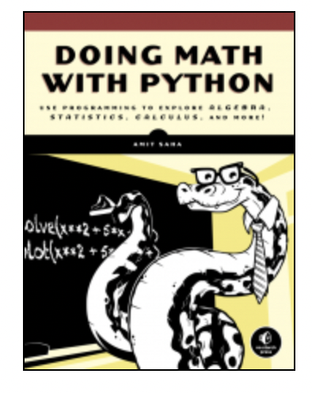
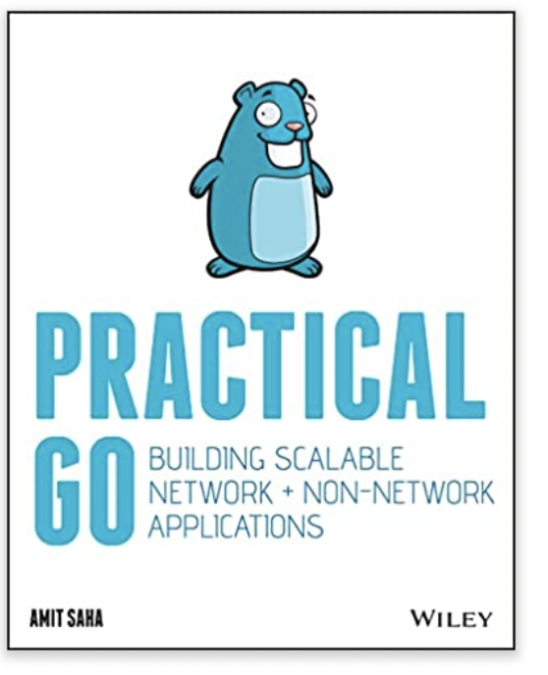
Thanks, Contact and Self Promotion
https://echorand.me
mail@echorand.me
Check out my books!
Practical Go: https://practicalgobook.net
Doing Math with Python: https://doingmathwithpython.github.io
Notes:
I hope you have gained insights into the internals of middleware as they apply to WSGI and ASGI applications and go away with a few new neural pathways formed in your brain. Thank you for coming to my talk. I hope you will check out my books and enjoy the rest of your conference!

