Slide 1

Lecture 3 Coordinate Geometry

Slide 2

Outlines
What the coordinate system (x,y)
What is the gradient of two points
What is the gradient of straight line
What are the equations of straight line

Slide 3
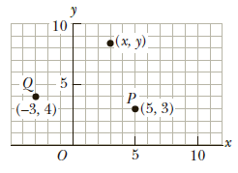
Coordinate Systems
A fixed reference point O, called the origin.
A set of specified axes, or directions, with an appropriate scale and labels on the axes.

Slide 4
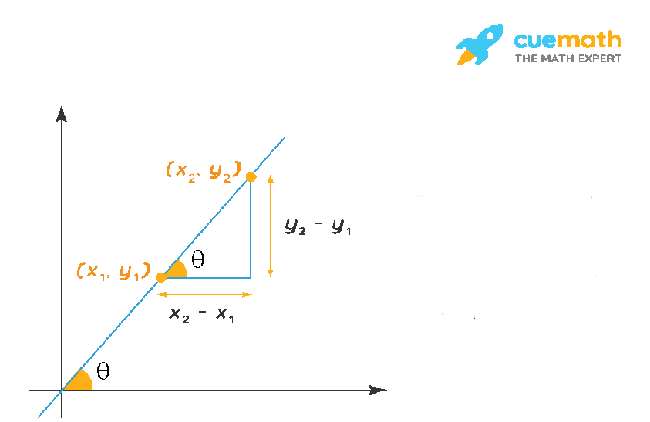

What is the gradient of two points?
Consider the two points (x₁,y₁) and (x₂,y₂) on the line.
The slope of the nonvertical line passing through (x₁,y₁) and (x₂,y₂) is
Slope = m = $\frac{y_{2 } − y_{1}}{x_{1}− x_{2}}$

Slide 5

Example
Find the slope of line that path through two point (2,3), (1,-4)
Solution:
(x₁,y₁) = (2,3), (x₂,y₂) = (1,-4)
Slope = m = $\frac{y_{2 } − y_{1}}{x_{2}− x_{1}}$
m = $\frac{−4−3}{1−2}$ = 7

Slide 6
Class work
Find the slope of line that path through two point (-3.0), (-1,6)

Slide 7
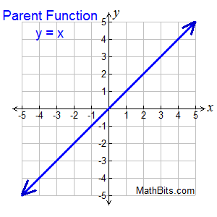
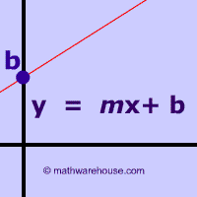
THE SLOPE-INTERCEPT EQUATION OF A LINE
y = mx + b
y = y axes
x = x axes
m = slope
b= intercepted part of y axes

Slide 8
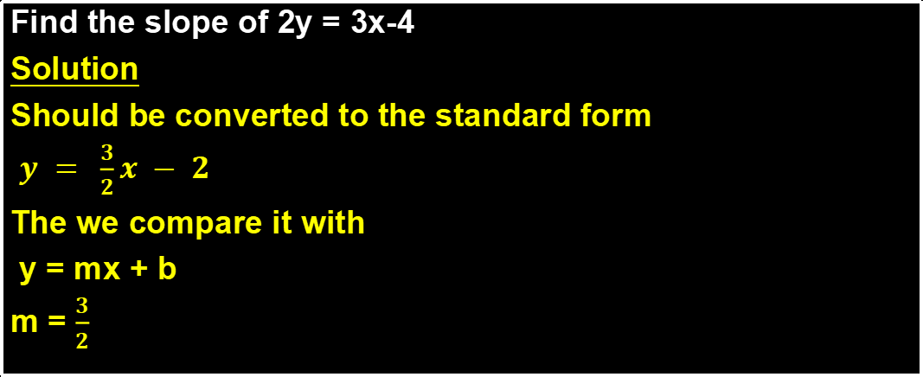
Example
Find the slope of 2y = 3x-4
Solution
Should be converted to the standard form
$y = \frac{3}{2}x − 2$
The we compare it with
y = mx + b
m = $\frac{3}{2}$

Slide 9
Class work
Find the slope of 3y - 6x + 9 = 0

Slide 10

The point-slope equation of a line
This equation, involving the two variables and can be rewritten in the form:
($y− y_{1}$) = m($x− x_{1}$)

Slide 11

Example:
Find the equation of the line that has a slope of m = 3 and passes through the point (2,-1).
Solution:
Since m = 3 and (x₁,y₁) = (2,-1)
($y− y_{1}$) = m($x− x_{1}$)
(y+1) = 3(x-2) → y +1= 3x - 6
y = 3x - 7
*** Solve :
Find the equation of the line that has a slope of m = 3 and passes through the point (-1,2).

Slide 12

PARALLEL AND PERPENDICULAR LINES
Two distinct nonvertical lines are parallel if and only if their slopes are equal that is, if and only if
m₁ = m₂
Two nonvertical lines are perpendicular if and only if their slopes are negative reciprocals of each other that is, if and only if
m₁ = $− \frac{1}{m_{2}}$

Slide 13
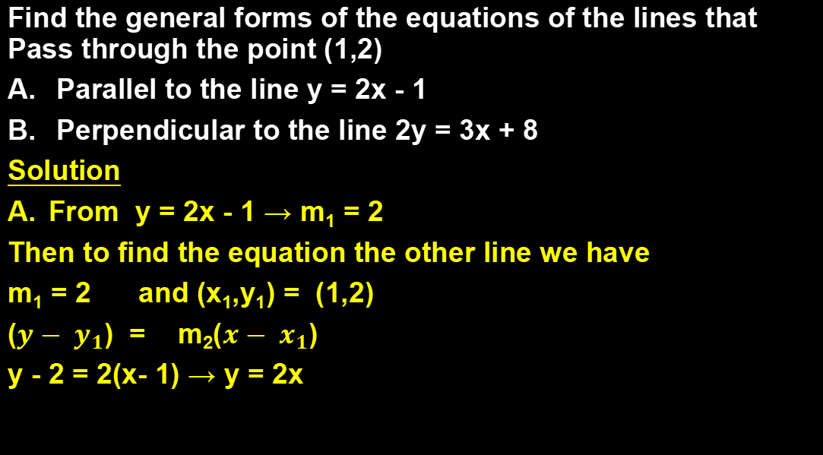
Find the general forms of the equations of the lines that Pass through the point (1,2)
Parallel to the line y = 2x - 1
Perpendicular to the line 2y = 3x + 8
Solution
From y = 2x - 1 → m₁ = 2
Then to find the equation the other line we have
m₁ = 2 and (x₁,y₁) = (1,2)
($y− y_{1}$) = m₂($x− x_{1}$)
y - 2 = 2(x- 1) → y = 2x

Slide 14
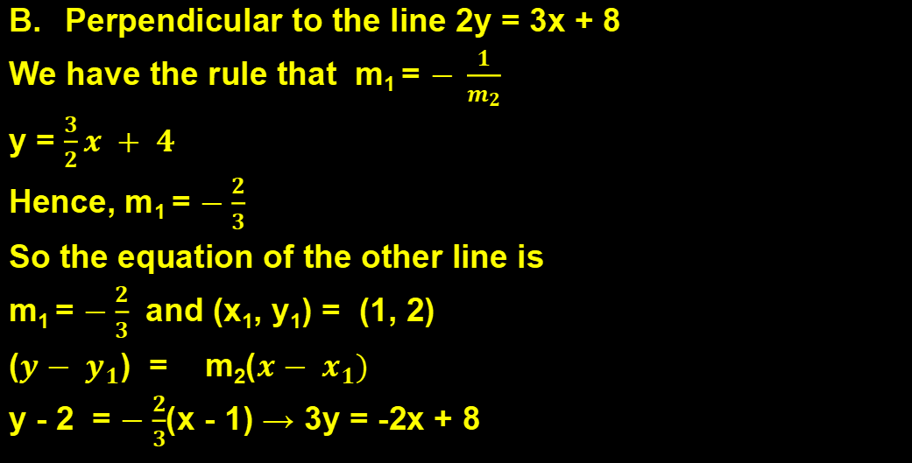
Perpendicular to the line 2y = 3x + 8
We have the rule that m₁ = $− \frac{1}{m_{2}}$
y = $\frac{3}{2}x + 4$
Hence, m₁ = $−\frac{2}{3}$
So the equation of the other line is
m₁ = $−\frac{2}{3}$ and (x₁, y₁) = (1, 2)
($y− y_{1}$) = m₂($x− x_{1})$
y - 2 = $−\frac{2}{3}$(x - 1) → 3y = -2x + 8

