Slide 1
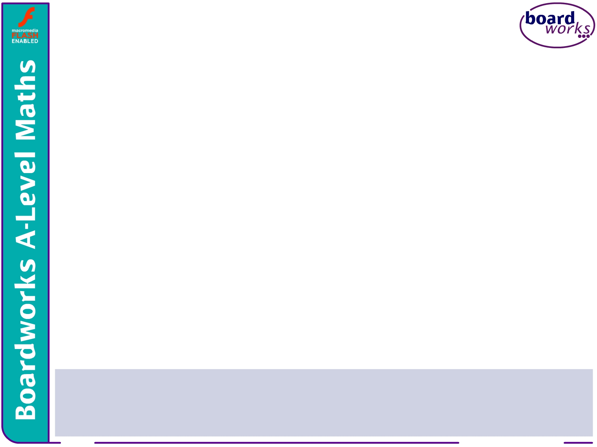






Integration 2

Slide 2



Integration by substitution
Integration by parts
Contents
<number> of 57
© Boardworks Ltd 2006

Slide 3
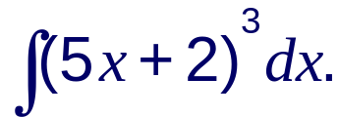
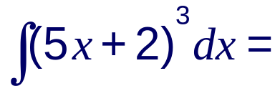
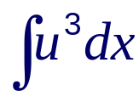
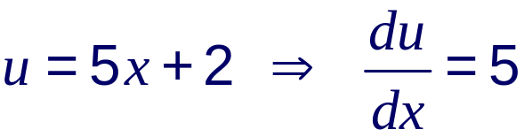
With practice, the technique of integration by recognition can save a lot of time.
However, when it is too difficult to use integration by recognition we can use a more formal method of reversing the chain rule called integration by substitution.
To see how this method works consider the integral
Let u = 5x + 2 so that
The problem now is that we can’t integrate a function in u with respect to x. We therefore need to write dx in terms of du.

Slide 4

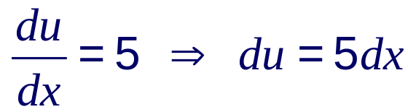
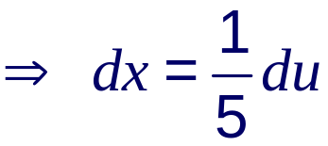
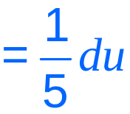
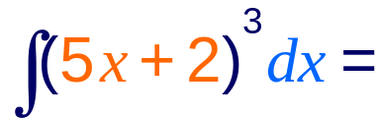
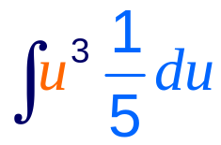
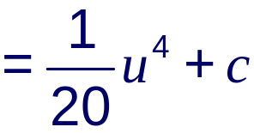
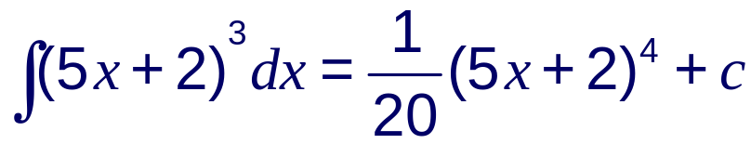
When we used the chain rule for differentiation we saw that we can treat informally as a fraction, so:
So if u = 5x + 2 and dx :
Now change the variable back to x:
Notes:
Stress that we must change the variable back to x at the end.
We can check that the final solution is correct by differentiating it using the chain rule.

Slide 5
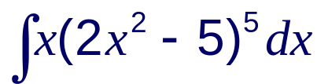
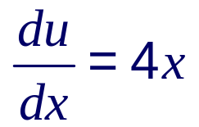
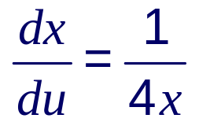
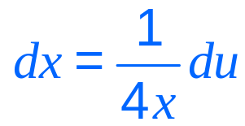
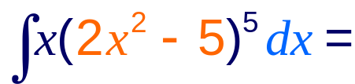
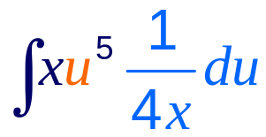
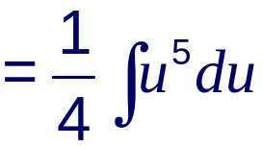
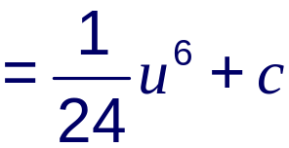
Use a suitable substitution to find .
Let u = 2x² – 5
Substituting u and dx into the original problem gives:
Notice that the x’s cancel out.

Slide 6
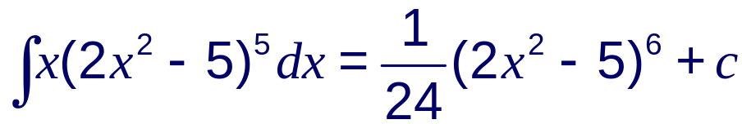
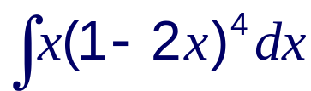
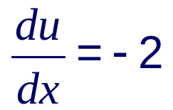
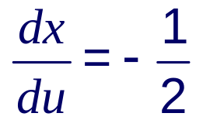
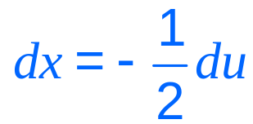
Now we need to change the variable back to x :
This integral could also have been found directly by recognition.
However, there are functions that can be integrated by use of a suitable substitution but not by recognition. For instance:
Use the substitution u = 1 – 2x to find .
If u = 1 – 2x then

Slide 7
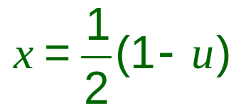
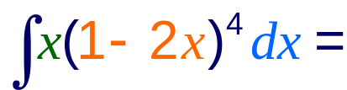
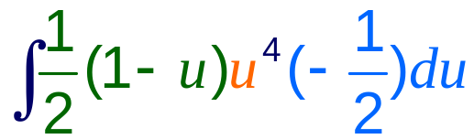
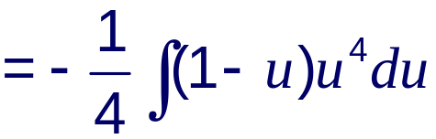
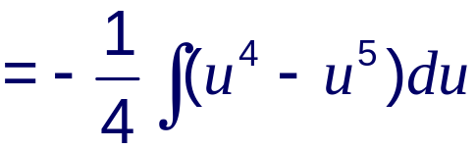
Also if u = 1 – 2x then
We also have to substitute the x so that the whole integrand is in terms of u.
Substituting these into the original problem gives:

Slide 8
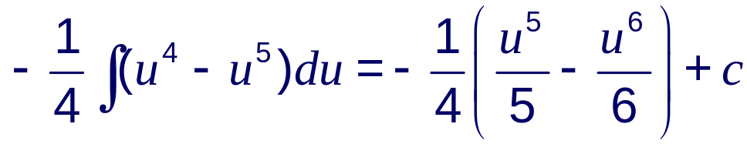
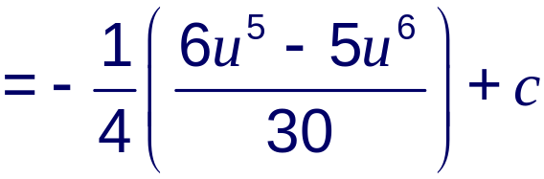
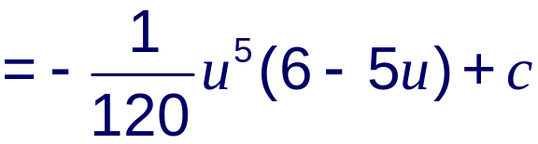
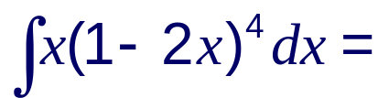
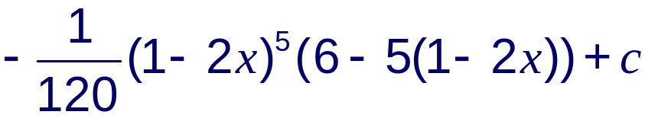
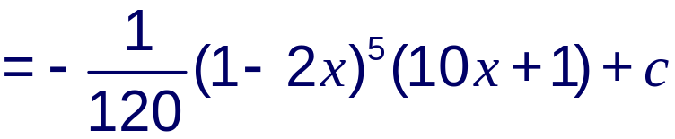
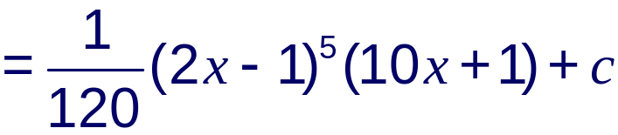
Changing the variable back to x gives:
Notes:
The final step brings the minus sign into one of the brackets to give a slightly ‘tidier’ form.

Slide 9

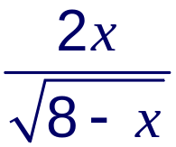

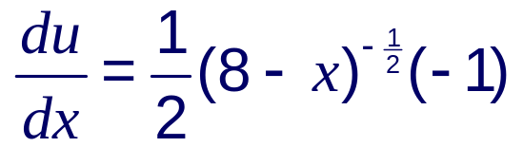
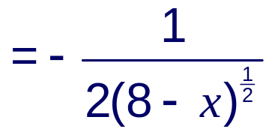
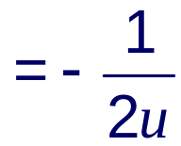
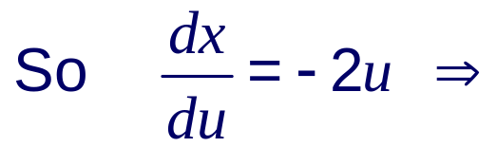

When a definite integral is found by substitution it is easiest to rewrite the limits of integration in terms of the substituted variable.
Use the substitution u = to find the area under the curve
y = between x = 4 and x = 7.
Using the chain rule for differentiation.
If u = then

Slide 10


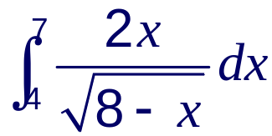
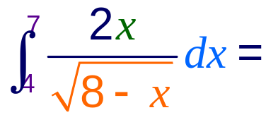
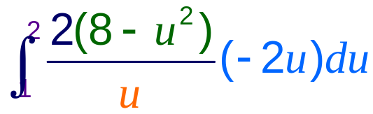
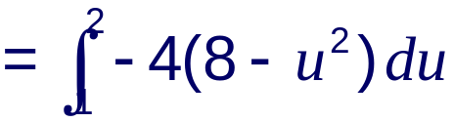
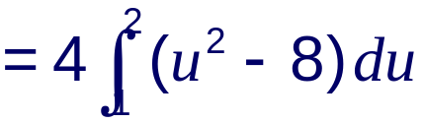
Now we need to find x in terms of u.
If u = then
u² = 8 – x
x = 8 – u²
Rewrite the limits in terms of u:
when x = 3,
when x = 1,
The area is given by . Rewrite this in terms of u:

Slide 11
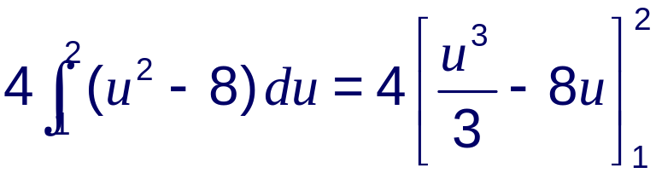
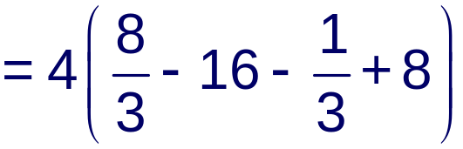
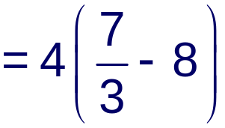


Therefore, the required area is units squared.
Notes:
The final calculation can be done using a calculator if required.

Slide 12
Integration by parts
Contents
<number> of 57
© Boardworks Ltd 2006

Slide 13


Suppose we wish to integrate the product of two functions, such as x sin x, where one of the functions is not related to the derivative of the other.
An expression such as this can be integrated using the method of integration by parts.
When we differentiate the product of two functions u and v we use the product rule:
where u and v are functions of x.
Integrating throughout with respect to x gives:
Notes:
Stress that integrating ^{d}/_{dx}(uv) with respect to x gives uv.

Slide 14





This can be rearranged to give:
To integrate a product using this formula we let one part equal
u and the other equal .
We find by differentiating the part we called u.
We find v by integrating the part we called .
It is important to choose u and so that
is easier to integrate than .

Slide 15







So, to integrate x sin x with respect to x:
Let and
differentiate
integrate
So
and
We don’t need the “+ c” here.
Now, using the formula :

Slide 16






Find .
Let and
So and
Now, apply the formula :

Slide 17









Find .
We don’t know the integral of ln x so:
let and
so and
Now, using the formula, :
Notes:
In general if one of the functions in the product is a power of x then we let that function equal u so that it is simplified when differentiated. Products where one of the functions is of the form ln x are an exception to this general rule as shown here.

Slide 18







We can also use integration by parts to find the integral of ln x.
We do this by writing ln x as (1 × ln x).
Let and
So
and
Now we can integrate by parts:
Notes:
This result does not need to be learnt, but students should be familiar with its derivation.

Slide 19










To evaluate a definite integral using integration by parts we use:
Evaluate .
Let and
So
and
sin ^{π}/₂ = 1
cos ^{π}/₂ = 0
cos 0 = 1

