Slide 1





AS-Level Maths:
Core 2 for Edexcel
C2.8 Integration
These icons indicate that teacher’s notes or useful web addresses are available in the Notes Page.
This icon indicates the slide contains activities created in Flash. These activities are not editable.
For more detailed instructions, see the Getting Started presentation.
<number> of 36
© Boardworks Ltd 2005

Slide 2



Evaluating definite integrals
Evaluating definite integrals
The area under a curve
The trapezium rule
Examination-style questions
Contents
<number> of 36
© Boardworks Ltd 2005

Slide 3
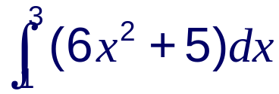
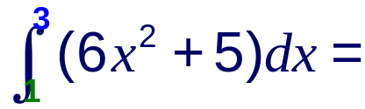
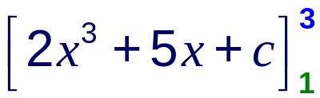


Definite and indefinite integrals
When we find the indefinite integral of a function the answer takes the form of an expression plus a constant of integration.
When we find a definite integral of a function we find the integral between two given limits to give a numerical result.
For example, the definite integral of 6x² + 5 between x = 1 and x = 3 is written as
It is evaluated as follows:
Notice that square brackets are used here …
…and rounded brackets here.
c cancels out.
Notes:
Talk through the process of evaluating a definite integral by substituting the limits.

Slide 4
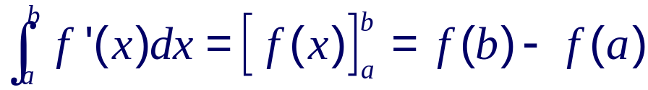
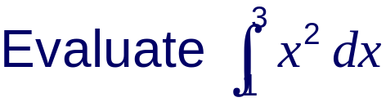
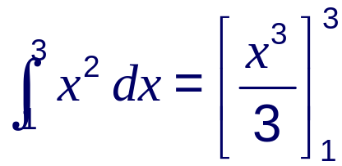
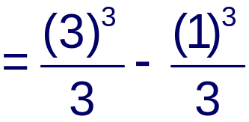


Definite integration
When evaluating a definite integral we can ignore constants of integration because they cancel out.
In general:
Notes:
At the moment the number 8²/₃ has no particular meaning other than being the definite integral of x² between 1 and 3. The next few slides look at examples where we need to find the area under a curve and links this to the integral.

Slide 5
The area under a curve
Evaluating definite integrals
The area under a curve
The trapezium rule
Examination-style questions
Contents
<number> of 36
© Boardworks Ltd 2005

Slide 6
The area under a velocity-time graph
The following graph shows how the velocity of a car changes over a period of 40 seconds.
What does the area under the graph represent?
8
velocity (m/s)
Consider the area of a thin strip of the graph.
6
4
2
If the strip is thin enough it can be treated as if it is rectangular.
0
0
5
10
15
20
25
30
35
40
time (s)
The area of the strip =
velocity × time =
distance
The area of each strip represents the distance travelled during a small period of time.
∴ The total area is the total distance travelled.
Notes:
Most students will have met problems involving the area under a graph in previous work involving travel graphs. It will also be familiar to students studying mechanics as part of their course.
Although we are considering a velocity-time graph we are using distance travelled as oppose to displacement to avoid discussion of vector and scalar quantities.

Slide 7
The area under a velocity-time graph
In many situations the acceleration will not be constant and the velocity-time graph will be curved.
For example, this graph shows the velocity-time graph for a car in the first 10 seconds after it moves off from rest.
To find the distance travelled by the car over this time we need to find the area under the curve.
8
6
velocity (m/s)
It is possible to estimate this area by dividing it into thin vertical strips and summing their areas.
4
2
0
However, if we know the velocity of the car as a function of time we can find the area more
0
2
4
6
8
10
time (s)
accurately by integration.
Notes:
The fact that the distance traveled (the area under the curve) can be found by integrating should not come as too much of a surprise when we consider that the velocity is the rate of change of distance s over time t. The velocity is therefore given by ^{ds}/_{dt}. Integrating ^{ds}/_{dt} with respect to time gives us s, the area under the curve.

Slide 8
The area under a curve
To see why the area under a curve can be found by integration, consider a continuous curve y = f(x).
Let A be the area shown between the curve y = f(x) and the x-axis from x = 0 to x.
y
δy
Now, imagine moving a small distance along the x-axis, δx.
A
δA
We can call the corresponding increase in area δA and corresponding increase in y δy.
0
x
x+δx
x
Let’s look more closely at this increase in area.
Notes:
We start by looking at the area under a curve between x = 0 and some general x-coordinate x.

Slide 9
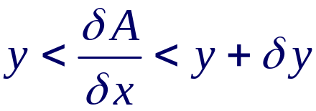
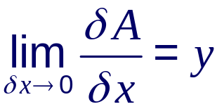
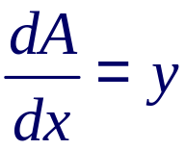
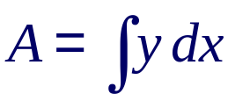
The area under a curve
We can see that δA must be between yδx and (y + δy)δx.
We can write this as
δy
yδx < δA < (y + δy)δx
Dividing through by δx gives
y
δA
y + δy
Now consider the limit as δx and δy → 0:
δx
so
Integrating both sides with respect to x gives
Notes:
By referring to the diagram explain why δA must lie between yδx and (y + δy)δx.
Ask students to imagine summing an infinite number of strips with height y and no width – one for every possible value of x – to give the area under the curve.
It should now be clear why the integral sign takes the form of an elongated S for sum. We could compare this symbol to Σ which is used to sum a discrete sequence of variables as oppose to a continuous set.

Slide 10
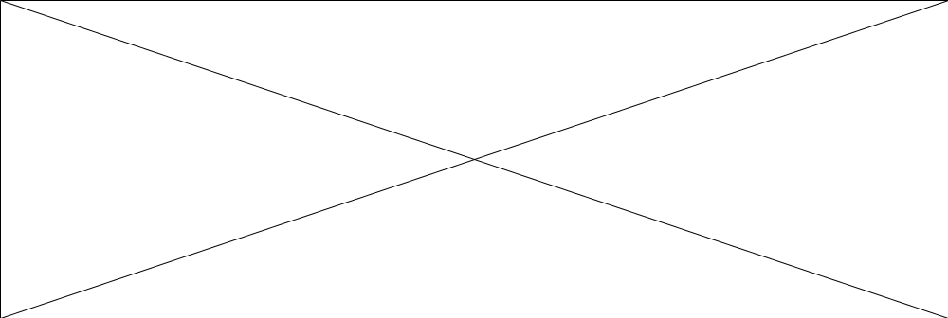
The area function
The area under a curve y = f(x) is therefore a function of x, which we can write as A(x).
A(x) is the area under the curve from x = 0 to x.
Look what happens when the area function y = A(x) is plotted for some function y = f(x) as x varies.
Notes:
Explain that just as we can plot the gradient function for a curve y = f(x), we can plot its area function.
Drag the point along the x-axis of the first graph to plot the area between the curve and the x-axis.
Point out that when y= f(x) reaches a maximum point the area is increasing most rapidly. When y = f(x) crosses the x-axis from positive to negative the area reaches a maximum. Stress that as f(x) moves below the x-axis the area becomes negative and so the area function starts to decrease.
Ask students to tell you the relationship between the curve on the right and the curve on the left. Establish that the curve on the left is the gradient function of the curve on the right (ignoring any constant value that may translate the graph upwards or downwards). This is reasonable since integration is the reverse of differentiation.

Slide 11
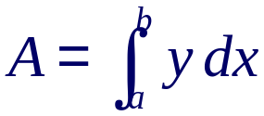
The area under a curve
Suppose that we want to find the area A under a curve between two given values of x; x = a and x = b.
If the area between x = 0 and b is A(b)
y
and the area between x = 0 and a is A(a)
then the area A under the curve from x = a to x = b must be
A(a)
A(b)
A
a
b
x
A = A(b) – A(a)
In general:
The area A under a curve y = f(x) between the limits x = a and x = b is given by
Notes:
Discuss how this argument can be adapted to include limits to the left of the y-axis.

Slide 12
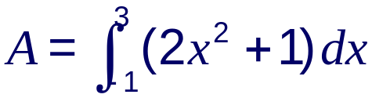
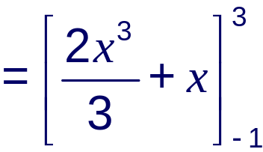
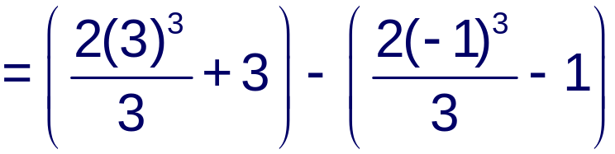



The area under a curve
Find the area bounded by the curve y = 2x² + 1, the x-axis and the lines x = –1 and x = 3.
Start by sketching the graph of y = 2x² + 1 and shading the required area.
y
y = 2x² + 1
A
–1
3
x
The final solution can be written as 22 units².
Notes:
It is important to sketch the function in case some of the required area lies below the x-axis. The function given in this case is y = 2x² + 1, which can be sketched by translating the graph of y = 2x² one unit upwards. It lies entirely above the x-axis.
It is quite common for this type of problem to involve the manipulation of fractions. Make sure that students can do this confidently. For example, ⁻²/₃ – 1 is equivalent to ⁻²/₃ – ³/₃ which is equal to ⁻⁵/₃ . Point out that it is usually easier to work with improper fractions than mixed numbers. Mixed numbers may, however, be preferable in the final solution.

Slide 13
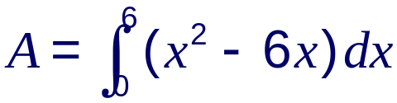
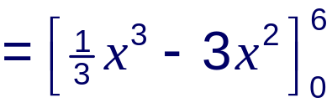
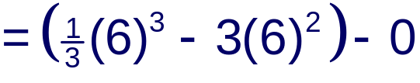

Areas below the x-axis
Suppose the area that we are trying to find is below the x-axis. For example:
Find the area bounded by the curve y = x(x – 6) and the x-axis.
y
This area is given by:
y = x(x – 6)
0
6
x
A
The calculated area is negative because it is below the x-axis.
We write the actual area as 36 units².
Notes:
Explain that areas below the x-axis are negative because the corresponding y values that give the area are negative.

Slide 14
Areas below the x-axis
In some cases the area may fall partly below the x-axis and partly above. For example:
Find the area between
y = 9x – x³ and the x-axis.
Factorizing gives
y
y = x(3 + x)(3 – x)
So the graph cuts the x-axis at x = –3, x = 0 and x = 3.
–3
0
3
x
Also, x³ is negative so the curve is -shaped.
The required area can now be shaded in.

Slide 15
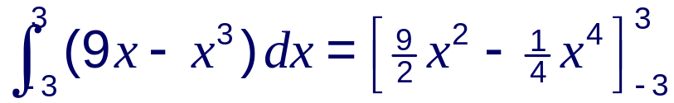
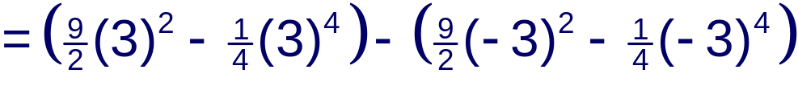


Areas below the x-axis
Look what happens if we try to find the area under y = 9x – x³ between –3 and 3.
From the shading on our graph we know the area isn’t 0.
What has happened is that the negative area below the graph has cancelled out the positive area above the graph.
To avoid this we have to find the areas above and below the x-axis separately and then add the two areas together.
Notes:
Once the values have been substituted the calculation can be done using a calculator.

Slide 16
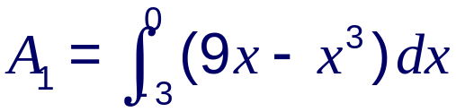
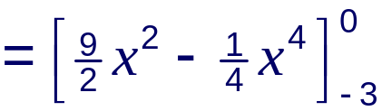
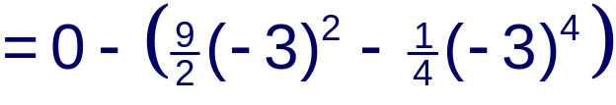

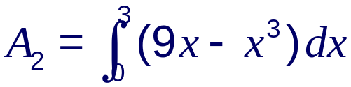
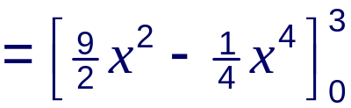
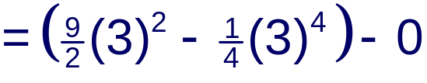


Areas below the x-axis
Let’s call the two areas A₁ and A₂.
y
A₂
–3
A₁
0
3
x
The total area = A₁ + A₂ = 40 units².
Notes:
In the final step point out that it is the positive value of each area that is added together.

Slide 17
The area between a curve and a line
Suppose we want to find the area between a curve and a line. For example:
Find the area bounded by the curve
y = x² + 1 and the line y = 2x + 4.
Start by sketching the graph, and shading the required area.
y
Next, we have to find the
x-coordinates of the points where the curve and the line intersect.
y = x² + 1
Solving:
x² + 1 = 2x + 4
x² – 2x –3 = 0
y = 2x + 4
–1
3
x
(x +1)(x – 3) = 0
∴ the curve and the line intersect when x = –1 and x = 3.
Notes:
Explain that to find the points where the curve and the line intersect we have to equate x² + 1 and 2x + 4.

Slide 18
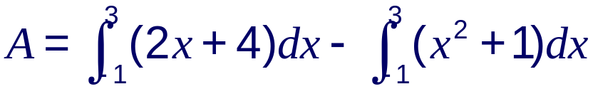
The area between a curve and a line
The area under the line y = 2x + 4 between x = –1 and x = 3 is this area:
While the area under the curve y = x² + 1 between x = –1 and
x = 3 is this area:
y
y = x² + 1
A
So the area we require, A, can be found by subtracting the area under the curve from the area under the line.
y = 2x + 4
–1
3
x
This area is given by:

Slide 19
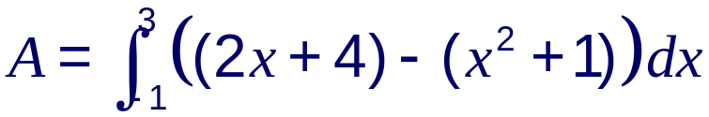
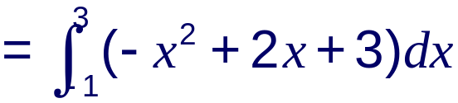
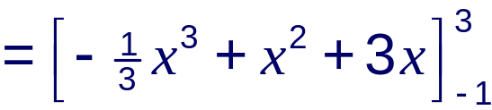




The area between a curve and a line
Since the limits are the same these two integrals can be combined to give
So the required area is 7 units².

Slide 20
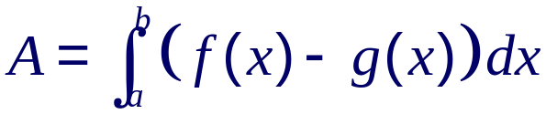
The area between two curves
The method used to find the area between a curve and a line can also be used to find the area between two curves.
In general:
y
y = f(x)
The area A between two curves y = f(x) and y = g(x) is given by
A
y = g(x)
a
b
x
For example:
Find the area bound by the curves y = 3 – 2x² and x = – 1 – x².
Notes:
Explain that in this definition f(x) is taken to be the curve above g(x) for the required region.

Slide 21
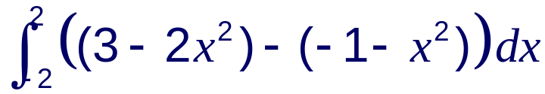
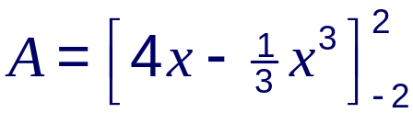
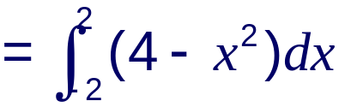



The area between two curves
Start by equating the curves to find out where they intersect.
y
y = 3 – 2x²
A
3 – 2x² = – 1 – x²
x
4 – x² = 0
(2 – x)(2 + x) = 0
y = – 1 – x²
So the curves intersect at x = 2 and x = –2.
Simplify the integral:
Find the area:
Notes:
Point out that, in this case, although part of the area lies below the x-axis this does not affect the value given for the area.

Slide 22
The trapezium rule
Evaluating definite integrals
The area under a curve
The trapezium rule
Examination-style questions
Contents
<number> of 36
© Boardworks Ltd 2005

Slide 23

Approximating the area under a curve
Sometimes the area under a curve cannot be found by integration.
This may be because we cannot find the integral of the equation of the curve or because we need to find the area under a curve produced from experimental data.
In these cases we can use a method to approximate the area under the curve.
One such method is called the trapezium rule.
It works by dividing the area under a curve into trapeziums and calculating their areas. Remember:
a
b
The area of a trapezium =
h
or
a
b
h

Slide 24
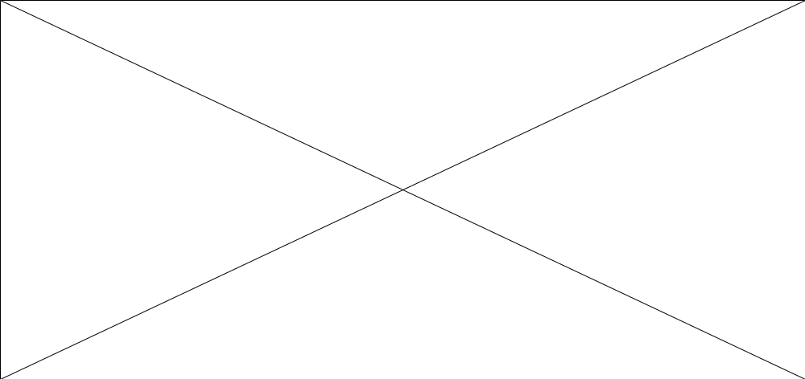
The trapezium rule
To demonstrate the method consider the area under the curve y = x² + 1.

Slide 25
The trapezium rule
The more trapeziums the area is divided into the more accurate the estimate.
Suppose we wish to find the area under a curve y = f(x) between x = a and x = b.
We can divide the area into four trapeziums of equal width h.
y
The parallel sides of the four trapeziums are given by the five ordinates y₀, y₁, y₂, y₃ and y₄.
y₀
y₁
y₂
y₃
y₄
h
h
h
h
a
b
x
In general, if there are n trapeziums there will be n + 1 ordinates.
Notes:
Note that, in this case, y₀ is the y-coordinate when x = a and y₄ is the y-coordinate when x = b.
Questions involving the calculation of an area using the trapezium rule will either specify the number of trapeziums (or strips) to be used, or they will specify the number of ordinates.

Slide 26
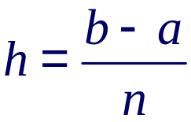
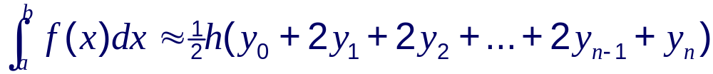
The trapezium rule
The approximate area using the trapezium rule is:
The ordinates have to be spaced out evenly so that the width of the trapeziums are the same.
∴ for n trapeziums of equal width h:
In general, the trapezium rule with n trapeziums is:

Slide 27
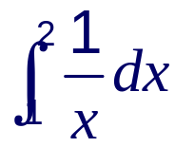
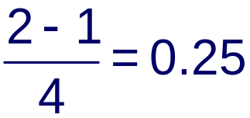
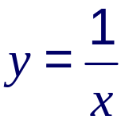
The trapezium rule
Use the trapezium rule with four trapeziums to estimate the value of
State whether this is an overestimate or an underestimate of the actual area.
The width h of each trapezium =
We can use a table to record the value of each ordinate.
x
1
1.25
1.5
1.75
2
1
0.8
0.667
0.571
0.5
y₀
y₁
y₂
y₃
y₄

Slide 28
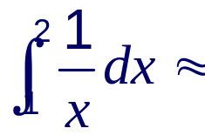
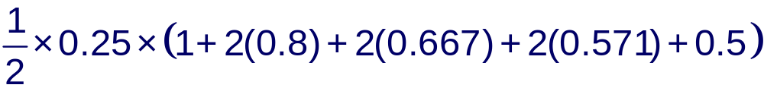
The trapezium rule
We can now work out the area using
with h = 0.25 and the ordinates given by the table, so:
= 0.70 (to 2 d.p.)
We can show whether this is an underestimate or an overestimate by sketching the area given by the trapezium rule on the graph of

Slide 29
The trapezium rule
y
1
2
x
We can see from this sketch that the approximation given by the trapezium rule is a slight overestimate of the actual area.
Notes:
Point out that if the gradient is increasing over the given interval the trapezium rule will give an overestimate of the area under the curve.
In this example the gradient in increasing since it is becoming ‘less negative’ over the interval.
You may wish to tell students that the integral of ¹/_{x} is ln x. The exact area is therefore given by ln 2 – ln 1 = 0.69 (to 2 d.p). This is only slightly under the approximation given by the trapezium rule.

Slide 30
Overestimates and underestimates
In general, when the gradient of the graph is increasing over the given interval the area given by the trapezium rule will be an overestimate of the actual area.
When the gradient of the graph is decreasing over the given interval the area given by the trapezium rule will be an underestimate of the actual area.
Notes:
Point out that the graphs on the left have positive gradients while the graphs on the right have negative gradients.
In some cases the gradient may be both increasing and decreasing over the given interval. In this case it may be difficult to determine whether the area given by the trapezium rule is an overestimate or an underestimate of the actual area.

Slide 31
The trapezium rule
Evaluating definite integrals
The area under a curve
The trapezium rule
Examination-style questions
Contents
<number> of 36
© Boardworks Ltd 2005

Slide 32
Examination-style question 1
The following diagram shows the curve with equation y = x² – 4x + 5 and the line y = 8 – 2x.
The line and the curve intersect at the points A and B.
y
Find the coordinates of A and B.
Find the area of the shaded region R.
A
R
B
x

Slide 33
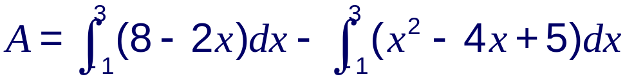
Examination-style question 1
a) Equating the given equations:
x² – 4x + 5 = 8 – 2x
x² – 2x – 3 = 0
(x + 1)(x – 3) = 0
x = –1 or x = 3
When x = –1, y = 10 and when x = 3, y = 2.
∴ The coordinates of A are (–1, 10) and the coordinates of B are (3, 2).
b) The area of R is given by

Slide 34
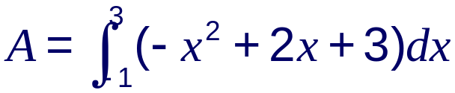
Examination-style question 1
Combining these gives
So the required area is 7 units².

Slide 35
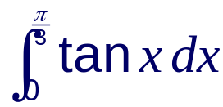

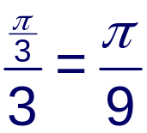



Examination-style question 2
Use the trapezium rule with 4 ordinates to estimate to 2 decimal places the value of
State whether the estimate given in part a) is an overestimate or underestimate of the area under the curve y = tan x between x = 0 and x = .
The width h of each trapezium =
Using a table to record the value of each ordinate:
x
0
y = tan x
0
0.364
0.839
1.732
Notes:
If there are 4 ordinates there will be 3 trapeziums.
Warn students to make sure their calculators are set to radians.

Slide 36

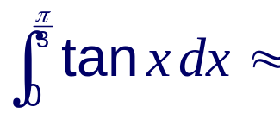
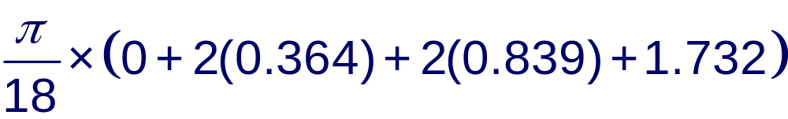

Examination-style question 2
We can now work out the area using
with h = and the ordinates given by the table, so:
= 0.72 (to 2 d.p.)
b) Sketching the curve y = tan x shows that the value given in a) is a slight overestimate of the actual area.
y
0
x
Notes:
If there are 4 ordinates there will be 3 trapeziums.
Warn students to make sure their calculators are set to radians.

