Slide 1
“Teach A Level Maths”
Vol. 1: AS Core Modules
Demo Disc
The following slides show one of the 51 presentations that cover the AS Mathematics core modules C1 and C2.

Slide 2
AS Mathematics
26: Definite Integration and Areas
© Christine Crisp

Slide 3
Module C1
Module C2
AQA
Edexcel
MEI/OCR
OCR
"Certain images and/or photos on this presentation are the copyrighted property of JupiterImages and are being used with permission under license. These images and/or photos may not be copied or downloaded without permission from JupiterImages"

Slide 4
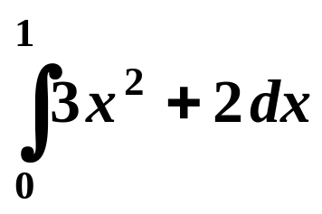
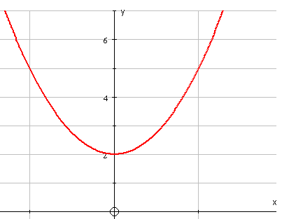

Areas
Definite integration results in a value.
It can be used to find an area bounded, in part, by a curve
e.g.
gives the area shaded on the graph
The limits of integration . . .
0
1

Slide 5
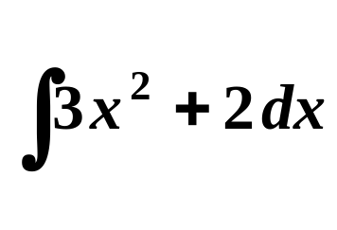
Areas
Definite integration results in a value.
It can be used to find an area bounded, in part, by a curve
e.g.
1
gives the area shaded on the graph
0
The limits of integration . . .
. . . give the boundaries of the area.
x = 0 is the lower limit
( the left hand boundary )
x = 1 is the upper limit
(the right hand boundary )
0
1

Slide 6
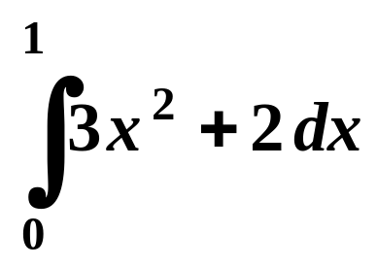
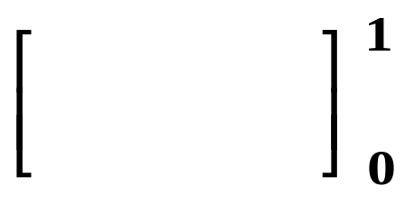
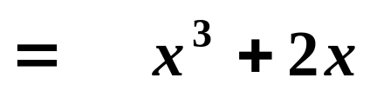

Finding an area
Since
y
=
3
x
2
+
2
the shaded area equals 3
0
1
The units are usually unknown in this type of question

Slide 7
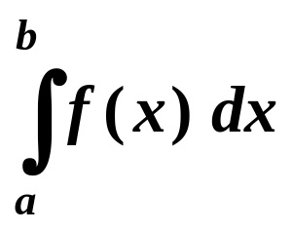
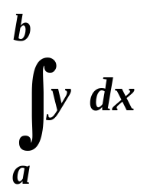


SUMMARY
The definite integral or gives the area between
the curve
the x-axis and
the lines x = a and x = b
PROVIDED that
the curve lies on, or above, the x-axis between the values x = a and x = b

Slide 8
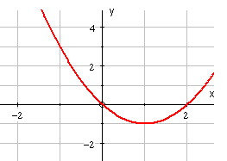
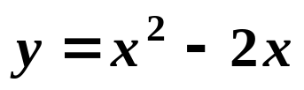
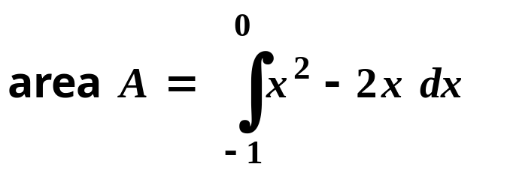
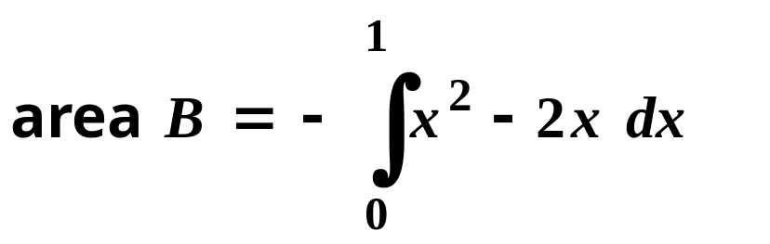
Finding an area
A
B
For parts of the curve below the x-axis, the definite integral is negative, so

Slide 9
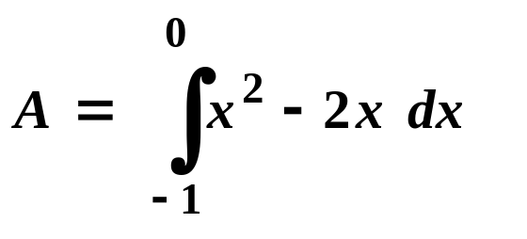
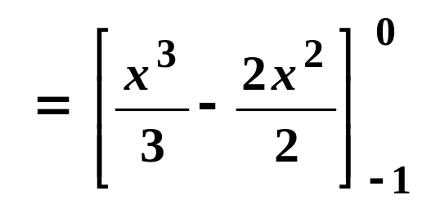

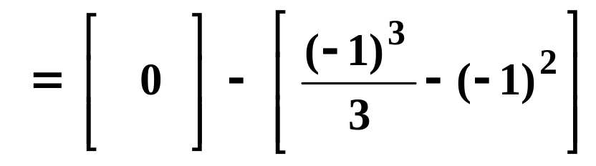
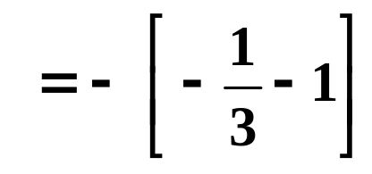
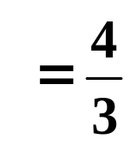

Finding an area
A
Area A

Slide 10
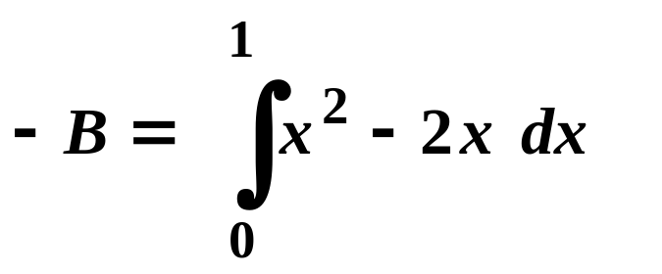
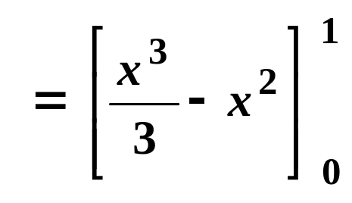
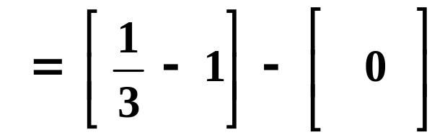
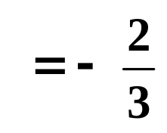
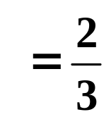
Finding an area
B
Area B

Slide 11
SUMMARY
An area is always positive.
The definite integral is positive for areas above the x-axis but negative for areas below the axis.
To find an area, we need to know whether the curve crosses the x-axis between the boundaries.
For areas above the axis, the definite integral gives the area.
For areas below the axis, we need to change the sign of the definite integral to find the area.

Slide 12

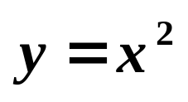
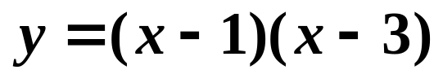
Exercise
Find the areas described in each question.
1. The area between the curve the x-axis and the lines x = 1 and x = 3.
2. The area between the curve , the x-axis and the x = 2 and x = 3.

Slide 13
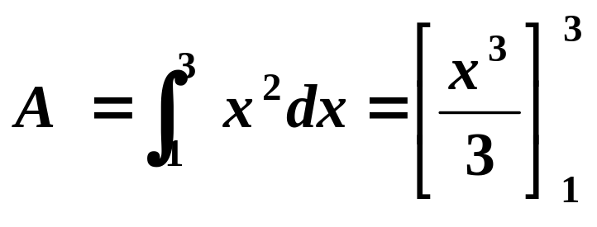
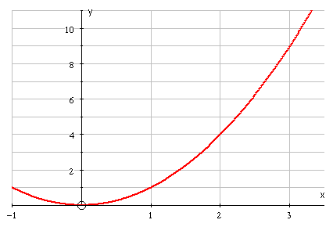

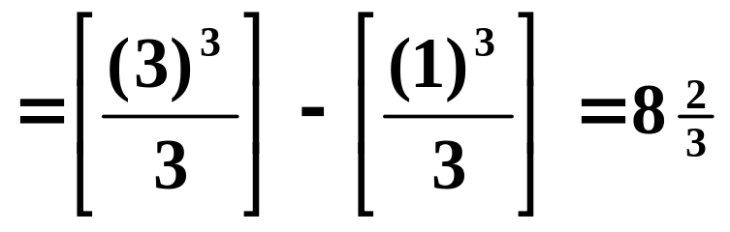
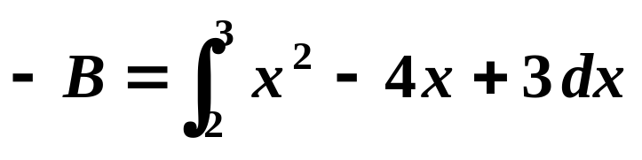
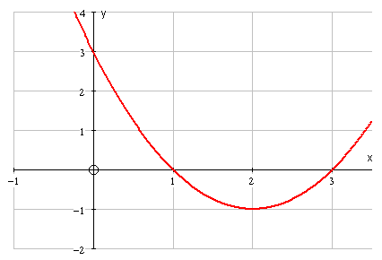
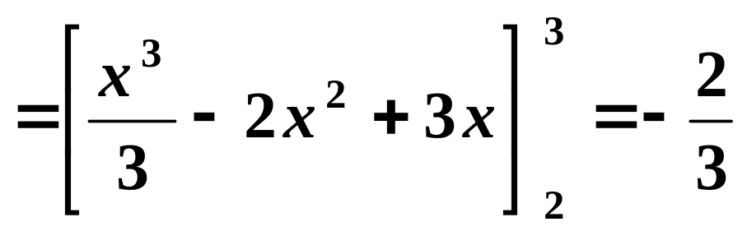
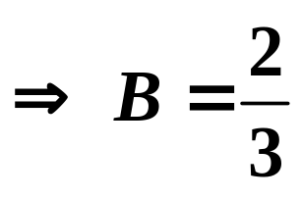
Solutions:
1.
A
2.
B

Slide 14
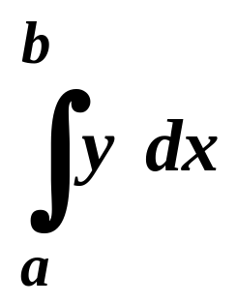
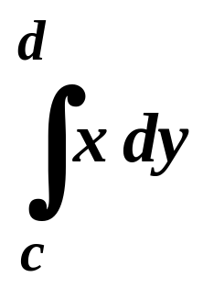
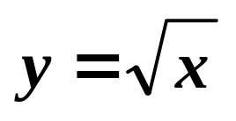
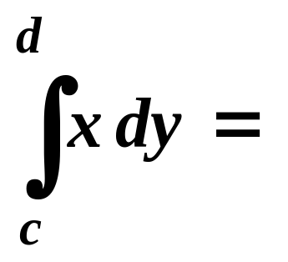
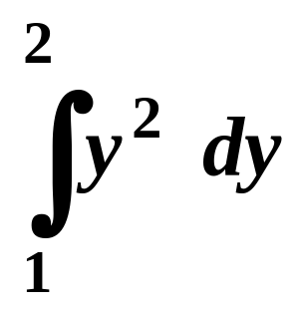
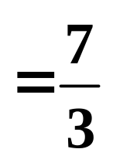
Extension
The area bounded by a curve, the y-axis and the lines y = c and y = d is found by switching the xs and ys in the formula.
So,
becomes
e.g. To find the area between the curve , the y-axis and the lines y = 1 and y = 2, we need

Slide 15
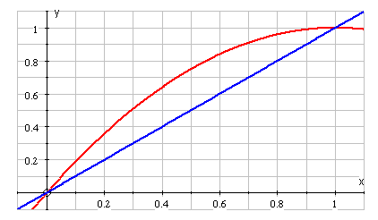
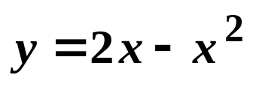


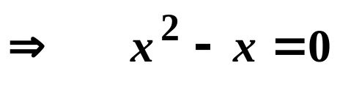


Harder Areas
e.g.1 Find the coordinates of the points of intersection of the curve and line shown. Find the area enclosed by the curve and line.
Solution: The points of intersection are given by

Slide 16





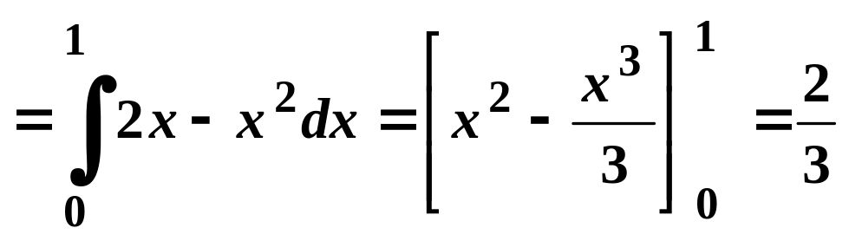
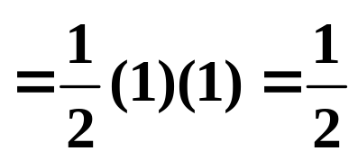
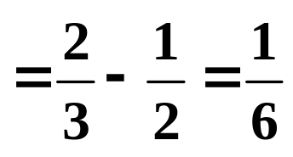
Substitute in
The area required is the area under the curve between 0 and 1 . . .
. . . minus the area under the line (a triangle )
Method 1
Area under the curve
Area of the triangle
Required area

Slide 17
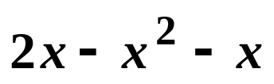
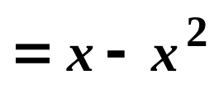
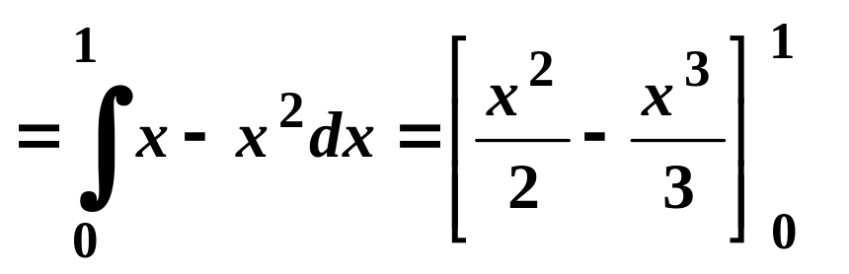
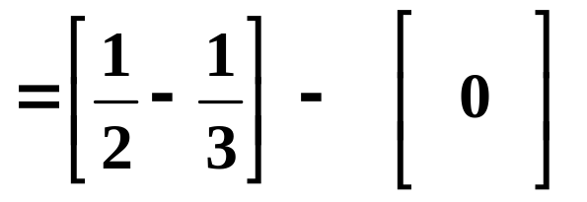
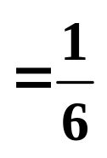
Method 2
Instead of finding the 2 areas and then subtracting, we can subtract the functions before doing the integration.
We get
Area

Slide 18
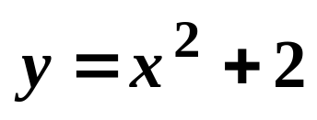
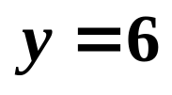








Exercise
Find the points of intersection of the following curves and lines. Show the graphs in a sketch, shade the region bounded by the graphs and find its area.
(a) ;
(b) ;
Solution:
(a)
( y = 6 for both points )

Slide 19




Shaded area = area of rectangle – area under curve
Area under curve
Shaded area

Slide 20














(b) ;
or
Substitute in :
Area under the curve
Area of the triangle
Shaded area = area under curve – area of triangle

Slide 21


If a curve crosses the x-axis between the limits of integration, part of the area will be above the axis and part below.
e.g. between −1 and +1
The symmetry of the curve means that the integral from −1 to +1 is 0.
To find the area, we could integrate from 0 to 1 and, because of the symmetry, double the answer.
For a curve which wasn’t symmetrical, we could find the 2 areas separately and then add.

Slide 22


You don’t need to know how the formula for area using integration was arrived at, but you do need to know the general ideas.
The area under the curve is split into strips.
The area of each strip is then approximated by 2 rectangles, one above and one below the curve as shown.
The exact area of the strip under the curve lies between the area of the 2 rectangles.

Slide 23


Using 10 rectangles below and 10 above to estimate an area below a curve, we have . . .
Greater accuracy would be given with 20 rectangles below and above . . .
For an exact answer we let the number of rectangles approach infinity.
The exact area is “squashed” between 2 values which approach each other. These values become the definite integral.

Slide 24


Slide 25
The following slides contain repeats of information on earlier slides, shown without colour, so that they can be printed and photocopied.
For most purposes the slides can be printed as “Handouts” with up to 6 slides per sheet.

Slide 26

Areas
Definite integration results in a value.
It can be used to find an area bounded, in part, by a curve
e.g.
1
gives the area shaded on the graph
0
The limits of integration . . .
. . . give the boundaries of the area.
x = 0 is the lower limit
( the left hand boundary )
x = 1 is the upper limit
(the right hand boundary )

Slide 27
SUMMARY
The definite integral or gives the area between
the curve
the x-axis and
the lines x = a and x = b
PROVIDED that
the curve lies on, or above, the x-axis between the values x = a and x = b

Slide 28

Finding an area
A
B
For parts of the curve below the x-axis, the definite integral is negative, so

Slide 29
SUMMARY
An area is always positive.
The definite integral is positive for areas above the x-axis but negative for areas below the axis.
To find an area, we need to know whether the curve crosses the x-axis between the boundaries.
For areas above the axis, the definite integral gives the area.
For areas below the axis, we need to change the sign of the definite integral to find the area.

Slide 30

Harder Areas
e.g.1 Find the coordinates of the points of intersection of the curve and line shown. Find the area enclosed by the curve and line.
Solution: The points of intersection are given by

Slide 31
Substitute in
The area required is the area under the curve between 0 and 1 . . .
. . . minus the area under the line (a triangle )
Area under the curve
Area of the triangle
Required area

