Slide 1
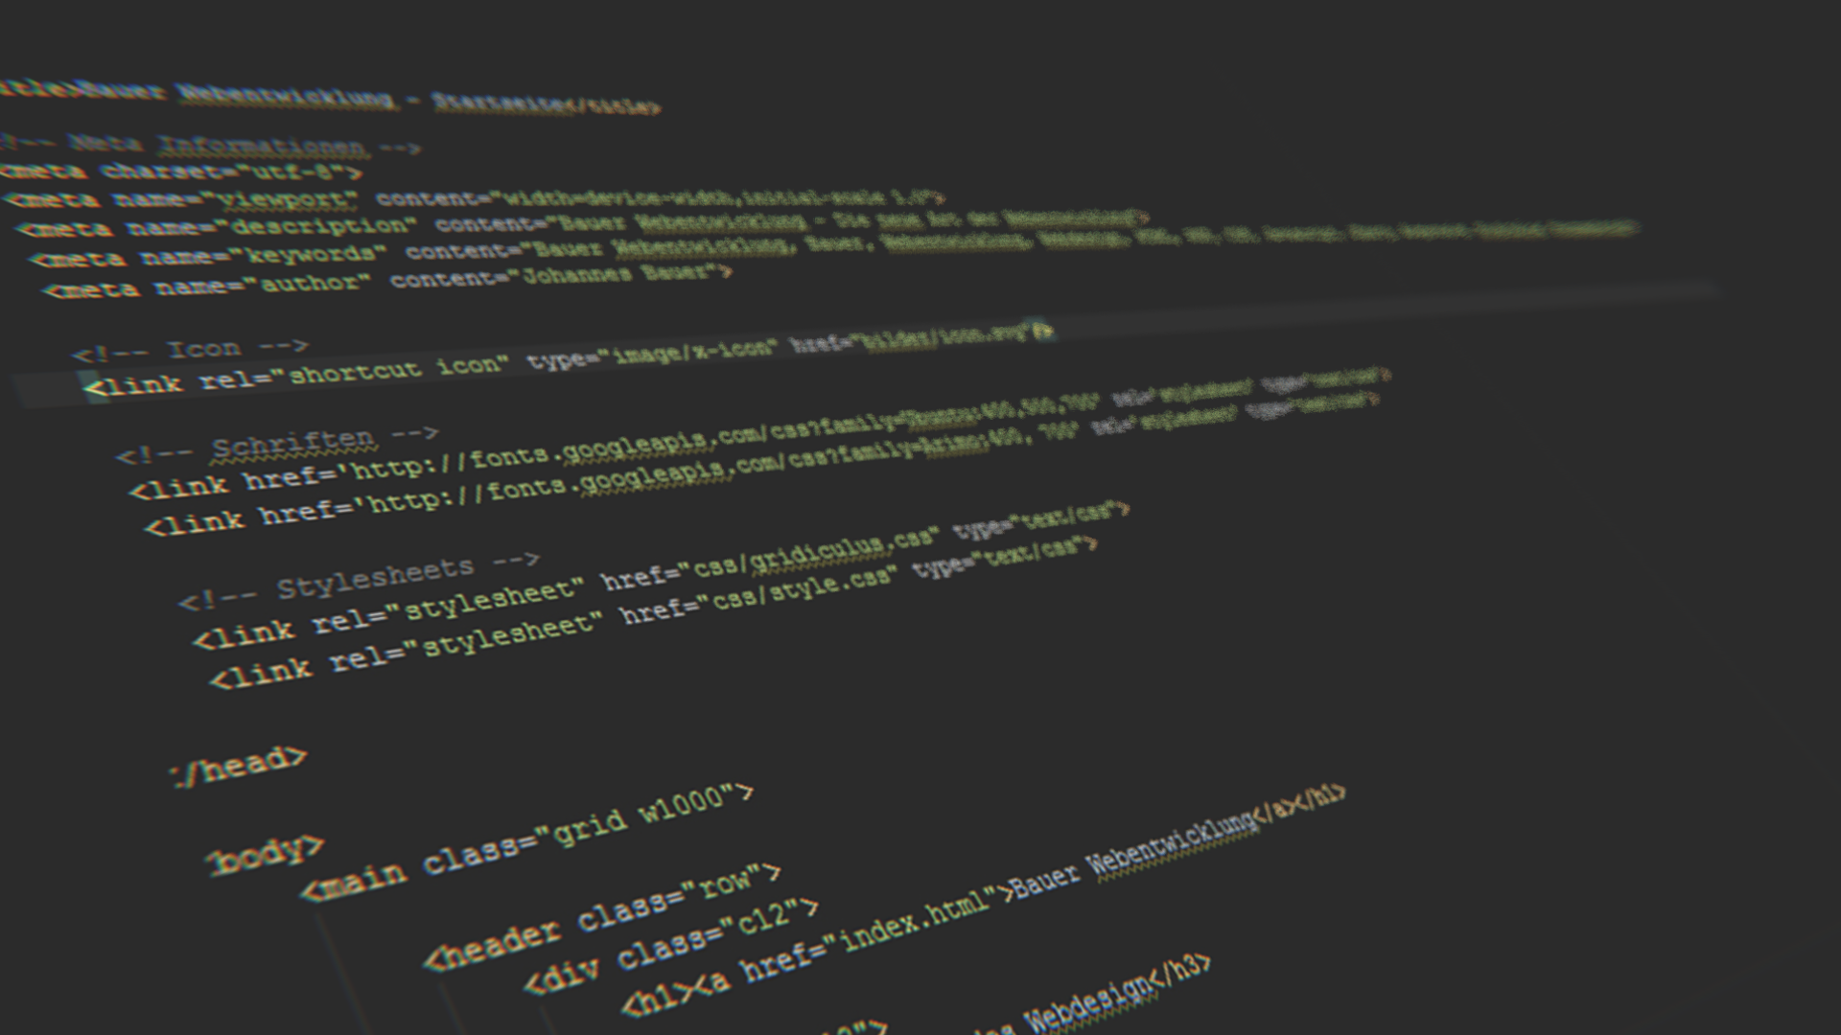


By Noonic

Slide 2
What?
AngularJS is a client side JavaScript framework for dynamic web apps
Essentially used for SPA (Single page applications) but it can be used in regular web applications as well
Uses MVC architectural pattern

Slide 3
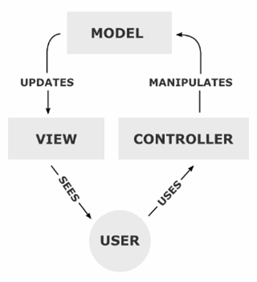
MVC architectural pattern
(I know you know MVC but still lets recall again)

Slide 4
Based On
Backbone JS
OOP implementation for JavaScript
jQuery
DOM manipulation
Require JS
Modular Structure
Dependency Injection

Slide 5
Alternatives
Knokout
Ember
… and several other

Slide 6
Ok, what the problem it solves actually?
Organized Code
Templating
Routing
Data Binding
Multiway
Scope
No setter or getter necessary
In short, ease of maintaining larger JavaScript code base

Slide 7
Concepts
Template (view)
Expression
Directives
Filter
Model
Controller
Scope
Data Binding
Dependency Injection
Module
Service

Slide 8
Talk is cheap, show me the code!
LETS BEGIN!

Slide 9

Don’t be afraid
to break the rules

Slide 10
Thanks.

