Slide 1

Librarian
Library management system
Using java

Slide 2

Traditional library management
The traditional library has received some bad press over the past few years.
Librarian collects data from reader and write down on book’s card or register book.
So if it will lost once then all of information will be lost. That is a vast problem in
library system. The library will affect huge problems. It also losses financial resources. It also a boring system to work long time.

Slide 3

What is the solution?

Slide 4

Librarian
Java based Library Management System
A library management software where admin can add/view/delete librarian and librarian can add/view books, issue, view issued books and return books. This is Java Projects on Library System, which provided a lot of facility to their user.

Slide 5
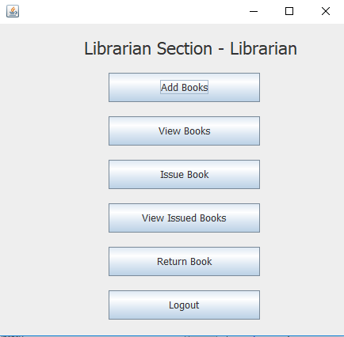
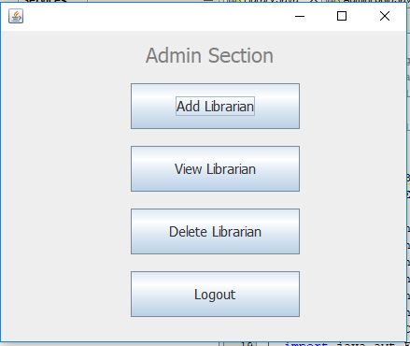
Features
1. Admin
Can add/view/delete librarian
Can logout
2. Librarian
Can add/view books
Can issue books
View issued books
Return Books
Can logout

Slide 6
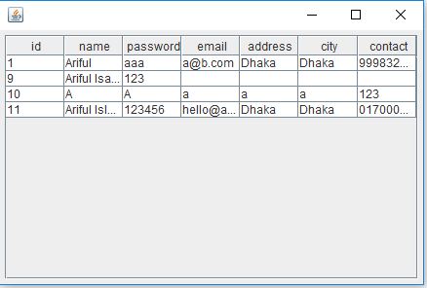
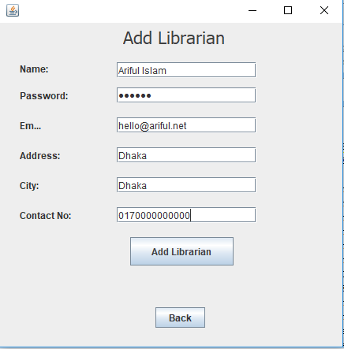
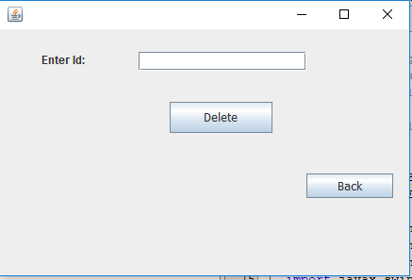
How it works?
View Librarian
Add Librarian
Delete Librarian

Slide 7
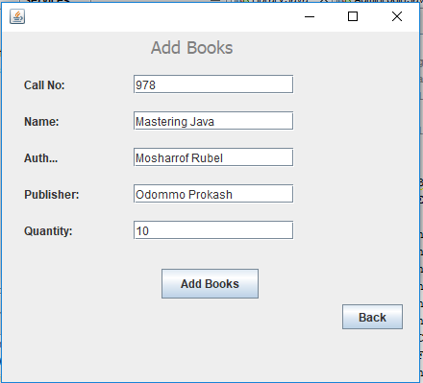
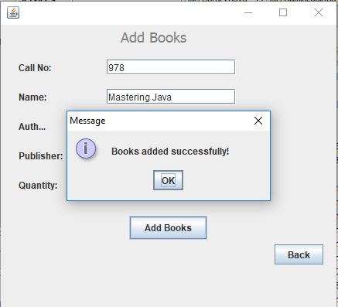
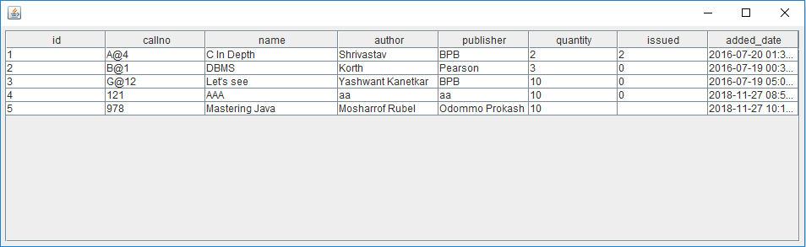
How it works?

Slide 8
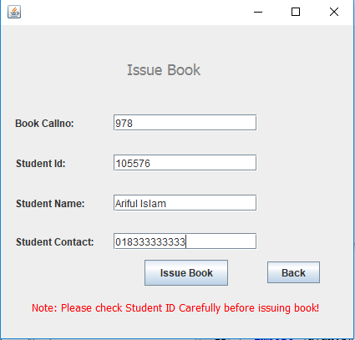
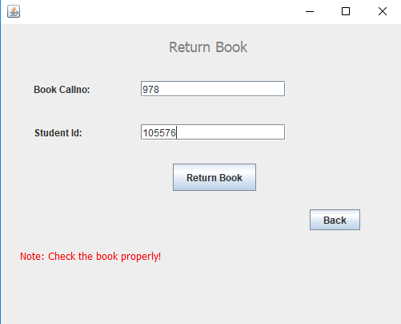
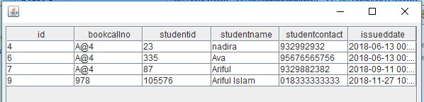
How it works?

Slide 9
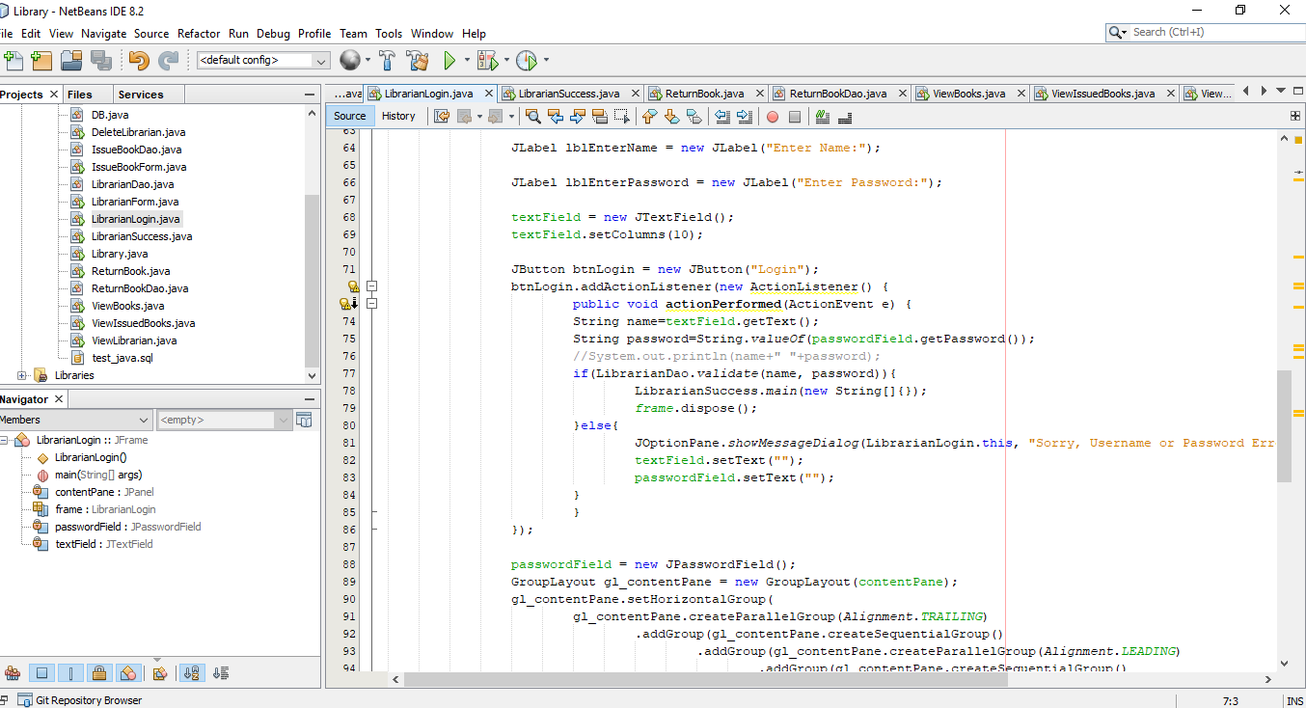
Implementation

Slide 10

Limitation and future plan
Limitation:
Difficulty in reports generating: Either no reports generating in a current system.
Inability of sharing the data: Data cannot be shared in the existing system. This means that no two persons can use the same data in existing system. Also, the two departments in an organization cannot interact with each other without the actual movement of data.
No data export system and import system.
Future implementation:
We will implement those limitations on upcoming version.

Slide 11

Any Question?

Slide 12
