Slide 1
perl
Kyle Ross

Slide 2
History of Perl
Written by Larry Wall in 1987 to solve his problems (Sys Dev Corp., first computer software)
Written to assist with text parsing, report creation and UNIX administration
Perl has gone through many changes and branches of evolution

Slide 3
History of Perl (Cont’d)
Widespread use after 1991: Programming Perl
Massive hacker culture & fanbase

Slide 4
What is Perl?
General purpose scripting language
High level
Dynamically typed
Interpreted, not Compiled
No binary files
Borrows concepts from Shell Scripting (bash), awk, sed, and Regular Expressions (grep)

Slide 5
How is Perl different?
Context is key
Large separation between Identifiers and Data Structures.
What is an Identifier? Data Structure? Variable?
Variables are prefixed (sigil) to indicate their Data Structure Type

Slide 6
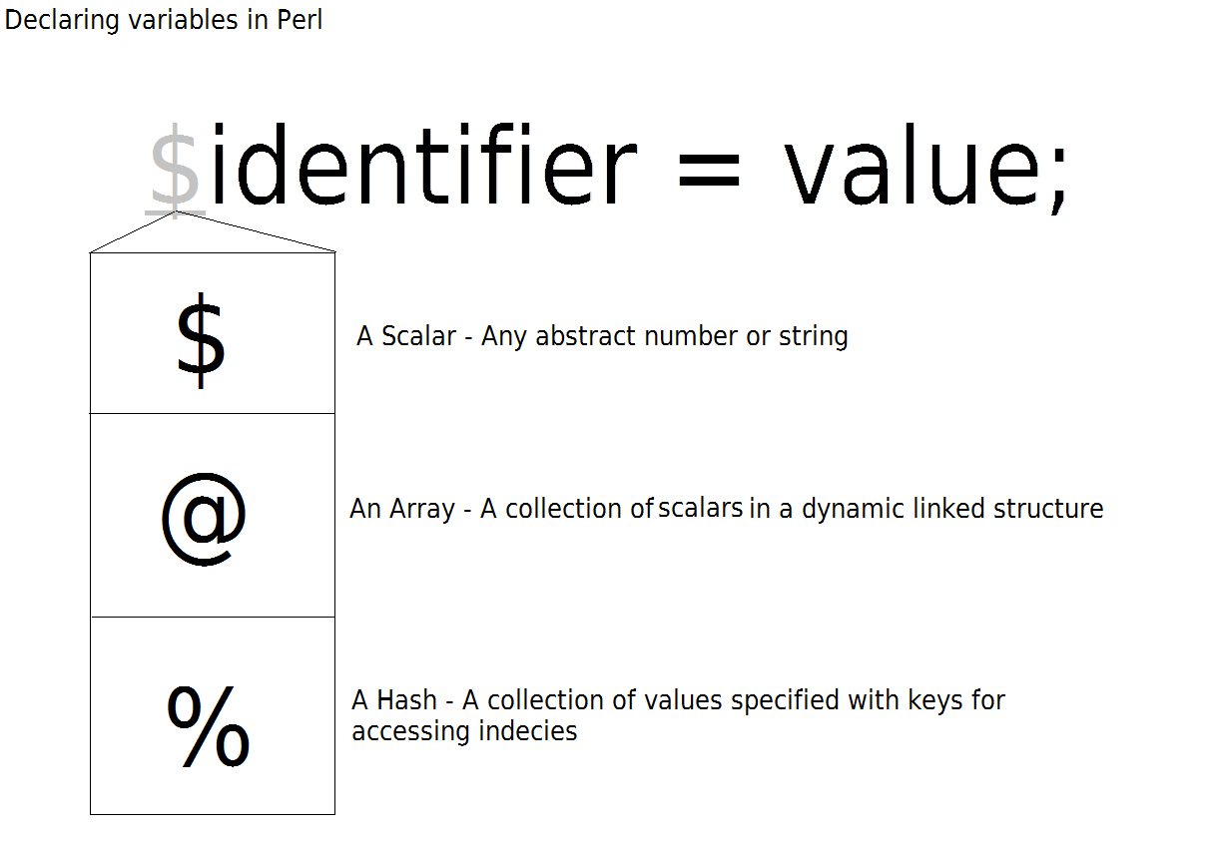

Slide 7
Data Structures
Scalar values
Numbers, Strings
Arrays are like Linked Lists
Push (Add), Pop, Shift & Unshift (Push)
Hashes are Key-Value Associative Array structures
References are like pointers. Scalar context
Dereferencing Scalars

Slide 8
How is Perl Different (Cont’d)
Heavy use of Context
Strings and Sigils
Declaring Scalar and Array Variables
Accessing Variables
Printing/formatting a Variable
Sub Routines & Magic Parameters

Slide 9
Objects
Classes are Packages
Any method can be a constructor
Manage own internal Reference

Slide 10
Package Shift
Person->new()
new Person()
new(Person, …)

Slide 11
Database Connectivity
DBI
Connection Strings
Prepared Statements
Arrays created in while loop
Accessed in Scalar context

