Slide 1
avatiser.
SERVICES CATALOG
every asset we can produce — branding, e-commerce, social, video, web
produced with AI · directed by humans · July 2026
avatiser. studios — services catalog
1

Slide 2
THE 2026 MARKET
Why this catalog wins on price and speed
$42,280
$25–75
$198
29% CAGR
average agency cost
per video project
per white-bg product image
(Amazon/PDP listing)
average cost per human
UGC video deliverable
growth of the UGC content
market through 2034
Traditional production has priced itself out of reach for most brands. AI-first studios deliver comparable output at 5–20% of that cost — and buyers already know it. The question a brand asks in 2026 isn't “AI or not AI” anymore, it's “can I tell?” and “how fast can you turn it around?”
Avatiser's wedge: agency-grade realism, at creator-economy prices, in 48 hours.
avatiser. studios — services catalog
2

Slide 3
LEGEND
How to read every entry
Market rate
what traditional agencies / freelancers charge today
Our zone
the price band Avatiser sells this asset for
Route
which part of the Avatiser production stack builds it — FLOW canvas, the studio engine, or a manual pass
ELEVEN CATEGORIES
E-commerce & Product · UGC & Creator Content · Performance/Paid Social · Organic Social · Video & Film
Branding & Identity · Website & Digital · Email & Lifecycle · Retail/Print/OOH · B2B & Corporate · Emerging/Premium
avatiser. studios — services catalog
3

Slide 4

CATEGORY A — E-COMMERCE & PRODUCT VISUALS
Product photography that never books a studio
PDP heroes, lifestyle sets, macro detail, full listing packs — the highest-demand, fastest-to-sell segment.
ASSET
MARKET RATE
OUR ZONE
Full PDP pack (7–9 images)
$500–2,000
$249–449 /SKU
Catalog-scale (50–500 SKUs)
$125–250k/yr
$3k–15k /project
Lifestyle & context shots
$100–500 /img
$40–90 /img
360° / multi-angle sets
$150–400 /SKU
$60–120 /SKU
Example: Olivia — suncare product film
avatiser. studios — services catalog
4

Slide 5
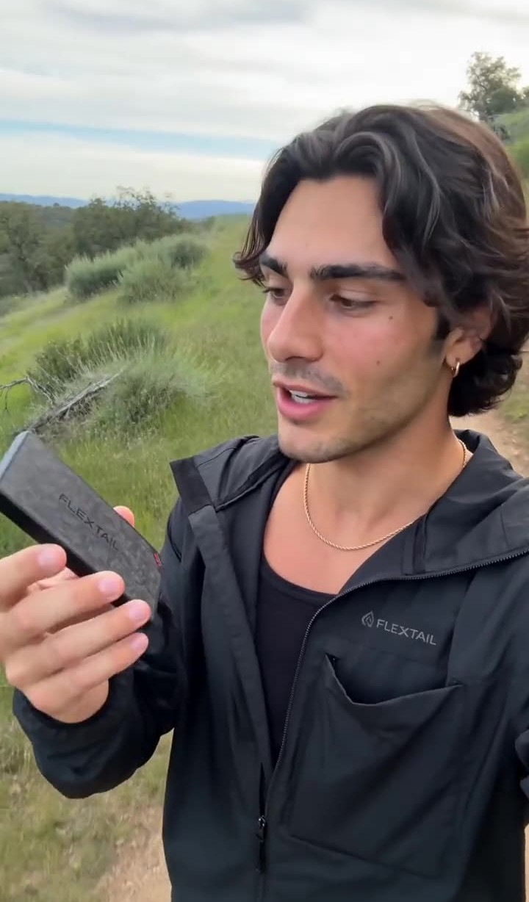
CATEGORY B — UGC & CREATOR-STYLE CONTENT
2026's hottest content format
AI creators deliver the same authentic, phone-shot energy as human UGC — without usage fees or creator churn.
ASSET
MARKET RATE
OUR ZONE
UGC-style video ad
$198 /video
$99–199
UGC variations pack (×5)
$500–1,500
$299–499
AI brand ambassador (recurring)
$2k–10k/mo
$500–1,500/mo
Unboxing / first-impression clips
$150–350
$79–149
Example: Flextail — UGC review
avatiser. studios — services catalog
5

Slide 6
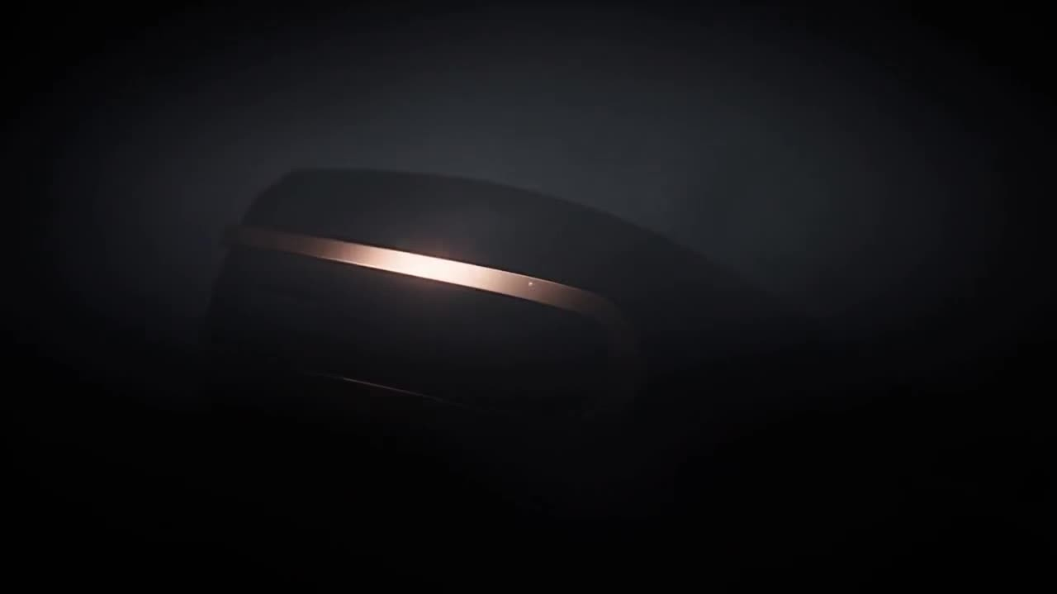
CATEGORY C — PERFORMANCE & PAID-SOCIAL CREATIVE
The volume game — where retainers live
Static and video ad creative built for Meta/TikTok/YouTube, tested at scale across hooks and audiences.
ASSET
MARKET RATE
OUR ZONE
Video ads (6s/15s/30s cuts)
$100–500 /video
$79–199
Creative-testing matrix (10–20 var.)
$1k–3k /batch
$499–999
Monthly creative retainer
€4k–21.5k/mo
$1.5k–5k/mo
Ad localization (per market)
$200–500
$99–199
Example: Ikonic Professional — hero reel
avatiser. studios — services catalog
6

Slide 7
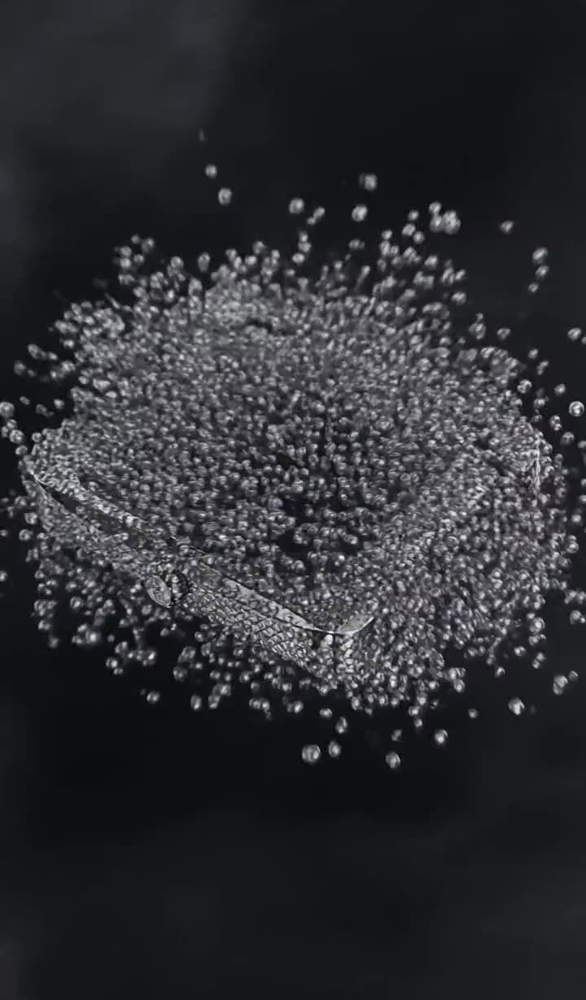
CATEGORY D — ORGANIC SOCIAL MEDIA CONTENT
The always-on content engine
Calendars, reels, carousels and profile kits that keep a brand feed alive between campaigns.
ASSET
MARKET RATE
OUR ZONE
Monthly content calendar
$1k–5k/mo
$499–1,999/mo
Reels / Shorts (entertainment-led)
$150–500
$99–199
Carousel posts (3–8 slides)
$100–300
$59–129
Founder / personal-brand visuals*
$500–2k/shoot
$199–399/set
Example: Signature — fragrance macro film
avatiser. studios — services catalog
7

Slide 8
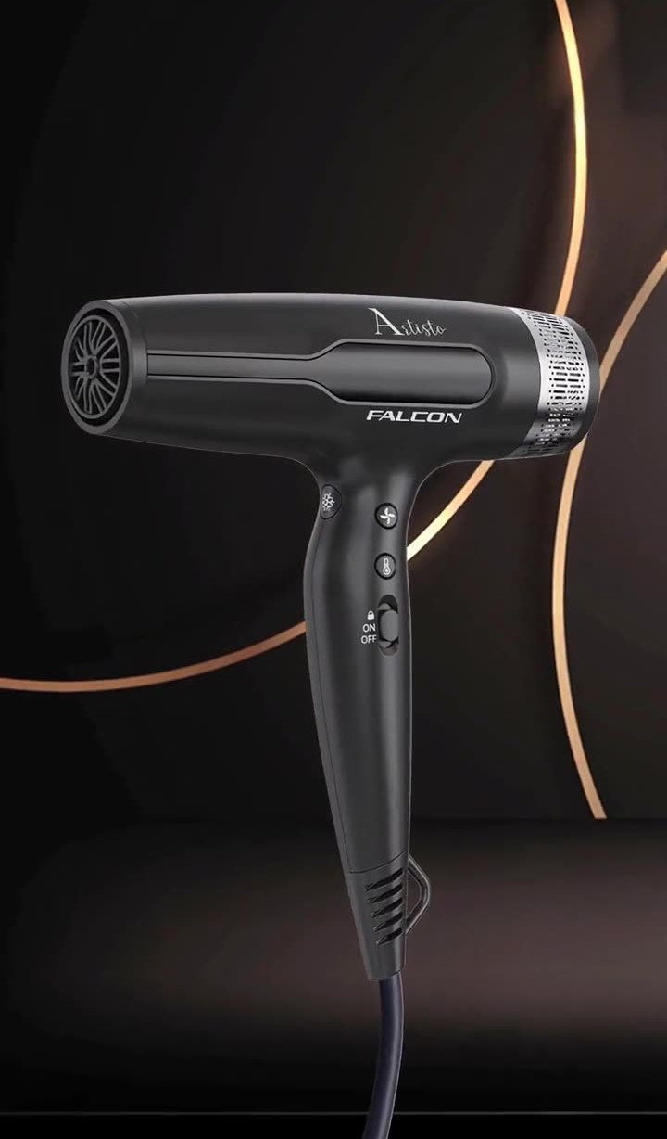
CATEGORY E — VIDEO & FILM
The flagship — shots no camera could take
From cinematic product films to CGI-impossible spectacle ads. This is the portfolio’s lead category.
ASSET
MARKET RATE
OUR ZONE
Cinematic product film
$5k–20k
$499–1,999
Brand anthem film (60–90s)
$10k–50k
$1,499–4,999
Product hero loops (web/retail)
$1k–3k
$199–499
"Impossible-shot" spectacle ads
$10k+ (CGI)
$799–1,999
Example: Hair Dryer — x-ray hero reel (impossible shot)
avatiser. studios — services catalog
8

Slide 9
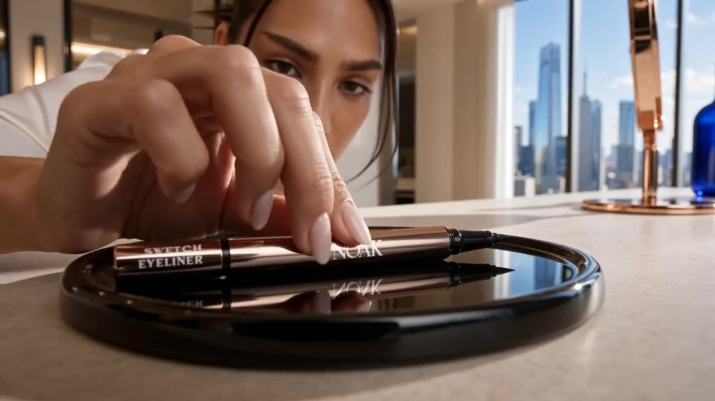
CATEGORY F — BRANDING & IDENTITY
A proprietary visual world, not a logo PDF
Skip commoditized logo work — sell full brand imagery systems nobody else can price this low.
ASSET
MARKET RATE
OUR ZONE
Brand imagery system (15–30 img)
$2k–8k shoot
$399–999
Visual identity starter
$2k–15k
$499–1,499
Brand mascot / character design
$2k–10k
$499–1,299
Packaging concept visualization
$1k–5k
$299–799
Example: Eyeliner — macro product film
avatiser. studios — services catalog
9

Slide 10
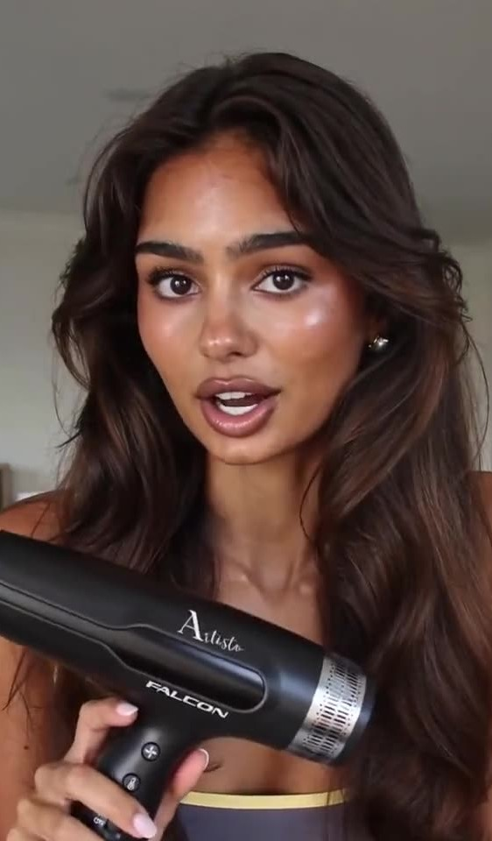
CATEGORY G — WEBSITE & DIGITAL ASSETS
Every pixel a site actually needs
Hero loops, imagery kits and landing visuals — the same system that built avatiser.com itself.
ASSET
MARKET RATE
OUR ZONE
Full site imagery kit (10–25 img)
$2k–6k shoot
$499–1,299
Website hero visuals / loops
$500–2k
$149–399
Landing-page visual pack
$800–2,500
$299–699
Icon & illustration sets
$500–3k
$199–599
Example: Haircare — UGC campaign reel
avatiser. studios — services catalog
10

Slide 11
CATEGORIES H–K
Supporting categories
Smaller standalone deal sizes — sell as add-ons to the categories above, not as lead offers.
H · Email & Lifecycle
I · Retail, Print & OOH
J · B2B & Corporate
K · Emerging / Premium
· Email hero images
· Billboard / OOH key visuals
· Pitch-deck visual systems
· AI spokesperson program
· Flow visual kits (welcome/abandon)
· POS / shelf material
· LinkedIn content packs
· Shoppable video kits
· Animated email GIFs
· Print-ad adaptations
· "Team-in-action" imagery
· Product-drop world-building
· Newsletter template visuals
· Retail screen loops
· Explainer / demo videos
· 3D spins / AR previews
avatiser. studios — services catalog
11

Slide 12
GO TO MARKET
Productized packages — fixed price, fixed scope, 48h
PDP Power Pack
$349
8-image full listing pack (hero, lifestyle, macro, infographics)
/ SKU
Launch Pack
$999
PDP pack + hero film + 3 UGC ads + 10 social posts
one-time
UGC Engine
$499
5 UGC videos + 5 creator stills, every month
/ month
The Full World
$2,499
Complete brand campaign — all 10 deliverables + film
one-time
Creative Retainer
$1,999
15 videos + 30 statics, 2 revision rounds, 72h SLA
/ month
avatiser. studios — services catalog
12

Slide 13
STRATEGY
Pricing rules & priority roadmap
PRICING RULES
PRIORITY ORDER
Anchor every proposal against the market rate — always show the agency number first.
1
PDP packs
clearest ROI story — start outbound tomorrow
2
UGC ads
Never price per-hour. Price per-asset or per-outcome — falling production cost is our margin, not the client’s discount.
hottest segment, 29% CAGR market
3
Creative retainers
First deal = free 3-visual sample → PDP pack → retainer. Land, prove, expand.
pursue after 3–5 project clients
4
Impossible-shot films
portfolio flagship + PR magnet
2 revision rounds included, then $49/asset — protects against infinite-tweak clients.
5
Brand imagery systems
differentiated, low competition
avatiser. studios — services catalog
13

Slide 14
BOUNDARIES
What we don't sell (yet)
✕
Media buying / running ads
different skill, different liability — partner instead, keep the creative line
✕
SEO / blog-content writing
off-brand, commoditized
✕
Real-person deepfakes or celebrity likenesses
never — consented client-founder content only, in writing
✕
Standalone logo design
crowded market — sell only inside identity packs
✕
Live-action shoots
the moment we rent a camera, we’re competing in the market we’re disrupting
avatiser. studios — services catalog
14

Slide 15
avatiser.
produced with AI — directed by humans
full detail + editable data: business/SERVICES_CATALOG.md
avatiser. studios — services catalog
15

