Slide 1
Omaima Yousef Al-twaim
Section : (A)
Course no.3143
New Seven Wonders of the World

Slide 2
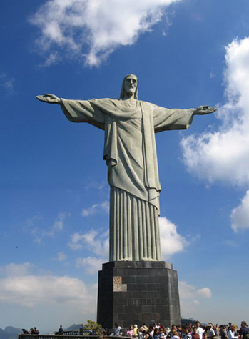
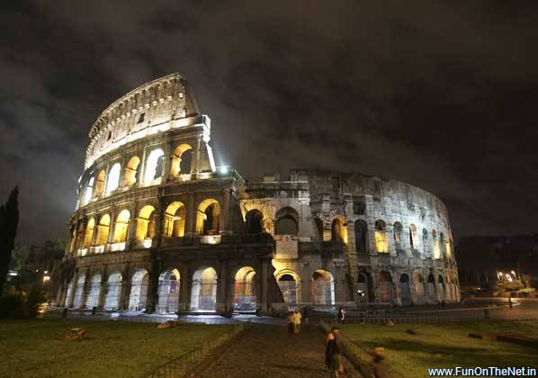
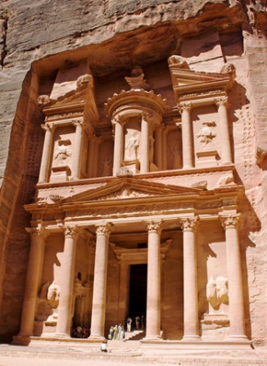
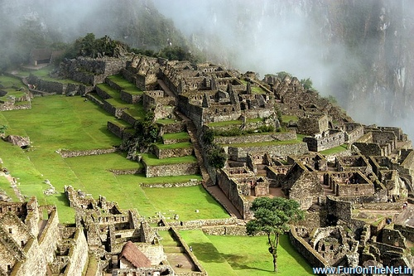
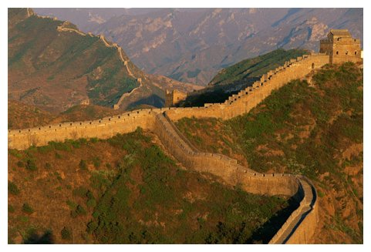
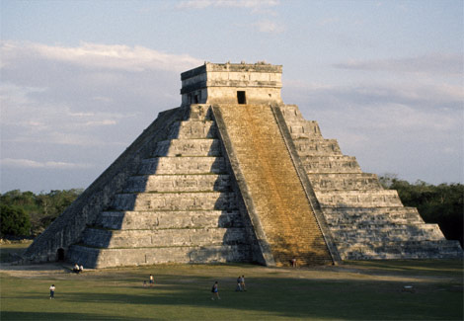
New Seven Wonders of the World
the new version of the seven wonders of the world have been elected by more than 100 million votes from all over the world in 7-7-2007.

Slide 3
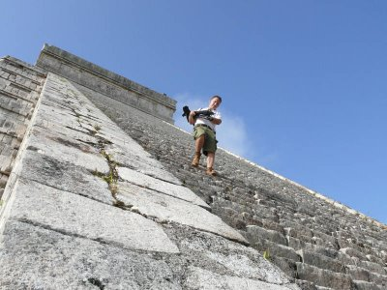
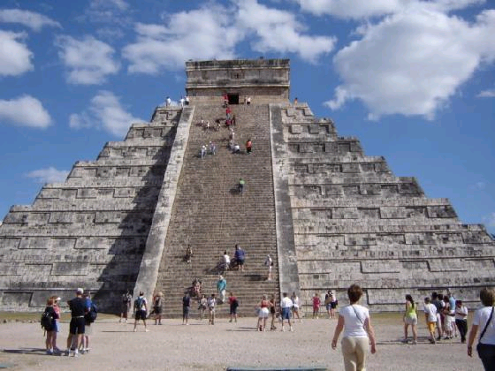
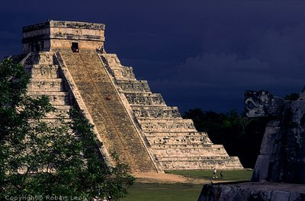
CHICHEN ITZA
the most famous temple city of the Mayas.
Each of its four sides has 91 steps—one step for each day of the year, with the 365th day represented by the platform on the top.
symbolizes Worship & Knowledge!

Slide 4
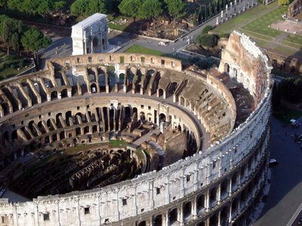
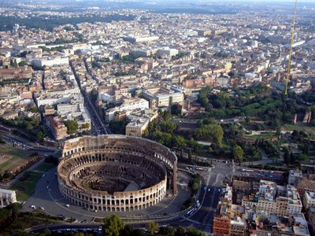
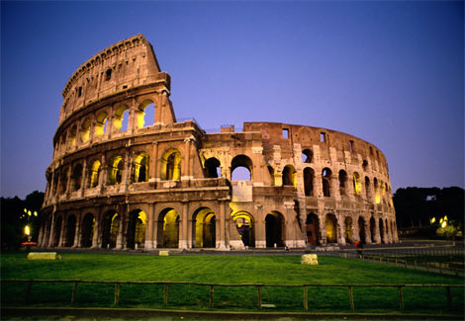
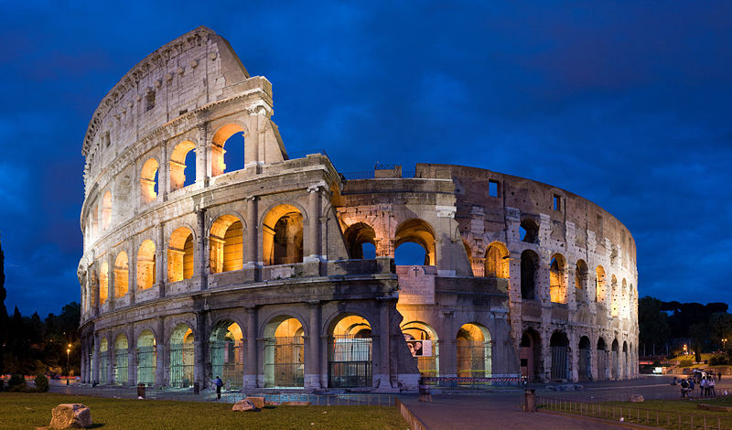
COLOSSEUM
In Rome.
capable of seating around 50,000 spectators
Gladiators’ fights and public performances.
a symbol of Joy & Suffering!

Slide 5
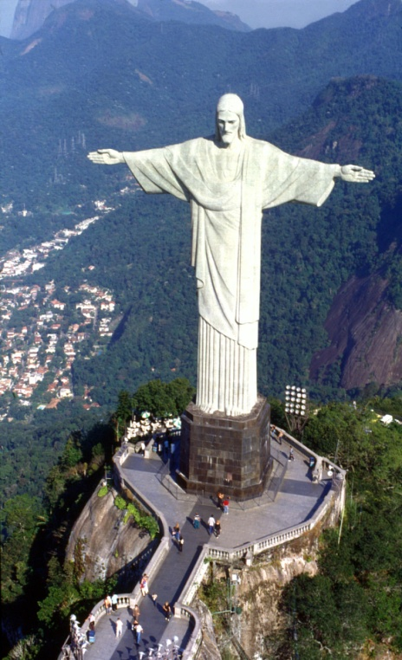
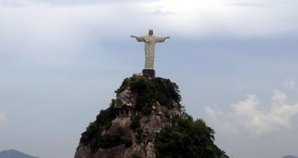
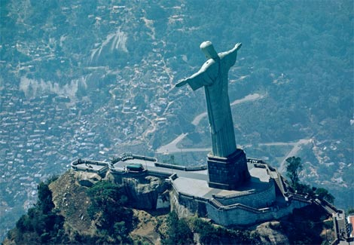
CHRIST THE REDEEMER
In Rio de Janeiro, Brazil.
a statue of Jesus Christ in Brazil.
Is located 700 m. above sea level.
stands for Welcoming & Openness!

Slide 6
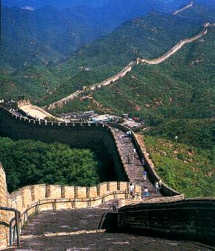
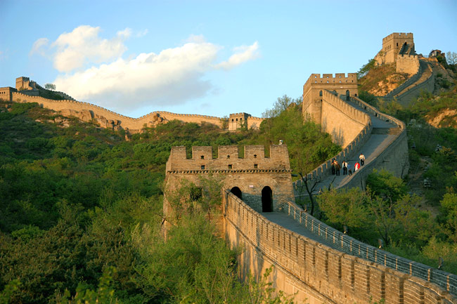
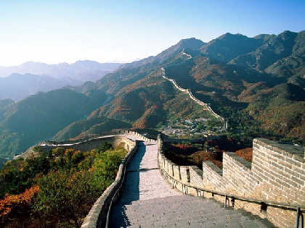
GREAT WALL OF CHINA
Is an ancient Chinese fortification.
It was built to protect the rule of China between the 5th century BC and the 16th century.
7,300 km from east to west.
is incredible proof of Perseverance & Persistence!

Slide 7
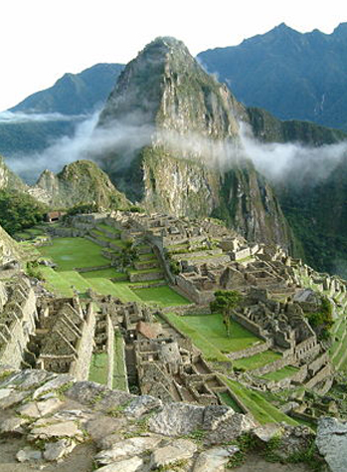
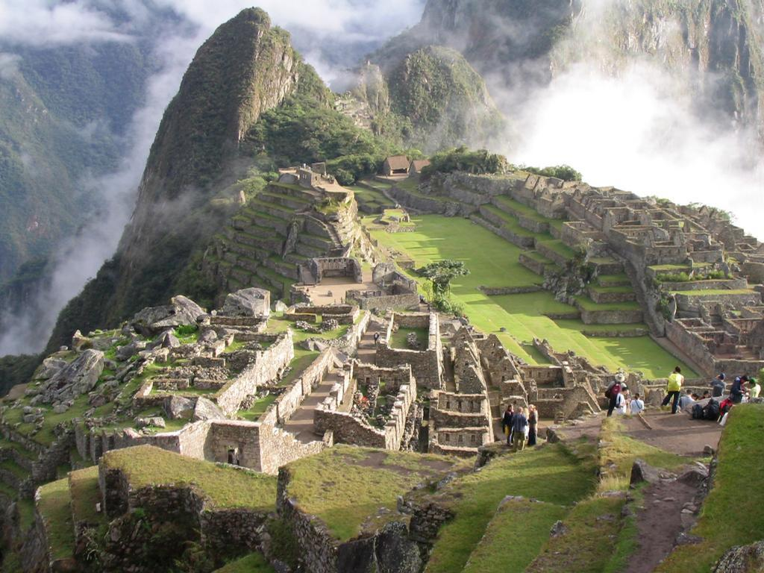
MACHU PICCHU
In the south of Perú
“Lost City”.
created by the Inca Empire
It was used as a religious sanctuary
and a palace.
a symbol of Community & Dedication!

Slide 8
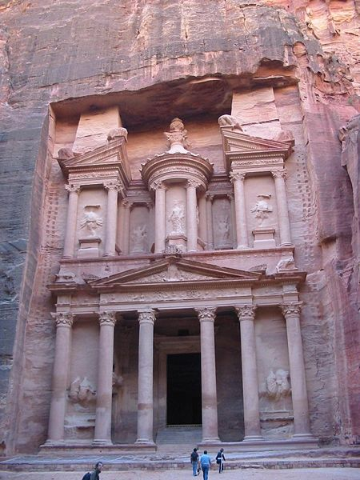
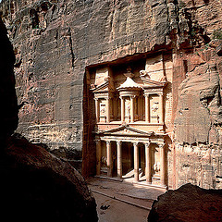
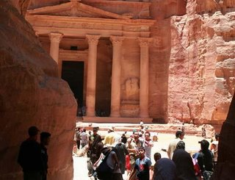
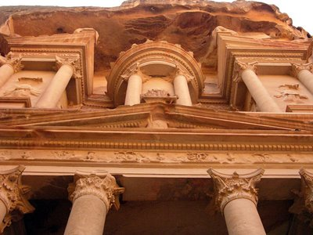
PETRA
In Jordan.
Petra means rock in Greek.
Its buildings are worked
on the same rock in the
Valley.
a great symbol of Engineering & Protection!

Slide 9
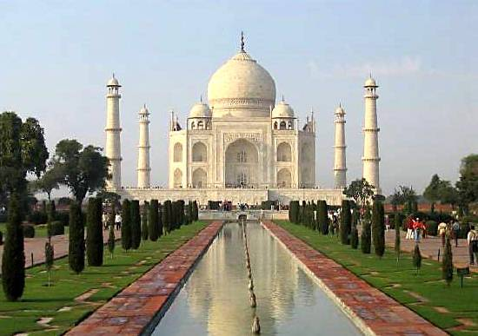
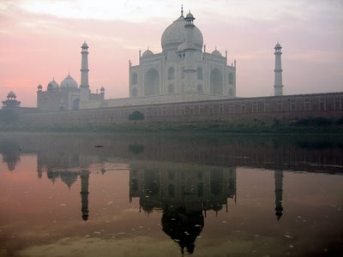
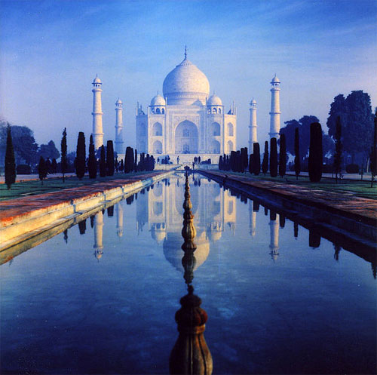
TAJ MAHAL
In Agra, India
15 years to complete
by Muslim Mughal Emperor Shah Jahan to honor the memory of his beloved late wife, , Mumtaz Mahal.
is a great symbol of Love & Passion!

Slide 10
