Slide 1




HIDE & SEEK
Prepositions
PLAY

Slide 2
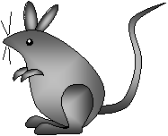

Where is the mouse?
in
between
on
above
under
near
next to
in front of
behind
NEXT

Slide 3

Where is the mouse?
in
between
on
above
under
near
next to
in front of
behind
NEXT

Slide 4
Where is the mouse?
in
between
on
above
under
near
next to
in front of
behind
NEXT

Slide 5
Where is the mouse?
in
between
on
above
under
near
next to
in front of
behind
NEXT

Slide 6
Where is the mouse?
in
between
on
above
under
near
next to
in front of
behind
NEXT

Slide 7
Where is the mouse?
in
between
on
above
under
near
next to
in front of
behind
NEXT

Slide 8

Where is the mouse?
in
between
on
above
under
near
next to
in front of
behind
NEXT

Slide 9
Where is the mouse?
in
between
on
above
under
near
next to
in front of
behind
NEXT

Slide 10

Where is the mouse?
in
between
Yes! It is under the hat.
on
above
OK
under
near
next to
in front of
behind
NEXT

Slide 11
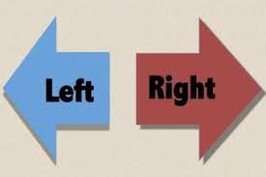
Right and Left

Slide 12
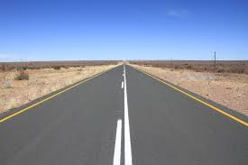

Straight

Slide 13
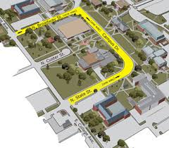
Block, corner and Intersection

Slide 14
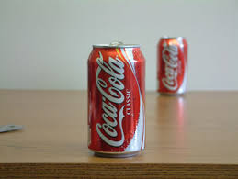
Close and far

Slide 15
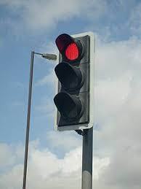
Traffic Light

Slide 16
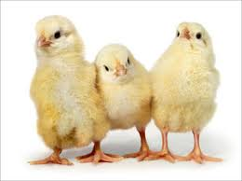
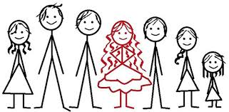
Middle

Slide 17
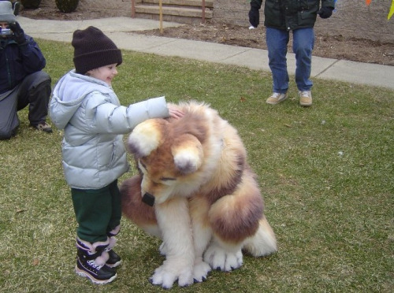
THIS
WHAT IS____________?
THIS IS A DOG.

Slide 18
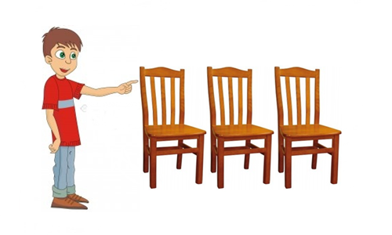
THESE
WHAT ARE _____________?
THESE ARE CHAIRS.

Slide 19
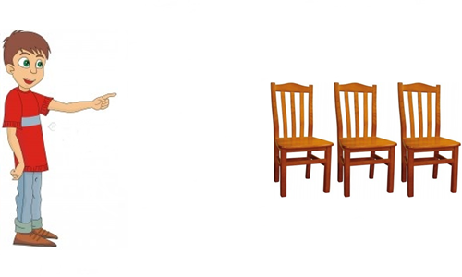
THOSE
WHAT ARE __________?
THOSE ARE CHAIRS.

Slide 20
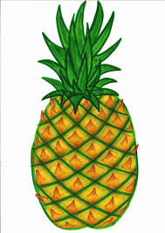

WHAT IS ______?
THAT
THAT IS A PINEAPPLE

