Slide 1
Week 2 Unit 4
Should/shouldn’t and comparatives

Slide 2
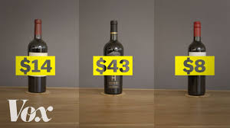
Expensive, cheap, cheaper

Slide 3

Brighter/duller

Slide 4
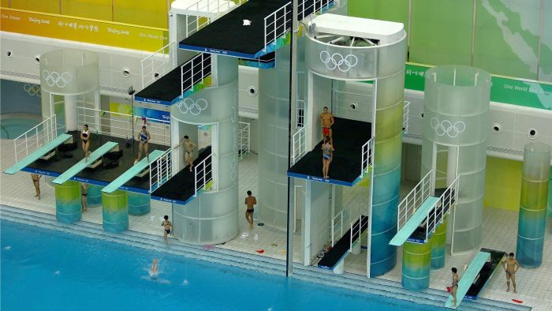
Higher and lower

Slide 5
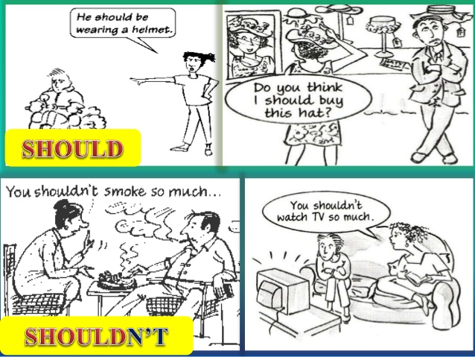
Should and Shouldn’t: Used to give advice

Slide 6
Should and shouldn’t
“You should” means, “I think it is a good idea for you to do it”.
“You shouldn't” means, “I think it is a bad idea for you to do it”.
“Should” expresses the opinion of a speaker and often follows I think or I don't think.

Slide 7
Rules
Should and shouldn’t are modal verbs
The modal verb goes before the verb in the sentence

Slide 8
Examples
You look tired. I think you should rest
Should you be working so much?
I have an English test tomorrow
You shouldn´t worry about it. You have worked really hard
I never have enough money
I don't think you should go out so much

Slide 9
Advertisements (Ads)

Slide 10
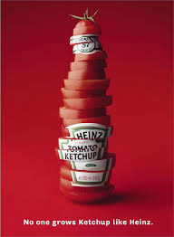
Fresher tasting and no more expensive
than any other tomato ketchup
Available at all supermarkets.
Price: $2.50 per bottle

Slide 11
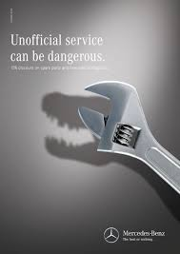
Our service is more expensive
But our quality is the best!
Find us at a Mercedes Benz dealer
In your area.
Prices vary based on services
provided

Slide 12
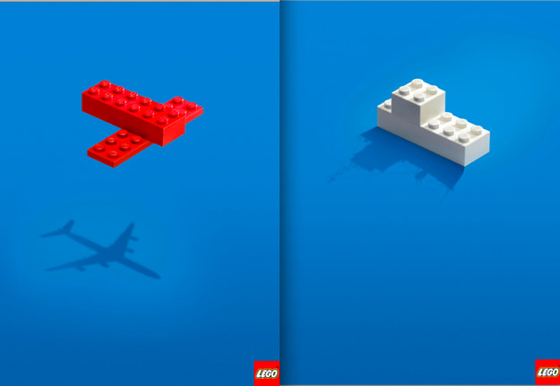
Let your imagination run wild.
Simple building blocks, infinite possibilities.
No other toy can compare.
Prices vary based on size of package.
Found in department stores near you.

