Slide 1
Who is behind the squares?
Call a number and answer a question to uncover a part of the picture.

Slide 2
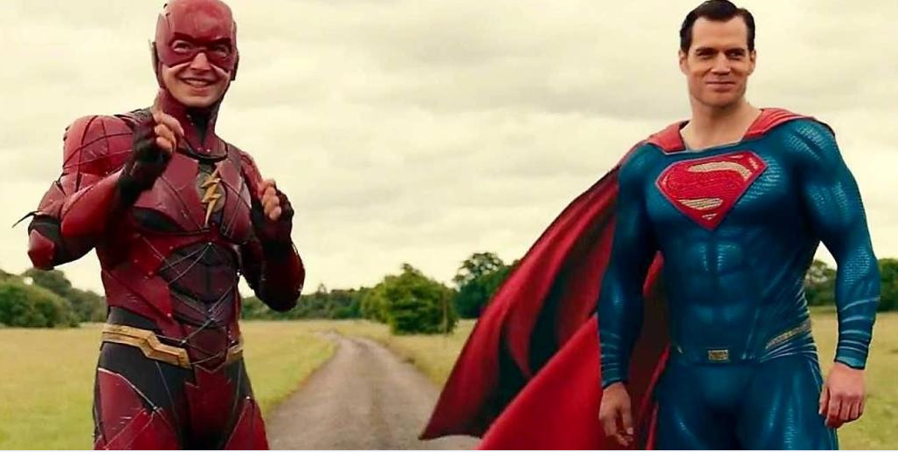
1
2
3
4
5
6
7
8
9
10
11
12
13
14
15
16
SHOW

