Slide 1

MEW · TENDER 44/2014-2015 · SECTION 5.1E
The Al Dhaher filling workflow,
end to end on S!aP
Every tanker becomes one governed, prepaid journey — from the gate to the MEW bank account, owned and configurable by MEW.
PREPARED FOR
SCOPE
CLASSIFICATION
DATE
Ministry of Electricity & Water
Al Dhaher LFS · 42 bays
Commercial-in-Confidence
[DD Month YYYY]

Slide 2

CONTENTS
What we will cover.
01
The end-to-end workflow
02
The cast — personas & things
One governed journey, gate to settlement.
Who acts and what moves through the flow.
03
Stage by stage
04
What the user sees
Entry, authenticate, fill, debit & settle.
The MEW Pay app and the operator platform.
05
Governance & resilience
06
Next step
Historized, governed, advised — and offline-safe.
What we are asking MEW to do.
astrikos.ai · Commercial-in-Confidence
2

Slide 3
THE POINT
One workflow turns 42 bays into
secured, prepaid, auditable revenue.
Every step — identity, authorisation, fill, debit, settlement — is historized and explainable, and keeps running when the network drops.
astrikos.ai · Commercial-in-Confidence
3

Slide 4
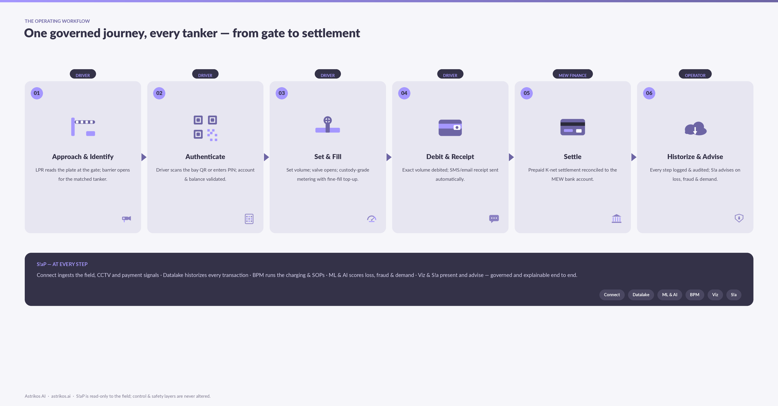
EXHIBIT · THE WORKFLOW
One governed journey, every tanker
astrikos.ai · Commercial-in-Confidence
4
Six steps, three personas, one platform underneath — read left to right; the ink band is what S!aP does at every step.

Slide 5
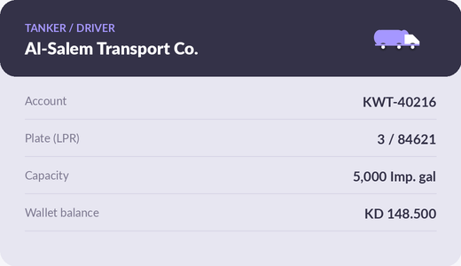









THE CAST
Who acts, and what moves through the flow
PERSONAS
Tanker driver
Arrives, authenticates and fills — via the truck card & MEW Pay app.
Station / Salmiya operator
Monitors bays, alarms and CCTV; acts on S!a guidance.
MEW finance & admin
THINGS IN THE FLOW
Owns accounts, K-net settlement, reporting and audit.
QR / PIN
Bay unit
Valve & meter
K-net
Receipt
Audit
astrikos.ai · Commercial-in-Confidence
5

Slide 6



STAGE 01 · DRIVER
A matched tanker, admitted without a ticket
LPR reads the plate
A gate camera captures the plate in day or 0-lux night and matches it to an account.
Barrier opens automatically
Matched tankers are admitted; unmatched vehicles fall back to QR at the gate.
Truck card in hand
Owner, account, plate and wallet travel with the driver — the actor for the whole journey.
The truck card — identity for the journey.
S!AP · CONNECT + ML & AI
LPR runs on S!aP ML & AI; the entry event is historized in the Datalake and matched to the tanker account in real time.
astrikos.ai · Commercial-in-Confidence
6

Slide 7
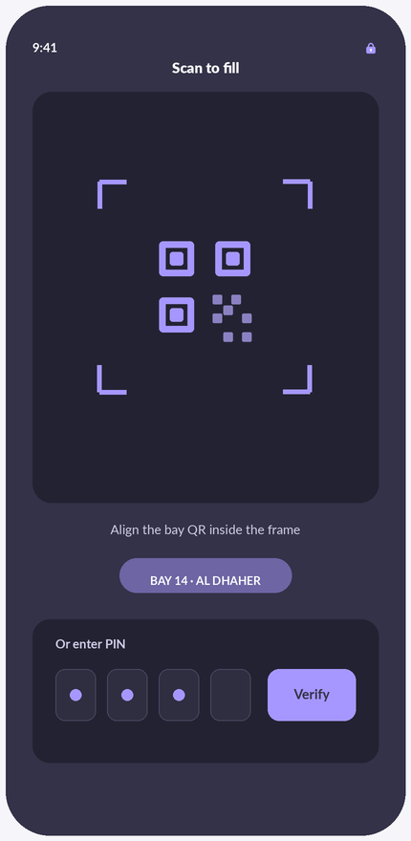


STAGE 02 · DRIVER
Only a valid account, with balance, can fill
Scan the bay QR
The driver scans the bay QR in the MEW Pay app — or enters the card serial.
Enter PIN
A numeric PIN authenticates the user; three wrong tries locks the account and alerts the owner.
Balance validated
S!aP checks the wallet and shows the balance before any valve opens.
S!AP · BPM + DATALAKE
MEW Pay — scan to fill
BPM validates the account and balance and opens the transaction; every attempt is logged with an immutable audit trail.
astrikos.ai · Commercial-in-Confidence
7

Slide 8
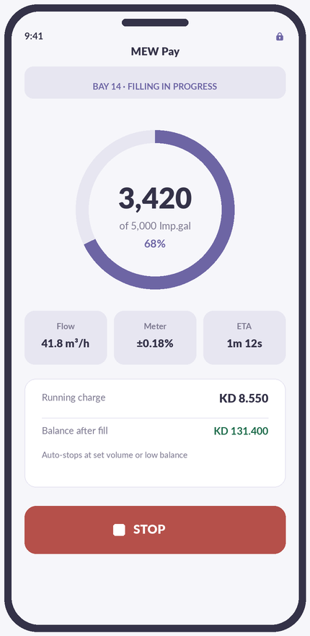


STAGE 03 · DRIVER
Exact volume, custody-grade, no water lost
Set volume, valve opens
The driver sets a volume; the tight shut-off valve opens under S!aP control.
Custody-grade metering
A certified meter (±0.18%) counts every gallon; fine-fill top-up hits the set point.
Auto-stop & anti-surge
Fills stop at the set volume or low balance, with smooth ramps to avoid water hammer.
S!AP · CONNECT + ML & AI
MEW Pay — filling in progress
Connect drives the valve/meter loop; mass-balance analytics compare inlet vs. dispensed to flag water loss.
astrikos.ai · Commercial-in-Confidence
8

Slide 9
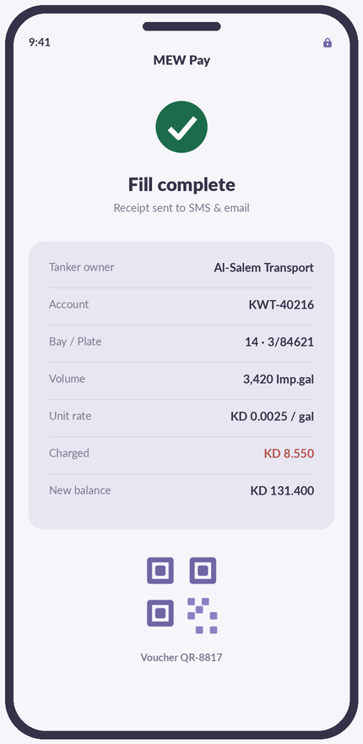

STAGE 04 · DRIVER & MEW FINANCE
Paid to the exact gallon, reconciled to the bank
Exact-volume debit
The wallet is debited for the precise volume dispensed — never an estimate.
Receipt on completion
An SMS and email receipt is sent automatically, with a voucher QR.
K-net settlement
Prepaid funds reconcile through K-net to the MEW bank account, matched daily.
S!AP · BPM + DATALAKE
MEW Pay — receipt
BPM posts the debit and settlement; the Reconciler agent matches K-net to the MEW bank and flags any mismatch.
astrikos.ai · Commercial-in-Confidence
9

Slide 10
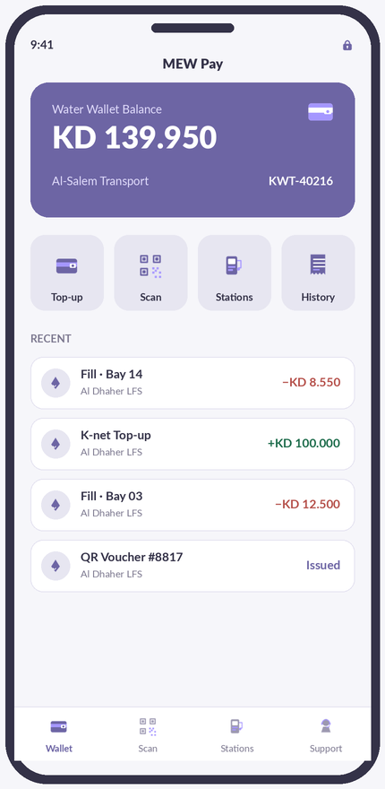
PRODUCT · DRIVER
What the tanker owner actually sees
Wallet & quick pay
One balance, top-up via K-net, scan-to-fill and full transaction history — in the driver’s pocket.
Receipt & voucher
Exact charge, new balance and a voucher QR — sent automatically to SMS & email on completion.
astrikos.ai · Commercial-in-Confidence
10

Slide 11
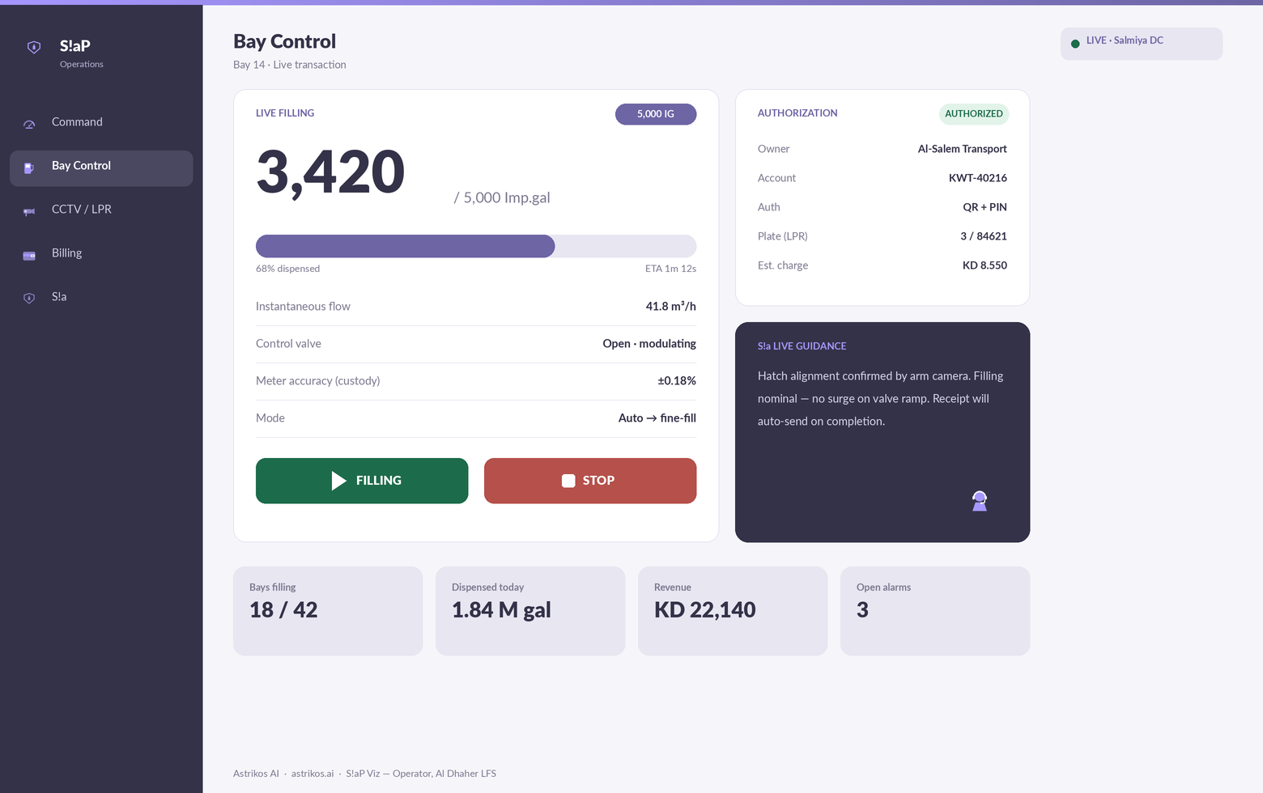
PRODUCT · OPERATOR
What the operator actually sees
astrikos.ai · Commercial-in-Confidence
11
S!aP Viz — live bay control at Al Dhaher, mirrored to the Salmiya command centre, with S!a guidance and one-click stop.

Slide 12

GOVERNANCE & RESILIENCE
Every step is owned, explained and safe
Historized
Governed
Advised
Every transaction, signal and event is stored in the Datalake — 10-year retention, DR-replicated to South Surra.
Prepaid rules, SOPs and RBAC in BPM & Core; an immutable audit trail for finance and inspection.
S!a scores water-loss, fraud and demand, and recommends actions behind human-approval gates.
OFFLINE-SAFE BY DESIGN
If the WAN drops, bays keep filling on the last-known balance and store transactions locally — a bay operates up to 15 days offline, then reconciles automatically when the link returns. Nothing is lost, nothing double-charged.
astrikos.ai · Commercial-in-Confidence
12

Slide 13
NEXT STEP
Approve a one-bay pilot and see the
full workflow run in four weeks.
A pilot bay proves identity, prepaid fill, receipt and settlement end to end before roll-out — the tender already provides for it (§2.9).
connect@astrikos.ai
Astrikos AI Technologies Limited · Bengaluru · Dubai · Singapore · Texas · astrikos.ai
Think it. Ask it. Act on it.

