Slide 1
Kubernetes
Introduction to k8s
Spark on k8s.
Vishnu Prasad

Slide 2

Kubernetes

Slide 3
What is Kubernetes ?
Kubernetes is an open source container orchestration engine for automating deployment, scaling, and management of containerised applications.

Slide 4
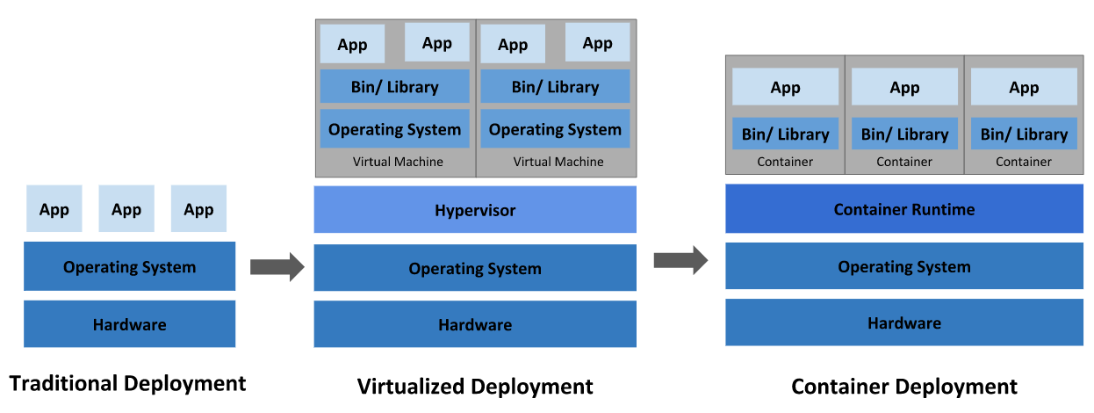
Going back in time

Slide 5
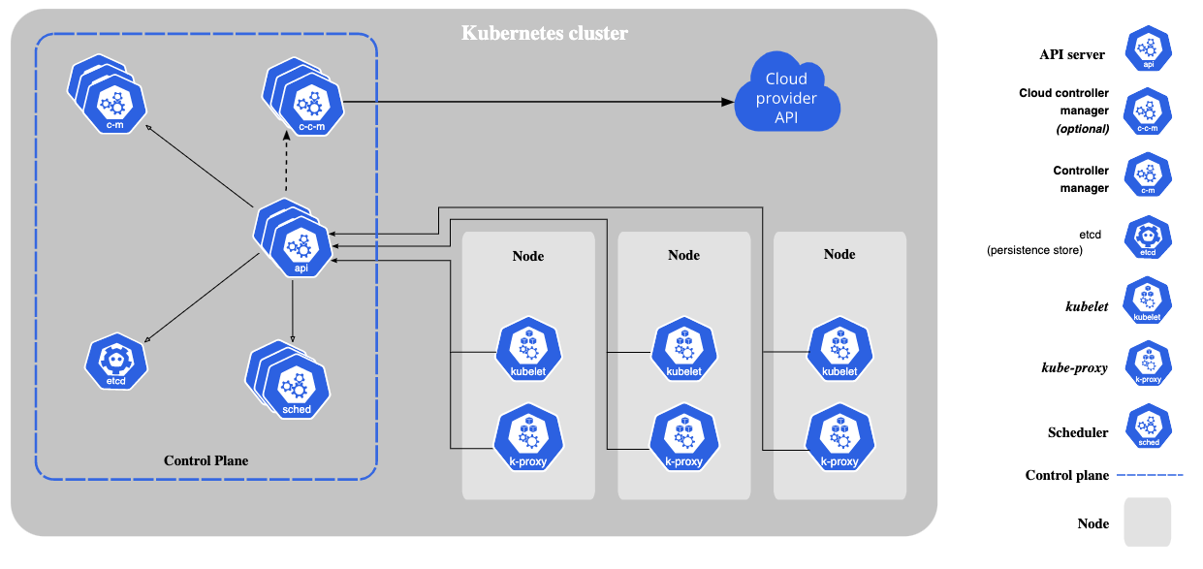
What is Kubernetes ?

Slide 6
Spark on Kubernetes

Slide 7
Spark Kubernetes Resource Scheduler
Native kubernetes support from spark > 2.3.
The interface is Still Experimental as of Spark 3.0.
So expect changes in interfaces.
Missing security features.
Missing full dynamic allocation of resources.

Slide 8
Spark on EMR
Slow boot up time.
Spark version is fixed based on the EMR version.
Dependency management is difficult as it has to be baked into the bootstrap scripts or as an AMI.
Additional premium cost for instances.

Slide 9
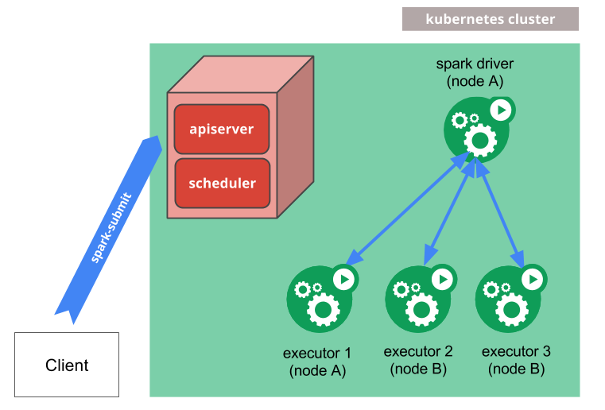
Spark on kubernetes

Slide 10
Spark on kubernetes
Very fast boot-up time.
Fast autoscaling of pods.
Shuffle aware scale-down. (Soft dynamic allocation)
All dependencies can be baked into the docker image.

Slide 11
Perquisites
A running Kubernetes cluster at version >= 1.6 with access configured to it using kubectl.
The service account credentials used by the driver pods must be allowed to create pods, services and configmaps.
You must have Kubernetes DNS configured in your cluster.

Slide 12
Cluster Mode
$ ./bin/spark-submit \
--master k8s://https://<k8s-apiserver-host>:<k8s-apiserver-port> \
--deploy-mode cluster \
--name spark-pi \
--class org.apache.spark.examples.SparkPi \
--conf spark.executor.instances=5 \
--conf spark.kubernetes.container.image=<spark-image> \
--conf spark.kubernetes.namespace=test-namespace \
s3://path/to/examples.jar
The spark UI can be accessed via kubectl proxy

Slide 13
Client mode
Change deploy mode to client.
Client Mode Networking (worker pods should be able to connect to the driver).
spark.driver.host & spark.driver.port
Client Mode Executor Pod Garbage Collection.
spark.kubernetes.driver.pod.name
Will ensure that once the driver pod is deleted from the cluster, all of the application’s executor pods will also be deleted.

Slide 14
Spark-on-k8s Operator
There are two ways of submitting spark jobs.
  spark-submit with master as k8s.
  (as previous examples)
  Spark-on-k8s Operator

Slide 15
Submitting Spark Jobs on k8s
Spark-Submit:
  Vanilla way from spark main open source repo
  Configs spread between Spark config (mostly) and k8s manifests.
  Little pod customisation support before Spark 3.0
  App management is more manual.
Spark-on-k8s operator:
  Open-sourced by Google.
  Config in k8s-style yaml.
  also supports configmaps, volumes and affinities.
  Tooling to read logs, kill, restart, schedule apps.
  Required a long-running system pod

Slide 16
Spark-on-k8s operator manifest file
apiVersion: "sparkoperator.k8s.io/v1beta2"
kind: SparkApplication
metadata:
name: spark-pi
namespace: default
spec:
type: Scala
mode: cluster
image: "spark:v3.0.0"
imagePullPolicy: Always
mainClass: org.apache.spark.examples.SparkPi
mainApplicationFile: "s3a://jars/spark-examples_2.12-3.0.0.jar"
sparkVersion: "3.0.0"
restartPolicy:
type: Never
volumes:
- name: "test-volume"
hostPath:
path: "/tmp"
type: Directory
driver:
cores: 1
coreLimit: "1200m"
memory: "512m"
labels:
version: 3.0.0
serviceAccount: spark
volumeMounts:
- name: "test-volume"
mountPath: "/tmp"
executor:
cores: 1
instances: 1
memory: "512m"
labels:
version: 3.0.0
volumeMounts:
- name: "test-volume"
mountPath: "/tmp"

Slide 17
App management in Practice
Spark-Submit:
# Run an app
$ spark-submit --master k8s://https://<api-server> …
# List apps
k get pods -label "spark-role=driver"
NAME READY STATUS RESTARTS AGE
my-app-driver 0/1 Completed 0 25h
# Read logs
k logs my-app-driver
# Describe app
# No way to actually describe an app and its parameters…
Spark-on-k8s operator:
# Run an app
$ kubectl apply -f <app-manifest>.yaml
# List apps
$ kubectl get sparkapplications
NAME AGE
my-app 2d22h
# Read logs
sparkctl log my-app
# Describe app
$ kubectl get sparkapplications my-app -o yaml
apiVersion: sparkoperator.k8s.io/v1beta2
kind: SparkApplication
arguments:
- s3://path/to/data/
mainApplicationFile: local:///opt/my-app/main.jar
...
status:
applicationState:
state: COMPLETED
...

Slide 18
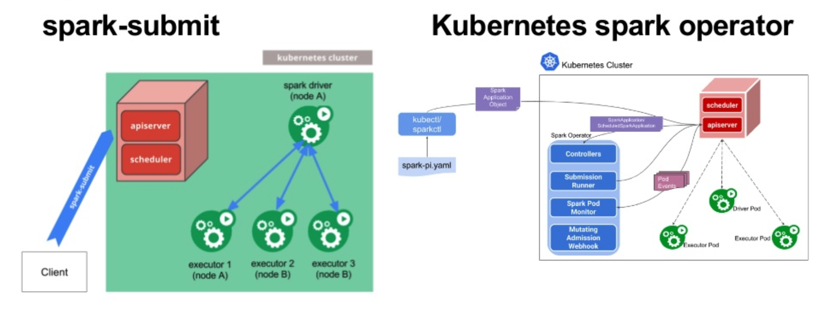
Comparison in workflow

Slide 19
Dynamic Allocation on kubernetes
Full dynamic allocation is not available. When killing an exec pod, you may lose shuffle files that are expensive to recompute. There is ongoing work to enable it (JIRA: SPARK-24432).
In the meantime, a soft dynamic allocation is available from Spark 3.0. Only executors which do not hold active shuffle files can be scaled down.

Slide 20
Cluster autoscaling & dynamic allocation.
k8s can be configured to autoscale if pending pods cannot be allocated.
Autoscaling plays well with dynamic allocation:
  <10s to get a new exec if there is room in the cluster
  1-2 min if the cluster needs to autoscale
Requires to install the cluster autoscaler on EKS (AWS).

Slide 21
Further cost reduction with spot instances.
Spot instances can reduce costs up to 75%.
  If an executor is killed, Spark can recover
  If the driver is killed, game over!
Node selectors and affinities can be used to constrain drivers on on-demand nodes.

Slide 22
Spark history server
Setting up a History server is relatively easy:
Direct your Spark event log file to S3/GCS/Azure Storage Account with the spark.eventLog.dir config
Install the Spark history server Helm chart on your cluster
What’s missing: resource usage metrics!

Slide 23
Export Spark metrics to a time-series database
Spark leverages the DropWizard library to produce detailed metrics.
The metrics can be exported to a time-series database:
InfluxDB
Prometheus
  Spark has a built-in Prometheus servlet since version 3.0

Slide 24
Security
Kubernetes security best practices apply to Spark on Kubernetes.
Access Control
Strong built-in RBAC system in Kubernetes.
Spark apps and pods benefit from it as native k8s resources.
Secrets management
Kubernetes secrets as a first step.
Integrations with solutions like HashiCorp Vault.
Networking
Mutual TLS, Network policies.
Service mesh like Istio.

Slide 25
Pod Templates
Kubernetes allows defining pods from template files. Spark users can similarly use template files to define the driver or executor pod configurations.
To do so, specify the spark properties spark.kubernetes.driver.podTemplateFile spark.kubernetes.executor.podTemplateFile
to point to local files accessible to the spark-submit process.

Slide 26
Using Kubernetes Volumes
Users can mount the following types of Kubernetes volumes into the driver and executor pods:
hostPath: mounts a file or directory from the host node’s filesystem into a pod.
emptyDir: an initially empty volume created when a pod is assigned to a node.
persistentVolumeClaim: used to mount a PersistentVolume into a pod.
--conf spark.kubernetes.driver.volumes.[VolumeType].[VolumeName].mount.path=<mount path>
--conf spark.kubernetes.driver.volumes.[VolumeType].[VolumeName].mount.readOnly=<true|false>
--conf spark.kubernetes.driver.volumes.[VolumeType].[VolumeName].mount.subPath=<mount subPath>

Slide 27
Features being worked on by the community.
Shuffle improvements: Disaggregating storage and compute
  Use remote storage for persisting shuffle data: SPARK-25299
  Goal: Enable full dynamic allocation, and make Spark resilient to node loss (e.g. spot).
Better Handling for node shutdown
  Copy shuffle and cache data during graceful decommissioning of a node: SPARK-20624.
Job Queues and Resource Management.

Slide 28
Why are we looking at Running spark on Kubernetes?
Sheer curiosity !!
Better context aware Auto Scaling.
Easier integration with services like Airflow & JupyterLab.
Simplified dependency management.

Slide 29
Cost Savings on the EMR premium.
In July we spent 126k on r5.2xl instances.
And another additional 31.5K on EMR premium.
That is a 25% additional cost we can save just by switching from EMR to EKS.

Slide 30
Things that we are working on and experimenting with.
Running Airflow on top of k8s.
Planning on using EKS as opposed to EMR for running our Spark jobs.
Airflow eks_hook (after k8s next release.)

Slide 31


Questions ?

Slide 32
EMR premium cost for different Instance types.
| instance-type | ec2 | premium | percentage |
|--------------- |------- |--------- |------------ |
| m5.xlarge | 0.192 | 0.048 | 25% |
| m5.2xlarge | 0.384 | 0.096 | 25% |
| m5.4xlarge | 0.768 | 0.192 | 25% |
| m5.8xlarge | 1.536 | 0.27 | 18% |
| m5.12xlarge | 2.304 | 0.27 | 12% |
| m5.16xlarge | 3.072 | 0.27 | 9% |
| m5.24xlarge | 4.608 | 0.27 | 6% |
| m4.large | 0.1 | 0.03 | 30% |
| m4.xlarge | 0.2 | 0.06 | 30% |
| m4.2xlarge | 0.4 | 0.12 | 30% |
| m4.4xlarge | 0.8 | 0.24 | 30% |
| m4.10xlarge | 2 | 0.27 | 14% |
| m4.16xlarge | 3.2 | 0.27 | 8% |
| c5.xlarge | 0.17 | 0.043 | 25% |
| c5.2xlarge | 0.34 | 0.085 | 25% |
| c5.4xlarge | 0.68 | 0.17 | 25% |
| c5.9xlarge | 1.53 | 0.27 | 18% |
| c5.12xlarge | 2.04 | 0.27 | 13% |
| c5.18xlarge | 3.06 | 0.27 | 9% |
| c5.24xlarge | 4.08 | 0.27 | 7% |
| r5.xlarge | 0.252 | 0.063 | 25% |
| r5.2xlarge | 0.504 | 0.126 | 25% |
| r5.4xlarge | 1.008 | 0.252 | 25% |
| r5.8xlarge | 2.016 | 0.27 | 13% |
| r5.12xlarge | 3.024 | 0.27 | 9% |
| r5.16xlarge | 4.032 | 0.27 | 7% |
| r5.24xlarge | 6.048 | 0.27 | 4% |

Slide 33
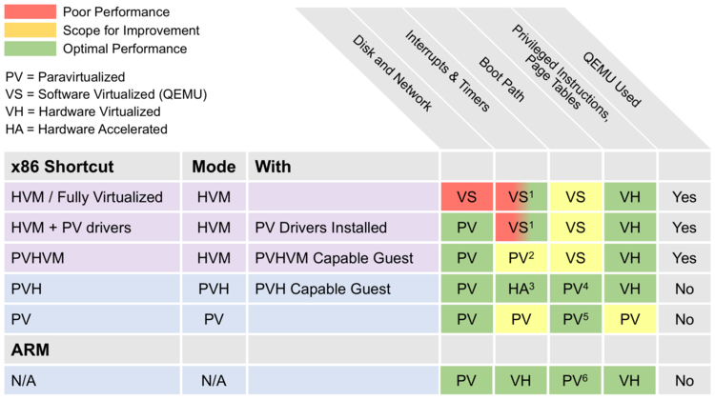
Xen virtualisation Mode comparison

