Slide 1
from voice memo to production-ready code
❯
Tom Alterman · tom@tomalterman.com · 30 Sep 2026
tom@ptsf ~ %
01 / 37
Notes:
Tonight I'm going to walk through how I use a combination of tools to go from a rough idea to a production-ready pull request.

Slide 2
Warning: We’re all figuring it out as we go
❯
tom@ptsf ~ %
02 / 37
Notes:
The tools will keep changing, and I'll swap them out when something better comes along.

Slide 3
Warning: Don’t trust any “AI experts”
❯
tom@ptsf ~ %
03 / 37
Notes:
The tools will keep changing, and I'll swap them out when something better comes along.

Slide 4
the stack
❯
tom@ptsf ~ %
04 / 37
Notes:
Five tools. Not married to any of them.

Slide 5
01
claude code
❯
or codex or cursor or grok or muse or whatever…
tom@ptsf ~ %
05 / 37
Notes:
The agent. Interchangeable.

Slide 6
02
github
❯
source of truth
tom@ptsf ~ %
06 / 37
Notes:
GitHub is the underlying source of truth.

Slide 7
03
compound engineering
❯
open-source plugin from Every · the secret sauce
tom@ptsf ~ %
07 / 37
Notes:
This is the core. Runs on Claude Code today, I've used it with Codex, works with whatever agent you point it at.

Slide 8
04
monologue
❯
voice → clean writing · also from Every
tom@ptsf ~ %
08 / 37
Notes:
Voice dictation that turns speech into clean writing, not a raw transcript. I used it to avoid typing. Now I record long rambling brain dumps and feed them straight to the model.

Slide 9
05
impeccable
❯
for when design matters
tom@ptsf ~ %
09 / 37
Notes:
A design skill with a couple dozen commands aimed at AI slop: Inter everywhere, purple gradients, cards in cards. I won't go deep tonight.

Slide 10
what compound engineering is
❯
tom@ptsf ~ %
10 / 37

Slide 11
the whole process, encoded.
❯
idea → shipped → maintained
tom@ptsf ~ %
11 / 37
Notes:
A group of very conscientious engineers tried to encode the entire process from idea to shipped, maintained product.

Slide 12
80% planning + review
20% execution
❯
tom@ptsf ~ %
12 / 37
Notes:
The philosophy is 80 percent planning and review, 20 percent execution.

Slide 13
the a-plus version of yourself that wrote it all down.
❯
tom@ptsf ~ %
13 / 37
Notes:
Imagine the A-plus version of yourself who thought carefully about what good brainstorming, planning and code review look like, and wrote it down as repeatable workflows.

Slide 14
a talented, patient engineering team.
❯
+ the world's laziest product manager
tom@ptsf ~ %
14 / 37
Notes:
It behaves like an incredibly talented, hard-working, patient engineering team, and I get to be the world's laziest PM.

Slide 15
the loop
❯
tom@ptsf ~ %
15 / 37
Notes:
36 skills in the plugin. The path from idea to running code is a short chain.

Slide 16
❯
36 skills. 6 I use most.
/ce-brainstorm
/ce-plan
/ce-work
/ce-code-review
/ce-commit-push-pr
/ce-compound
tom@ptsf ~ %
16 / 37
Notes:
Walk the chain top to bottom.

Slide 17
01 / 06
/ce-brainstorm
❯
what does this need to be? · one decision at a time
tom@ptsf ~ %
16 / 37
Notes:
An interactive Q&A that asks you one decision at a time and writes a requirements-only plan. This is where the Monologue brain dump goes.

Slide 18
02 / 06
/ce-plan
❯
what's needed to accomplish this? · requirements → implementation-ready
tom@ptsf ~ %
16 / 37
Notes:
Turns those requirements into an implementation-ready plan.

Slide 19
03 / 06
/ce-work
❯
build it. · verification + commits
tom@ptsf ~ %
16 / 37
Notes:
Executes the plan, with verification and commits.

Slide 20
04 / 06
/ce-simplify-code
❯
clean it before anyone looks
tom@ptsf ~ %
16 / 37
Notes:
Cleans up what was just written before anyone reviews it.

Slide 21
05 / 06
/ce-code-review
❯
multi-persona review against the plan
tom@ptsf ~ %
16 / 37
Notes:
The multi-persona review against the plan.

Slide 22
also in the toolbox
❯
tom@ptsf ~ %
17 / 37
Notes:
A few others I reach for.

Slide 23
DURING THE LOOP
/ce-prototype
❯
feel it before you commit · throwaway build → decisions written back into the plan
tom@ptsf ~ %
18 / 37
Notes:
Builds a throwaway so people can react, then writes those decisions back into the plan.

Slide 24
STARTING FROM A BUG
/ce-debug
❯
root cause · causal chain · optional fix + PR
tom@ptsf ~ %
19 / 37
Notes:
When I'm starting from a bug instead of a feature. Finds the root cause with a causal chain, then offers a fix and a PR.

Slide 25
AFTER THE PR IS OPEN
/ce-babysit-pr
❯
watches the PR · handles review comments · fixes CI · never merges on its own
tom@ptsf ~ %
20 / 37
Notes:
Watches the PR over time, handles incoming review, fixes CI failures. Won't merge on its own.

Slide 26
06 / 06
/ce-compound
❯
capture what we learned · the next loop starts smarter
tom@ptsf ~ %
21 / 37
Notes:
Writes down what was learned so the next loop starts smarter. This is the part that makes it compound.

Slide 27
/lfg
❯
tom@ptsf ~ %
22 / 37
Notes:
And then there's lfg.

Slide 28
❯
the whole pipeline. hands off.
plan
build
simplify
review + apply fixes
browser tests
commit · push · open PR
watch CI
tom@ptsf ~ %
23 / 37
Notes:
Plan, build, simplify, review, apply the fixes, run browser tests, commit, push, open a PR, watch CI with a bounded repair loop.

Slide 29
live example
❯
tom@ptsf ~ %
24 / 37
Notes:
Start with the voice memo, then show each step on screen.

Slide 30
$ demo
❯
voice memo → /ce-brainstorm → /lfg → PR
tom@ptsf ~ %
25 / 37
Notes:
Switch to the terminal.

Slide 31
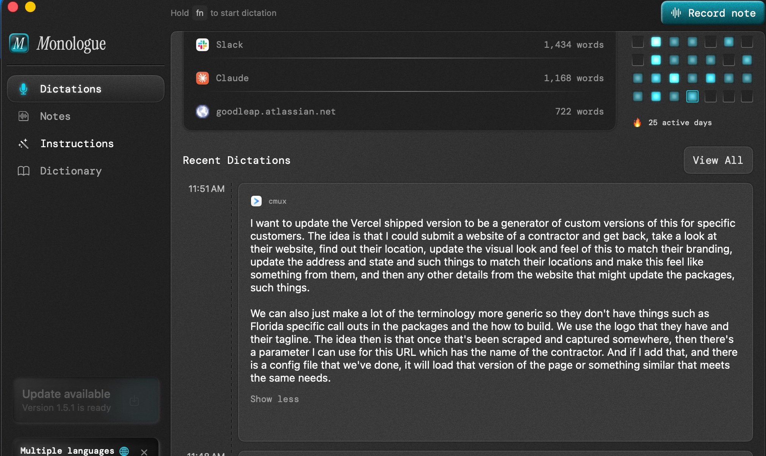
$ demo
❯
voice memo → /ce-brainstorm → /lfg → PR
tom@ptsf ~ %
26 / 37
Notes:
Switch to the terminal.

Slide 32
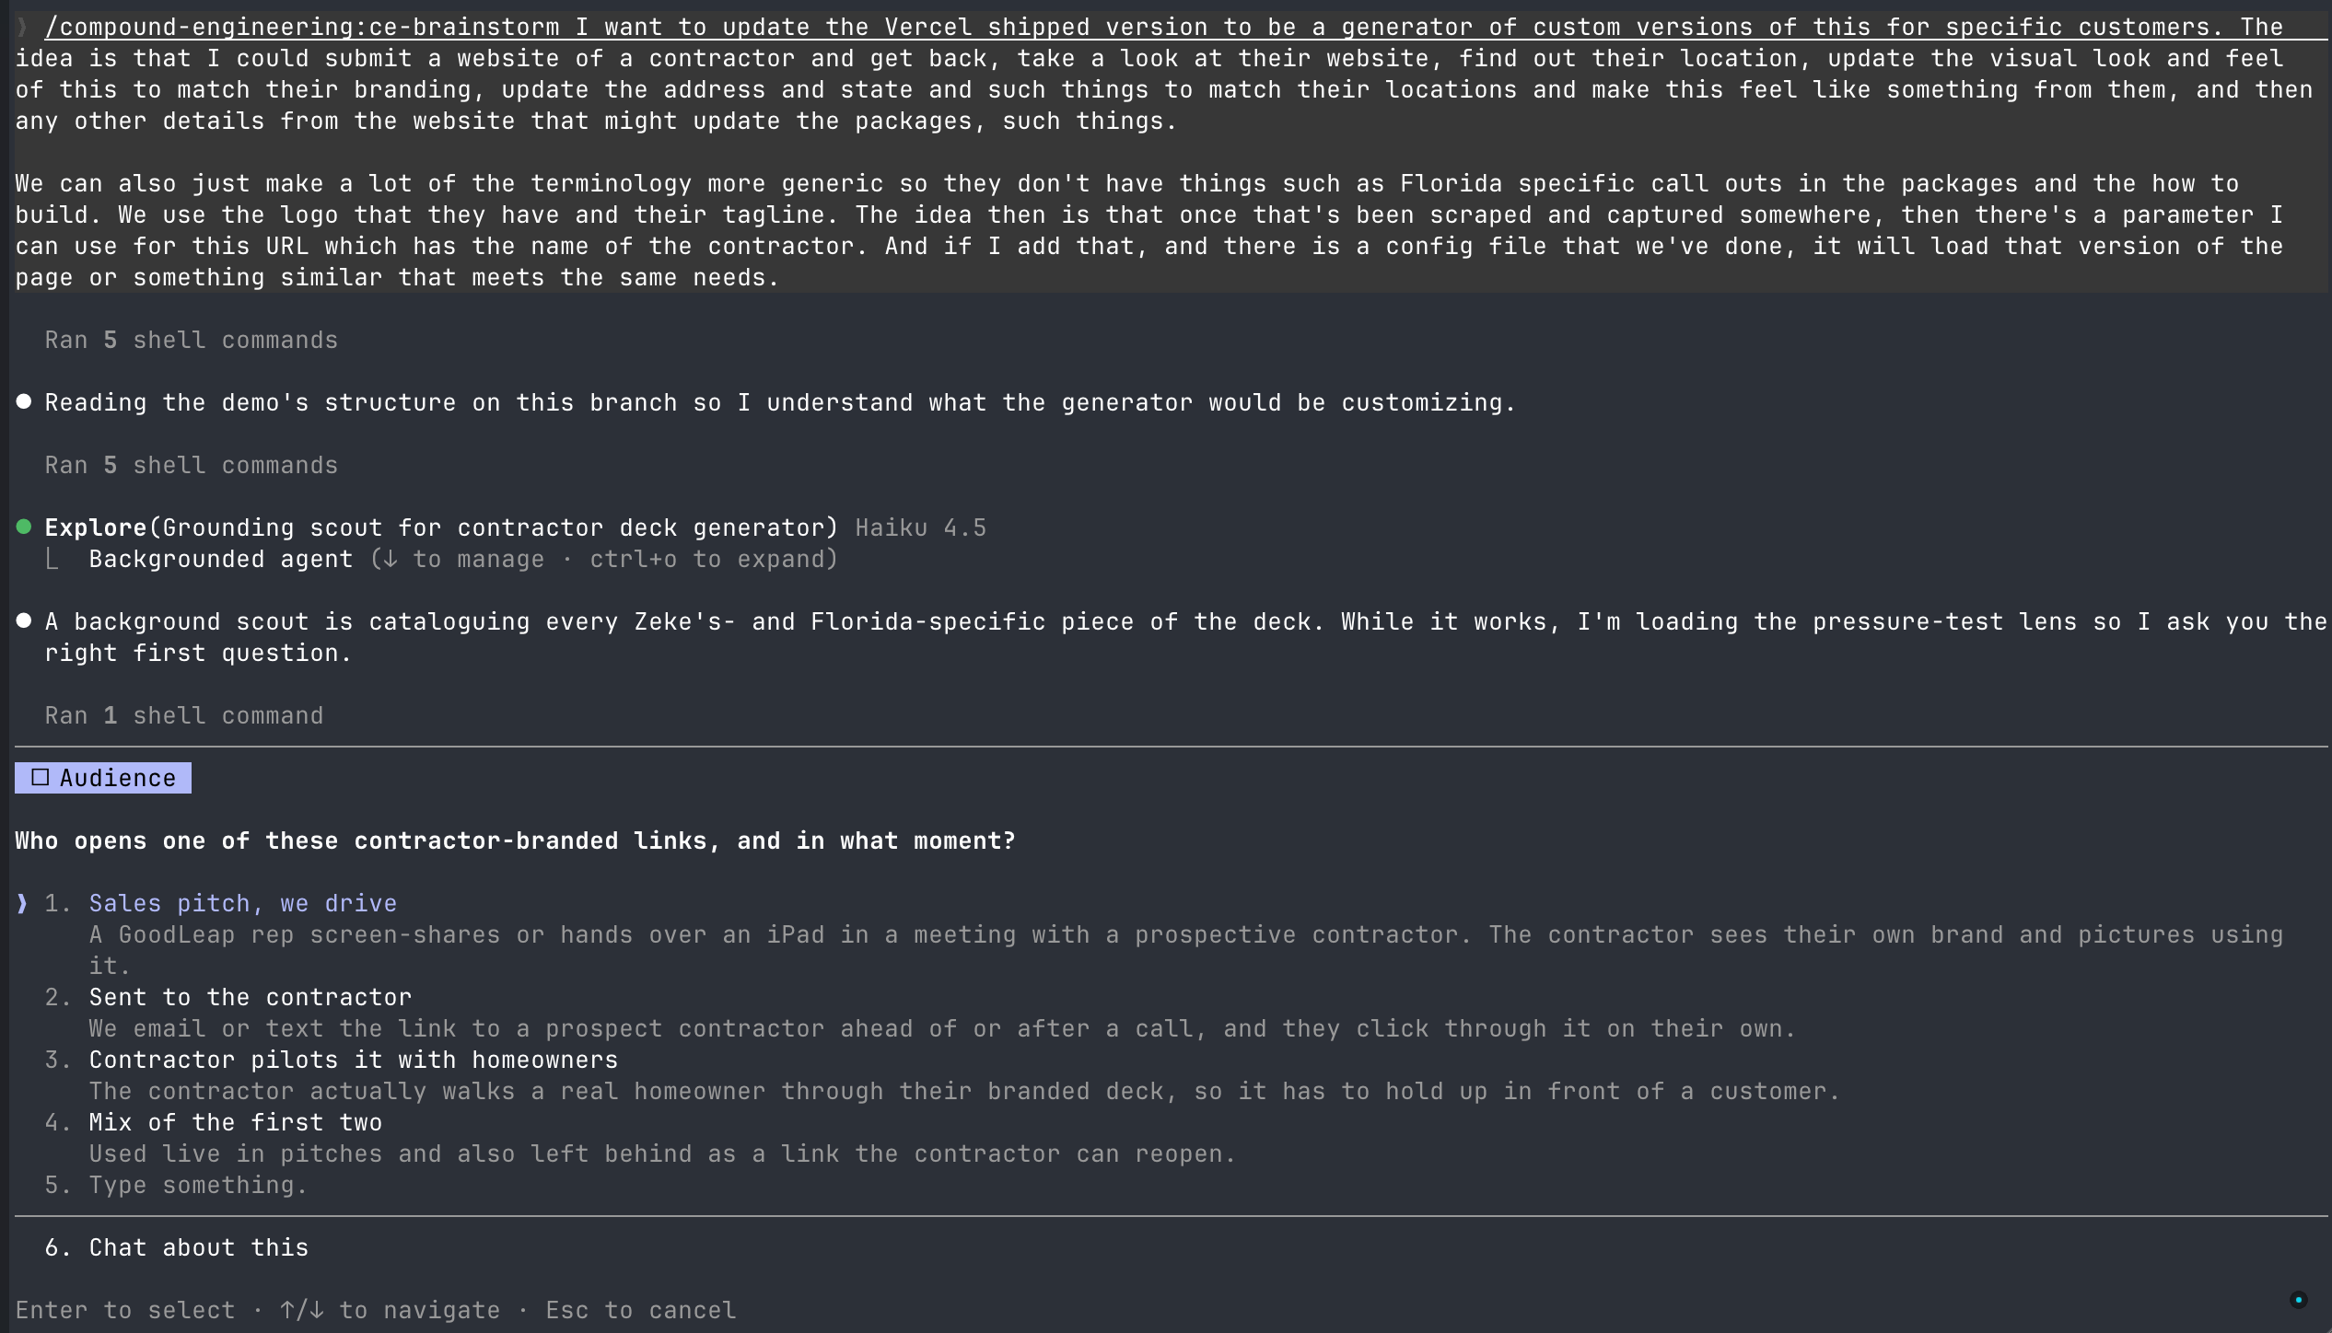
tom@ptsf ~ %
Notes:
Switch to the terminal.

Slide 33
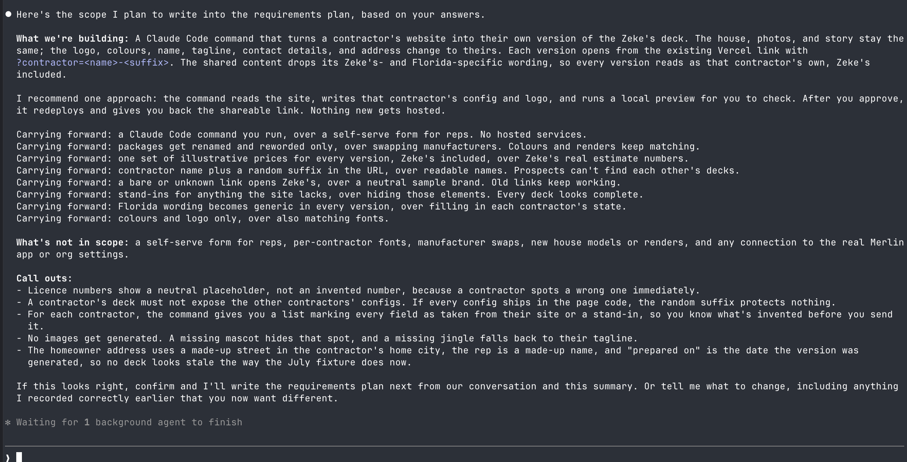
tom@ptsf ~ %
Notes:
Switch to the terminal.

Slide 34
takeaways
❯
tom@ptsf ~ %
29 / 37
Notes:
Start with the voice memo, then show each step on screen.

Slide 35
tools change.
❯
tom@ptsf ~ %
30 / 37
Notes:
The tools will keep changing, and I'll swap them out when something better comes along.

Slide 36
the bottleneck doesn't.
❯
deciding what to build
tom@ptsf ~ %
31 / 37
Notes:
What doesn't change is that the bottleneck is deciding what to build. This workflow clears away everything else.

Slide 37
the hard part was never the code.
❯
tom@ptsf ~ %
32 / 37
Notes:
The hard part of building software was never typing code.

Slide 38
the hard part:
deciding what to build
❯
tom@ptsf ~ %
33 / 37
Notes:
The hard part is figuring out the right thing to build and getting your team to agree with you.

Slide 39
the hard part:
deciding what to build
AND explaining it clearly
❯
tom@ptsf ~ %
34 / 37
Notes:
The hard part is figuring out the right thing to build and getting your team to agree with you.

Slide 40
the hard part:
deciding what to build
AND explaining it clearly
AND get others to agree
❯
tom@ptsf ~ %
35 / 37
Notes:
The hard part is figuring out the right thing to build and getting your team to agree with you.

Slide 41
❯
Links (will be in the GH repo)
github.com/EveryInc/compound-engineering-plugin
every.to/guides/compound-engineering
monologue.to
impeccable.style
tom@ptsf ~ %
36 / 37
Notes:
Links to share.

Slide 42
thanks.
❯
questions?
tom@ptsf ~ %
37 / 37

