Slide 1
AGENTIC COMMERCE
Storyboard and functional path
Four before/after frames of a day-in-the-life purchase, then the Mastercard Agent Pay path from user instruction to the transaction in the issuer app.
01–04
05–06
07–09
Storyboard frames
Path diagrams
Architecture slides
Intent → cart → credential → fulfillment
Light (Stripe) and original dark render
8-step flow, swimlane, issuer control points
Prepared from the August 2026 primer · Agent Pay first live Sep 2025
Agentic commerce storyboard · Mastercard Agent Pay path · August 2026
01 / 10

Slide 2
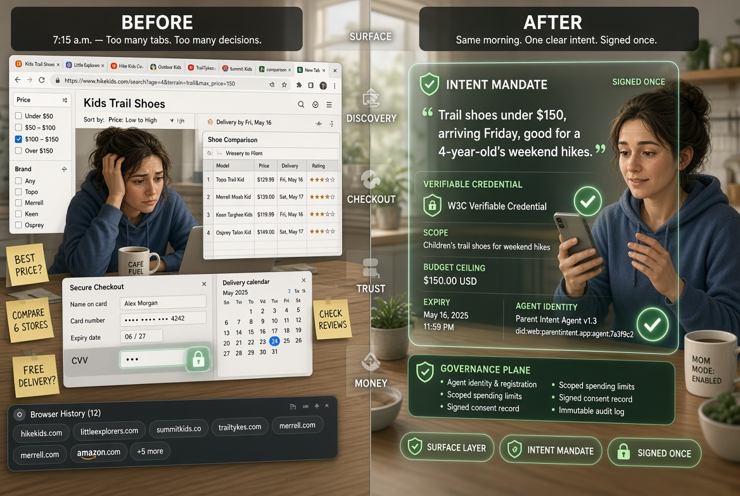
STORYBOARD · FRAME 1
Intent formation — the click disappears
SURFACE + TRUST
Left: tab-heavy search and a half-filled checkout. Right: one signed Intent Mandate. Governance plane is already on the credential.
Agentic commerce storyboard · Mastercard Agent Pay path · August 2026
02 / 10

Slide 3
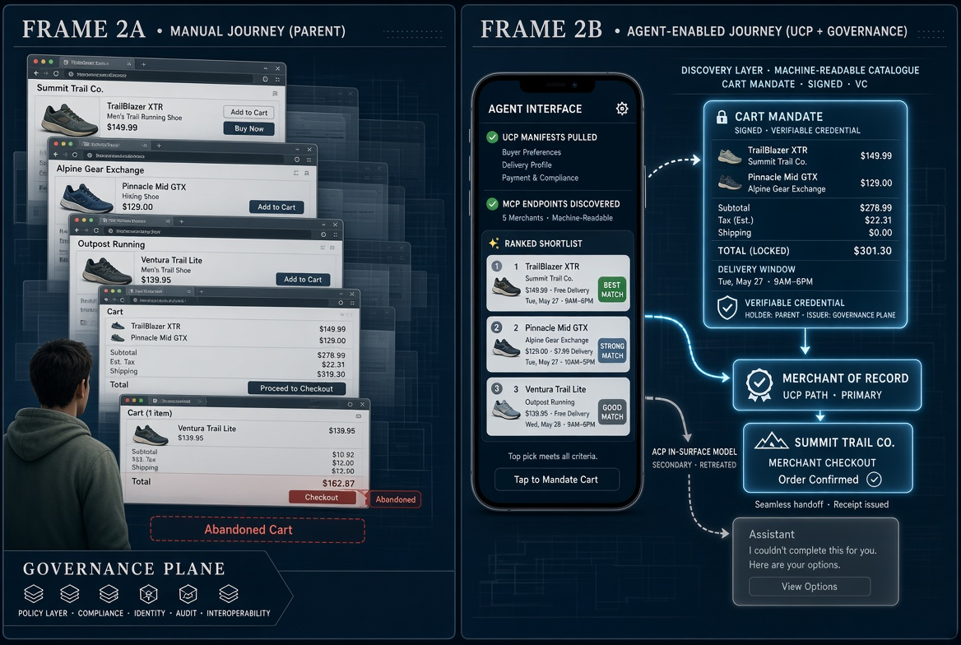
STORYBOARD · FRAME 2
Discovery and cart — merchant of record stays with the retailer
DISCOVERY + CHECKOUT
UCP path (bright) keeps the merchant as MoR. Grey ACP in-surface path is the retreated Instant Checkout model.
Agentic commerce storyboard · Mastercard Agent Pay path · August 2026
03 / 10

Slide 4
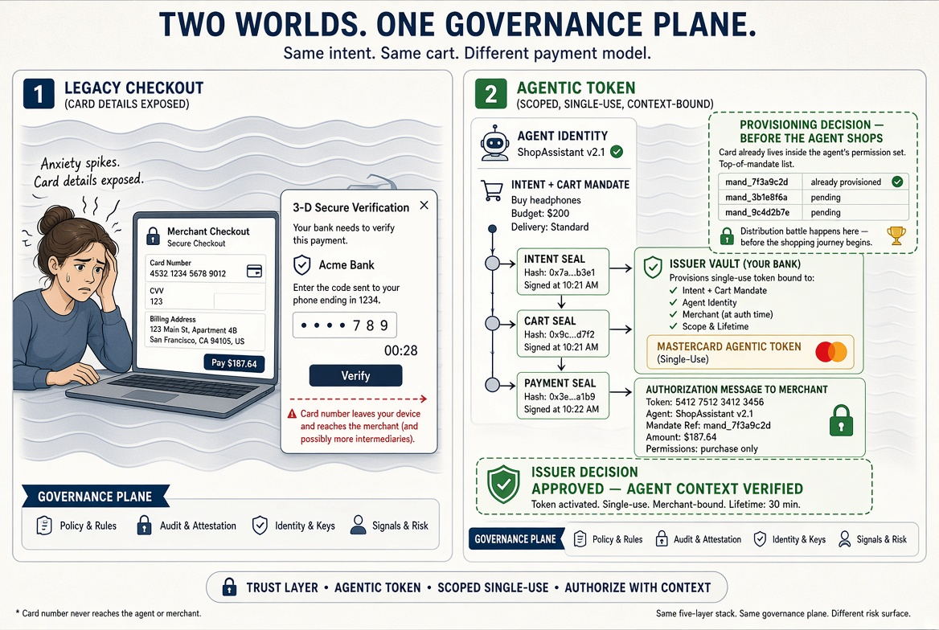
STORYBOARD · FRAME 3
Credential and authorise — provisioning before the agent shops
TRUST + MONEY
Inset is the distribution fight: the card must already sit in the agent’s permission set. PAN never reaches the agent.
Agentic commerce storyboard · Mastercard Agent Pay path · August 2026
04 / 10

Slide 5
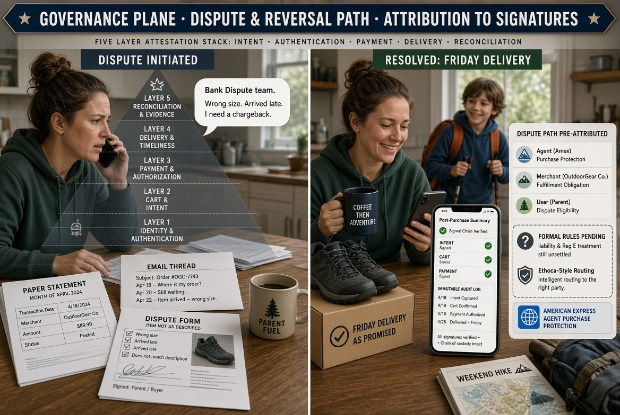
STORYBOARD · FRAME 4
Fulfillment — liability left as a living question
GOVERNANCE PLANE
Signed chain and audit log are visible. Formal chargeback rules and Reg E treatment of agent error remain unsettled.
Agentic commerce storyboard · Mastercard Agent Pay path · August 2026
05 / 10

Slide 6
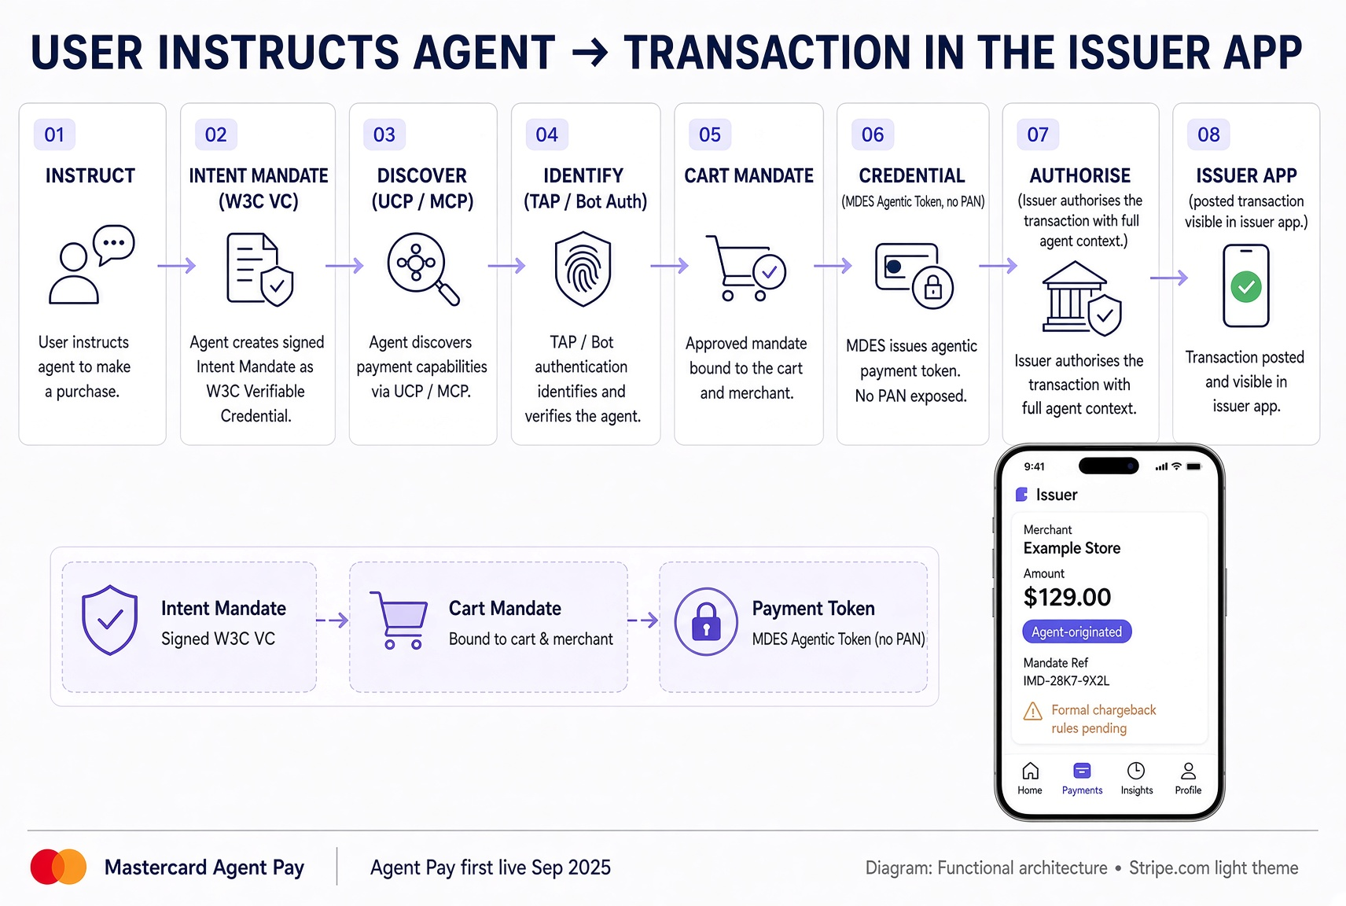
FUNCTIONAL PATH · STRIPE LIGHT
User instructs agent → transaction in the issuer app
PRIMARY DIAGRAM
Eight-step Agent Pay path with the Intent / Cart / Payment chain and an issuer-app posting.
Agentic commerce storyboard · Mastercard Agent Pay path · August 2026
06 / 10

Slide 7
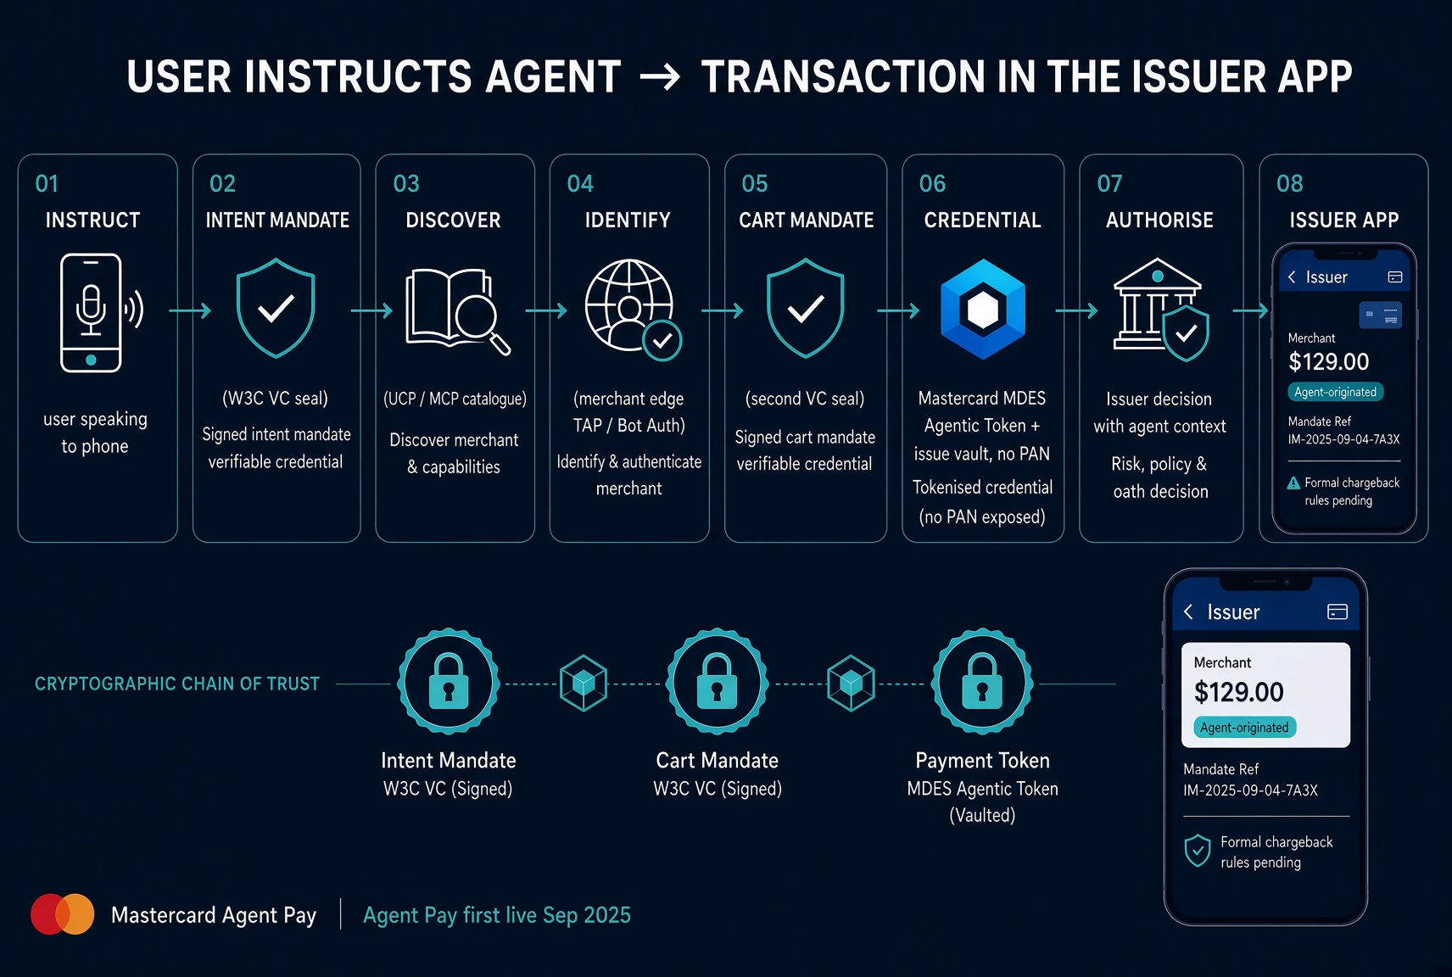
FUNCTIONAL PATH · EARLIER DARK RENDER
Same path, original dark rendering
APPENDIX
Kept as a working alternative. Content is identical to the light diagram — only the theme differs.
Agentic commerce storyboard · Mastercard Agent Pay path · August 2026
07 / 10

Slide 8
ARCHITECTURE · EIGHT STEPS
From user instruction to the transaction in the issuer app
Mastercard Agent Pay
Precondition: the card is already provisioned into the agent’s permission set (top of mandate). If it is not, it never enters the consideration set.
01
SURFACE
02
TRUST
03
DISCOVERY
04
TRUST
05
CHECKOUT
06
MONEY
07
MONEY
08
APP
Instruct
Intent mandate
Discover
Identify
Cart mandate
Credential
Authorise
Issuer app
User states the goal
User signs once
Agent reads catalogue
Merchant edge
Basket is bound
Issuer + MDES
Issuer decides
User sees it
“Trail shoes under $150, arriving Friday.” Surface owns the first question.
W3C VC: scope, budget, expiry, agent identity. Governance plane starts here.
UCP manifests + MCP endpoints. Unstructured merchants drop out.
Visa TAP / Web Bot Auth at Cloudflare/Akamai. Known agent vs scraper.
Second VC locks items, merchant, price. This signature is later dispute evidence.
Single-use Mastercard Agentic Token. PAN never reaches the agent.
Auth carries agent ID + mandate ref. Approve wrong = fraud; decline wrong = switch.
Posted txn with agent flag, merchant, amount, mandate chain, dispute path.
THE SIGNED CHAIN THAT TRAVELS WITH THE PURCHASE
WHAT THE ISSUER APP SHOWS
Intent Mandate
Cart Mandate
Payment credential
Merchant + amount + date
Agent-originated flag (instrument now)
Mandate reference / agent identity
Token last-4, not the PAN
Dispute path: user · merchant · agent
Open: formal chargeback rules pending
Goal, budget, expiry
Agent identity
Signed by user
Items + merchant
Locked price
Dispute evidence
Issuer-issued token
Bound to both VCs
Single-use, scoped
Agentic commerce storyboard · Mastercard Agent Pay path · August 2026
08 / 10

Slide 9
SWIMLANE · WHO DOES WHAT
The issuer only touches provision, credential, auth, and the app
Governance plane cuts every lane
USER
Cardholder
1. States goal
2. Signs Intent
5. Signs Cart
8. Sees it in app
Natural language
VC · budget · expiry
Items · merchant · $
Agent flag + path
AGENT
Surface
Owns first ask
3. Discovers
Builds basket
Requests pay
Consideration set
UCP + MCP feeds
Within mandate
Never holds PAN
MERCHANT
+ edge
Structured data
4. IDs agent
MoR checkout
Or invisible
TAP / Bot Auth
UCP path (live)
MASTERCARD
Agent Pay / MDES
Network rules
6. MDES token
Agent Pay
Scoped single-use
ISSUER
Bank + app
Provisioned first
7. Auth + context
App posting
Before agent shops
Issuer decision
Visible to user
Agentic commerce storyboard · Mastercard Agent Pay path · August 2026
09 / 10

Slide 10
CONTROL POINTS · WHAT THE ISSUER OWNS
Three durable positions: provisioning, the trust decision, and app evidence
Everything else sits above the card
A
PROVISIONING
B
TRUST + AUTH
C
ISSUER APP + DISPUTE
Before the agent shops
At the moment of pay
After it posts
▸ Card enabled for Agent Pay in the agent permission set
▸ MDES issues a single-use agentic token bound to both mandates
▸ Transaction visible with agent-originated flag and mandate ref
▸ Scoped limits already bound (category, merchant class, ceiling, expiry)
▸ Auth message carries agent identity + mandate reference
▸ Cardholder can open the signed chain from the app
▸ If this step is missed, the issuer is not in the consideration set at all
▸ Issuer approves or declines with agent context, not blind
▸ Dispute must resolve to user, merchant, or agent
▸ This is distribution, not product — and it compounds
▸ PAN never leaves the vault; agent never sees the card number
▸ Formal network chargeback rules and Reg E treatment still open
WATCH-OUTS ON THIS SPECIFIC PATH
Agent Pay first went live with US issuers in Sep 2025 and extended across US cardholders in Nov 2025. That makes the rails real. It does not make checkout-inside-the-assistant real — Instant Checkout retreated. The conversion that matters is still: provisioned → discovered → signed cart → tokenised auth → visible in the issuer app. Instrument the agent flag in auth, fraud and dispute data before holiday volume arrives, or the first year of evidence is unreadable.
Agentic commerce storyboard · Mastercard Agent Pay path · August 2026
10 / 10

