Slide 1
Market Design for U.S. Coast Guard Assignments
LCDR Luke Carani, Data Scientist
Officer Personnel Management Division
Officer Assignments Branch (CG-PSC-OPM-2)
U.S. Coast Guard Reserve (USCGR)
Intermediate Deterministic Models, Thursday, February 12th, 2026

Slide 2
Intro
LCDR Luke Carani, USCGR
Career:
DWO/BO/1LT, USCGC ESCANABA (2015 – 2017)
GEOINT Analyst, National Geospatial-Intelligence Agency (2017 – 2020)
Grad School (ORDA PG / Adv Ed Program) (2020 – 2022)
Data Scientist, Workforce Planning and Analytics Div (DCMS-DPR-22) (2022 – 2024)
Data Scientist, OPM-2 (2024 – Present, started reserves October 2025)
Forward Deployed Engineer, Vannevar (2025 – Present)
Education:
US Coast Guard Academy, BS in Operations Research & Computer Analysis, ‘15
National Intelligence University, MSTI in Cyber Intelligence & Data Analytics, ‘20
Stanford University, MS in Management Science & Engineering, ‘22

Slide 3
Agenda
Background & Context
Market Design Overview
2-sided Matching Algorithms (DA + TTC)
Toy Problem # 1 – DA
Toy Problem # 2 – TTC
Assignment Problem Framing (O5 and below)
Assignment Problem Framing (O6)
Assignment Problem Framing (New Accessions)
Further Reading
Notes:
GaleandShapley.revised.IJGT.pdf

Slide 4
Background: Assignment Process
Assignment Officer (Detailer) → make assignments of officers to new jobs
Divided by different “accounts” – afloat, aviation, prevention, intel, response, cyber, etc.
E-Resume → rank-ordered list of specific jobs (billets) an officer is interested in for their next assignment. Required to submit when “in play” or “up for rotation”
Notes:
Assignment process is manual, tedious, information is constantly changing. COLOs, special needs, submitting new lists, new jobs come out, promotions, new list…

Slide 5
Background: Assignment Process
Three distinct groups:
  New accessions (USCGA, OCS, DCO)
  O5 and below
  O6
Can think of these as three different “markets” for trying to assign the right person to the right job
Trying to achieve notion of “optimal” assignment: desired by member, good for career, good for the service, unit, program, etc.
Can we design a marketplace to achieve these outcomes?
Notes:
Helpful to think of three distinct groups or “markets”
Historically very manual process

Slide 6
What is Market Design?
Market design: how can we construct an environment that incentivizes “players” (agents) to follow certain behaviors so that we achieve a desired outcome
Behavior: true (and exhaustive) preferences of officers
Outcome: accelerated, “quality” assignments that rank highly on each officer’s E-Resume
Notes:
Market Design: how do we set up a strategic environment so that if “players” follow a certain type of behavior, we get a desired outcome?

Slide 7
What is Market Design?
Computer Science
Operations Research
Economics
“Reverse Game Theory”
Goals: Fair, Repeatable, Equitable, Defendable, Interpretable
Market Design
Notes:
Compared to Game Theory (2 sides of same coin)
Market Design: how do we set up a strategic environment so that if “players” follow a certain type of behavior, we get a desired outcome?
In market design, when all of the data is available, the problem simply reduces to an optimization problem that can be solved with well known techniques / procedures
Integer programming, linear programming, dynamic programming
The problem is that the real world is more fuzzy. Information is privately held, and we must utilize various incentive mechanisms to reveal information (like true billet rankings)
We need a matching mechanism: a mechanism that maps reported preferences into an assignment/matching.
So, let’s design a marketplace to assign officers to billets!
Goals? Efficiency, simplicity, fairness, and transparency
Two-sided matching problem!

Slide 8
Why Market Design?
When all data is available, the problem simply reduces to an optimization problem that we can solve with well known techniques (IP, LP, etc.)
Real world is more fuzzy. Information is privately held
Need to utilize incentive mechanisms to reveal information (“truthful”) and elicit “good” outcomes
Create a strategic environment in which we can algorithmically make “optimal” matchings in a 2-sided market
Notes:
Market Design: how do we set up a strategic environment so that if “players” follow a certain type of behavior, we get a desired outcome?
In market design, when all of the data is available, the problem simply reduces to an optimization problem that can be solved with well known techniques / procedures
Integer programming, linear programming, dynamic programming
The problem is that the real world is more fuzzy. Information is privately held, and we must utilize various incentive mechanisms to reveal information (like true billet rankings)
We need a matching mechanism: a mechanism that maps reported preferences into an assignment/matching.
So, let’s design a marketplace to assign officers to billets!
Goals? Efficiency, simplicity, fairness, and transparency
Two-sided matching problem!

Slide 9
Models for Matching: algorithms for two-sided matching
Deferred Acceptance (DA) (aka, Gale-Shapley) algorithm
Top Trading Cycle (TTC) algorithm
Many others and variations, but we’ll stick with these for today
Notes:
Let’s talk about 2 matching algorithms today

Slide 10
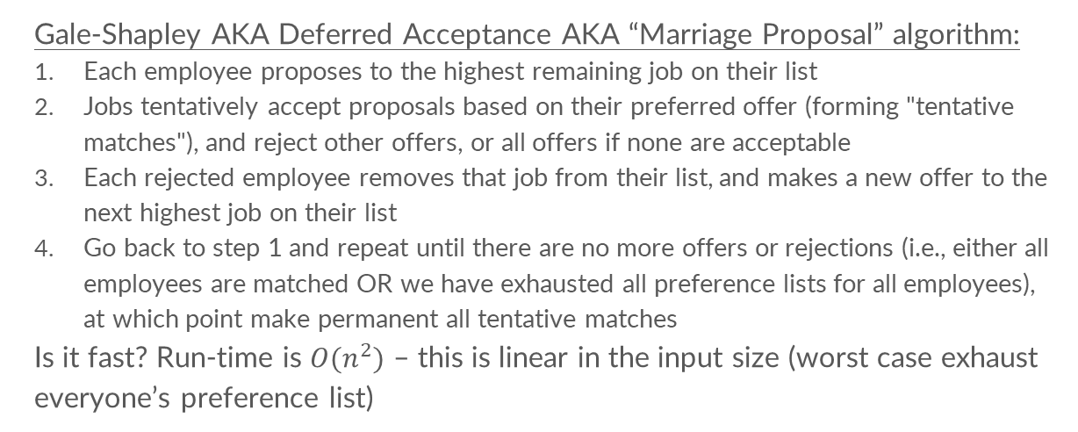
Deferred Acceptance Algorithm
Gale-Shapley AKA Deferred Acceptance AKA “Marriage Proposal” algorithm:
Each employee proposes to the highest remaining job on their list
Jobs tentatively accept proposals based on their preferred offer (forming "tentative matches"), and reject other offers, or all offers if none are acceptable
Each rejected employee removes that job from their list, and makes a new offer to the next highest job on their list
Go back to step 1 and repeat until there are no more offers or rejections (i.e., either all employees are matched OR we have exhausted all preference lists for all employees), at which point make permanent all tentative matches
Is it fast? Run-time is ${O(n}^{2})$ – this is linear in the input size (worst case exhaust everyone’s preference list)

Slide 11
Toy Problem – Deferred Acceptance (DA)

Slide 12
Example
e1 : j2, j1, j3
e2 : j1, j2, j3
e3 : j1, j2, j3
j1 : e1, e2, e3
j2 : e3, e1, e2
j3 : e1, e2, e3
Example:
e1 = employee 1
j1 = job 1
Notes:
*** Luke in progress ***

Slide 13
e1 : j2, j1, j3
e2 : j1, j2, j3
e3 : j1, j2, j3
j1 : e1, e2, e3
j2 : e3, e1, e2
j3 : e1, e2, e3
e1
j1
e2
j2
e3
j3
Example:
e1 = employee 1
j1 = job 1
Notes:
*** Luke in progress ***

Slide 14
e1 : j2, j1, j3
e2 : j1, j2, j3
e3 : j1, j2, j3
j1 : e1, e2, e3
j2 : e3, e1, e2
j3 : e1, e2, e3
e1
j1
e2
j2
e3
j3
Example:
e1 = employee 1
j1 = job 1
Notes:
*** Luke in progress ***

Slide 15
e1 : j2, j1, j3
e2 : j1, j2, j3
e3 : j1, j2, j3
j1 : e1, e2, e3
j2 : e3, e1, e2
j3 : e1, e2, e3
e1
j1
e2
j2
e3
j3
Example:
e1 = employee 1
j1 = job 1
Notes:
*** Luke in progress ***

Slide 16
e1 : j2, j1, j3
e2 : j1, j2, j3
e3 : j1, j2, j3
j1 : e1, e2, e3
j2 : e3, e1, e2
j3 : e1, e2, e3
e1
j1
e2
j2
e3
j3
Example:
e1 = employee 1
j1 = job 1
Notes:
*** Luke in progress ***

Slide 17
e1 : j2, j1, j3
e2 : j1, j2, j3
e3 : j1, j2, j3
j1 : e1, e2, e3
j2 : e3, e1, e2
j3 : e1, e2, e3
e1
j1
e2
j2
e3
j3
Example:
e1 = employee 1
j1 = job 1
Notes:
*** Luke in progress ***

Slide 18
e1 : j2, j1, j3
e2 : j1, j2, j3
e3 : j1, j2, j3
j1 : e1, e2, e3
j2 : e3, e1, e2
j3 : e1, e2, e3
e1
j1
e2
j2
e3
j3
Example:
e1 = employee 1
j1 = job 1
Notes:
*** Luke in progress ***

Slide 19
e1 : j2, j1, j3
e2 : j1, j2, j3
e3 : j1, j2, j3
j1 : e1, e2, e3
j2 : e3, e1, e2
j3 : e1, e2, e3
e1
j1
e2
j2
e3
j3
Example:
e1 = employee 1
j1 = job 1
Notes:
*** Luke in progress ***

Slide 20
e1 : j2, j1, j3
e2 : j1, j2, j3
e3 : j1, j2, j3
j1 : e1, e2, e3
j2 : e3, e1, e2
j3 : e1, e2, e3
e1
j1
e2
j2
e3
j3
Example:
e1 = employee 1
j1 = job 1
Notes:
*** Luke in progress ***

Slide 21
e1 : j2, j1, j3
e2 : j1, j2, j3
e3 : j1, j2, j3
j1 : e1, e2, e3
j2 : e3, e1, e2
j3 : e1, e2, e3
e1!
j1
e2
j2
e3
j3
Example:
e1 = employee 1
j1 = job 1
Notes:
*** Luke in progress ***

Slide 22
e1 : j2, j1, j3
e2 : j1, j2, j3
e3 : j1, j2, j3
j1 : e1, e2, e3
j2 : e3, e1, e2
j3 : e1, e2, e3
e1
j1
e2
j2
e3
j3
Example:
e1 = employee 1
j1 = job 1
Notes:
*** Luke in progress ***

Slide 23
e1 : j2, j1, j3
e2 : j1, j2, j3
e3 : j1, j2, j3
j1 : e1, e2, e3
j2 : e3, e1, e2
j3 : e1, e2, e3
e1
j1
e2
j2
e3
j3
Example:
e1 = employee 1
j1 = job 1
Notes:
*** Luke in progress ***

Slide 24
e1 : j2, j1, j3
e2 : j1, j2, j3
e3 : j1, j2, j3
j1 : e1, e2, e3
j2 : e3, e1, e2
j3 : e1, e2, e3
e1
j1
e2!
j2
e3
j3
Example:
e1 = employee 1
j1 = job 1
Notes:
*** Luke in progress ***

Slide 25
e1 : j2, j1, j3
e2 : j1, j2, j3
e3 : j1, j2, j3
j1 : e1, e2, e3
j2 : e3, e1, e2
j3 : e1, e2, e3
e1
j1
e2
j2
e3
j3
Example:
e1 = employee 1
j1 = job 1
Notes:
*** Luke in progress ***

Slide 26
e1 : j2, j1, j3
e2 : j1, j2, j3
e3 : j1, j2, j3
j1 : e1, e2, e3
j2 : e3, e1, e2
j3 : e1, e2, e3
e1
j1
e2
j2
e3
j3
Example:
e1 = employee 1
j1 = job 1
Notes:
*** Luke in progress ***

Slide 27
e1 : j2, j1, j3
e2 : j1, j2, j3
e3 : j1, j2, j3
j1 : e1, e2, e3
j2 : e3, e1, e2
j3 : e1, e2, e3
e1
j1
e2
j2
e3
j3
Example:
e1 = employee 1
j1 = job 1
Notes:
*** Luke in progress ***

Slide 28
e1 : j2, j1, j3
e2 : j1, j2, j3
e3 : j1, j2, j3
j1 : e1, e2, e3
j2 : e3, e1, e2
j3 : e1, e2, e3
e1
j1
e2
j2
e3
j3
Example:
e1 = employee 1
j1 = job 1
Notes:
*** Luke in progress ***

Slide 29
e1 : j2, j1, j3
e2 : j1, j2, j3
e3 : j1, j2, j3
j1 : e1, e2, e3
j2 : e3, e1, e2
j3 : e1, e2, e3
e1
j1
e2
j2
e3
j3
Example:
e1 = employee 1
j1 = job 1
Notes:
*** Luke in progress ***

Slide 30
Complete!
e1 : j2, j1, j3
e2 : j1, j2, j3
e3 : j1, j2, j3
j1 : e1, e2, e3
j2 : e3, e1, e2
j3 : e1, e2, e3
e1
j1
e2
j2
e3
j3
Example:
e1 = employee 1
j1 = job 1
*Note: doesn’t matter which employee proposes first!
Notes:
Stable match no matter who starts first (might be different, although it’s not in this case)

Slide 31
Deferred Acceptance Algorithm – Properties
Stable match: there is no incentive for re-contracting (higher employee satisfaction and morale)
Stability helps people understand that matching makes sense (transparency and fairness)
  Notion of stability. Unstable means there is at least one blocking pair.
  A pair (e, j) is called a blocking pair if both e and j prefer each other more than their current match.
  In final matching, if there is an employee e that envies another employee’s (e’) assignment, that job (j) MUST “prefer” e’ over e (j: e’ ≻ e) (no-justified-envy)
Employee-proposing DA is strategy-proof for employees (i.e., employees are incentivized to report their true preferences)
  A mechanism is strategy proof if for each participant it is always optimal to be truthful, i.e. optimal to report his/her true preferences regardless of what everyone else’s preferences are
Notes:
NOTES:
Assuming strict preferences:
Multiple stable-matchings are actually possible, but DA always yields the same stable matching (regardless of the order in which job offers are made) – employee optimal/job pessimal or employee-pessimal/job optimal.
The officer-proposing DA algorithm results in a billet-pessimal stable matching, i.e., billets gets their least favorite officer in any stable-matching (therefore, billets could theoretically improve by misreporting their true preferences. We don’t have to worry about this though, since we’re simulating billet preferences over officers with the priority score!).
Employee-optimal and Job-pessimal. Each employee gets the highest-ranked job they could possibly obtain in any stable matching, and each job gets the lowest-ranked employee it could ever receive in any stable matching. Intuition: receivers can only reject or hold their current offers.
Not strategy-proof for the “proposees”
In economics and social choice theory, a no-justified-envy matching is a matching in a two-sided market, in which no agent prefers the assignment of another agent and is simultaneously preferred by that assignment.

Slide 32
DA – Informal Proof
e is an employee; j and j’ are jobs
Suppose (e, j) are matched, but e prefers j'
  At some point, e proposed to j' and was rejected (employees go through their lists in rank order) or e was tentatively matched to j’ and then got bumped
  At that point, j' preferred their tentative match to e
  As algorithm goes forward, j' can only do better
  So j’ must prefer their final match to e
Therefore, there can never be any blocking pairs
NOTE: the order in which we iterate and assign officers to jobs will always result in a stable match

Slide 33
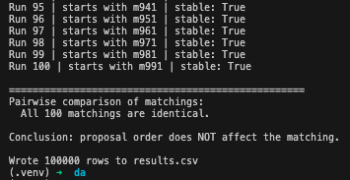
DA Algorithm – Solution Optimality
The DA algorithm in which employees propose to jobs always yields the same stable matching – regardless of the order in which job offers are made – and the resulting stable matching is the best for all employees and worst for all jobs among all stable matchings.
In this case, the final matching is Employee-optimal and Job-pessimal: each employee gets the highest-ranked job they could possibly obtain in any stable matching, and each job gets the lowest-ranked employee it could ever receive in any stable matching.
[100 runs of 1000x1000 matching with random strict preferences]
Notes:
NOTES:
Assuming strict preferences:
Multiple stable-matchings are actually possible, but DA always yields the same stable matching (regardless of the order in which job offers are made) – employee optimal/job pessimal or employee-pessimal/job optimal.
The officer-proposing DA algorithm results in a billet-pessimal stable matching, i.e., billets gets their least favorite officer in any stable-matching (therefore, billets could theoretically improve by misreporting their true preferences. We don’t have to worry about this though, since we’re simulating billet preferences over officers with the priority score!).
Employee-optimal and Job-pessimal. Each employee gets the highest-ranked job they could possibly obtain in any stable matching, and each job gets the lowest-ranked employee it could ever receive in any stable matching. Intuition: receivers can only reject or hold their current offers.
Not strategy-proof for the “proposees”
In economics and social choice theory, a no-justified-envy matching is a matching in a two-sided market, in which no agent prefers the assignment of another agent and is simultaneously preferred by that assignment.

Slide 34
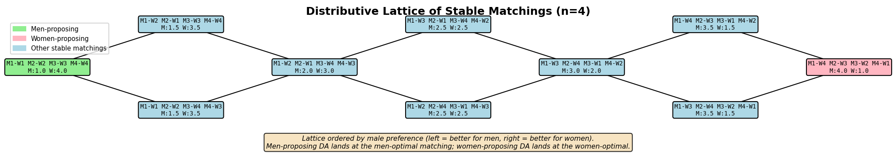
DA Algorithm – Solution Optimality
Multiple stable-matchings are actually possible, but DA always yields the same stable matching
The employee-optimal and job-optimal matchings form the top and bottom elements of the lattice of stable matchings
Notes:
NOTES:
Assuming strict preferences:
Multiple stable-matchings are actually possible, but DA always yields the same stable matching (regardless of the order in which job offers are made) – employee optimal/job pessimal or employee-pessimal/job optimal.
The officer-proposing DA algorithm results in a billet-pessimal stable matching, i.e., billets gets their least favorite officer in any stable-matching (therefore, billets could theoretically improve by misreporting their true preferences. We don’t have to worry about this though, since we’re simulating billet preferences over officers with the priority score!).
Employee-optimal and Job-pessimal. Each employee gets the highest-ranked job they could possibly obtain in any stable matching, and each job gets the lowest-ranked employee it could ever receive in any stable matching. Intuition: receivers can only reject or hold their current offers.
Not strategy-proof for the “proposees”
In economics and social choice theory, a no-justified-envy matching is a matching in a two-sided market, in which no agent prefers the assignment of another agent and is simultaneously preferred by that assignment.

Slide 35
DA – Applications
National Resident Matching Program (NRMP)
  Switched from “hospital-proposing” to “resident-proposing”
School matching (San Francisco, New Orleans, New York, Boston)
  “Student-proposing” – they have strict preferences, schools generally seeking the same thing (diverse student body with good test scores)
Army Assignments

Slide 36
Other options? Top Trading Cycle algorithm

Slide 37
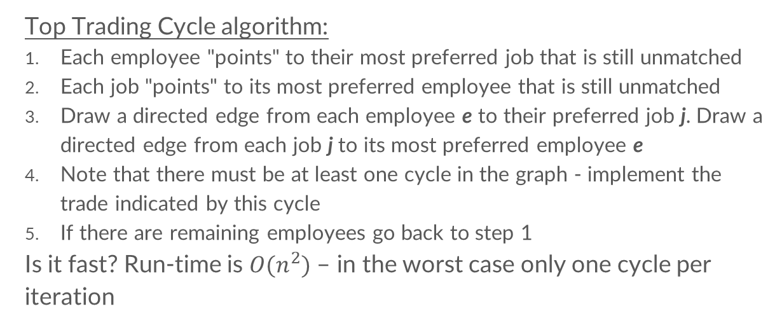
TTC - Algorithm
Top Trading Cycle algorithm:
Each employee "points" to their most preferred job that is still unmatched
Each job "points" to its most preferred employee that is still unmatched
Draw a directed edge from each employee e to their preferred job j. Draw a directed edge from each job j to its most preferred employee e
Note that there must be at least one cycle in the graph - implement the trade indicated by this cycle
If there are remaining employees go back to step 1
Is it fast? Run-time is ${O(n}^{2})$ – in the worst case only one cycle per iteration

Slide 38
Toy Problem – Top Trading Cycle (TTC)

Slide 39
Example
e1 : j2, j1, j3
e2 : j1, j2, j3
e3 : j1, j2, j3
j1 : e1, e2, e3
j2 : e3, e1, e2
j3 : e1, e2, e3
Example:
e1 = employee 1
j1 = job 1
Notes:
*** Luke in progress ***

Slide 40
e1 : j2, j1, j3
e2 : j1, j2, j3
e3 : j1, j2, j3
j1 : e1, e2, e3
j2 : e3, e1, e2
j3 : e1, e2, e3
e1
j1
e2
j2
e3
j3
Example:
e1 = employee 1
j1 = job 1
Notes:
*** Luke in progress ***

Slide 41
e1 : j2, j1, j3
e2 : j1, j2, j3
e3 : j1, j2, j3
j1 : e1, e2, e3
j2 : e3, e1, e2
j3 : e1, e2, e3
e1
j1
e2
j2
e3
j3
Example:
e1 = employee 1
j1 = job 1
Notes:
*** Luke in progress ***

Slide 42
e2
e1 : j2, j1, j3
e2 : j1, j2, j3
e3 : j1, j2, j3
j1 : e1, e2, e3
j2 : e3, e1, e2
j3 : e1, e2, e3
j1
e3
e1
j2
Example:
e1 = employee 1
j1 = job 1
j3
Notes:
*** Luke in progress ***

Slide 43
e2
e1 : j2, j1, j3
e2 : j1, j2, j3
e3 : j1, j2, j3
j1 : e1, e2, e3
j2 : e3, e1, e2
j3 : e1, e2, e3
j1
e3
e1
j2
Example:
e1 = employee 1
j1 = job 1
j3
Notes:
*** Luke in progress ***

Slide 44
e1 : j2, j1, j3
e2 : j1, j2, j3
e3 : j1, j2, j3
j1 : e1, e2, e3
j2 : e3, e1, e2
j3 : e1, e2, e3
e1
j1
e2
j2
e3
j3
Example:
e1 = employee 1
j1 = job 1
Notes:
*** Luke in progress ***

Slide 45
e1 : j2, j1, j3
e2 : j1, j2, j3
e3 : j1, j2, j3
j1 : e1, e2, e3
j2 : e3, e1, e2
j3 : e1, e2, e3
e1
j1
e2
j2
e3
j3
Example:
e1 = employee 1
j1 = job 1
Notes:
*** Luke in progress ***

Slide 46
e1 : j2, j1, j3
e2 : j1, j2, j3
e3 : j1, j2, j3
j1 : e1, e2, e3
j2 : e3, e1, e2
j3 : e1, e2, e3
e1
j1
e2
j2
e3
j3
Example:
e1 = employee 1
j1 = job 1
Notes:
*** Luke in progress ***

Slide 47
Complete!
e1 : j2, j1, j3
e2 : j1, j2, j3
e3 : j1, j2, j3
j1 : e1, e2, e3
j2 : e3, e1, e2
j3 : e1, e2, e3
e1
j1
e2
j2
e3
j3
Example:
e1 = employee 1
j1 = job 1
Notes:
*** Luke in progress ***

Slide 48
TTC - Properties
Just like the DA algorithm, TTC is a truthful mechanism (i.e., strategy-proof)
Under strict preferences, TTC guarantees:
  Unique core allocation: no subset of agents can improve their situation by trading only among themselves
  Individual rationality: each agent receives an item at least as good as their initial allocation (since they can always choose to keep their original allocation)
  Pareto efficiency: there is no other allocation that would make at least one agent better off without making anyone worse off
Notes:
Individual rationality – will make more sense when we talk about housing
In the context of jobs though, if you knew which job most desired you, you could just “point” to that job, and you would be guaranteed to get it

Slide 49
TTC - Applications
Housing allocation
School choice (New Orleans, temporarily)
Kidney exchange
  Top Trading Cycles and Chains (TTCC)
Notes:
NOTES:
Multiple stable-matchings are actually possible. DA does not produce a unique stable match, just a single stable match.
The officer-proposing DA algorithm results in a billet-pessimal stable matching, i.e., billets gets their least favorite officer in any stable-matching (therefore, billets could theoretically improve by misreporting their true preferences. We don’t have to worry about this though, since we’re simulating billet preferences over officers with the priority score!).

Slide 50
TTC – Intuition
In each graph G constructed in every iteration of the algorithm, there is at least one cycle, and every agent is part of at most one cycle
This is by construction; G is a directed graph in which every node has out-degree of exactly one (there is always an outgoing edge, cannot get “stuck”)
Since we find a cycle every round, at least one agent is removed at the end of every round, and the algorithm will terminate after at most n rounds

Slide 51
TTC – Intuition
Another way to think about the algorithm is that agents are trading priorities with each other
Let’s look back at the final matching from the DA algorithm
Notes:
Market Design: how do we set up a strategic environment so that if “players” follow a certain type of behavior, we get a desired outcome?
In market design, when all of the data is available, the problem simply reduces to an optimization problem that can be solved with well known techniques / procedures
Integer programming, linear programming, dynamic programming
The problem is that the real world is more fuzzy. Information is privately held, and we must utilize various incentive mechanisms to reveal information (like true billet rankings)
We need a matching mechanism: a mechanism that maps reported preferences into an assignment/matching.
So, let’s design a marketplace to assign officers to billets!
Goals? Efficiency, simplicity, fairness, and transparency
Two-sided matching problem!

Slide 52
Let’s reformat
e1 : j2, j1, j3
e2 : j1, j2, j3
e3 : j1, j2, j3
j1 : e1, e2, e3
j2 : e3, e1, e2
j3 : e1, e2, e3
e1
j1
e2
j2
e3
j3
Example:
e1 = employee 1
j1 = job 1
Notes:
Final TTC match. Let’s reformat

Slide 53
TTC - Unstable:
(e2, j1) form a blocking pair
e1 : j2, j1, j3
e2 : j1, j2, j3
e3 : j1, j2, j3
j1 : e1, e2, e3
j2 : e3, e1, e2
j3 : e1, e2, e3
e1
j1
e2
j2
e3
j3
Example:
e1 = employee 1
j1 = job 1
Stability vs. Pareto-efficiency
Notes:
*** Luke in progress ***

Slide 54
e1 : j2, j1, j3
e2 : j1, j2, j3
e3 : j1, j2, j3
DA - Stable:
no blocking pairs
j1 : e1, e2, e3
j2 : e3, e1, e2
j3 : e1, e2, e3
e1
j1
e2
j2
e3
j3
Example:
e1 = employee 1
j1 = job 1
Stability vs. Pareto-efficiency
Notes:
*** Luke in progress ***

Slide 55
Stable Matching, What About Pareto Optimality?
For DA, there can be no matching (even an unstable matching) that all employees prefer strictly to the employee-optimal stable matching
It may be possible to make some employees better off without making other employees worse off, but this will make the matching unstable (see our previous example)
Put another way, the employee-optimal stable matching is Pareto efficient within the set of stable matchings, but there can exist an unstable matching that makes some strictly better off, and no one worse off, but it would have a blocking pair
TTC found the Pareto-optimal matching! But it is unstable
Tradeoffs!
Notes:
Previous slide, we found matching M= (e1, j1), (e2, j3), (e3, j2)
e1 and e3 receive their second choice while e2 receives their last choice
Suppose we have the (unstable) matching M′= (e1, j2), (e2, j3), (e3, j1)
e1 and e3 now each receive their first choice so they are strictly better off than the employee-optimal stable matching M and e2 is not worse off. Note that M′ is unstable because (e2, j1) forms a blocking pair.

Slide 56
Chose DA for Officer Assignments
The outcome of the algorithm is a stable match!
Stable? No blocking pairs. Elicits true preferences – optimal for employees. No justified-envy.
Less “black box” more interpretable / easier to explain – transparency is key
Discovered that AOs were essentially already trying to execute this algorithm by hand! Natural progression
Notes:
NRMP has been using a version of the algorithm since the 1950s, even though the “Deferred Acceptance” Algorithm wasn’t officially published by David Gale & Lloyd Shapley until 1962.
no-justified-envy matching is a matching in a two-sided market, in which no agent prefers the assignment of another agent and is simultaneously preferred by that assignment

Slide 57
Three distinct markets
O5 and below
O6
New accessions (USCGA, OCS, DCO)
Notes:
Helpful to think of three distinct groups or “markets”

Slide 58
Framing: O5 and below Assignments (beta-test)
For this algorithm to work well, we need rank-ordered preferences of both sides of the market. We have this from officers (E-Resumes) but not yet from the jobs
Develop a mental model for how the AOs evaluate candidates and make assignments, use this as a proxy for how jobs “rank” candidates
Code the software program and algorithm to make assignments in a way that follows the current AO process as closely as possible
Validated assumptions regularly with AOs

Slide 59
Inputs
Employees
Jobs
Employee Qualification Data
Job Requirements Data
E-Resumes (Dream Sheets)
Employee OER Data
Notes:
Employee data: rank, paygrade, etc. for each officer
Roles data: what competencies does each billet require (along with importance values)
Achievements data: what qualifications does each officer have
Billets data: current “shopping list”
E-Resume data: rank-ordered preference lists for the current AY
OER data: evaluations for each member

Slide 60
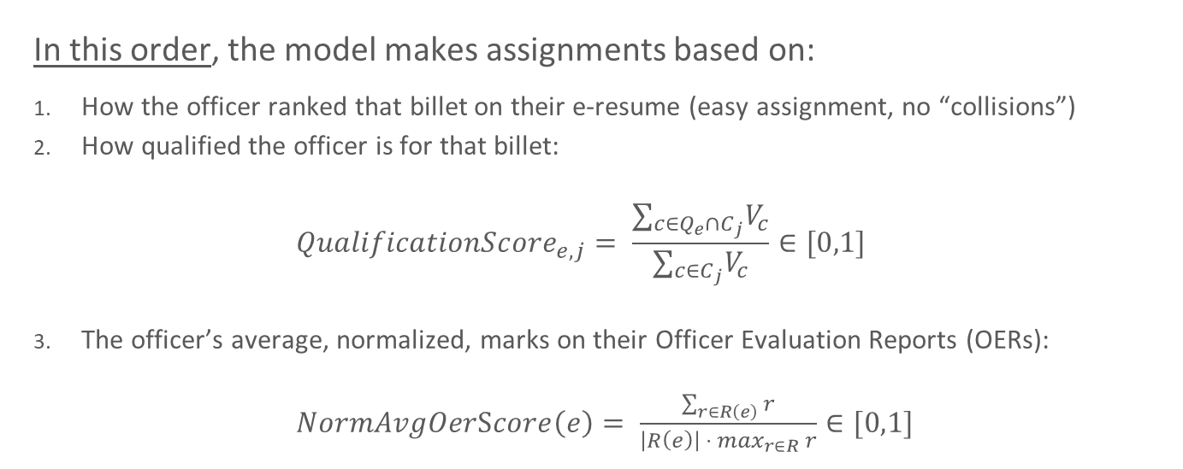
Framing: Mirroring the current AO workflow:
In this order, the model makes assignments based on:
How the officer ranked that billet on their e-resume (easy assignment, no “collisions”)
How qualified the officer is for that billet:
$${QualificationScore}_{e,j}= \frac{∑_{c∈Q_{e}∩C_{j}}V_{c}}{∑_{c∈C_{j}}V_{c}}∈[0,1]$$
The officer’s average, normalized, marks on their Officer Evaluation Reports (OERs):
$NormAvgOerScore\left(e\right)= \frac{\sum_{r∈R\left(e\right)}{r}}{{\left|R\left(e\right)\right| ⋅ max}_{r∈R} r}∈[0,1]$
Notes:
Let E be the set of employees and J be the set of jobs. Each employee e \in E has a set of qualifications Q_e, and each job j \in J has a set of required competencies C_j with associated importance codes V_c for each competency c. Example – Luke (employee e) has Q_e: {CGSEI234, ORANLST}, job has competences C_j: { ORANLST (IC 5), CGSEI234 (IC 5), and CGSEI153 (IC 3)} Luke’s QS(e,j)= (5 + 5) / (5 + 5 + 3) = 10/13 ~= 0.77
For a given employee e and job j, the qualification score QS_{e,j} can be calculated with the above formula.
Let’s denote the set of all employees E and the set of all OERs as R. For each employee e \in E they have a set of OERs, which we denote as R(e). The number of OERs for a particular employee can be denoted as |R(e)| (cardinality).
Example – Luke has three OERs with scores 120, 115, 130. The max possible score is 137. Luke’s NormAvgOerScore is (120+115+130) / ( (3) * (137) ) = 365/411 ~= 0.88

Slide 61
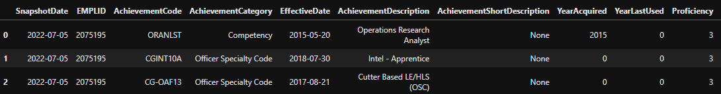
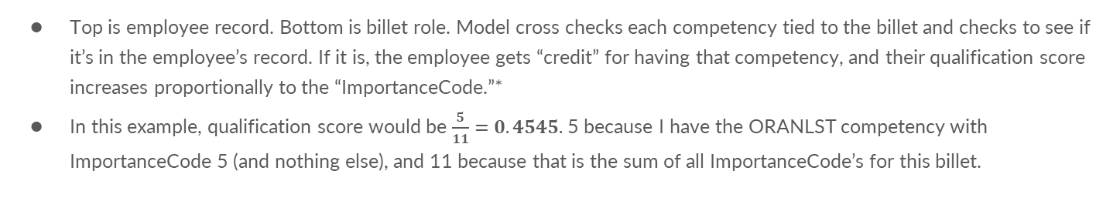
Current Methodology: computing qual scores
Top is employee record. Bottom is billet role. Model cross checks each competency tied to the billet and checks to see if it’s in the employee’s record. If it is, the employee gets “credit” for having that competency, and their qualification score increases proportionally to the “ImportanceCode.”*
In this example, qualification score would be $\frac{5}{11}=0.4545.$ 5 because I have the ORANLST competency with ImportanceCode 5 (and nothing else), and 11 because that is the sum of all ImportanceCode’s for this billet.
Notes:
*Also gives partial credit for lesser quals, full credit for a higher qual, and having the required (or higher) security clearance also improves a candidates score.

Slide 62
Current Methodology: computing qual scores
Top is employee record. Bottom is billet role. Model cross checks each competency tied to the billet and checks to see if it’s in the employee’s record. If it is, the employee gets “credit” for having that competency, and their qualification score increases proportionally to the “ImportanceCode.”*
In this example, qualification score would be $\frac{5}{11}=0.4545.$ 5 because I have the ORANLST competency with ImportanceCode 5 (and nothing else), and 11 because that is the sum of all ImportanceCode’s for this billet.
Notes:
*Also gives partial credit for lesser quals, full credit for a higher qual, and having the required (or higher) security clearance also improves a candidates score.

Slide 63
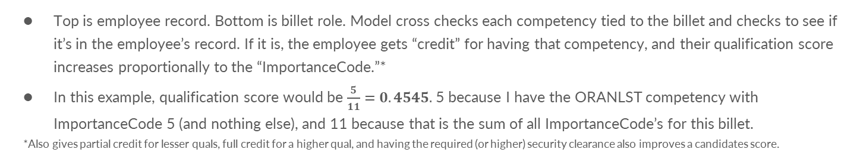
Current Methodology: computing qual scores
Top is employee record. Bottom is billet role. Model cross checks each competency tied to the billet and checks to see if it’s in the employee’s record. If it is, the employee gets “credit” for having that competency, and their qualification score increases proportionally to the “ImportanceCode.”*
In this example, qualification score would be $\frac{5}{11}=0.4545.$ 5 because I have the ORANLST competency with ImportanceCode 5 (and nothing else), and 11 because that is the sum of all ImportanceCode’s for this billet.
*Also gives partial credit for lesser quals, full credit for a higher qual, and having the required (or higher) security clearance also improves a candidates score.
Notes:
*Also gives partial credit for lesser quals, full credit for a higher qual, and having the required (or higher) security clearance also improves a candidates score.

Slide 64
Current Methodology: computing qual scores
Top is employee record. Bottom is billet role. Model cross checks each competency tied to the billet and checks to see if it’s in the employee’s record. If it is, the employee gets “credit” for having that competency, and their qualification score increases proportionally to the “ImportanceCode.”*
In this example, qualification score would be $\frac{5}{11}=0.4545.$ 5 because I have the ORANLST competency with ImportanceCode 5 (and nothing else), and 11 because that is the sum of all ImportanceCode’s for this billet.
*Also gives partial credit for lesser quals, full credit for a higher qual, and having the required (or higher) security clearance also improves a candidates score.
Notes:
*Also gives partial credit for lesser quals, full credit for a higher qual, and having the required (or higher) security clearance also improves a candidates score.

Slide 65
Findings
OER scores are inflated, not helpful for differentiating candidates
CWO billets lack a “demand” signal (billet requirements)
O1-O5 assignments are typically broadening – the CG values diversity of experience, it’s not until O6+ that qualifications are a good proxy for “fit”
Better billet “tagging” (staff → ops → staff)
Notes:
Need to improve “demand signal” from billets (missing data for competencies required)
Quals are not good driver / metric for prioritization – staff vs. ops would be better

Slide 66
What if we just had jobs “ranking” all people (no proxy)?

Slide 67
Framing: O6 and below Assignments (beta-test)
For O6 assignments we don’t need a proxy! Flags rank all O6 candidates for every job
For this 2-sided market (O6s mbrs and O6 jobs), just collect E-resumes and Flag preferences, and run the algorithm
Beta-tested in AY25, used modeled assignments to aid the AO assignment process and give recommended matches
>50% of final slate matched algorithm recommendations
Better Flag preferences would improve process
Notes:
Market Design: how do we set up a strategic environment so that if “players” follow a certain type of behavior, we get a desired outcome?
In market design, when all of the data is available, the problem simply reduces to an optimization problem that can be solved with well known techniques / procedures
Integer programming, linear programming, dynamic programming
The problem is that the real world is more fuzzy. Information is privately held, and we must utilize various incentive mechanisms to reveal information (like true billet rankings)
We need a matching mechanism: a mechanism that maps reported preferences into an assignment/matching.
So, let’s design a marketplace to assign officers to billets!
Goals? Efficiency, simplicity, fairness, and transparency
Two-sided matching problem!

Slide 68
What if we had strict ranking of all officers?

Slide 69
Framing: New Accession Assignments
CGA + OCS assignments! Use class rank to make assignments
Known in the literature as serial dictatorship algorithm
Replicating what AOs used to do manually but in code. Reduce 4+ days to a few seconds with option for multiple simulations adjusting constraints
Challenge just becomes coding implementation (e-resumes, program requirements, dynamic gender ratios on cutters, flight panel, cyber panel, COLOs, NOLOs, etc.)
Used successfully for USCGA ‘25 and ‘26, 3 OCS classes
Notes:
Market Design: how do we set up a strategic environment so that if “players” follow a certain type of behavior, we get a desired outcome?
In market design, when all of the data is available, the problem simply reduces to an optimization problem that can be solved with well known techniques / procedures
Integer programming, linear programming, dynamic programming
The problem is that the real world is more fuzzy. Information is privately held, and we must utilize various incentive mechanisms to reveal information (like true billet rankings)
We need a matching mechanism: a mechanism that maps reported preferences into an assignment/matching.
So, let’s design a marketplace to assign officers to billets!
Goals? Efficiency, simplicity, fairness, and transparency
Two-sided matching problem!

Slide 70
2025
USCGA Results
2026
Mbr Choice | # | %
NR 1 | 112 | 43.2%
TOP 5 | 178 | 73.0%
TOP 10 | 213 | 84.2%
TOP 15 | 233 | 91.9%
TOP 20 | 242 | 95.0%
Mbr Choice | # | %
NR 1 | 98 | 38.0%
TOP 5 | 180 | 69.8%
TOP 10 | 205 | 79.5%
TOP 15 | 221 | 85.7%
TOP 20 | 234 | 90.7%
Notes:
Market Design: how do we set up a strategic environment so that if “players” follow a certain type of behavior, we get a desired outcome?
In market design, when all of the data is available, the problem simply reduces to an optimization problem that can be solved with well known techniques / procedures
Integer programming, linear programming, dynamic programming
The problem is that the real world is more fuzzy. Information is privately held, and we must utilize various incentive mechanisms to reveal information (like true billet rankings)
We need a matching mechanism: a mechanism that maps reported preferences into an assignment/matching.
So, let’s design a marketplace to assign officers to billets!
Goals? Efficiency, simplicity, fairness, and transparency
Two-sided matching problem!

Slide 71
Current Job
Forward Deployed Engineer (Customer facing Full Stack Software Engineer)
Vannevar – Defense Tech Company
Build apps for military / government customers
https://www.vannevarlabs.com/

Slide 72
Further Reading (Spring Break)
“Who Gets What—And Why: The New Economics of Matchmaking and Market Design” – Alvin Roth (Book; 2016)
“College Admissions and the Stability of Marriage” – Gale and Shapley (DA Paper; 1962)
“On cores and indivisibility” – Shapley and Scarf (TTC Paper; 1973)
“Deferred Acceptance Algorithms: History, Theory, Practice, and Open Questions” – Alvin Roth (Paper; 2007)
Notes:
Market Design: how do we set up a strategic environment so that if “players” follow a certain type of behavior, we get a desired outcome?
In market design, when all of the data is available, the problem simply reduces to an optimization problem that can be solved with well known techniques / procedures
Integer programming, linear programming, dynamic programming
The problem is that the real world is more fuzzy. Information is privately held, and we must utilize various incentive mechanisms to reveal information (like true billet rankings)
We need a matching mechanism: a mechanism that maps reported preferences into an assignment/matching.
So, let’s design a marketplace to assign officers to billets!
Goals? Efficiency, simplicity, fairness, and transparency
Two-sided matching problem!

Slide 73
Questions?
Notes:
Market Design: how do we set up a strategic environment so that if “players” follow a certain type of behavior, we get a desired outcome?
In market design, when all of the data is available, the problem simply reduces to an optimization problem that can be solved with well known techniques / procedures
Integer programming, linear programming, dynamic programming
The problem is that the real world is more fuzzy. Information is privately held, and we must utilize various incentive mechanisms to reveal information (like true billet rankings)
We need a matching mechanism: a mechanism that maps reported preferences into an assignment/matching.
So, let’s design a marketplace to assign officers to billets!
Goals? Efficiency, simplicity, fairness, and transparency
Two-sided matching problem!

Slide 74
Backup Slides

Slide 75

Harry’s top choice was Gryffindor
Both Gryffindor and Slytherin wanted Harry as their top choice
Harry ends up in Gryffindor because this is a “wizard-optimal” & “house-pessimal” implementation of the algorithm
J.K. Rowling studied market design! (probably)
https://screenrant.com/sorting-hat-harry-potter-trivia-secret-facts/
Notes:
DA algorithm

Slide 76
DA – Informal Proof
Given n officers and n billets, DA algorithm outputs a complete stable matching:
  Claim 1: At every iteration, current match is stable w.r.t. non-free officers and billets.
  Claim 2: once a billet is matched, it remains matched (possibly to a different officer) until end of algorithm
  Claim 3: At the end of algorithm, every officer and billet is matched.

Slide 77
Metrics: Model vs. AOs Assignment Years 2022-24
 |  | AY22 | AY23 | AY24
↑ | % of officers* receiving a job ranked higher on their list | 30% | 34% | 32%
↔ | % of officers* receiving a job of the same rank (unaffected) | 23% | 41% | 42%
↓ | % of officers* receiving a job ranked lower on their list | 47% | 25% | 26%
↑ | % of billets receiving a more qualified officer | 35% | 24% | 22%
↔ | % of billets receiving someone with same qualification level | 62% | 69% | 73%
↓ | % of billets receiving a less qualified officer | 3% | 7% | 5%
*O2-O5, CWOs only
Notes:
AY22 and AY23 and AY24 comparisons – AY = assignment year

Slide 78
DA vs. TTC: tradeoffs?
Truthful & strategy-proof
(Unique & Pareto-efficient) vs. (non-unique & stable)
(Graphs & cycles) vs. (proposing & rejecting)
→ Interpretability and explainability?
Notes:
Market Design: how do we set up a strategic environment so that if “players” follow a certain type of behavior, we get a desired outcome?
In market design, when all of the data is available, the problem simply reduces to an optimization problem that can be solved with well known techniques / procedures
Integer programming, linear programming, dynamic programming
The problem is that the real world is more fuzzy. Information is privately held, and we must utilize various incentive mechanisms to reveal information (like true billet rankings)
We need a matching mechanism: a mechanism that maps reported preferences into an assignment/matching.
So, let’s design a marketplace to assign officers to billets!
Goals? Efficiency, simplicity, fairness, and transparency
Two-sided matching problem!

Slide 79
At a high-level, metrics look good!
But…
Notes:
AY22 and AY23 and AY24 comparisons

Slide 80
References
https://dl.acm.org/doi/abs/10.1145/2692375.2692379
https://scholar.google.com/scholar?hl=en&as_sdt=0%2C5&q=cadet+matching&btnG=
http://assafromm.weebly.com/research.html
https://www.nrmp.org/intro-to-the-match/how-matching-algorithm-works/
https://web.stanford.edu/~iashlagi/papers/ties-anr.pdf
https://web.stanford.edu/~alroth/papers/GaleandShapley.revised.IJGT.pdf

