Slide 1
Singer Matching

Slide 2
Problem Statement
Each year, first-year student singers at C-Major College vie for coveted spots in a cappella singing groups, while at the same time, those groups compete for singers. Students rank-order their preferences for group to join and groups rank-order their preferences for students. Formulate this problem as a stable marriage problem and solve it.

Slide 3
Data
Student Preferences for Groups
  Ethan: CapellaSize, TrebleMaker, DinTones, NoteWorthy
  Liam: DinTones, CapellaSize, TrebleMaker, NoteWorthy
  Sophia: CapellaSize, DinTones, NoteWorthy, TrebleMaker
  Emma: TrebleMaker, NoteWorthy, DinTones, CapellaSize
Group Preferences for Students
  DinTones: Ethan, Liam, Sophia, Emma
  CapellaSize: Ethan, Sophia, Emma, Liam
  TrebleMaker: Sophia, Liam, Ethan, Emma
  NoteWorthy: Emma, Sophia, Ethan, Liam

Slide 4
Using SMP Utilities
Our Python utilities allowed us to create a dictionary of preferences, keyed by student (or group) name. For example:
>> prefs_dict['TrebleMaker']
['Sophia', 'Liam', 'Ethan', 'Emma’]
Another function within our utilities allows us to create a dictionary of “better matches”.
  Given a matching, it will list better matches for the 1st party in the match in rank order.
  For example if NoteWorthy was matched with Liam, its “better matches” are as follows:
>> better_matches[('NoteWorthy','Liam')]
['Emma', 'Sophia', 'Ethan']

Slide 5
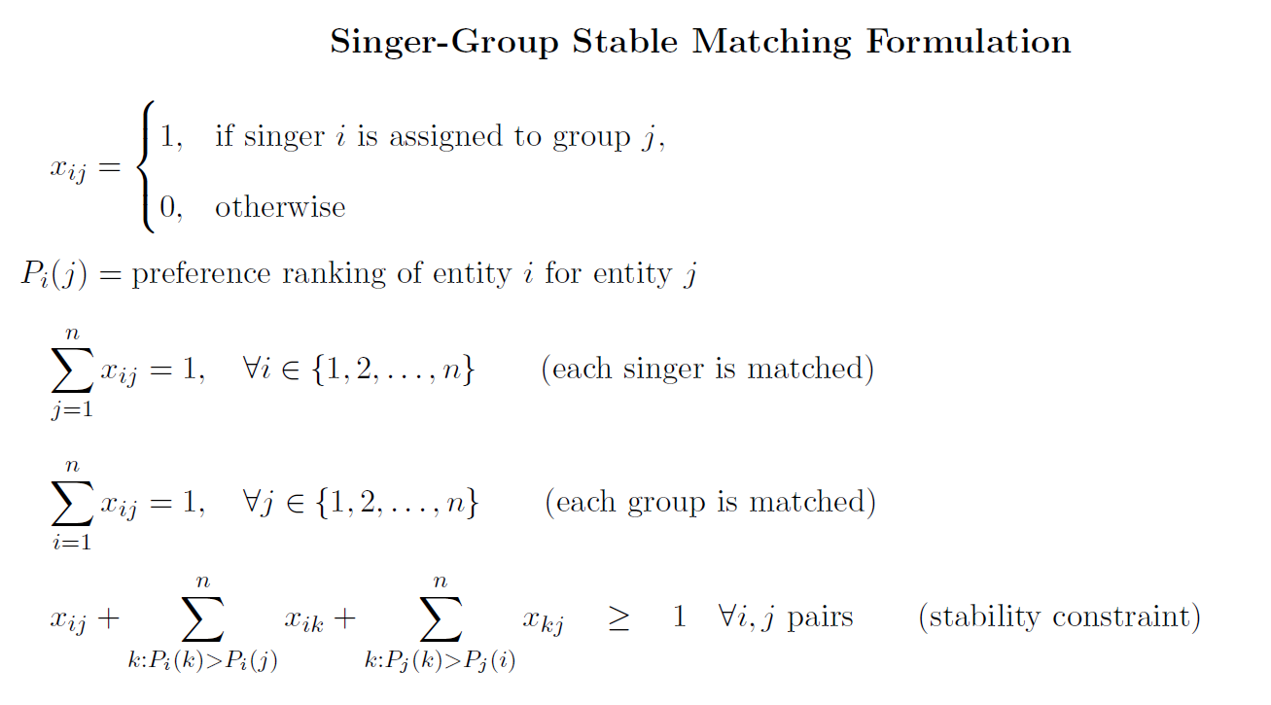
Model Formulation

Slide 6
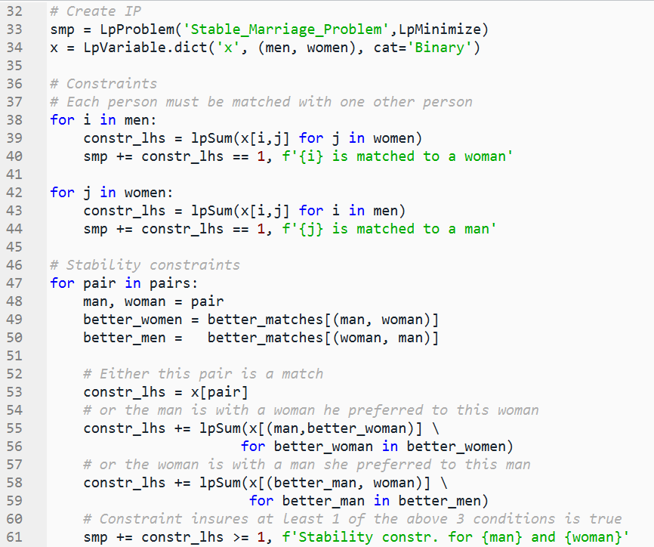
Computer Implementation of the Model
In the code, singers are represented by “men”, groups by “women”
continued on the next slide

Slide 7
Computer Implementation of the Model (continued)
singers are represented by “men”, groups by “women”

Slide 8
Results
Matches:
Ethan - CapellaSize
Liam - DinTones
Sophia - TrebleMaker
Emma - NoteWorthy
Status: Optimal
Objective value = None
Stable matching? True
Ranks singers received -
Ethan ranked CapellaSize 1
Liam ranked DinTones 1
Sophia ranked TrebleMaker 4
Emma ranked NoteWorthy 2
Ranks groups received -
CapellaSize ranked Ethan 1
DinTones ranked Liam 2
TrebleMaker ranked Sophia 1
NoteWorthy ranked Emma 1

Slide 9

Objective
The singers received these rankings of their choices: 1, 1,4 and 2. Can we do better? Let’s add an objective to minimize the sum of the singer rankings.
The code to implement this objective
  men_rank_obj = lpSum( mens_ranks[m,w]*x[m,w] for m in men for w in women)
  smp += men_rank_obj
  Notes:
  using men for singers again
  mens_ranks was computed earlier using mens_ranks = prefs_to_ranks(mens_prefs_dict)
Results:
objective value = 6
Ranks singers received - Ethan ranked CapellaSize 1 Liam ranked DinTones 1 Sophia ranked NoteWorthy 3 Emma ranked TrebleMaker 1 | Ranks groups received - CapellaSize ranked Ethan 1 DinTones ranked Liam 2 NoteWorthy ranked Sophia 2 TrebleMaker ranked Emma 4

Slide 10
Gale-Shapley Results
Implementing the Gale-Shapley algorithm and to solve the problem with singers proposing, and then with groups proposing.
I used the utility code to create the preference dictionaries as before
I downloaded Gale-Shapley code from Google AI, inspected it, and ran results through smp_utils.is_it_stable
Results:
  singers proposing:
Ethan: CapellaSize Liam: DinTones,
Sophia: NoteWorthy Emma: TrebleMaker
  groups proposing
DinTones: Liam CapellaSize: Ethan
TrebleMaker: Sophia NoteWorthy: Emma

Slide 11
Analysis
IP – No objective
Ranks singers received -
Ethan ranked CapellaSize 1
Liam ranked DinTones 1
Sophia ranked TrebleMaker 4
Emma ranked NoteWorthy 2
Ranks groups received -
CapellaSize ranked Ethan 1
DinTones ranked Liam 2
TrebleMaker ranked Sophia 1
NoteWorthy ranked Emma 1
IP – min singers rankings
Ranks singers received -
Ethan ranked CapellaSize 1
Liam ranked DinTones 1
Sophia ranked NoteWorthy 3
Emma ranked TrebleMaker 1
Ranks groups received -
CapellaSize ranked Ethan 1
DinTones ranked Liam 2
NoteWorthy ranked Sophia 2
TrebleMaker ranked Emma 4
Gale-Shapley
Ranks singers received -
Ethan ranked CapellaSize 1
Liam ranked DinTones 1
Sophia ranked NoteWorthy 3
Emma ranked TrebleMaker 1
Ranks groups received -
CapellaSize ranked Ethan 1
DinTones ranked Liam 2
NoteWorthy ranked Sophia 2
TrebleMaker ranked Emma 4
The min singers objective did work to skew the results to be more favorable to the singers (sum of ranks = 6) as compared to no objective (sum of ranks = 8).
Gale-Shapley (with singers proposing) produces the same results as the IP with the min singers objective.
  Interestingly, if the groups propose instead of singers, the Gale-Shapley results match the solution to the IP with no objective.

