Slide 1
More Programming in VBA
Part 3

Slide 2
Today
Variables
Arrays
Introduction to User Forms

Slide 3
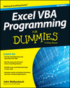
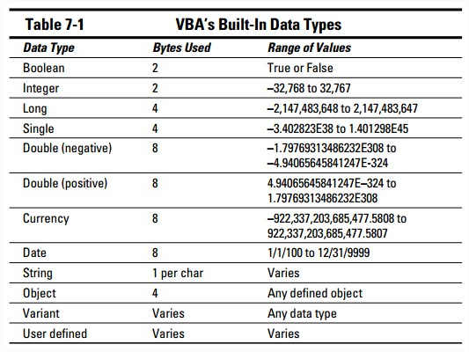
Variables
More on Variables on pp 111 - 122
Recall, from VBA Day 1, we saw some data types were:

Slide 4
Variables
Recall, to declare a variable:
Dim varName As dataType
Option Explicit at the top of your module forces you to define ALL variables
  Without Option Explicit, VBA will allow you to use variables not previously defined – VBA determines the variable’s type at run time (like Python)
  Why bother?
    Faster execution and more efficient memory usage (see Dummies p 103)

Slide 5
Variable Scope
Procedural Level
  variable defined within a sub or function
  ‘visible’ during any portion of the sub/function they are defined in
Module Level
  variable defined outside of all subs/functions (right below ‘Option Explicit’)
  ‘visible’ to any part of the module
Public Module Level
  defined outside of all subs/functions with the keyword Public.
  Ex: Public txt as String
  ‘visible’ anywhere in the workbook
More on Variable Scope on pp 114 - 120

Slide 6
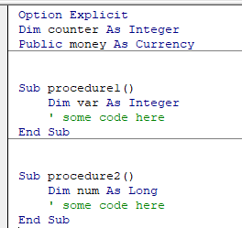
Variable Scope - Practice
Can the sub access the variable?
Variable | procedure1 | procedure2 | Another sub in this module | A sub in another module of this workbook | Scope level?
var
num
counter
money

Slide 7
Variable Scope - Practice
ANSWERS
Can the sub access the variable?
Variable | procedure1 | procedure2 | Another sub in this module | A sub in another module of this workbook | Scope level?
var | Y | N | N | N | procedural
num | N | Y | N | N | procedural
counter | Y | Y | Y | N | module
money | Y | Y | Y | Y | public module

Slide 8
Arrays
Arrays in VBA are similar to lists in Python
Type this in the Immediate Window in the VBE:
  m = Array(“a”, “b”, “c”) [note copy/paste from this slide may not work]
  Print m(0)
So what is the lowest index (aka the “base” index) in a VBA array and how does that compare with Python?
In VBA, Arrays must be declared
  What do these statements do:
    Dim myArray(5) As Integer
    Dim myArray(2, 5) As Double
More on Arrays on pp 127 - 129

Slide 9
Arrays
  General syntax for declaring arrays (replace datatype with a specific one such as Integer or Long):
  Ex: Dim myArray(100) As Integer makes an array of 101 integers, with the lower index being 0
Form | Notes
Dim arrayName(m) as dataType | Goes from element 0 to element m (so m+1 elements in the array)
Dim arrayName(n to m) as dataType | Starts the indexing at n (instead of 0)
Dim arrayName() as dataType | useful when you are not yet sure of the dimension of the array

Slide 10
Arrays
Base index
  Arrays default to base index 0
  To change to 1-based indexing (starts at 1):
    Can specify starting index value for a specific array:
      Ex: Dim myArray(1 To 100) As Integer when declaring variable
    Can specify 1-based indexing for all arrays in module:
      Ex: include Option Base 1 at the top of your module
Can specify array size later or change size using ReDim in body of Sub
    Ex: Dim grades() as Double
  ReDim grades(26) as Double
Read/understand the getGrades() sub in VBA-III-Examples.xlsm

Slide 11
Multi-Dimensional Arrays
We can also declare multi-dimensional arrays.
Ex: (assume we have ‘Option Base 1’ at the top of our module)
Dim MyArray(2, 3) As Integer
‘ this sets aside 2*3 = 6 locations in memory for this array
MyArray(1,1) = 50
MyArray(1,2) = 85
MyArray(1,3) = 90
MyArray(2,1) = 98
MyArray(2,2) = 100
MyArray(2,3) = 70
50 | 85 | 90
98 | 100 | 70
Let’s redo our x, x² display Sub from last class using arrays
Notes:
See array1( ) in vba3_examples.xlsm

Slide 12
Functions
Specific type of Sub that returns a value
Can be executed by:
  calling it from a sub or another function
  calling it from an Excel cell using an Excel worksheet formula
Example:
    Function CubeRoot(number As Double) As Double
    CubeRoot = number ^ (1/3)
    End Function
  What’s going on?
    What is the name of the return value?
    What is the input argument?
    What are the two “As Double” declarations for?
More on Functions in CH 5

Slide 13
Functions (continued)
    Function CubeRoot(number As Double) As Double
    CubeRoot = number ^ (1/3)
    End Function
Functions (like subs) can take arugments
name of the variable that will be returned = name of the function
  ** There must be a variable within the function, with the same name as your function. **
    This variable will be returned
  no ‘return’ statement in VBA
More on Functions in CH 5

Slide 14
Functions (continued)
General Syntax:
Function fctName(var1 As dataType, var2 as dataType, …) As dataType
‘ stuff goes here manipulating fctName
‘ fctName is what will be returned
End Function
More on Functions in CH 5

Slide 15
Calling Functions from a Sub
Sub CallerSub()
Dim Ans As Double
Ans = CubeRoot(125)
MsgBox Ans
End Sub
Note: This assumes that the function and sub are in the same module
Let’s look at this one in
VBA-III-Examples.xlsm.
More on Functions in CH 5

Slide 16
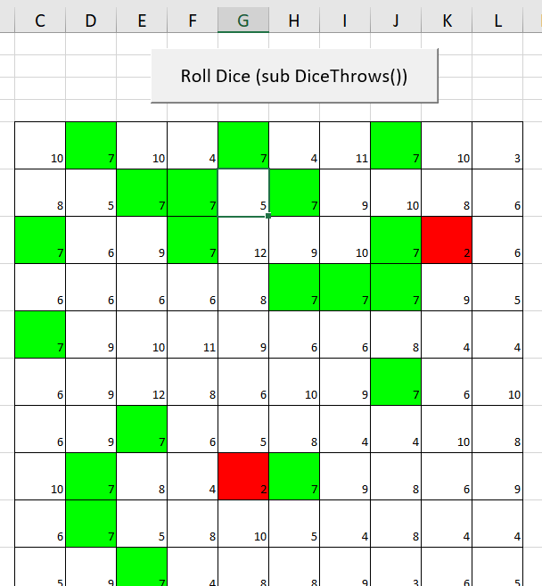
Dice Example
Open VBA-III-Dice.xlsm found in the course repo
What it does
  Simulates rolling two dice repeatedly
  Sums written to cells
  Cell color-coded based on sum
    2 = Red
    7 = Green
How it works
  uses a range called “Throws” in the Excel workbook
  iterates over each cell in this range populating the cell with the sum of two die
  the file contains 2 subs
    both accomplish the same display
    the 2nd one stores the results in an array

Slide 17
Dice Example (cont)
second sub of VBA-III-Dice.xlsm called “diceXwithArray” that stores the dice values in an array
as with the first sub, it uses WorksheetFunction.RandBetween(1, 6) to set the random numbers
this creates a fixed random # in the cell
if instead we had used “=RandBetween(1,6)” the cell value would update whenever a change was made to the sheet (unless xlCalculationManual was set, see previous slides)
then the array would not match what is on the sheet

Slide 18
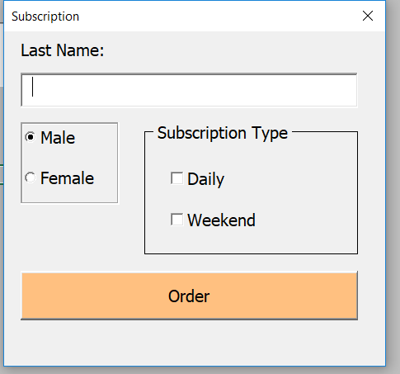
User Forms (Dialog Boxes)
We interact with various dialog boxes on a regular basis
  Print dialog box
  File Open Dialog box
In VBA these are known as User Forms

Slide 19
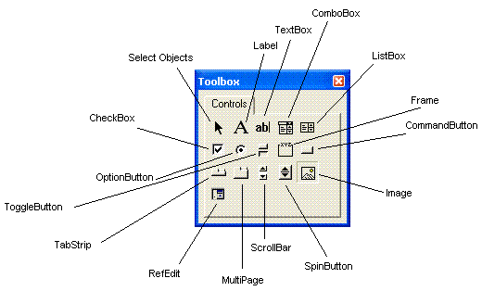
Controls on User Forms
Controls are the visual, interactive elements on the user form
  In VBA, controls are objects with methods and properties
  Control properties can be edited in the properties window, (color, font, location, etc)
  Controls have special methods to handle events.
Examples of events include:
  Clicking a button
  Selecting an item in a list box
  Checking a check box
You can check out the events
associated with various objects
through the object browser.
For more on user form controls see pp 279-280

Slide 20
User Forms – what we will cover
  insert or select user form, design view
  drag/drop controls on the form
  set properties
  add event handling methods
  call other VBA code from events
  use information from a user form in a program
References for today: Ch 17 + Ch 18 + Ch 19

Slide 21
User Form Creation Process
There are two parts to creating user forms:
Designing the user form
  Keep functionality in mind
  Looks professional / set up in a logical way
Write event handlers that sit behind the user form waiting to respond appropriately to whatever the user does
** Before you start coding, plan how your user form control events will interact with the procedures in other modules in your program.

Slide 22
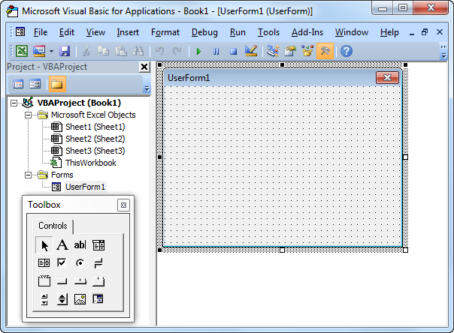
Creating User Forms
For more on creating user forms see pp 277 - 279
In VBE: Insert → User Form
Designing user forms requires knowing:
which controls are available
how to place, resize, and line up controls on a user form
how to give controls properties in Properties window

Slide 23
Available Controls

Slide 24
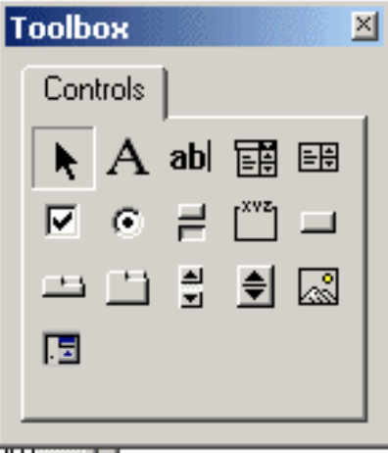
Available Controls
Some important controls:
CommandButton – click to run things
Label – for information about items and output
TextBox – for input
ListBox, ComboBox – choose from item list
Checkbox – check all items that apply
OptionButton (radio button) – push to select just one of several items
Frame – group of related controls, required around OptionButtons (it groups the option buttons so the user can only select one)
To add a control to a user form, drag/drop onto the user form
See Table 17-1 on p 279 for more on controls

Slide 25
User Form controls
After you add controls, you then set properties of the controls
Remember that controls are objects in VBA
  they have their own methods and properties
  see the Object Browser for lists and documentation

Slide 26
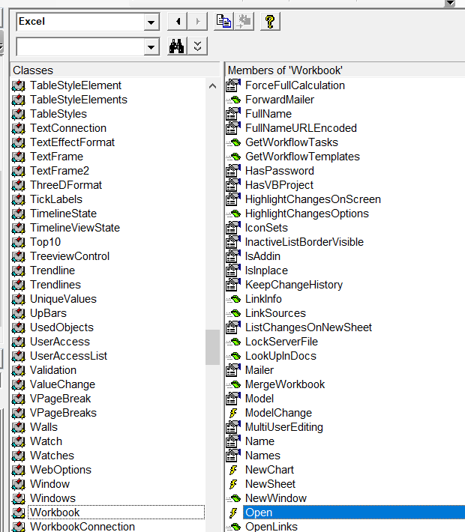
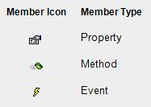
Object Browser
With each library, you can view all of the classes within the library
For each class, you can view properties, methods, and events
Open is an event for a workbook. If you write code within the open event, your code will run when the workbook is opened.

Slide 27
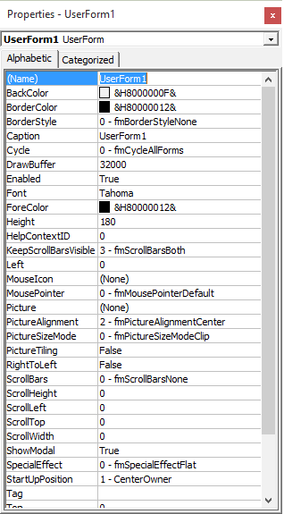
User Form controls :
Use the Properties Window in the lower left pane in VBE to access a control’s properties
You will want to update the Name and Caption properties
You can change/set many other properties in this properties window

Slide 28
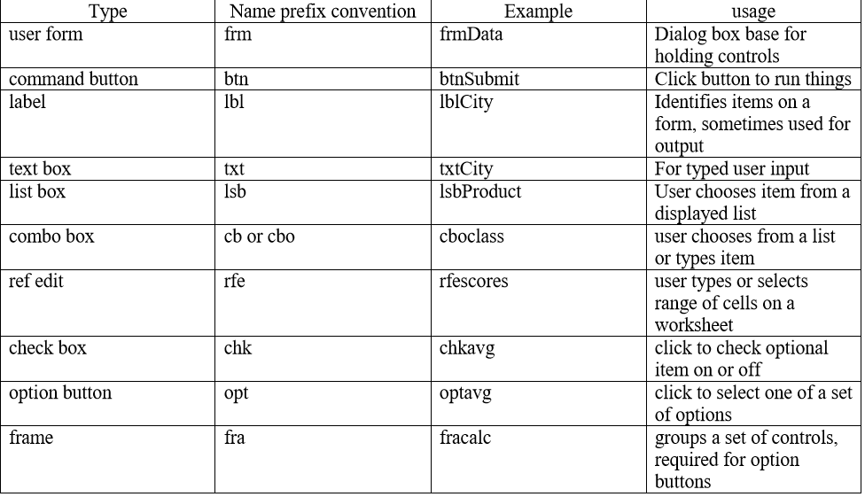
User Form Controls – Naming Conventions
** Use these prefixes for the Name Property
** These should be in camelCase
Ex: frmSubscription

Slide 29
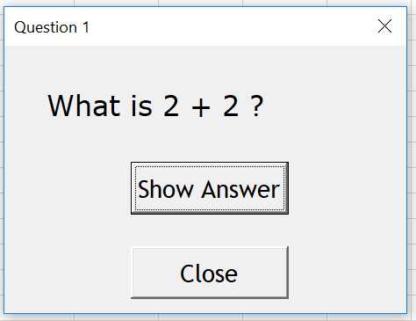
Let’s Try
Create the following user form (check out the useful info on the next 2 slides):
Notes:
Sub showMyUserForm()
frmQ1.Show
End Sub
Private Sub btnClose_Click()
Unload frmQ1
End Sub
Private Sub testButton_Click()
MsgBox "4"
End Sub

Slide 30
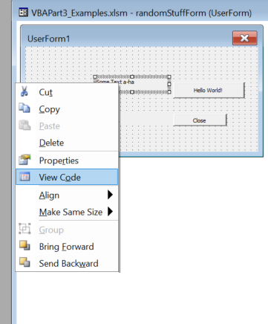
Useful Information
Creating code for a form control:
Right-click on the form control
Choose View Code
A module will open
  it will have a default button-click sub for that form control

Slide 31
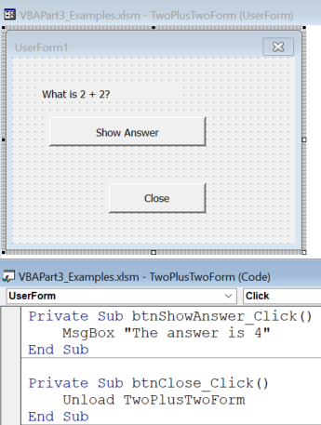
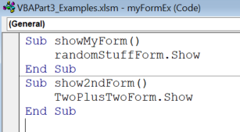
More Useful Information
A form will have its own module (if it is meant to be interactive)
Elsewhere in a normal VBA module, there will be code to:
  launch the form and
  possibly handle events triggered by the form
Use the Unload VBA command to close the form specified
Use the .Show method of the form control to launch it

