Slide 1


Reference:
https://pandas.pydata.org/pandas-docs/stable/tutorials.html

Slide 2
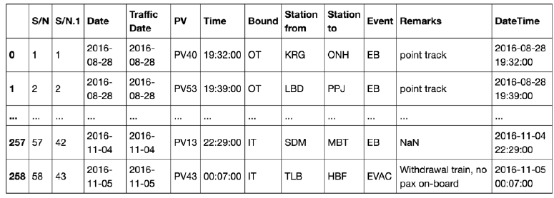
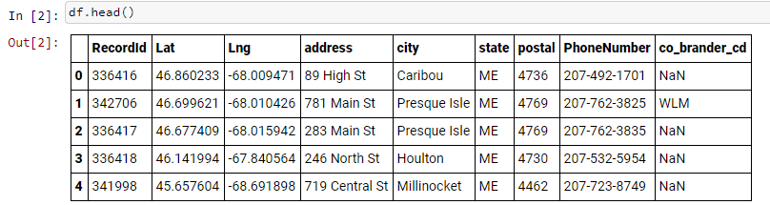
DataFrames
Recall these tables we saw last time:
Singapore
train incidents:
Dunkin’
locations:
Tables of data with attached row and column labels are called DataFrames

Slide 3
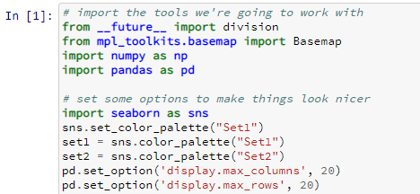
Pandas
Python library used for data “wrangling” and analysis
Provides efficient implementation of DataFrames
Offers powerful data operations familiar to users of both:
  Spreadsheet programs and
  Database frameworks
Often used by Data Scientists
To use Pandas, import the library, typically as follows:
import pandas as pd
(use pd as an alias to pandas – much simpler to type!)
if pandas is not found, install it in an Anaconda prompt by typing “pip install pandas”
Notes:
Markdown: HTML, LaTex,

Slide 4
1. Creating a Pandas DataFrame
  There are many methods. Here are some:
  Using a numpy* array of your data
  Using a dictionary of your data
  Importing data into a DataFrame from a csv file
  df = pd.read_csv(‘filename.csv’)
  Example:
  https://data.cityofnewyork.us/dataset/311-Service-Requests-From-2011/fpz8-jqf4
    * numpy is a Python library with support for mathematical functions, array manipulation, and more

Slide 5
Pandas
2. Inspecting the data
  Looking at the first / last few rows:
    df.head() df.tail()
  To see a summary of the data
    df.info()

Slide 6
Pandas
3. Selecting rows / columns
  Select rows:
    df[#:#]
  Select columns:
    df[‘column name’]
    To select several columns:
    df[[‘column name 1’, ‘column name 2’]]
    (Note the double brackets in this case.)

Slide 7
Pandas
4. Column Operations
  Sorting rows:
    df.sort_values(by=“Col Name”)
    Note: an optional parameter is ascending = True/False
  Creating a new column:
    df[‘new col name’] = density
    Note: the new column can be some function of the other columns
  Unique values
    df[‘col name’].unique()

Slide 8
Pandas
5. Counting values
  To count the values in a given column:
    df[’col name'].value_counts()
    To plot those values:
    df[’col name'].value_counts().plot()
    Note: to make plots show up inline with your Jupyter notebook, it may be necessary to include in the cell before your plot command: %matplotlib inline

Slide 9
Pandas
6. Isolating columns with a particular value
(aka “filtering”)
  To subset the data based on a column value:
    df[ df[’col name'] == ’value’]
returns True/False if that row contains that value or not
returns a Pandas dataframe of all rows that contain that value

Slide 10
Printing a Jupyter Notebook
Jupyter Notebooks can be exported to various file types (html, pdf, …)
One method of printing that works reasonably well from Chrome and some other browsers is
  File : Print from Jupyter’s menu
  Choose Save as PDF
  You then have a PDF you can keep and print
Note – sometimes the notebook may get very long if you have displayed a large data frame within it. You can compact it by deleting output cells showing the full data frame.

