Slide 1
SQL – Part I
Introduction and Overview

Slide 2
Today: Introduction to SQL
Overview and basics of SQL
Hands-on practice:
  Write SQL statements when “You Try” slides appear for the database
  Employee.accdb available in the course repo.
See also these references:
https://support.microsoft.com/en-us/topic/93fb69b7-cfc1-4f3e-ab56-b0a01523bb50#ID0EBBD=SQL_syntax
https://www.codecademy.com/articles/sql-commands
Notes:
Other Refs:

Slide 3
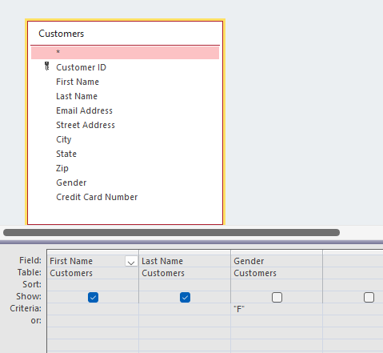
Access - Queries
Recall: in Access we were able to run queries like this
What did it return?
What are the entity/field pairs?
Notes:
customers-first name, customers-last name, customers-gender

Slide 4
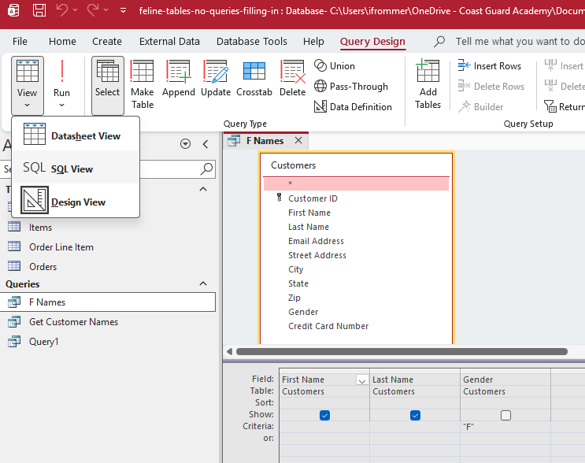
Access - Queries
Notes:
Access was

Slide 5
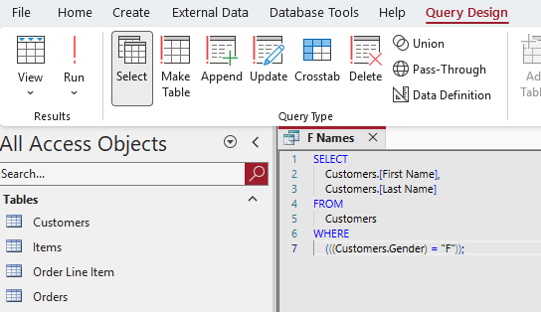
Access - Queries
Access was giving us a tool to build SQL statements in the background, without needing to know SQL

Slide 6
SQL - Background
SELECT Last_Name
FROM Contacts
WHERE First_Name = ‘Mary’;
SQL = Structured Query Language
Developed at IBM by Donald Chamberlin and Raymond Boyce in the 1970s
Used to retrieve data from a relational databases (like Access)
SQL and the many of associated database systems originating in the 1970s are still in use today -> longevity of use another reason for SQL’s importance and ubiquity
If Access will build these statements, why learn SQL?
  SQL is not unique to Access – useful for any relational database
  Can help you write better queries
Notes:
Understanding how SQL works can help you create better queries and can make it easier for you to understand how to fix a query that is not returning the results that you want.
Indeed.com lists of 20,000 that pay >100K a year that require knowing SQL – i.e. this is useful skill to have!

Slide 7
SQL – Use in Industry
SQL is a highly sought-after skill according to job postings for data scientists…
Notes:
Understanding how SQL works can help you create better queries, and can make it easier for you to understand how to fix a query that is not returning the results that you want.
Indeed.com lists of 20,000 that pay >100K a year that require knowing SQL – i.e. this is useful skill to have!

Slide 8
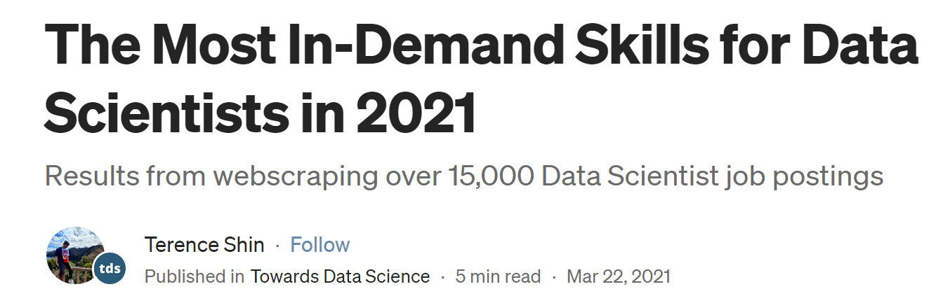
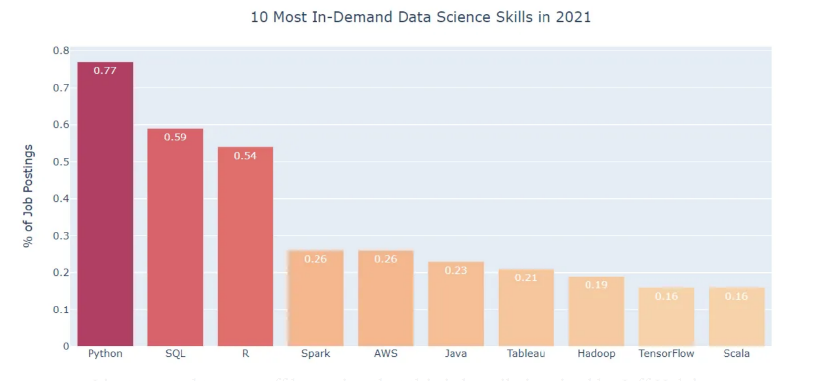
https://towardsdatascience.com/the-most-in-demand-skills-for-data-scientists-in-2021-4b2a808f4005

Slide 9
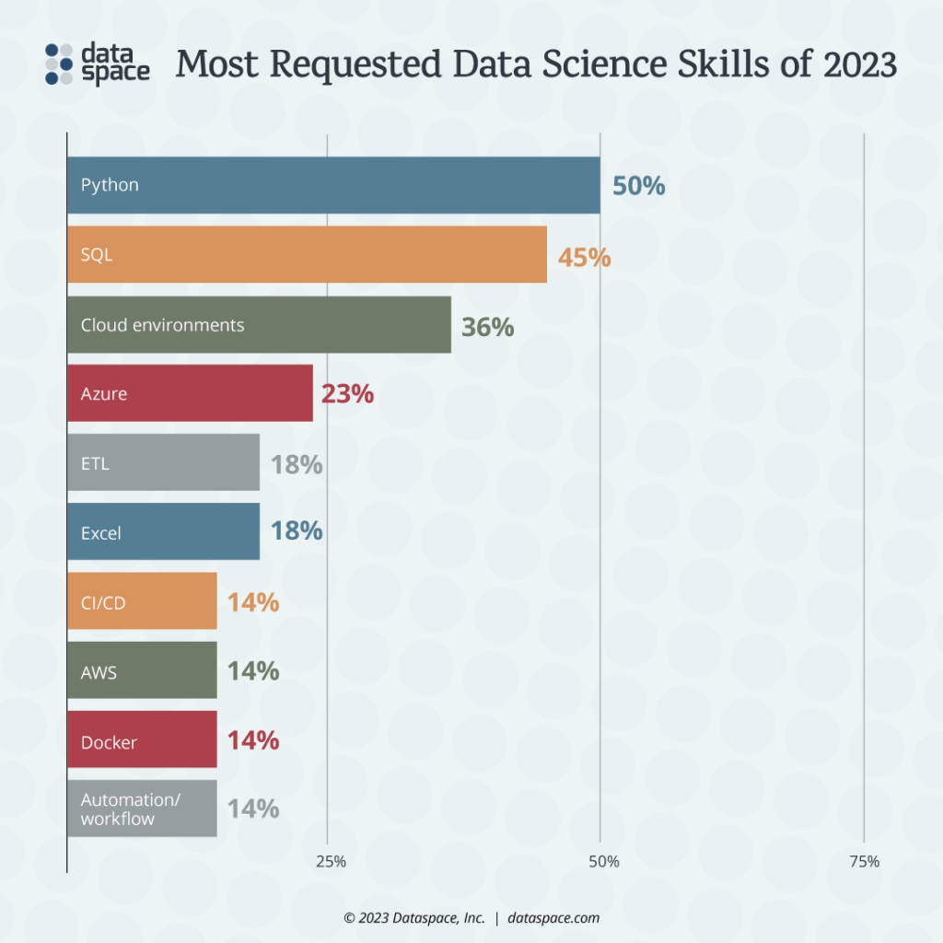
https://dataspace.com/data-job-seekers/2023-top-data-science-skills/

Slide 10
Basic SQL Clauses
SELECT, FROM, WHERE
A SQL statement takes the general form:
SELECT field_1
FROM table_1
WHERE criterion_1
;
Note:
- Line breaks are not required but improve readability
- Every SELECT statement ends with a semi-colon (;)
Ex of basic SQL statement:
SELECT Last_Name
FROM Contacts
WHERE First_Name = ‘Mary’;
Notes:
Strings: Use single quotes like 'Active'.

Slide 11
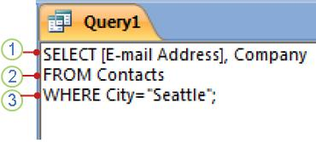
Basic SQL Clauses
SELECT, FROM, WHERE
Ex:
This example SQL statement reads:
"Select the data that is stored in the fields named E-mail
Address and Company,
from the table named Contacts,
specifically those records in which the value of the field
City is Seattle."
Notes:
Identifiers (table or column names): Always use square brackets if they have spaces like [First Name].
Strings: Use single quotes like 'Active'.

Slide 12
Basic SQL Clauses
SELECT, FROM, WHERE
Ex:
SELECT clause:
  consists of an operator (SELECT)
  followed by 1 or more identifiers (fields) -- [E-mail Address] and Company in this example
Note: If an identifier contains spaces or special characters (such as "E-mail Address"), it must be enclosed in square brackets

Slide 13
Basic SQL Clauses
SELECT, FROM, WHERE
Ex:
FROM clause:
  consists of an operator (FROM)
  followed by an identifier (table) – Contacts in this example

Slide 14
Basic SQL Clauses
SELECT, FROM, WHERE
Ex:
WHERE clause:
  consists of an operator (WHERE)
  followed by an expression (City="Seattle“ in this example)
  provides a criterion for the query
Note: a WHERE clause is not required

Slide 15
Basic SQL Clauses
SELECT
Fields with spaces require square brackets:
SELECT [Phone Number]
Multiple fields are separated with commas
SELECT Name, Number
All fields can be selected using an asterisk
SELECT *
You can change how a field name appears in the query result by using the AS statement
SELECT [Phone Number] AS [Contact #]

Slide 16
Basic SQL Clauses
FROM
Tables with spaces require square brackets:
FROM [Employee Data]

Slide 17
Basic SQL Clauses
WHERE
Fields with spaces require square brackets:
WHERE [Last Name] = ‘Smith’
operators that can be used in WHERE clauses:
= equal
> greater than
< less than
>= greater than or equal to
<= less than or equal to
<> not equal
AND and OR can also be used in WHERE clauses

Slide 18
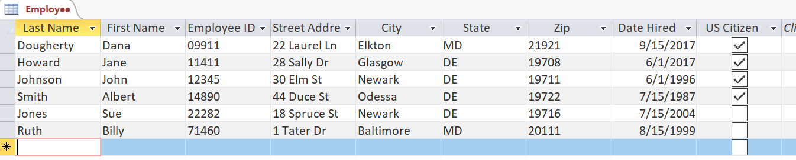
YOU TRY:
Write a SQL statement in Employee.accdb that retrieves the first and last names of those employees that live in Maryland.
Notes:
SELECT [Last Name], [First Name]
FROM Employee
WHERE State = 'MD'
;

Slide 19
Basic SQL Clauses
AS
Returns a table or field under a different alias
Column
SELECT fieldName AS aliasName
FROM tableName;
Table
SELECT fieldName
FROM tableName AS aliasName;

Slide 20
Basic SQL Clauses
ORDER BY
Sorts a query's resulting records on a specified field or fields in ascending or descending order
The default is to list in ascending order:
SELECT LastName
FROM Employee
ORDER BY LastName;
To put into descending order, add DESC to end
SELECT LastName
FROM Employee
ORDER BY LastName DESC;

Slide 21
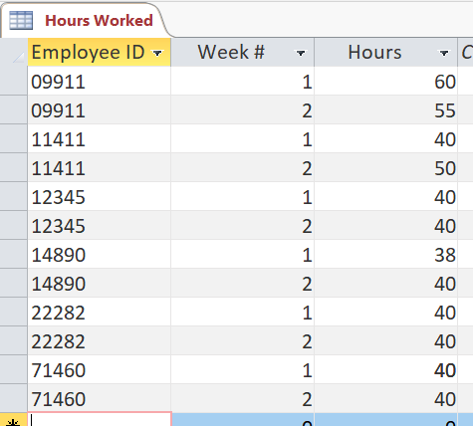
YOU TRY:
Write a SQL statement that retrieves the Employee ID, Week #, and Hours for all Employees who have worked >40 hours during Week 2. Put the results in descending order (by hours). Rename the Hours as Hours Worked
Notes:
SELECT [Employee ID], [Week #], Hours AS [Hours Worked]
FROM [Hours Worked]
WHERE [Week #] = 2 AND Hours > 40
ORDER BY Hours DESC;

Slide 22
Aggregate Functions
SQL allows you to compute aggregate values over columns by using functions such as:
Avg
Count
First, Last
Min, Max
Stdev
Sum
Var
Used in the SELECT statement. Example:
SELECT Sum(Hours)
FROM [Hours Worked];
Notes:
https://support.office.com/en-us/article/sql-aggregate-functions-a810ee71-c1cd-43d7-9c55-8005f1893be5

Slide 23
YOU TRY:
Write a SQL statement that returns the number of times any employee worked more than 40 hours
Notes:
SELECT Count(Hours) AS [Number of Overtime Weeks]
FROM [Hours Worked]
WHERE Hours > 40;

Slide 24

Write a SQL statement that returns the number of times any employee worked more than 40 hours
  SELECT Count(Hours) AS [Number of Overtime Weeks]
  FROM [Hours Worked]
  WHERE Hours > 40;

Slide 25
A more challenging query
Write a SQL statement that returns the number of employees who have worked more than 40 hours in a week
This requires use of:
the DISTINCT keyword in SQL
use of SQL subqueries
Notes:
SELECT Count(Hours)
FROM [Hours Worked]
WHERE Hours >= 40;

Slide 26
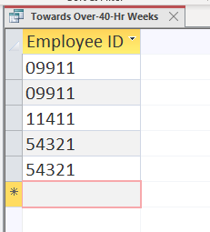
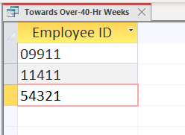
A plan for this challenging query:
This query finds all >40-hour weeks, showing the corresponding employee ID:
    SELECT [Employee ID]
    FROM [Hours Worked]
    WHERE Hours>40;
Wrapping the selected employee IDs inside the “DISTINCT” keyword yields unique employee IDs only:
    SELECT Distinct [Employee ID]
    FROM [Hours Worked]
    WHERE Hours>40;

Slide 27
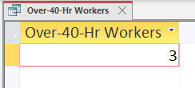
Now pass the previous query as a subquery to one that simply counts that number of records returned by the subquery
SELECT Count(*) as [Over-40-Hr Workers]
FROM
(
SELECT DISTINCT [Employee ID]
FROM [Hours Worked]
WHERE Hours>40
)
;
Note – outside of Access, this query could be accomplished more easily by wrapping Count around Distinct, as in:
SELECT COUNT(DISTINCT[Employee ID]) …

Slide 28
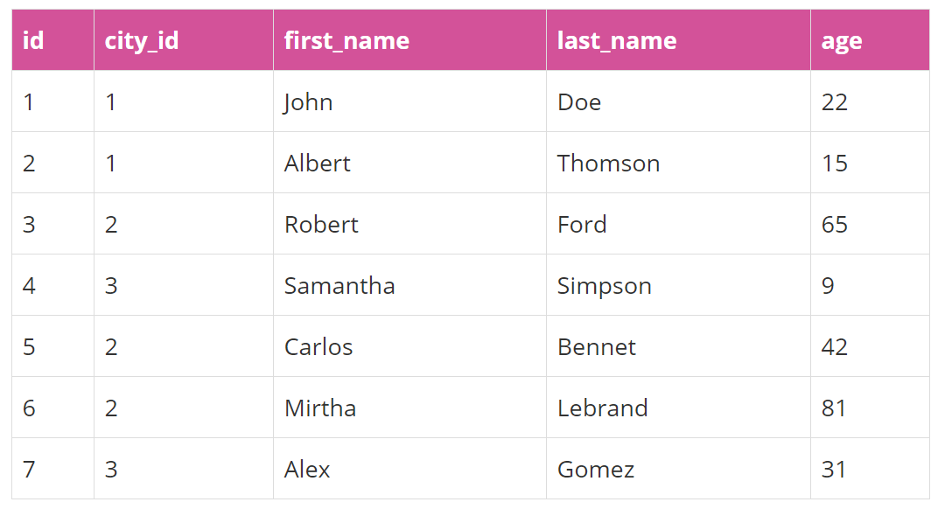
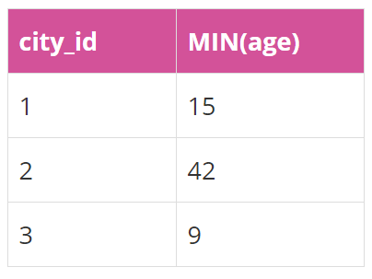
Aggregate Functions
GROUP BY
Table: users
We want to find the
min age for each city.
Think “Group” the
records “by”
city 1st, then…
SELECT city_id, MIN(age)
FROM users
GROUP BY city_id;
https://academy.vertabelo.com/blog/beginners-guide-sql-aggregate-functions/

Slide 29
Aggregate Functions
GROUP BY
Lets us perform aggregations on a group of values based on given fields.
Example from previous slide:
SELECT city_id, MIN(age)
FROM users
GROUP BY city_id;
Groups records by city_id,
then computes the minimum for each city_id.
https://academy.vertabelo.com/blog/beginners-guide-sql-aggregate-functions/

Slide 30
YOU TRY:
Write a SQL statement that returns the Employee ID with the total number of hours worked
Notes:
SELECT [Employee ID], Sum(Hours) as [Employee Hrs]
FROM [Hours Worked]
GROUP BY [Employee ID]
;

Slide 31
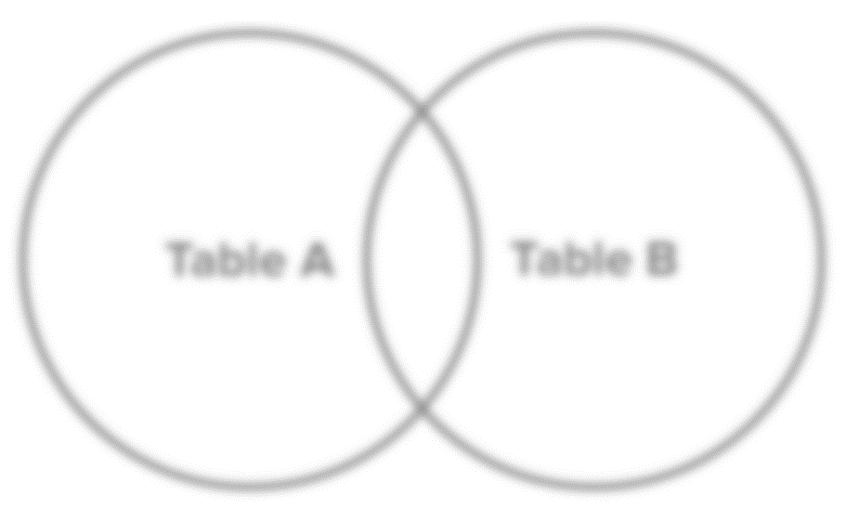
Next time: Joins in SQL
So far we’ve been doing SQL statements that involve only one table. Joins will allow us to query from multiple tables.
Consider this visual representation of table A and table B, which are connected through primary and foreign keys.
http://www.sql-join.com/sql-join-types

