Slide 1
Excel and
Visual Basic for Applications (VBA)

Slide 2
Today
  Broad overview of Excel
  Intro to VBA
Next Time – Continue VBA
  Loops
  Dialog Boxes

Slide 3
Excel – Recall?
Think/Pair/Share
What are these in Excel:
        Workbook
        Worksheet
        Cell
        Range
      Answer with a definition or sketch
      Don’t peek at next slide yet

Slide 4
Excel
Excel is spreadsheet software developed by Microsoft
An Excel file (.xls file) is a Workbook
A Workbook consists of Worksheets
  Worksheets are organized by tabs that contain data, formulas, functions
Worksheets are organized into rows and columns of cells, referenced by column then row
  Ex: B27
A range is a rectangular collection of cells
  Ex: A1:B2 is a 2x2 rectangle of cells
  Ex: C10:C20 is 11x1 rectangle of cells
Can name ranges to help make models more effective/readable

Slide 5
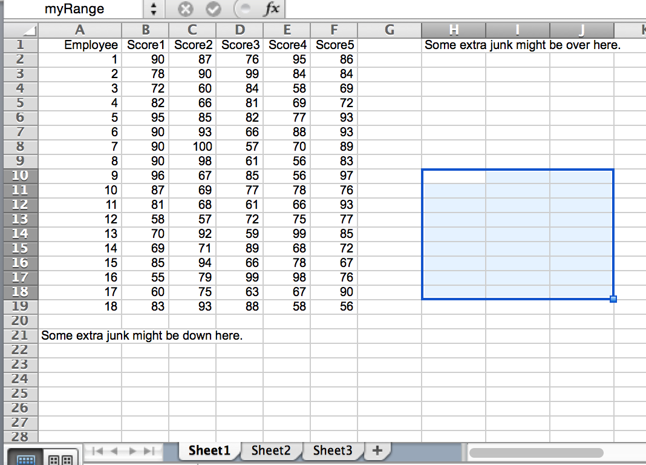
Excel
Excel Applications:
Data Visualization
  Charts, Tables
Data Analysis
Pivot Tables
Import/Export Data
Excel Structure:
Workbook
Worksheets
Ranges/Cells
  Formatting
  Formulas
Etc.

Slide 6
Intro to VBA
Visual Basic for Applications (VBA) is a programming language specific to Microsoft Office products
  For this course our focus is EXCEL VBA
VBA is NOT the same as Visual Basic (VB)
  VB is a software development language that you can buy and run separately, without the need for Office

Slide 7
Why learn VBA?
Why learn VBA?
  To further your applications in Excel including DSS
  Office is available on all CG work stations
    Senior Capstone
    Future Assignments
VBA vs Python in the ORDA curriculum
  We won’t go into as much depth in VBA as Python
  Many Python ideas apply to VBA, though with different syntax
  Ex: for i in range(10): vs. For i = 0 to 10

Slide 8
Visual Basic Editor (VBE)
Our Integrated Development Environment (IDE) for VBA/Excel
  Note: In CML our IDE was Spyder
To access the VBE:
  Alt-F11 key
  Or, Developer → Visual Basic Applications
    Note: if you do not have the Developer tab, follow the directions on pg 17-18 in your textbook
Notes:
Right click any part of the ribbon and choose Customize the Ribbon from the shortcut menu
In the Customize Ribbon tab of the Excel Options dialog box, locate Developer in the 2nd column
Put a check mark next to Developer
Click OK

Slide 9
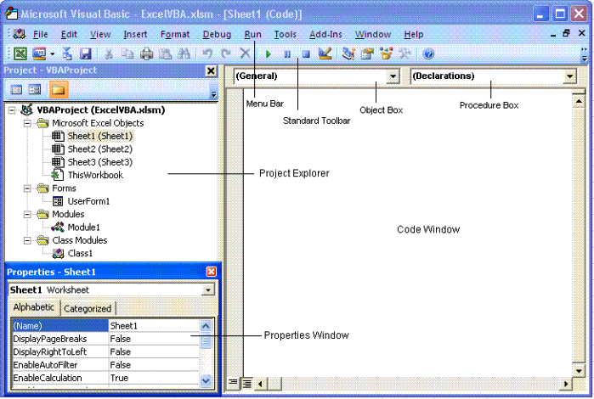
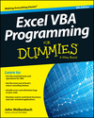
Visual Basic Editor
More on VBE on pp 31-33
Notes:
More on VBE on pages 31-33

Slide 10
VBA Essentials – Part 1
Record a macro
Discuss procedures in VBA
  Sub procedure
  Function procedure
  Event procedure
Discuss variables in VBA
  Variables
  Objects
  Constants
Discuss Ranges – powerful object within Excel
Not today

Slide 11
What is a Macro?
Macros are little programs in Excel that:
  are the result of the recording of a series of tasks,
  automate common repetitive tasks, and
  are written with VBA.
https://blog.udemy.com/excel-macros-tutorial/

Slide 12
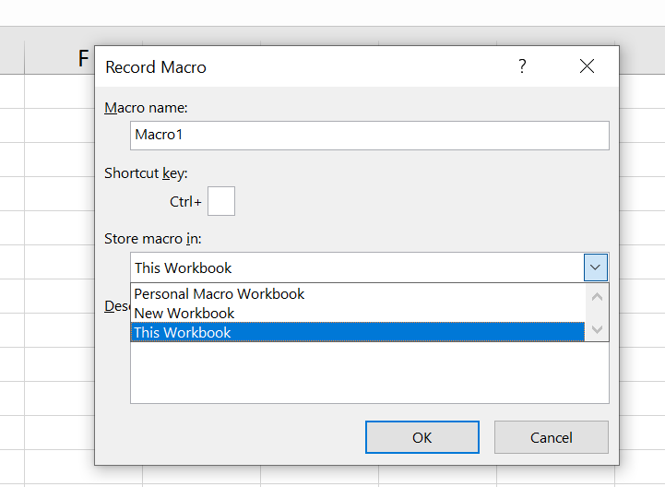
1. Record a Macro
Purpose of recording a macro:
  Helpful for beginners to learn VBA
  Useful for experienced VBA programmers to refine skills
How to record a macro in Excel:
On the Developer Tab, choose “Record Macro”
  Name the macro
  Make sure that under “Store macro in:” you select “This Workbook” (or “New Workbook”)
Perform some tasks in Excel
Click “Stop Recording” on the Developer Tab
Open Visual Basic Editor to view the code that was generated

Slide 13
1. Record a Macro
Let’s Try
The macro we are about to create will:
  Type your name in a cell
  Enter the current date and time in the cell below
  Format both cells to display bold
  Change the font size of both cells to 16 pt font
  Let’s look at the resulting code in the VBE.
More on the Recording Macros including step-by-step instructions on pp 19-24 & Ch 7
Notes:
Demo this in class → open up VBE and examine the recorded macro
Things to point out:
- name of the Sub
- comments (‘)
- give time for everyone to read through it (although it may not make compete sense)

Slide 14
1. Record a Macro
Let’s Try
Go to Excel and the VBE now…
Notes:
Demo this in class → open up VBE and examine the recorded macro
Things to point out:
- name of the Sub
- comments (‘)
- give time for everyone to read through it (although it may not make compete sense)

Slide 15
2. Sub Procedures (Sub)
A Sub Procedure is a group of VBA statements that performs an action (or actions) with Excel
To Create a Sub:
  Open VBE → Insert → Module
Syntax:
  All subs begin with Sub SubName()
    The parenthesis can hold arguments/parameters
  All subs end with End Sub
  Sub SubName(arg1, arg2)
  `comments and code
  `do something with arg1 and arg2
  End Sub
More on Sub Procedures in Ch 5
Notes:
Ex: pg 14

Slide 16
2. Sub Procedures (Sub)
Let’s Try
Open VBE → Insert → Module
Type the following:
  Sub ShowMessage()
  MsgBox "That's all folks!"
  End Sub
To execute: Run → RunSub/UserForm in VBE or
Click in VBE
More on Sub Procedures in Ch 5

Slide 17
2. Sub Procedures (Sub)
Let’s Try
Add the following:
  Sub ShowSquaredNum()
  Num = InputBox("Enter a number")
  MsgBox Num ^ (2)
  End Sub
More on Sub Procedures in Ch 5
Notes:
Pointing out we have two subs…how to run them each

Slide 18
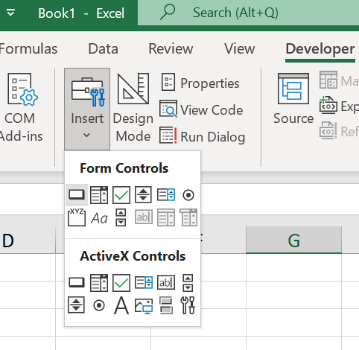
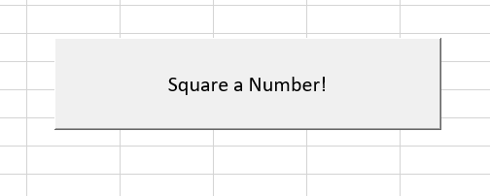
2. Sub Procedures (Sub)
Executing a Sub from a button
We can execute a sub directly from an Excel worksheet:
  Activate a worksheet
  Go to Developer : Insert : Form Controls and click the button tool to add a button (see Figure at right)
  Drag in the worksheet to create the button
  Select the macro you want to assign to the button
  Right-click the button to edit its text
  Click OK
Go to Excel and do this
More on Executing Subs w/ buttons on p73

Slide 19
3. Declaring Variables
Recall, in Python, you did not have to declare a data type to a variable before using it:
Cost = 15.12
isSold = True
parts = 25
With VBA, we also do not have to declare a data type for a variable before we start using it, but it’s a good idea to do so:
Variable declaration syntax: Dim variableName As VariableType
Examples:
Dim cost As Currency
Dim parts As Integer
Dim isSold As Boolean
‘or as a list:
‘Dim cost As Currency, parts As Integer, isSold As Boolean
Cost = 15.12
isSold = True
parts = 25
More on Variables on p111-120

Slide 20
3. Declaring Variables
So if we don’t have to declare a variable, why would we?
  More efficient memory use
  Faster execution
  Makes debugging easier
  (ex: if you misspell a variable, it’ll be hard to detect!)
To force a requirement to declare variables, use the following statement at the top of your VBA module
Option Explicit
Note: if you do not declare a variable, VBA uses the default data type: Variant – which can change data types depending on what you do with it.

Slide 21
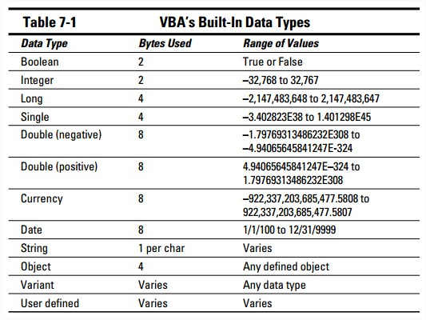
3. Declaring Variables
(Some) VBA variable types:

Slide 22
3. String Variables
Dim firstName As String, lastName As String, name As String
firstName = “John”
lastName = “Smith”
name = firstName & “ “ & lastName
‘Useful String functions
shortString1 = Right(“Hello”, 2)
shortString2 = Left(“Hello”,2)
shortString3 = Mid(“Hello”, 2,3)
nCharacters = Len(“Hello”)
Useful sidelight: the Immediate window – works like the console in Spyder
  VBE: View > Immediate Window
  ?myVariable – to see value of a variable
  ?expression - to see value of an expression
  and other features; try out string expressions above in the Immediate window

Slide 23
VBA Essentials – Part 1
Record a macro
Discuss procedures in VBA
  Sub procedure
  Function procedure
  Event procedure
Discuss variables in VBA
  Variables
  Objects
  Constants
Discuss Ranges – powerful object within Excel
Not today
Before we get into object variables and ranges, we will introduce VBA’s object model.

Slide 24
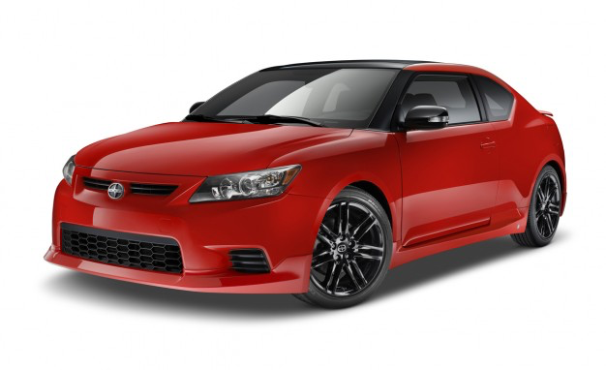
VBA - Objects
VBA is an object oriented programming language
VBA objects have
  Properties (attributes)
  Methods (functions specific to the object)
Example:
Object: Car
Properties: color, number of
doors, etc.
Methods: drive, sell, etc.

Slide 25
VBA - Objects
VBA has a set of predefined objects which is referred to as the object model for each application.
  Using VBA in Word, Access, etc. would require you learning its object model
VBA objects in Excel: Range, worksheet, workbook, etc
VBA also has collections. Collection is a type of object that contains a set of related objects.
  Ex: a used car lot is a collection of car-objects
  VBA collections in Excel: Worksheets, workbooks, etc.
More on objects in CH 4
Notes:
CH 4 in nook

Slide 26
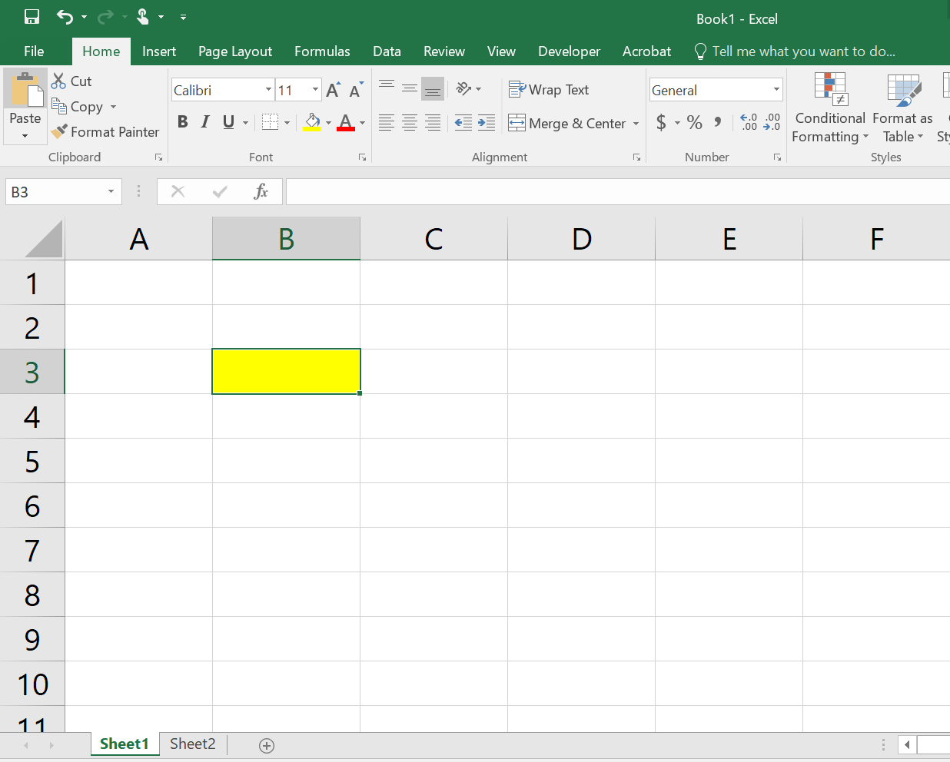
VBA – Objects
Hierarchy
Application
-Addin
-Window
-Workbook
-WorksheetFunction
-Chart
-Name
-VBProject
-Window
-Worksheet
-Comment
-Hyperlink
-Name
-PageSetup
-PivotTable
-Range
More on Object Hierarchy on pgs 52-53
Ex. Application.Workbooks(“Book1.xlsx”).Worksheets(“Sheet1”).Range(“B3”)
Notes:
Pg 52-53

Slide 27
VBA – Objects
Hierarchy
Excel
Workbook
Worksheet
Range
More on Object Hierarchy on pgs 52-53
Notes:
Pg 52-53

Slide 28
VBA – Objects
Referencing Objects
Excel
Workbook
Worksheet
Range
To work with Excel objects, we need a way to reference them. For example, range “B3” can be referenced this way:
Application.Workbooks(“Book1.xlsx”).Worksheets(“Sheet1”).Range(“B3”)
Notice how each part of the hierarchy is referenced.
More on referring to objects on pp 53-56

Slide 29
VBA – Objects
Referencing Objects
Excel
Workbook
Worksheet
Range
Application.Workbooks(“Book1.xlsx”).Worksheets(“Sheet1”).Range(“B3”)
However, this is a mouthful – Excel allows us to simplify (under certain conditions):
Range(“B3”)
Notes:
- Application is assumed to be excel
If the workbook is active and the worksheet is active, it can be assumed
We are left with B3

Slide 30
VBA – Objects
Method and Properties
So now that we have range “B3” referenced – what might we want to do with it?
Read or modify its properties
Specify a method of action to be used with it
More on methods and properties on pp 57-64

Slide 31
VBA – Objects
Method and Properties
Attributes (properties) of a range?
  Value , alignment, Formula, etc.
  Ex: Range(“B3”).Value
Methods of a range?
  Clear, Copy, Format, etc.
  Ex: Range(“B3”).Copy
More on methods and properties on pp 57-64

Slide 32
VBA – Objects
Method and Properties
You can check out all of the objects in Excel/VBA through the object browser
Developer Tab → Visual Basic Application → View → Object Browser
You can read more about the object browser on p 62 in your text
Let’s look at Range in the object browser.
More on the Object Browser on pp 62-63

Slide 33
VBA Essentials – Part 1
Record a macro
Discuss procedures in VBA
  Sub procedure
  Function procedure
  Event procedure
Discuss variables in VBA
  Variables
  Objects
  Constants
Discuss Ranges – powerful object within Excel
Not today
Back to our agenda,
continue with Objects

Slide 34
3. Object Variables
Object variables are assigned using Set
Dim scoreRange As Range
Set scoreRange = ActiveWorkbook.Worksheets(“Data”).Range(“Scores”)
By setting the range named “Scores” to an object variable named scoreRange, we can simply refer to the scoreRange when working with that range in our VBA code.

Slide 35
3. Constant Variables
Use the keywork Const
Const PI = 3.1415
Built in Constants (built into Excel, VBA, and Microsoft Office)
  Preceded by the prefix xl, vb, or mso
  vbBlue, xlCalculationManual, vbYes
More on Constant Variables on pp 120-122

Slide 36
4. Range Objects
A Range consists of one or more contiguous cell(s) in an Excel spreadsheet
A Range is an object in the Excel Library (see object browser)
  This is a VERY important object that you will likely use in every program you make with VBA/Excel
More on Range Objects in CH 9

Slide 37
4. Range Objects
Ranges can be referenced several different ways:
  By address:
  Range(“A1”) or Range(“A1:B10”)
  By range name:
  Range(“Sales”)
  With a variable for a range name:
  rangeName = “Sales”
  Range(rangeName)
NOTE: the above references are for ranges on the active worksheet, otherwise need to specify worksheet name (Worksheets(“Sheet 1”).Range(“K9”))
More on Range Objects in CH 9

Slide 38
4. Range Objects
Let’s learn more about the Range object through example. See the ‘ranges-essentials.xlsm’ file in the lec18-VBA-1 folder of the course repo.
More on Range Objects in CH 9
Notes:
HW 10

