Slide 1
Excel and VBA:
PART 2

Slide 2
Practice Outside of Class
Open range-essentials.xlsm (under lec18-VBA-I in the course repo)
For each of the Subs:
Range5 and Range6
Take a few minutes and do the following:
  Run it
  Alter it slightly to try to learn something and re-run
  Note any questions (e.g. What does .Offset do in Range6?)
  Write down what you did / what questions you have
Hint: Try using the Immediate window (see:
https://www.excelcampus.com/vba/vba-immediate-window-excel/ )
Notes:
Whtie board:
[some range].Address
Cells(row #, col #)
What does

Slide 3
Today’s New Material
Dialog Boxes
the With Construction
If-Then-Else
Loops

Slide 4
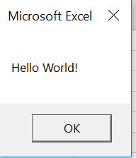
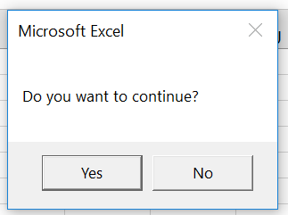
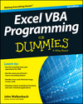
Dialog Boxes
1) Displaying message with OK button:
  MsgBox(“This is fun”)
2) Using message box to get user input:
result = MsgBox(“Do you want to continue?”, vbYesNo)
vbYesNo
built-in VBA constant
when present, it tells MsgBox to display the “Yes” and “No” buttons
More on Dialog Boxes in chapter 16
Notes:
Note, InputBox and MsgBox are functions

Slide 5
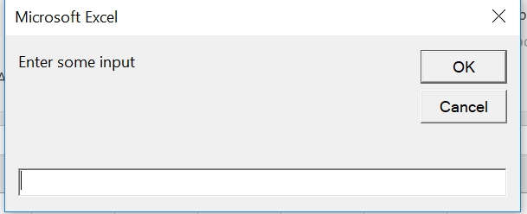
Dialog Boxes
Use InputBox if you want the user to provide feedback
  userInput = InputBox(“Enter some input”)
Notes:
Note, InputBox and MsgBox are functions

Slide 6
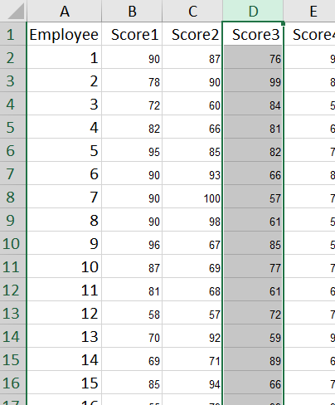
VBA’s With Construction
Sub Range7 in Range(essentials).xlsm had some code
like this:
With Range("A1:F19")
.Rows(12).Select
.Rows(12).EntireRow.Select
.Columns(4).Select
.Columns(4).EntireColumn.Select
End With
This saves one the trouble of typing the range repeatedly (A1:F19 in this case):
Range("A1:F19").Rows(12).Select
Range("A1:F19").Rows(12).EntireRow.Select
Range("A1:F19").Columns(4).Select
Range("A1:F19").Columns(4).EntireColumn.Select

Slide 7
the With Construction
Purpose: shortcut when working with objects and their properties & methods
With Construction:
  First line has the keyword With, followed by the object reference
  Body consists of
    any object, property, or method of object on With line
    starts with a period, gets “tacked onto” the object referenced in the first line
  Last line has the keywords End With
Example:
With Range("A1:F19")
.Rows(12).Select
.Rows(12).EntireRow.Select
.Columns(4).Select
.Columns(4).EntireColumn.Select
End With
More on With Construction on pp 253-254
Notes:
Think: “While working with ________”
or
“We are working with _____________”

Slide 8
A More Complicated Example using With
Workbooks(“Sales”).Worksheets(“March”).Range(“A1”).Value = “Sales for March”
Workbooks(“Sales”).Worksheets(“March”).Range(“A1”).HorizontalAlignment = xlLeft
Workbooks(“Sales”).Worksheets(“March”).Range(“A1”).Font.Name = “Times New Roman”
Workbooks(“Sales”).Worksheets(“March”).Range(“A1”).Font.Bold = True
Workbooks(“Sales”).Worksheets(“March”).Range(“A1”).Font.Size = 14
VS.
With Workbooks(“Sales”).Worksheets(“March”).Range(“A1”)
.Value = “Sales for March”
.HorizontalAlignment = xlLeft
With .Font
.Name = “Times New Roman”
.Bold = True
.Size = 14
End With
End With

Slide 9
If Statements
Take 5 minutes to:
Read the next slide about IF statements in VBA
Write a VBA “Guess My Number” Sub:
  Store your number in a variable
  Ask the user to guess your number
  Display a message letting the user know whether their guess was correct or not
  Hint: Int(myString) converts a string to integer
[Optional, for now] Modify your Sub so that it lets user know if they were:
    Correct Hint: Use ElseIf
    Incorrect but close
    Incorrect and not close
More on If Statements on pp 166-170
See also
“VBA’s Most Useful Built-In Functions” handout

Slide 10
If Statements
Purpose: when one or more possible conditions require its own code
Single-Line If Construction:
If condition Then statement1 [Else statement2]
If numberOrdered <= 200 Then unitCost = 1.3
If numberOrdered <= 200 Then unitCost =1.3 Else unitCost =1.2
If-Then-Else-End Construction:
  If condition Then
  statements1
  [Else
  statements2]
  End If
ElseIf statements exist in VBA too!

Slide 11
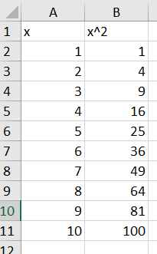
For-Next Loops
Let’s write a Sub to:
  display x and f(x) values for f(x) = x²
Plan
  Sketch out pseudo-code/ideas
    Use range offsets from cell A1
      When x = 1, the row offset = 1, etc.
    Loop through x values
      Fill in the cell values in x and x² columns
  What is the VBA For-Next loop syntax?
    For counterVar = firstValue To lastValue [Step stepValue]
    statements
    Next [counterVar]
Now you try to write this Sub. See next slide for more info and examples you should make sure you understand.

Slide 12
For-Next Loops
Purpose: repetitive tasks
For Loop Construction:
  For counterVar = firstValue To lastValue [Step stepValue]
  statements
  Next [counterVar]
Examples:
For i = 1 To 100
sum = sum+1
Next
--------
With Worksheets(“salaries”).Range(“A1”)
For i = 1 to 500
if .Offset(i,0).Value = “James Snyder” Then
isFound = True
Exit For
End If
Next
End With
More on For-Next Loops on pp 174-179
Notes:
For i = 1 To 100 Step 2
[counter] not necessary but used for clarity – esp when multiple for loops being used

Slide 13
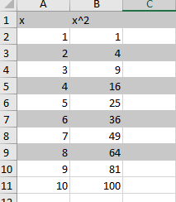
For-Next-Step Loops
Sub forNextStepDemo()
' shade every other row
For i = 1 To 10 Step 2
Rows(i).Interior.Color = RGB(200, 200, 200)
Next i
End Sub
Understand?

Slide 14
For-Each Loops
Take a few minutes and figure out what this code will do:
Sub forEachDemo()
For Each ws In ActiveWorkbook.Worksheets
MsgBox (ws.Name)
counter = counter + 1
Next
MsgBox "There were " & Str(counter) & " worksheets."
End Sub
Try running it. See also next slide.
For-Each Loop Construction:
Dim item as Object
For Each item in Collection
Statements
Next
More on For-Each Loops on pp 180-182

Slide 15
For-Each Loops
Purpose:
to loop through all objects in a collection
  such as cells in a Range, or worksheets in a workbook’s Worksheets collection.
especially useful if you do not know how many objects are in a collection
For Each Loop Construction:
Dim item as Object
For Each item in Collection
Statements
Next
  For Each ws in ActiveWorkbook.Worksheets
  If Left(ws.Name, 5) = “Sheet” Then
  counter = counter +1
  End If
  Next
  MsgBox "There were " & Str(counter) & " worksheets."

Slide 16
Do Loops
Let’s redo the “Guess My Number” Sub in 2 new ways:
User keeps guessing while their guess is wrong
User keeps guessing until their guess is correct
VBA Do-While syntax → Do While condition
                statements
                Loop
Sub GuessMyNumWhile()
' updated version of the if then one
myNumber = 9
yourGuess = InputBox("Guess my number (from 1 to 10):")
‘ YOUR CODE HERE (the Do-While ; try it)
msg = "You got it!"
MsgBox msg
End Sub
Notes:
Notice the condition can be at the top vs the bottom…

Slide 17
Do Loops
Let’s redo the “Guess My Number” Sub in 2 new ways:
User keeps guessing while their guess is wrong
User keeps guessing until their guess is correct
2. VBA Do-Until syntax → Do Until condition
                statements
                Loop
Sub GuessMyNumUntil()
' updated version of the if then one
myNumber = 9
yourGuess = InputBox("Guess my number (from 1 to 10):")
Do Until Int(yourGuess) = myNumber
MsgBox "Sorry, that's incorrect."
yourGuess = InputBox("Guess my number (from 1 to 10):")
Loop
msg = "You got it!"
MsgBox msg
End Sub
Notes:
Notice the condition can be at the top vs the bottom…

Slide 18
Do Loops
Purpose: when you need to loop while some condition holds or until some condition holds
Do Loop Construction: 4 variations
1
Do Until condition
statements
Loop
Do While condition
statements
Loop
2
Do
statements
Loop Until condition
Do
statements
Loop While condition
3
4
More on Do Loops on pp 179-180
Notes:
Notice the condition can be at the top vs the bottom…

Slide 19
Infinite Loop
Ctrl-Break or ESC
Breaks you out of an infinite loop

Slide 20
Other useful tips
Screen Updating
(See: VBA-II-Ex1.xlsm, screenUpdatingExample)
Application.ScreenUpdating = False
  Application.ScreenUpdating = True
Timer
(See: VBA-II-Ex1.xlsm, screenUpdatingExample)
startTime = Timer
elapsedTime = Timer - startTime
Stop Automatic Recalculations
(See: VBA-II-Ex1.xlsm, lookingForNumber)
Application.Calculation = xlCalculationManual
Application.Calculation = xlCalculationAutomatic
p. 249
p. 156
p. 250
Notes:
https://msdn.microsoft.com/en-us/vba/excel-vba/articles/excel-improving-calcuation-performance

Slide 21
Examples in the course repo
VBA-II-Ex1.xlsm
  messageBoxExample
  screenUpdatingExample
  lookingForNumber
VBA-II-Ex2.xlsm
  Module 1:
    NESTED FOR LOOPS
    For Each statement
**Be sure you go through these examples and understand them. **

